Slide 1
Top 10 Tuesday
FEATURING THE PPC PROCEDURES &
DEVELOPMENT
STAFF
Notes:
Slide 1– Introduction – Mr. McElroy
Welcome everyone to the latest installment of our Top 10 Tuesday! This PPC virtual series is brought to you by the world renowned Procedures and Development staff. My name is CWO McElroy and I will be your host today as we explore the October edition for 2017. With me today are Training Specialists Charlie Bartocci, Sandra Cottrell and Madeline Jackson as well as our Business Communications Assistant Matthew O’Connell.

Slide 2
Direct Access Self Service 101
Notes:
Slide 2 – Top 10 List – Mr. McElroy
Today’s list is the top 10 things you should know about (CLICK) Direct Access Self Service 101. This topic applies to each and every member. Since this is an important subject, we are here to make sure you have the latest and greatest information available to you. Without further ado, I’m going to start this off! (CLICK)

Slide 3
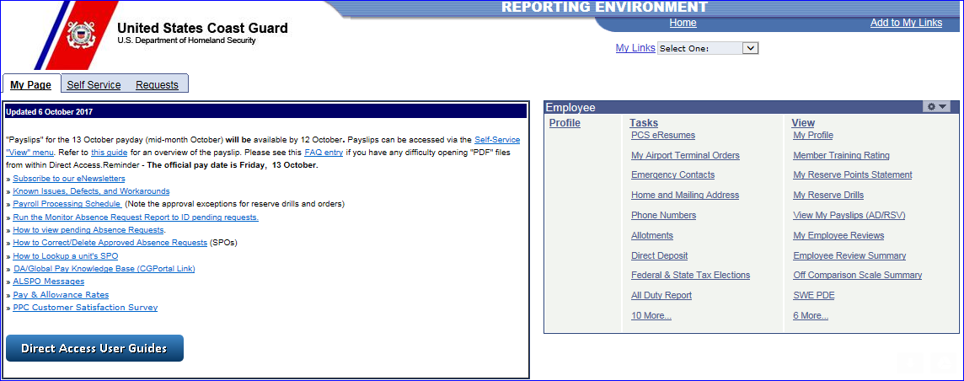
Overview of
Self Service
10
Notes:
Ok everyone we are going dive off into number 10 this is a general overview of what capabilities you have in Self Service. For those of you unfamiliar with where the self service options are take a look at the center of your screen in D/A. I've outlined it in red for you just in case.
Note that there are 2 categories “Tasks” and “View” both are equally beneficial to you so lets explore each one. (Click)

Slide 4
Overview of
Self Service
10
Notes:
The View tab is where you can take a look at pertinent info that ranges from your Pay slips to your Government Charge Card balance and everything in between. These options are “view” only and no modifications can be made in this tab.

Slide 5
Overview of
Self Service
10
Notes:
The Task tab is where you can make changes to various aspects of your profile, modify your Direct deposit, submit your E-resume, update your taxes, manage your TSP and so much more! There is some major functionality in here that you all should be utilizing. Check out the guides on P&D’s website to figure out how to properly update your info.
Ok that’s all for number 10 now that we’ve explored the surface of Self Service functionality, lets dive off into requesting user access roles in Direct access. (CLICK)

Slide 6
9
DA User Access
Notes:
Number 9 for this month is how to request user access in DA.
ALSPO G/15 (https://www.uscg.mil/ppc/alspo/2016/DAuserrolesALLSPOG16.pdf) announced that DA user role management in DA would be expanded. Several "Functional Roles" have been added to DA. These functional roles will give you all the roles required to perform in that position. These users no longer need to ask for specific roles. Specific roles required for these "Functional Roles" are handled by PPC.
Lets take a look at where to start. In the top right corner of the main DA screen there is the “Requests” tab, click on that to get the ball rolling.

Slide 7
9
DA User Access
Notes:
From there you’re gonna scroll through the Self Service request menu until you get to the “User Access Request” link. (Click)

Slide 8
9
DA User Access
Notes:
Once you click on User access Request this screen will appear. Please verify that your name and EMPLID are correctly reflected prior to moving forward.
Once you have done that please click on the Initiate Request button.

Slide 9
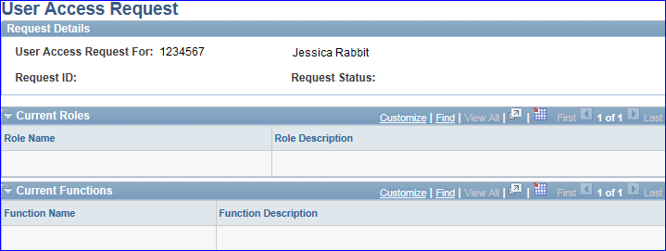
9
DA User Access
Notes:
A list of your current roles and functions will populate, if all you have is “Self Service user” roles this will be what your screen looks like. Please note that upon PCS your roles will reset to “Self Service user”.

Slide 10
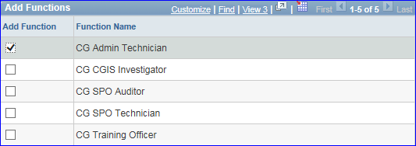
9
DA User Access
Notes:
Once you’ve made it to this screen you can select the functions your position requires. If you need to search for a role that isn’t listed on your profile you can utilize the look up option. (Click)

Slide 11
9
DA User Access
Notes:
Once all functions and roles have been added, enter the Justification for the request, enter the Approver’s Emplid or use the lookup to select it, check the Acknowledgement box and then hit Submit for Approval. Some roles (like the UA Coordinator) will also require the designation memo be sent via trouble ticket to Customer Care.
Ok that’s all I have for number 9 folks, Sandi is up next with number 8.

Slide 12
Addresses
8
Why is updating my Mailing Address so important???
W-2’s
W-2’s
W-2’s
Payslips/Official Correspondence
Thrift Savings Plan (TSP)
Government Travel Credit Card (GTCC)
Notes:
Greetings Everyone I am continuing on with Number 8 and all about updating addresses in Direct Access. There are several important reasons for keeping your MAILING address updated and they are…
(CLICK) your W-2 form will have old information on it when you are filing your current taxes at your new address.
(CLICK) again W-2’s. It’s tax season and you are waiting on your W-2 to come in the mail. If the address is your old address and is returned to sender (PPC), you will keep on waiting- why you ask?
(CLICK) well all W-2’s that are returned to PPC will not be reissued until after February 15th. Ok that is finally it about W2’s and now on to…
(CLICK) All the official correspondences mailed to you as well as the information that is provided on your payslip come from this mailing address in direct access.
(CLICK) Another important address that must be entered into DA is for your TSP and it must be added before you can even enroll in the TSP program. I will present this procedure in the next slide.
And one last thing to remember about changing your address in Direct Access is that (CLICK) address changes submitted for any personnel and pay data are not provided to the Government Travel Credit Card (GTCC) program. Card holders must notify GTCC separately to update address changes to that account.
(CLICK)

Slide 13
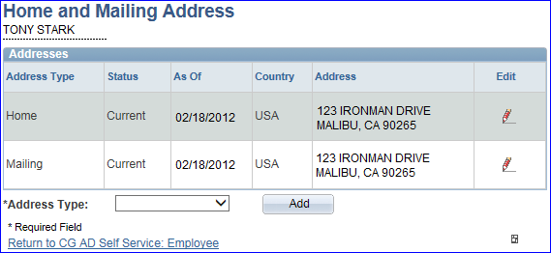
Addresses
8
Address Update
Notes:
By clicking on the Home and Mailing address link in the Employee Pagelet, your current addresses will all instantly be displayed.
(CLICK) Click the pencil icon to the right of the address you want to update or change. (CLICK)

Slide 14
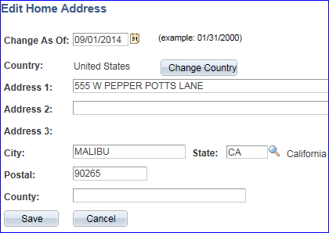
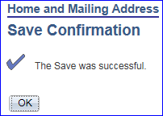
Addresses
8
Notes:
The current address will display. Update the (CLICK) Change As Of date to the date you arrived or will be arriving at the and new address and yes it can be future dated if you want to be ahead of the game. Next click (CLICK) Save. If the save was successful, (CLICK)this pop-up will display. Click OK to return to the address page to make sure it is correct. (CLICK)

Slide 15
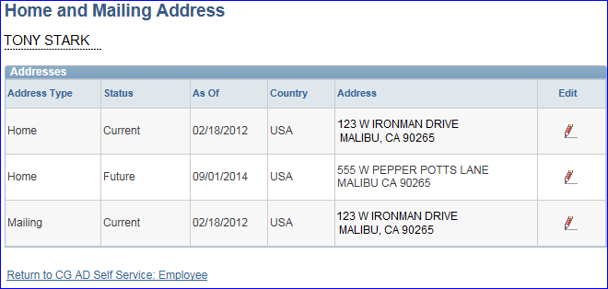
Addresses
8
Notes:
The (CLICK) updated information will display. Repeat the process to edit the other addresses if applicable. When finished, click (CLICK)the Return to CG AD Self Service: Employee link.
(CLICK)

Slide 16
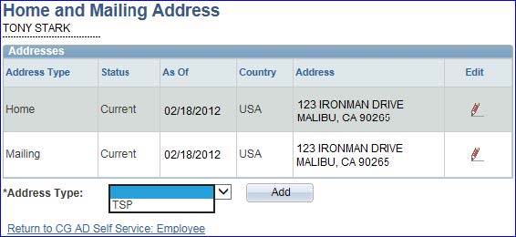
Addresses
8
Thrift Savings Plan Address
Notes:
Like I said earlier, your TSP address must be entered as a separate entity in DA and it can be the same as the mailing address.
(CLICK) Select the TSP selection in the Address Type drop down and (CLICK) click the add button. And don’t forget, all addresses can be updated at any time in Self Service by clicking on the pencils. (CLICK)

Slide 17
Addresses
8
Address Change Known Issues
Do NOT use any special characters when entering foreign addresses (e.g. ã, á, ñ, ú, Ñ, Ú, etc.).
The address line must not contain more than 25 characters.
Notes:
There are some known issues about addresses in Direct Access so keep these in mind:
(CLICK) Do not use any special characters. The data source for OTHER information systems that cannot use special characters comes from these addresses. (CLICK)
And also the address line must not be more than 25 characters in length. (CLICK)

Slide 18
Emergency Contacts
7
PCS, divorce, remarry or death
Spouse
Parents
Siblings
Notes:
Speaking of addresses, number 7 is about updating your emergency contacts in Direct Access.
(Click) When you PCS, divorce, remarry or a death occurs, make sure you are also updating your emergency contact information as well. In most cases, these will be a (Click) spouse, (Click) a parent or (Click) a sibling and it is important to keep this information current in case of emergencies concerning your well being. (Click)

Slide 19
Emergency Contacts
7
Person(s) you designate, who are to be contacted in the event of an emergency.
Any person may be contacted in the event the "Primary" contact cannot be reached.
Notes:
(Click) Emergency Contacts are persons that you designate to be contacted in the event of an emergency.
(Click) And any person entered in the system may be contacted in the event that the "Primary" contact you entered cannot be reached. If all of the contact information is incorrect or outdated, the wrong person could be notified that was not intended.(Click)

Slide 20
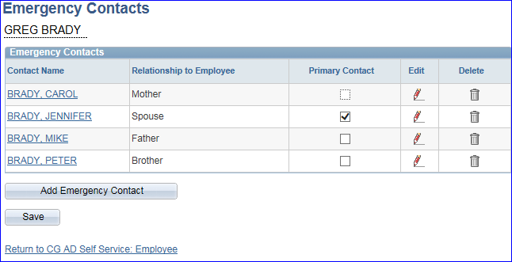
Emergency Contacts
7
Direct Access Employee Pagelet
Select the Emergency Contacts link
Notes:
In the Employee pagelet, select the Emergency Contacts link to view (Click) all your current contacts. From this screen, you may:
Click the (Click) Contact Name links to review the current information, Select or change the (Click) Primary Contact by checking the box, Delete any outdated Contacts by (Click) clicking the trash can icon and (make sure to click save after hitting the delete button)!! To Edit a Contact by (Click) again click the pencil icon. In this example, the spouse’s contact information will be changed. (Click)

Slide 21
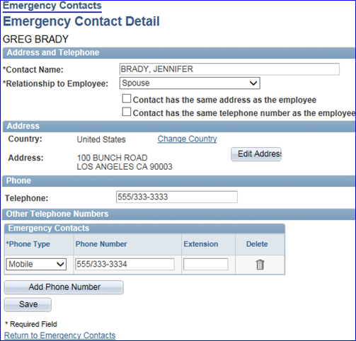
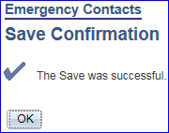
Emergency Contacts
7
Notes:
The Emergency Contact Details for the spouse will display. Any field on this page can be edited with the new information. When you are finished, just click the (Click) Save button and you will have to (Click) click OK on this pop-up screen to return to the emergency contacts page. That is all have for this month. Don’t forget there are step by step guidance for both changing addresses and updating your emergency contacts on our P & D webpage. Now on to Mr. O’Connell, take it away Matt.

Slide 22
6
Direct Deposit
Authority: M7220.29C, Coast Guard Pay Manual (Section 9.A.4.a)
Member’s Responsibility:
Keep your account up to date
Make sure you have the correct routing number and account number
Know that this will not affect your allotments
Notes:
-----------------------------------------------------------UNMUTE--------------------------------------------------------
Well, thank you, Sandy
CLICK
Direct Deposit comes in at Number 6 on our Top Ten.
CLICK
The Authority for requiring Direct Deposit is found in the Pay Manual and is currently appearing on your screen. There was a time when the member could choose to have a check mailed to them but these days are largely gone.
CLICK
The member has two major responsibilities with respect to Direct Access: Keep your account up to date and make sure the information is correct.
CLICK
You should also remember that changing your Direct Deposit will not alter the addresses on your allotments.

Slide 23
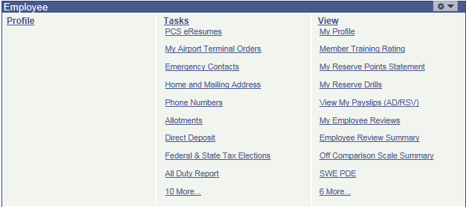
6
Direct Deposit
Notes:
Changing your Direct Deposit is really quite easy.
CLICK
Log on to Direct Access
Go to Employee Pagelet.
CLICK
Under TASKS select Direct Deposit
CLICK

Slide 24
6
Direct Deposit
Notes:
CLICK
Your current information will appear.
CLICK
Click the EDIT button.

Slide 25
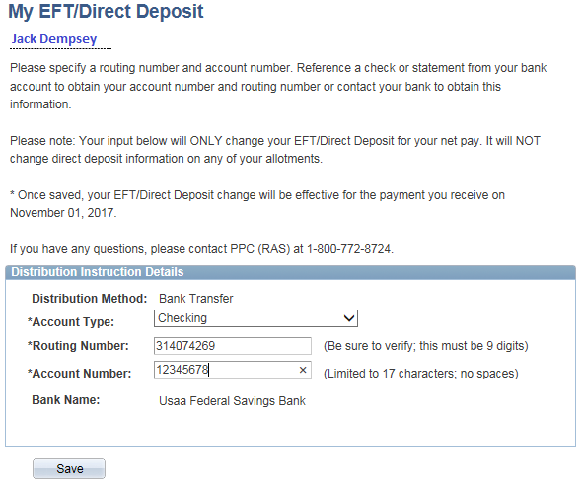
6
Direct Deposit
Notes:
2 CLICKS
My EFT/Direct Deposit will appear
CLICK
Once you enter the routing number and click TAB the Bank Name should populate.
CLICK
If the wrong bank name appears you most likely will have entered the wrong info.
CLICK
Enter your account number
CLICK
Click SAVE and you have updated your information.
CLICK

Slide 26
5
Thrift Savings Plan
Must be in a pay status
Must have a TSP Address (can be done during Accession)
Must contribute via Payroll Deduction
Currently no matching funds for Military Members (This will change under the Blended Retirement System (BRS))
Minimum Contribution is: 1%
Maximum Contribution is: Subject to Internal Revenue Code (IRC) limits (currently $18,000.00)
Special Pay Contributions are allowed (must contribute from Basic Pay first)
Notes:
Which brings us to number FIVE, the Thrift Savings Plan (TSP)
Here are some things you should keep in mind with respect to TSP:
CLICK
You must be in a Pay Status (no pay /no contribution) CLICK
You must have a TSP address in DA CLICK
You must contribute via Payroll Deduction CLICK
Currently there are no matching funds for Military Members CLICK
This will change under the coming Blended Retirement System (more about that later) CLICK
1% is the minimum contribution CLICK
The max limit is subject to IRC limits which is currently $18,000 CLICK
Special Pay Contributions are allowed CLICK

Slide 27
5
Thrift Savings Plan
CATCH UP CONTRIBUTIONS: THE OVER 50 CROWD
Allows you to exceed the yearly cap
Payroll Deduction
Cannot be made from tax-exempt money
Only from Base Pay
Reserve members who also have a Civilian TSP account do not get two Catch-up amounts
If you turn 50 in 2018 you can start your catch-up amounts on 1 Jan 2018
Current limit is $6,000.00
Must make new election each Calendar Year
Notes:
Now, some information for the Over Fifty Crowd:
If you are over fifty or turning 50 you can contribute extra money to your TSP:
This allows you to exceed your yearly cap CLICK
The contribution can be accomplished by Payroll Deduction or by sending TSP a check CLICK
You cannot use your tax-exempt money to make contribution CLICK
The money must come from your Base Pay CLICK
You cannot exceed the yearly cap by having two TSP accounts CLICK
As long as you turn 50 in the current calendar year you can start making contributions at the beginning of the year CLICK
The current limit is $6,000 CLICK
You have to make a new election each year CLICK

Slide 28
5
Thrift Savings Plan
TRADITIONAL VS. ROTH
Traditional TSP account is established from pre-tax contributions
Roth TSP account is established from money on which taxes have been paid
When you withdraw from Traditional TSP you will pay taxes on the money before it is sent to you
When you withdraw from a Roth TSP, you will pay no taxes
TRADITIONAL CONTRIBUTION: $5,000
UPON RETIREMENT: $25,000
TAXED AT THE MARGINAL RATE OF 28%, THEN YOU OWE $7,000 IN TAXES
ROTH: SAME DEAL
UPON RETIREMENT: NO TAXES ON EITHER THE CONTRIBUTION OR THE FULL AMOUNT
Notes:
There are two types of TSP accounts: the Traditional and the Roth.
When you make contributions to the Traditional Account, you will suffer zero tax deductions at the time you make the contributions but TSP will deduct taxes at a future date when you begin to make deductions.
With the ROTH Account, taxes are deducted at the time of contribution and you will pay no taxes later on.
On the screen is an example of how this works in the real world.
You can withdraw money from TSP at age 59 and ½.
If you have Traditional account and you contributed FIVE THOUSAND DOLLARS with an accumulated amount of TWENTY-FIVE THOUSAND DOLLARS upon retirement, you will pay the current marginal rate on that money.
Using the same contributory amount with a ROTH Account, you will have already paid taxes on the FIVE THOUSAND DOLLARS and so you will suffer ZERO tax deduction upon withdrawal.
CLICK

Slide 29
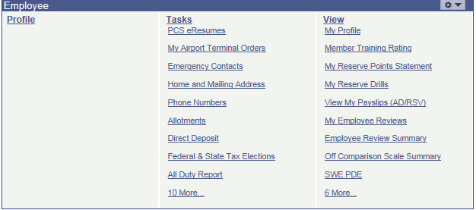
5
Thrift Savings Plan
Notes:
3 CLICKS
To effect contributions within DA, you can segue to the EMPLOYEE PAGELET again and click on 10 More

Slide 30
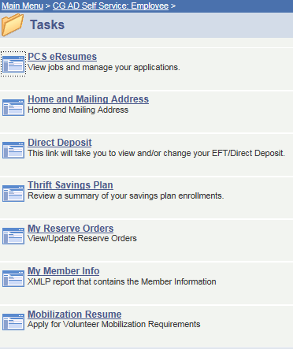
5
Thrift Savings Plan
Notes:
3 CLICKS
Under TASKS, click on THRIFT SAVINGS PLAN

Slide 31
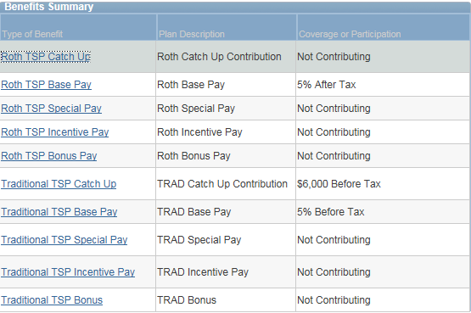
5
Thrift Savings Plan
Notes:
CLICK
Your Benefit Summary will appear:
As you can see, this fellow has both types of TSP accounts and he is also contributing a Catch Up amount.
Keep in mind the Catch up amount is a monthly deduction. I just put in $6,000 to see if the edit was working and I am happy to announce it did.
If you click on any of the links you will be pathed to the relevant link. I clicked on ROTH TSP BASE PAY.

Slide 32
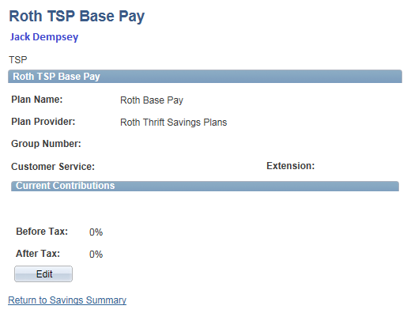
5
Thrift Savings Plan
Notes:
2 CLICKS
You just click EDIT

Slide 33
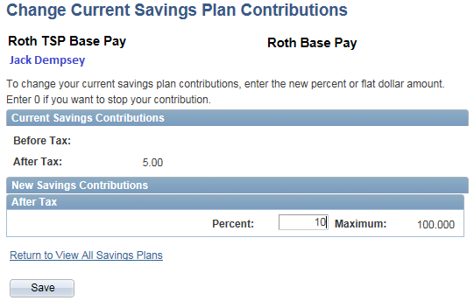
5
Thrift Savings Plan
Notes:
2 CLICKS
You will now be allowed to either change or begin your contribution amount.
In this case I changed the account from FIVE PERCENT to TEN PERCENT
CLICK
I clicked SAVE and….

Slide 34
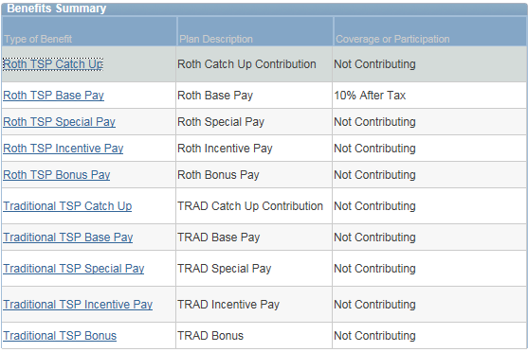
5
Thrift Savings Plan
Notes:
CLICK
You can see it updated to the new amount

Slide 35
5
Thrift Savings Plan
BENEFICIARY FORM
Thrift Savings Plan Service Office P.O. Box 385021 Birmingham, AL 35238
TSP-3
Notes:
Regardless of the account you choose, TSP wants you to fill out the Beneficiary Form. On the screen I imaged Block 1.
CLICK
This is the address they want you to mail it to.
CLICK
Under that I’ve HYPERLINKED THE form for your convenience.

Slide 36
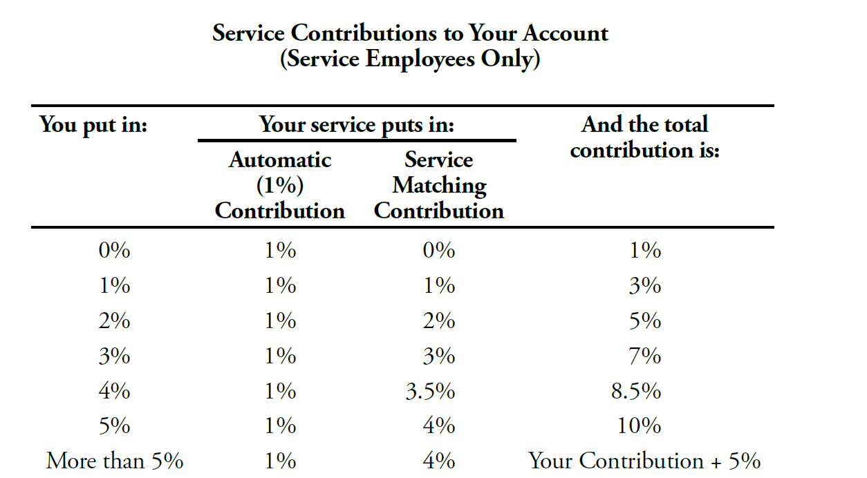
5
Thrift Savings Plan
UNDER THE BLENDED RETIREMENT SYSTEM (BRS)
Notes:
CLICK
In conclusion, let me briefly review what TSP will look like under BRS:
You will automatically have an equivalent of 1% of your pay contributed:
CLICK
This is called the Service Automatic Contribution and it results in no deduction of money from your pay.
Should you wish to contribute some of your pay, you will find the government will match you dollar for dollar up to 3 PERCENT.
The next two percent will be matched at FIFTY CENTS for every dollar you contribute.
Once you reach a FIVE PERCENT contribution, you will no longer receive matching funds.
CLICK
You may contribute more of your pay if you wish up to (theoretically) 100% but keep in mind you cannot use TSP to exempt yourself from FICA.

Slide 37
THRIFT SAVINGS PLAN
DIRECT DEPOSIT
www.TSP.gov
5
Thrift Savings Plan
Notes:
One more thing:
I’ve Hyperlinked our two Guides for your convenience:
Direct Deposit
Thrift Savings Plan
THANK YOU FOR YOUR TIME AND NOW ON TO MADDY JACKSON
------------------------------------------------------MUTE----------------------------------------------------------------

Slide 38
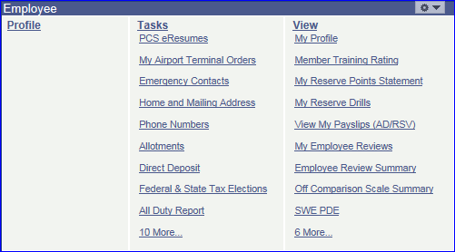
4
Pay Slips
Notes:
Thanks, Matt! Welcome back, everyone!
Number 4 for our Top 10 Tuesday is Payslips!
To view your payslip in Direct Access, click on the View My Payslips (AD/RSV) link from the View side of the Self Service pagelet.

Slide 39
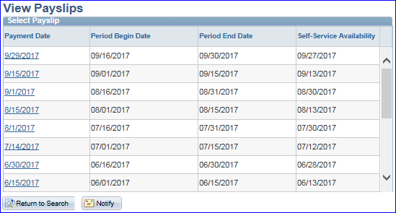
4
Pay Slips
Notes:
Select the Payslip that you wish to view. We’re going to take a look at the end-month September payslip.

Slide 40
4
Pay Slips
Notes:
The payslip is one of the many places where your address change will show up.
(CLICK) This box will tell you whether or not your promotion has taken effect. If so, your rank and pay grade would both update.
(CLICK) Here you can validate whether you have the correct taxes coming out for both federal and state. Notice that the Marital Status shows what tax option you selected, which may be different than your actual marital status.

Slide 41
4
Pay Slips
Notes:
Here you can see whether or not you are receiving the correct pay and or allowances. Some of these items are automatic (like Basic Pay and BAS) and some are manually started by your SPO. If you see something missing, let your Yeoman know as soon as possible. In this example, this member is obviously on a ship (since they are getting Career Sea Pay), but notice that (CLICK) there isn’t a Coast Guard Standard Meal Rate (formerly known as Discount Meal Rate) listed in the Deductions section. If I were this CS3, I’d be looking for my Yeoman to ask this question.
(CLICK) This section shows the actual dollar amounts for the taxes that were taken from your check.
(CLICK) If this member had any allotments, they would be listed here.

Slide 42
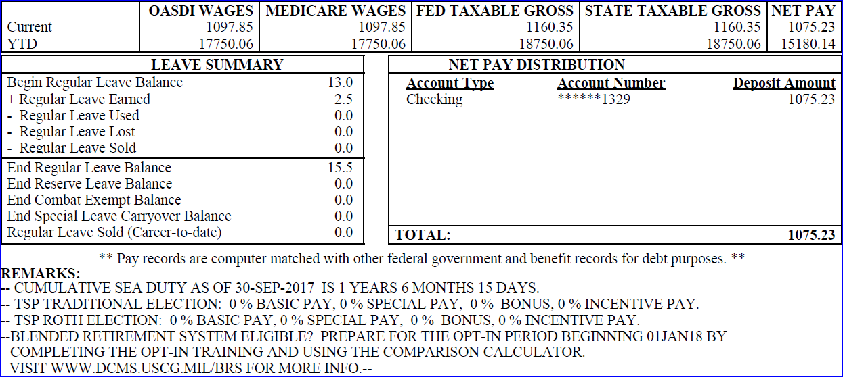
4
Pay Slips
Notes:
Here’s where all of your current and year to date wages and taxes show up. This is what is pulled at the end of the year for your W2 information.
(CLICK) A summary of your leave is shown here. This may not be the most up-to-date balance, so be careful.
(CLICK) The Net Pay Distribution section shows your Direct Deposit info and the amount that was actually deposited into your account.
(CLICK) Finally, the remarks are unique to each member. They will show unique information such as how much sea time you have accumulated as well as (CLICK) TSP information. (CLICK) They also use the remarks to pass on important information such as the upcoming Blended Retirement System.

Slide 43
3
Personal Data Extract
Notes:
Let’s roll on to Number 3 for our Top 10 Tuesday, which is the Personal Data Extract or PDE. I’d like to take a couple quick polls.
First of all, who’s taking the service-wide either this month for the Reservists with us or next month?
Great! And for those that are taking it, did you verify your PDE was correct?
Hopefully you did and got in any changes before the deadline. Let’s take a look at a PDE.

Slide 44
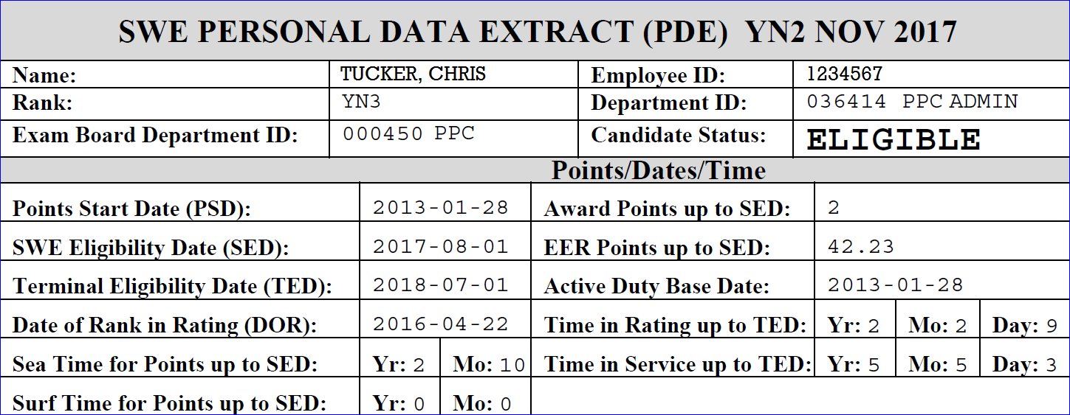
3
Personal Data Extract
Notes:
The first place I look on the PDE is the status…are you Eligible or Not? It will tell you right here. If you are NOT ELIGIBLE, it will give you a reason down in the Eligibility Results which I’ll show you in a minute.
In case you missed our July Top 10 Tuesday about Advancements, I’m going to go over a couple important parts of this PDE.
(CLICK) The first is the Service Wide Exam Eligibility Date or SED. The SED is the deadline for which members must complete all current eligibility requirements for that exam. Your Sea Time and other various factors are calculated out to the SED.
Next is the (CLICK) Terminal Eligibility Date or TED. The TED is basically the 1st day you could potentially advance off of the SWE you are taking. Example: The TED for the May 2017 SWE is 1January 2018, The TED for the November 2017 SWE is 1July2018. Your time in grade and time in service for advancement are calculated out to your TED. That’s why it appears that you have more time than you do on your PDE.
Hopefully knowing the difference between those dates will help you verify the rest of your PDE, such as your (CLICK) Sea Time, (CLICK) Award points and your (CLICK) Time in Rate & Service.

Slide 45
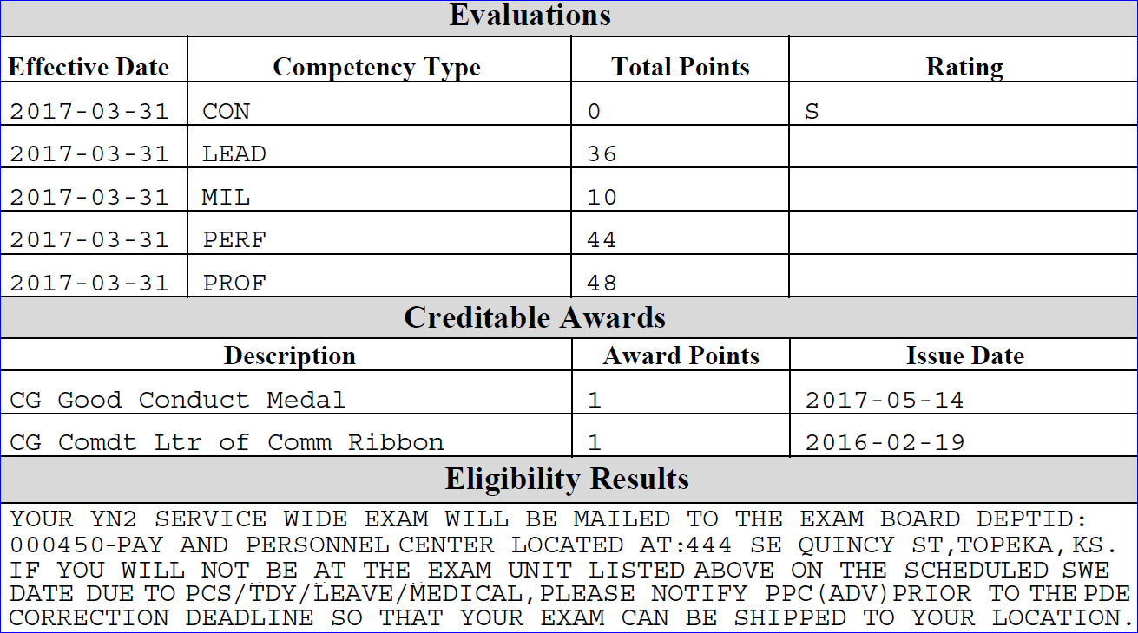
3
Personal Data Extract
Notes:
Make sure all your competencies are all listed, (CLICK) as well as your awards.
(CLICK) The Eligibility Results will either explain why you are not eligible, or it will give the address of where your exam is being mailed.
That’s all for me this month…bring us home, Charlie!

Slide 46
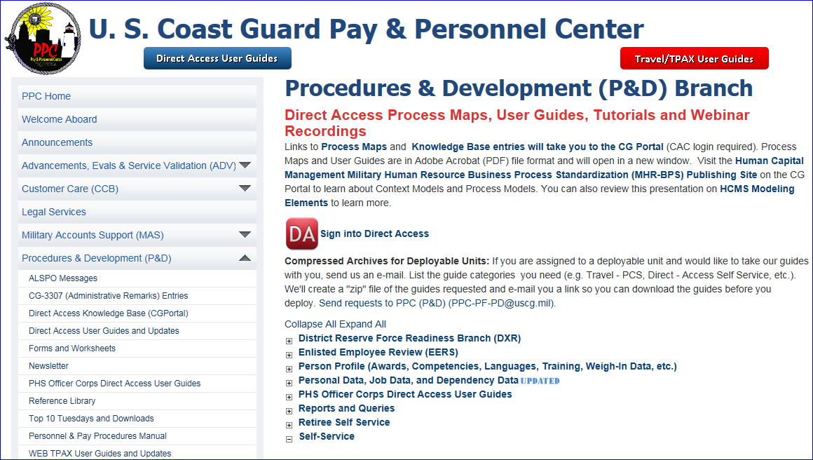
Reserve Specific
2
Notes:
Hello to everyone…Number 2 on our Top10 we are going to take a few minutes and talk about Self-Service for Reservists. A little earlier, you heard from CWO McElroy giving an overview of the Self Service functions available in Direct Access. I am going to dig just a little deeper into some of the links with just a bit more information, specifically for reservists.
Once you navigate to PPC Procedures and Development webpage, you will see several options to access the user guides. These guides were created to help members navigate and enter data into Direct Access. I strongly encourage everyone to take a few minutes to click around our webpage and become familiar with all the information available to you. But this morning we are going to focus on self-service functions.
(click) One option to access the user guides is to click on the DA User Guides button at the top of the page.
(click) For those that may not be aware, P&D branch updated most of the travel user guides. All new format and easy to follow step by step procedures for entering travel claims into TPax. As an example, when Reservists are on Long Term AD, we broke down separate claim guides for completing a Beginning, Middle and End Travel claims. Please take a look at all the travel guides that are available, I will bet your paycheck you will find them extremely useful.
(click) Moving to the meat and potatoes, click the “self-service” expansion button to access and the SS user guides.

Slide 47
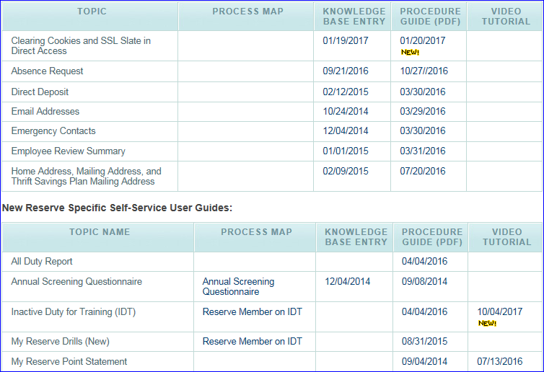
Reserve Specific
2
Notes:
(click) This is a sampling of the information available to you. I just did a small snip of the self-service guides, for example how to change your Emergency Contracts, Home and Mailing Addresses, Thrift Savings Plan updates…just a few of the topics that were previously discussed by Sandi, Matt and Maddy.
(click) If you scroll down the page you will see Reserve Specific Self-Service guides. There are step by step procedures for how to view and interpret a reserve members All Duty Report, or how to complete the Annual Screening Quesitonnaire.
There are four categories of information.
(click) The process map, which is a flow chart for the process.
(click) A knowledge Base Entry section, where general overview information and policy is available.
(click) Of course the link to the actual Procedure Guides
(click) and finally the Video Tutorial section. This is where we are recording voice over step by step procedures of the user guides. So if you want to plug in your speakers or headphones, you can sit back, watch and listen to the process.
One last note, all the dates displayed identify when the last update was made. So if you print out guides, you may want to make sure you have the latest version.

Slide 48
Reserve Specific
2
Notes:
(click), Now lets take a look at the links available to Reservists in Direct Access.
(click) On the DA main page you will see a Requests link. We will show you this link on the next slide.
(click) As Mr.McElroy outlined earlier, there are two sections in the Employee Self-Service pagelet…Tasks, where the links to enter date into Direct Access…
(click) and the View section where the links to general information and reports with member information is viewable.

Slide 49
Reserve Specific
2
Notes:
(click) Let’s talk about a few of the links and what they are used for:
(click) In the Requests tab, this is where you enter
(click) an Absence Request or
(click) view all your Absence Requests recorded in Direct Access.
(click) For our Reservists listening in, this is the link you use to Submit a Drill Request.

Slide 50
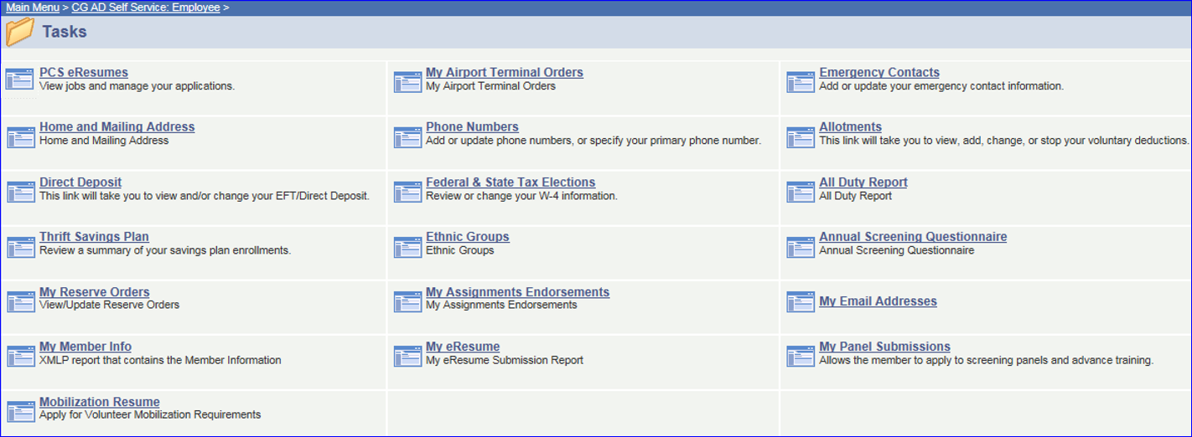
Reserve Specific
2
Notes:
(click) Now let’s take a look at the Tasks section in Self-Service specific for Reservists. We are going to point out a few first, then we will open a couple of these links to show the actual page in Direct Access.
(click) My Reserve Orders, this is the link used when requesting Active Duty.
(click) The Mobilization Resume function is fairly new to Direct Access. This is where members search for and request to serve on active duty to meet specific mobilization vacancies.
(click) Next let’s talk about the All Duty Report…Reservists, the all duty report will list ANY and ALL duty recorded in Direct Access by Fiscal Year. It not only displays any orders (IDT and AD), but it will identify the current status of those orders. Great place to see if your orders are completed.
(click) All you Reservists know that you are required to complete the ASQ annually between 1AUG and 30SEP. You should absolutely complete a new ASQ at ANY time the information changes, like new job, new supervisor, are you available for mobilization. It is your responsibility…and REQUIRED to meet the requirements for being a “reservist in good standing”.

Slide 51
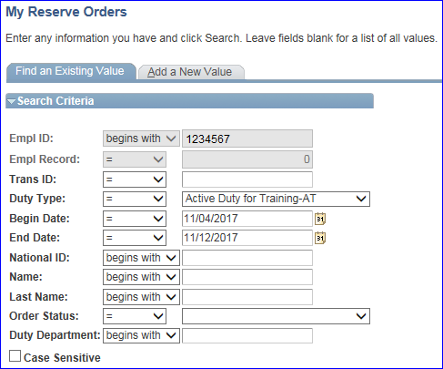
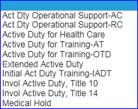
Reserve Specific
2
Notes:
Now let’s take a look at the Tasks we just talked about. We want to show the My Reserve Orders link in DA. After clicking the link, the My Reserve Orders page will display.
(click) Click the Duty Type drop-down and select the type of orders you are completing. ALL reserve orders are entered into Direct Access using this link. Then enter the inclusive dates for the orders.
(click) When finished, click the Add a New Value tab.

Slide 52
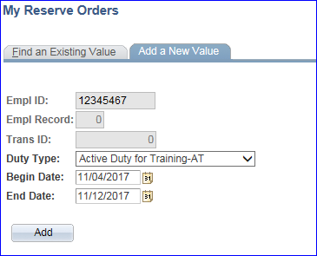
Reserve Specific
2
Notes:
The Duty Type and Dates previously entered will populate the next screen.
(click) Click the Add button to create a new set of orders

Slide 53
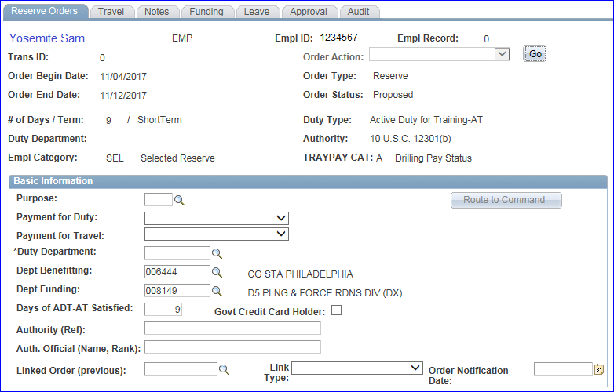
Reserve Specific
2
Notes:
The Reserve Orders module will open, and you are off and running. As a member, you only need to complete the first tab. It is recommended that you follow the procedures in the My Reserve Orders Requests guide on the PPC (P&D) webpage.

Slide 54
Reserve Specific
2
Notes:
(click) Next, lets take a look at the All Duty Report
(click) Enter the Fiscal Year you want to review, then click the View Results button.
(click) A list of ALL Orders (IDT’s and AD orders) will be listed. This member had 32 rows of orders.
(click) The key field would be the Duty Status. This lets you know if the IDT is complete or the AD orders are in a Finished status.

Slide 55
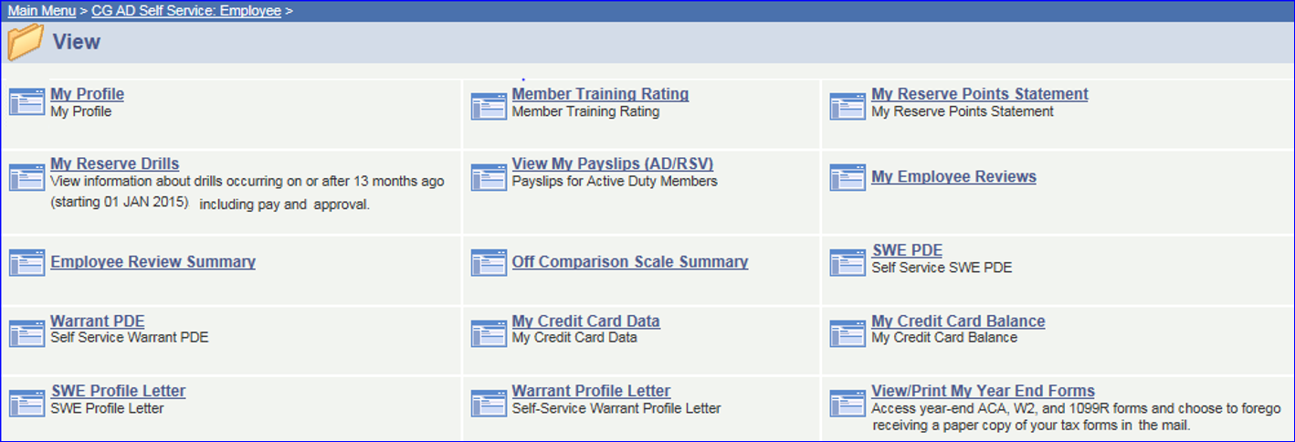
Reserve Specific
2
Notes:
(click) OK, on to the View options available. Again, only going to highlight a couple then we will take a look at a couple in the system.
(click) First up, the My Reserve Drills link. This will generate a .pdf document of ANY and ALL IDT’s entered into DA since 1 January 2015.
(click) Maddy outlined the SWE PDE, equally important in the SWE Profile Letter. The letter is generated at the end of the SWE cycle. This outlines all your points that are factored into what is called your “final multiple”, which is how you are placed on an advancement list. Maddy referred to our July Top10 Tuesday that gave a complete breakdown of the SWE process including the Profile Letter.
(click) One of the most important documents for Reservists is the My Reserve Points Statement. In just a few slides we are going to give a quick break-down of the information contained in the statement.
(click) The last item we would like to point out is the View/Print My Year End Forms. With the CY17 coming to an end, you are going to need your tax document to file your taxes.

Slide 56
Reserve Specific
2
Notes:
First up, the My Reserve Drills link. This will generate a document listing of ANY and ALL IDT’s entered into DA since 1 January 2015. This is THE best tool for reservists to do a quick check on the status of IDT’s!!!
(click) It not only lists the IDT’s, but give a complete breakdown of each step in the process from submitting the request to who at the SPO and when, approved the drill for pay. This is where you should absolutely look first to ensure your IDT has been processed to the end.

Slide 57
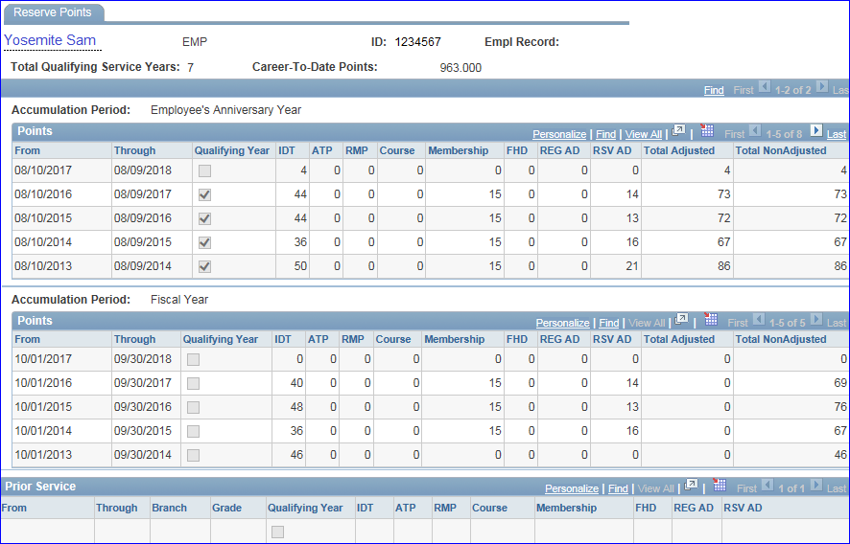
Reserve Specific
2
Notes:
The Reserve Retirement Point Statement, or in the Self-Service section is called My Reserve Points Statement, is probably one of the most important documents for a reservist. This is a total account of all Retirement points earned during your career. I cannot overemphasize the importance of ensuring it is accurate. All your military service and creditable retirement points should be listed in this document.
(click) This section lists ALL creditable retirement points by Anniversary Year. Check it often to ensure your IDT’s and other points are updated.
(click) If you have ANY prior military service (other than Coast Guard) it should be listed here.
(click) And the last point to emphasize is the Total Qualifying Service Years. Until this identifies 20 satisfactory years of service, you will not be eligible to retire. And just as important, when you do retire, your retired pay is calculated using the total Career to Date Points…essentially “more points equals more money” at retirement. So ensure ALL your creditable points are recorded. If there are errors in your statement, see PPC (ADV) web page for how to submit for corrections. There are WAY TOO MANY Reservists with incorrect point statements and are losing credit for their service.

Slide 58
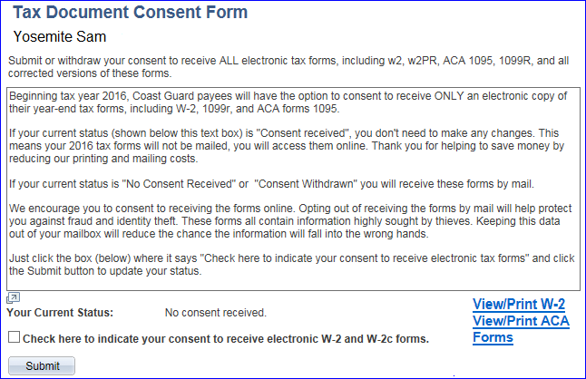
1
Year End Forms
Notes:
(click) And now we have reached #1 on our Top 10 List. When you click the link, on the View/Print your Tax Documents, the Consent Form will display.
(click) If you want to only receive electronic copies of your documents (nothing will be mailed to you), click the check-box then the submit button.
(click) To print the W-2 for the current or immediate past year, click the View/Print W-2 link.
(click) To print the Affordable Care Act form, click the View/Print ACA link.

Slide 59
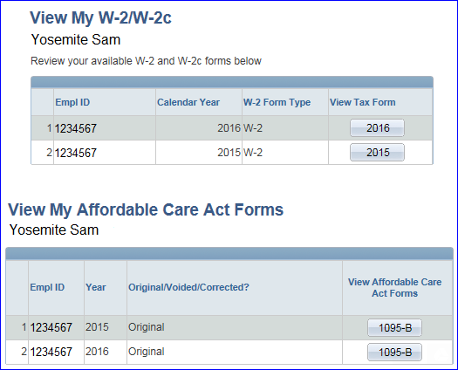
1
Year End Forms
1
1
Notes:
When you click either link, the applicable screen will appear, just click on the year of each document you wish to print. Notice that only 2015 or 2016 is currently available. As soon as the 2017 documents are available, they will be listed here.

Slide 60
Q&A
Notes:
…Q&A. We want to make sure you that all your doubts or concerns are covered so start typing in any questions you may still have. And while you are typing in questions, I am going to move this downloadable presentation onto the screen so you can click on it to download for future use and reference.
(Make small talk)

Slide 61
FEATURING THE
PPC PROCEDURES &
DEVELOPMENT STAFF
PPC-PF-PD@uscg.mil
Notes:
Mr. McElroy – Thank you for joining us here today for this edition of our monthly Top 10 Tuesday. Any unanswered questions will be addressed and posted as soon as possible on our P & D webpage so check back soon to find answers to today‘s questions as well as past month’s Q & A postings. We will also post the link for this recording so you can share it with your shipmates. This concludes the session for today, have a great Coast Guard day!

