Slide 1
Welcome, National Retiree Council Members and Other Distinguished Guests!

Slide 2
A Snapshot of Team RAS

Slide 3
Team RAS
Mission – Vision – Values
The Human Condition will always
require us to ask and answer the
question:
“Why do we do what we do?”

Slide 4
Team RAS
We are honored and privileged to serve those who served our Great Nation:
Our Heroes!

Slide 5
Team RAS
What We Do in Support of Whom:
68,000+ Customers
USCG (59,000), NOAA (500), USPHS (9,000)
Retirees: 57,000
Annuitants: 6,800
Former Spouses: 4,300
Number of Retirees Receiving VA Comp: 32,000+

Slide 6
Team RAS
What We Do in Support of Whom:
We often are the member him/herself.
We are the PERSRU/SPO/ADMIN Shop.
We are the Exceptions Team.

Slide 7
Team RAS
We provide excellent and caring pay and personnel service to over 68,000 heroes.
Do the Right Thing
Take Care of Your Shipmates
WE ARE HUMAN FIRST

Slide 8
Team RAS
Our Specialty Teams:
Customer Response Team
New Retiree Accessions Team
Account Maintenance/Accounting Tech Team
VA Compensation Team
Deceased Claims Examiners Team

Slide 9
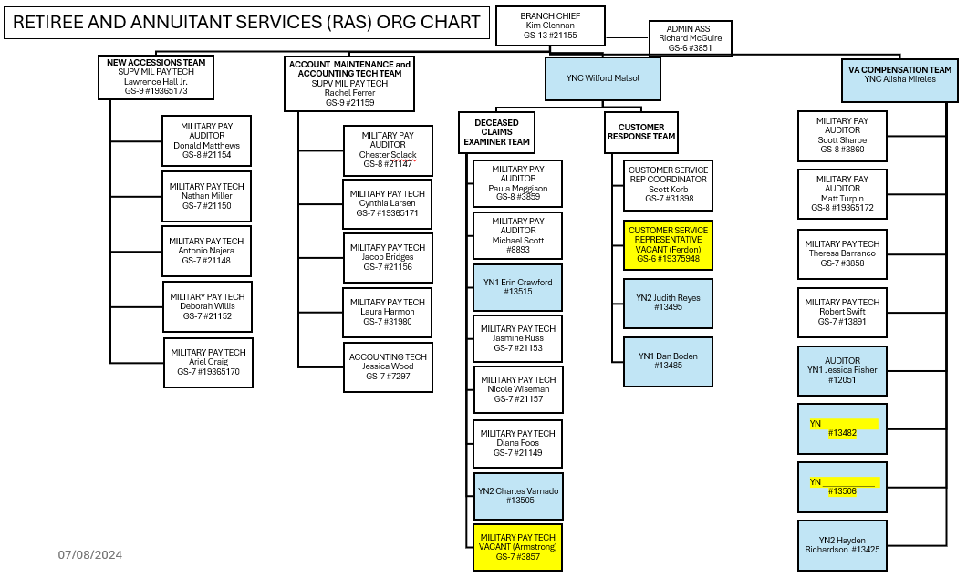
Team RAS

Slide 10
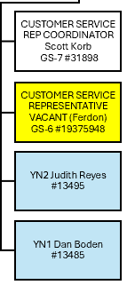
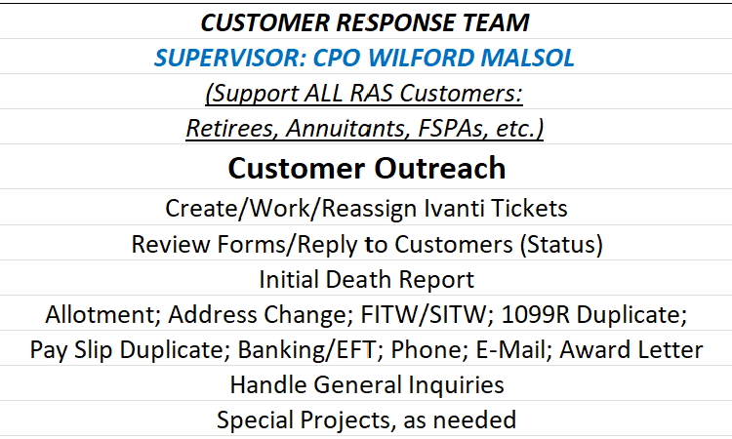
Team RAS

Slide 11
Team RAS: CRT
Examples of Improvements Made:
Better outreach to customers
More useful and informative RAS web site—better customer resource for information

Slide 12
Team RAS: CRT
Outlook/Forecast:
Continue to expand our customer outreach efforts

Slide 13
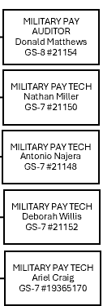
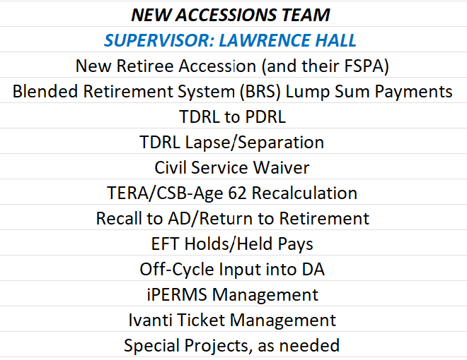
Team RAS

Slide 14
Team RAS: New Accessions
Examples of Improvements Made:
DA now automatically updates disability page
DA now calculates a high-three average for members with demotion in history

Slide 15
Team RAS: New Accessions
Outlook/Forecast:
DA will automate more of the steps within the process for a member resuming retirement after a period of being recalled to active duty

Slide 16
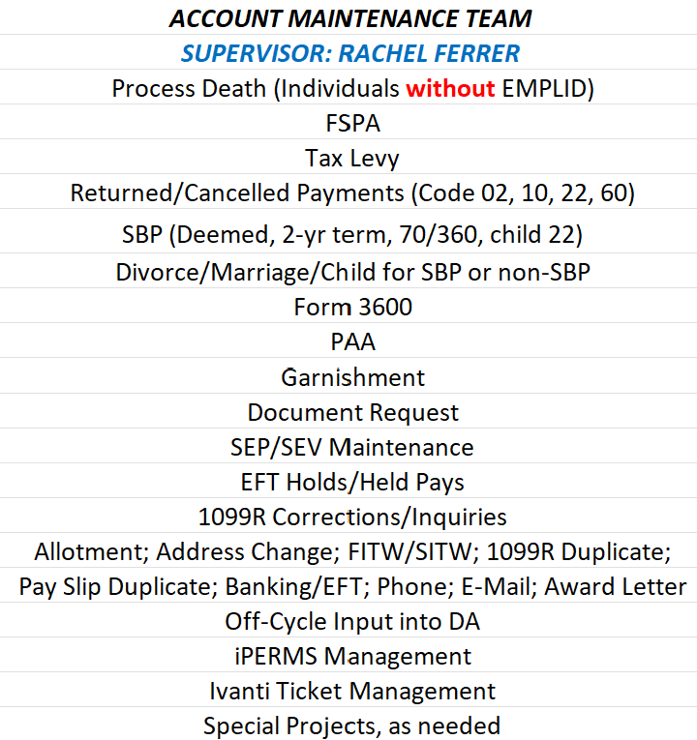
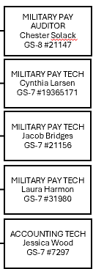
Team RAS

Slide 17
Team RAS: Account Maint
Example of Improvement:
Modified DA for SBP children beneficiary turning 22 report to reflect whether child is disabled
Created Excel tool to help automate processes, eliminating manual input

Slide 18
Team RAS: Account Maint
Outlook/Forecast:
Member Data Validation requirement for all Customers who access DA Self-Service—they will be prompted to review/change/certify mailing address, e-mail address, phone number, current beneficiaries for SBP/Final Pay

Slide 19
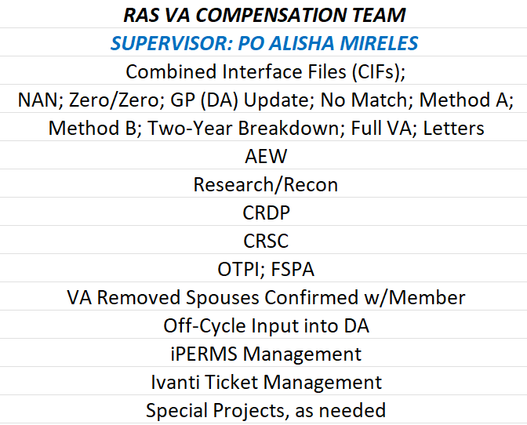
Team RAS

Slide 20
Team RAS: VA Comp
Example of Improvement:
As of January 2024, VA DAT File transmits semi-monthly vice monthly

Slide 21
Team RAS: VA Comp
Outlook/Forecast:
DA Automation of VA CIF will Eliminate Approximately 60% of Manual Processing Hours

Slide 22
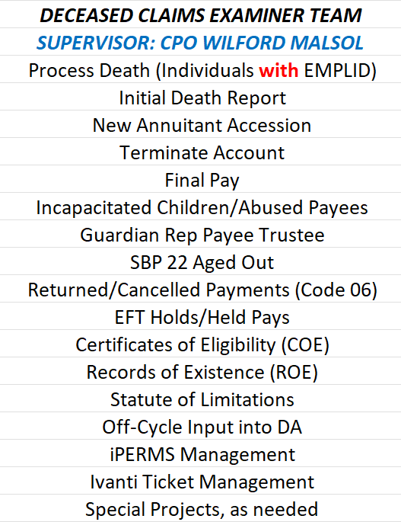
Team RAS

Slide 23
Team RAS: DCE Team
An Example of an Improvement Made:
Increased FTEs: Two (2) additional Auditors and one (1) additional Tech

Slide 24
Team RAS: DCE Team
Outlook/Forecast:
We are on a continuous path of process improvement

Slide 25
Team RAS—OVERALL
Outlook/Forecast:
We are looking into getting ADOS and contractor support for RAS

Slide 26
Team RAS
Whom does RAS serve?
What processes does RAS perform?
How well does RAS perform them?

Slide 27
Team RAS
Customers now have better opportunities to find answers they need.
RAS Web Site Improvements: You will be able to see these yourselves in RAS this afternoon!
Better guidance with signing up and using Direct Access Self-Service

Slide 28
Team RAS
Additional Opportunities for Our Customers:
Use Direct Access Self-Service to perform 12 transactions with nearly immediate results

Slide 29
Team RAS
We understand that there will ALWAYS be customers who are UNABLE to use Self-Service, and we will ALWAYS be happy to assist them in making changes to their DA accounts.

Slide 30
Team RAS: DA Self-Service
Password reset | Mailing address | E-mail
Phone number | Direct deposit | Allotment
Federal/State taxes | View/print pay slip | View/print tax forms
View final pay beneficiaries | Print award letter (pay verification) | Delivery method for pay slips, Long Blue Line, 1099R

Slide 31
Team RAS
Direct Access Self-Service:
We have seen a modest rise in the use of Self-Service: 1000 more in 2023 compared to 2018
Plus so many additional benefits!

Slide 32
Team RAS
Direct Access Self-Service
We depend on you and your influence.
If even 25% more of our customer base would use Self-Service, we would be able to assist others with more complicated matters more quickly.

Slide 33
Team RAS
Some Successes:
Better Comms with Customers
More BRAVO-ZULUs
Fewer Complaints
Excellent Partnerships

Slide 34
Team RAS
So, what’s next for our customers/us?
Continue to encourage customers to use Direct Access Self-Service
Continue creating more robust RAS Web Site content
Expand our customer outreach efforts

Slide 35
Team RAS
…and…
Leverage system automation as much as possible to improve our processes
Continue to establish and maintain excellent professional relationships/ partnerships
Continue efforts to right-size Team RAS

Slide 36
Team RAS
Keeping on our radar:
Continue finding ways to be more responsive to our Customers
Work with others to increase the number of DMDC/DEERS data loads (currently monthly)

Slide 37
Team RAS
Keeping on our radar:
Partner with you in creating and making available a useful “Survivor Guide”
Continue making the RAS web site more useful and easier to navigate

Slide 38
Team RAS
And we are ALWAYS committed to maintaining a wonderful connection with you, our National Retiree Council!

Slide 39
Thank You for Your Excellent Partnership with Team RAS! We Promise to Always Be Human First!

