Slide 1
Advanced Approver User Settings, Routing Pools and Reports
United States Coast Guard

Slide 2
Agenda
1
Training Objectives
2
Administer Users: User Settings
3
Routing Pools
4
Reports Overview

Slide 3
Objectives
Administer Users
Routing Pools
Reports
Access and review or modify a user’s settings, initialize and unlock user accounts and view documents.
View and modify routing pools
Access, generate and review standard reports
Notes:
Please do not create test reservations. If you create a reservation and do not plan to travel, please cancel it or you risk being charged fees. Work with your Travel Assist Team if you need access to a test or training environment to perform any internal demonstrations or training sessions.

Slide 4
Administer Users

Slide 5
Administer Users
Administer Users allows approvers (or other users) that have been provided the permissions to view a user’s settings.
Administer Users functionality is used to search for existing users, modify user settings, move users to another minor customer, and unlock or initialize accounts.
USCG will have a feed from the HR system to E2 to create profiles. Each time someone joins USCG, Direct Access will send over a profile load to E2 on a regularly scheduled basis.

Slide 6
Scenario 1
Searching Users and Viewing User Settings
Search for an existing user by name.
Access the user and view their user settings:
Basic Information
Customer Selector
Traveler Regulations
Miscellaneous Settings
Access Level Settings and Permissions
View process to move user to another Minor Customer.

Slide 7
Searching for a User
Notes:
You can search for users you have access to using:
Last or first name
E2 User Id or User Type or Admin level
Use Advanced search options to search within a specific hierarchy.
Enter the search criteria and click Search. The search results display below the search window.

Slide 8
Reviewing Search Results
The name, E2 User Id, User Type, Admin Level, and Major and Minor customer the user is in are displayed.
Users can be deleted from E2 if they have not created any trips or local travel claims in the system.
Notes:
The search results display below the search window.
The name, E2 User Id, User Type, Admin Level, and Major and Minor customer the user is in are displayed.
You can delete users if you have Delete Users admin permission. You can only delete a user that has no associated trips or local travel claims, or has not approved a document in E2.
If you cannot delete the user but need to prevent them from using E2, you can disable the user’s account.
Locate the user in the list and click Delete. The Delete User page appears.
Once a user has been deleted, you cannot restore the user account. If a user account is deleted in error, you must add a new user to E2.
To access the user settings, click on the name to open the User Settings page.

Slide 9
User Settings Basic Information
User Settings
Basic Information includes:
Account Status
Last login date
User Type
E2 User Id
Name
Employee ID
User Status
Email Addresses
Notes:
The user settings are displayed. Fields that are editable can be changed by an agency administrator.
If any changes are made throughout the user settings, scroll down to the bottom of the page and Save your changes.
The Basic Information section includes:
Account Status and Last login date
User Type: Traveler, Approver or Auditor (All users have access to Traveler functionality.)
E2 User Id
Name
Employee ID
SSN: USCG WILL NOT ADD SSN TO THE USER’S PROFILE – PLEASE DO NOT ADD
User Status
Primary and alternate email addresses that the user or an administrator has added to the profile.
A user’s type can be changed at any time.
If changing from Traveler to Approver, the user will need to log out/in before the change is seen.
If changing from Approver to Traveler, the system will prevent the change if the approver is associated to any pools that are currently in use. The approver must first be removed from the pools which will be identified.
User accounts of active users should show Enabled. An account can be disabled when an employee leaves the agency.
A user with an Account Status of Disabled is prevented for logging into E2.

Slide 10
User Settings User Type
User Types available are Traveler, Approver or Auditor. User Types can be changed at anytime.
All user types have access to traveler functionality.
Notes:
User Types Available:
Traveler (default) – Select this option to allow the user to create travel documents in E2. (All other user types include the ability to perform traveler functions.)
Approver – Select this option to allow the user to perform document approval functions.
Auditor – Select this option to allow the user to audit other user's travel expenses.
To change the user type, click the drop down and make a selection.

Slide 11
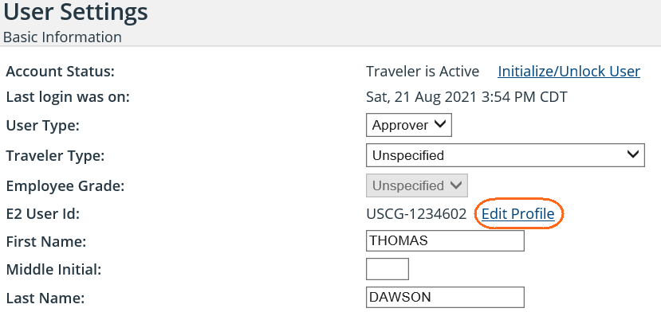
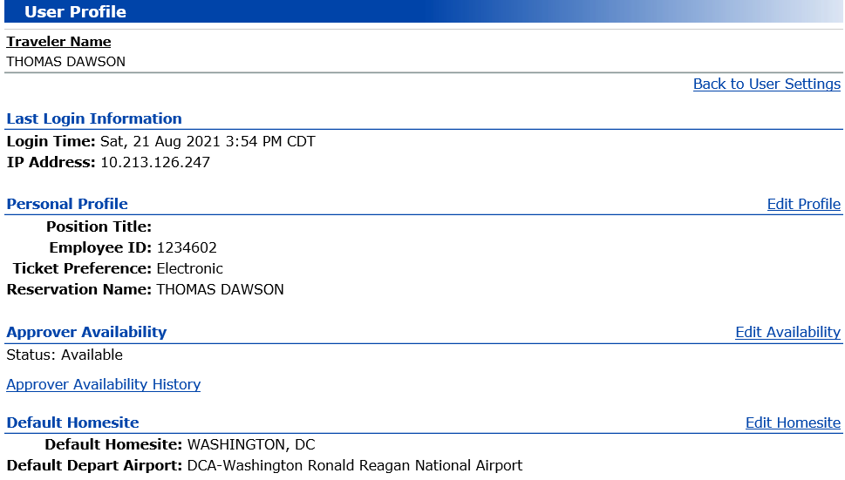
User Settings View or Edit Profile
Notes:
Click the link to the right of the E2 User Id field to view or edit the user’s E2 profile. The User Profile page for that user appears.
Review the information or make changes. If you can make changes, links appear on the right side of each section, and in the Other Features section at the bottom of the page. Click a link to edit the information in that section.

Slide 12
User Settings Update User Status
Notes:
You can enable or disable users if you have Create/Edit Users admin permission for the user type.
Select the User Status. If you disable a user who is currently logged on, the user will be disabled when the current session ends (after logging out of the current session or after the current session times out).
In the User Status field, select Disabled.
For security compliance, disabling a user removes credit card information from the user's E2 profile. Any user who is temporarily disabled and then enabled must complete credit card information in their user profile before booking travel.
Click OK.
Enter the reason you are disabling the account in the Reason Disabled field.
After making any other changes to the user settings, scroll down to the bottom of the page and click Save.
If you need to re-enable an account that has been disabled, click Enabled.

Slide 13
User Settings Customer Selector
The Customer Selector displays the hierarchy the user belongs to including the Agency, Organization, Major and Minor Customer.
Notes:
User accounts can be moved from one minor customer to another.
Users can be moved to a new minor customer at any time even if they have open trips.
Documents created prior to moving a user will remain with the originating minor customer and will keep the same routing path applied initially.
To move the user to a new minor customer, click Move User to New Minor Customer.

Slide 14
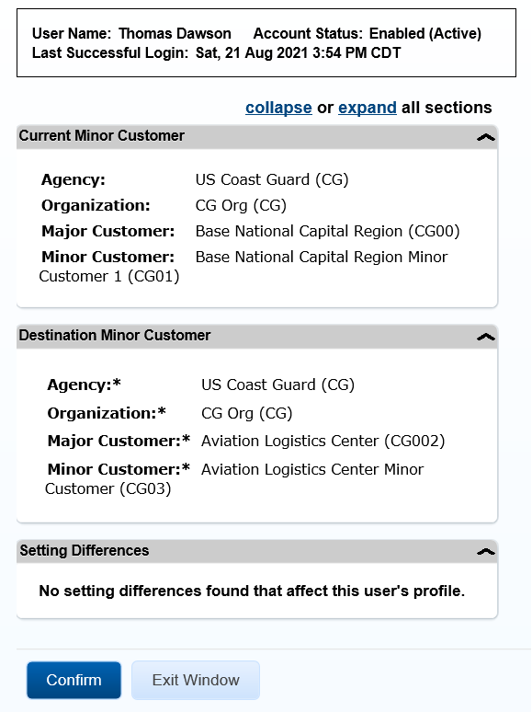
Moving a User to a New Minor Customer
Notes:
After clicking Move User to New Minor Customer, the Select Destination Minor Customer window appears.
Review the user name in the status bar and the current hierarchy shown in the Current Minor Customer section to be sure this is the user you want to move, and then select the new user hierarchy from the lists in the Destination Minor Customer section. The lists and selections available to you are controlled by your own administrator access level.
Click Validate. The Confirmation window appears.
Review the information in the Setting Differences section. If differences are shown, E2 customer support may need to take additional actions before the move is complete.
Click Confirm.

Slide 15
User Settings Travel Regulations
The Travel Regulations section displays the travel policy followed by the user - the Federal Travel Regulations (FTR) or the Joint Travel Regulations (JTR).
Notes:
To change the Traveler’s Regulation, click the drop down and select FTR or JTR.

Slide 16
User Settings Miscellaneous Settings
Notes:
Miscellaneous Settings include:
TMC Profile
Identifiers for Invitational, Traveler, Trained, Self Approver and Automatic Audit
Ad Hoc Reporting
Report Scheduling
TMC Profile ID - The user’s travel management center (TMC) profile identifier. This field remains blank for a new user. The TMC Profile ID is automatically generated when Edit Travel Preferences is selected in the user’s profile.
Invitational Traveler - Select this check box to identify an invitational traveler.
Trained - Select this check box if you would like to indicate the user has received E2 training. This field is not used by E2, but may be used by your agency or workgroup.
Self-Approver - Select this check box to enable an approver to approve their own travel authorizations. The User Type must be Approver or this setting will have no effect. When this setting is checked users will be able to approve their own authorizations but not their own vouchers or local travel claims.
Automatic Audit - Select this check box to enable an automatic audit each time the user submits a travel voucher. TDY voucher audit pre-payment or post-payment audit functionality must be enabled for the user's minor customer.
Ad Hoc Reporting and Report Scheduling – Select this check box to provide permission for expanded Reporting capabilities.

Slide 17
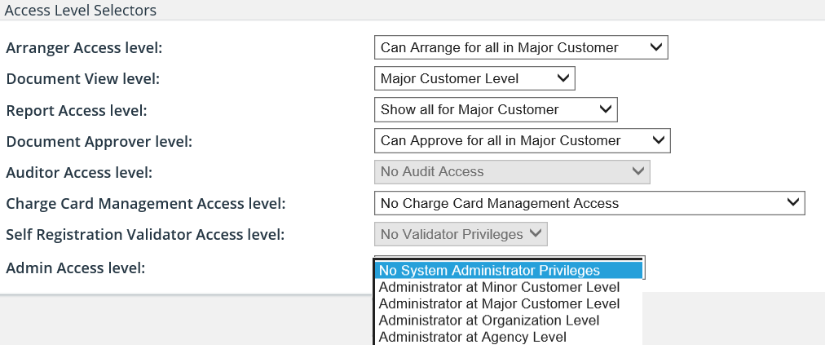
User Settings Access Level Selectors
Notes:
An access level controls the hierarchy at which the user can perform the associated functions.
The access level selections available to you are limited by your user type and your own administrator and other access level settings.
Access Level Selectors include:
Arranger Access level - allows the user to arrange travel for any travelers within the selected hierarchy without being a designated arranger for the traveler.
Document View level – allows the user to view travel documents created by other users within the selected hierarchy.
Report Access level – allows the user to generate travel reports for the selected hierarchy.
Document Approver level – available if the user type is Approver and indicates the level at which the user may approve documents.
Auditor Access level – available if the user type is Auditor and indicates the level at which the user may audit documents.
Charge Card Management Access level is linked to management of the centrally billed credit cards used for VTF payments.
Admin Access level – indicates at what hierarchy level user can perform system administration functions.

Slide 18
User Settings Admin Access Level and Permissions
Notes:
You can make update or change the users admin permissions by checking or unchecking the checkboxes for these selections. These checkboxes only appear if an Admin Access level has been selected for the for user.
Admin access levels are:
No System Administrator Privileges (default)
Administrator at Minor Customer Level
Administrator at Major Customer Level
Administrator at Organization Level
Administrator at Agency Level
If the Admin Access Level is No System Administrator Privileges, these selections do not appear.
The permissions available for selection are controlled by the admin access level selected for the user and your own admin permissions. You can only assign permissions equal to or less than your own permissions.

Slide 19
User Settings Travel Charge Card Setting
Notes:
You can change the setting selection to indicate whether a user has a government travel charge card (GTCC) or personal credit card (PCC) information in their E2 user profile. These toggle settings may impact the related minor customer air and rail travel payment settings, and can also impact the availability of the online booking function.
The user cannot book a hotel (online or via the travel management center) without a GTCC or a PCC.
If any changes have been made to the user settings, at the bottom of the User Settings page, click Save.

Slide 20
Initialize and Unlock Accounts

Slide 21
User Accounts and Password Information
A user's credentials are automatically initialized when the user is added to E2.
After receiving the new user email, the user logs on for the first time and creates a security profile, including a password and personal security questions and answers.
At times, an administrator may need to initialize or unlock a user’s account.
When an account is initialized, the user receives the new user email where a new password and security answers need to be established.
When an account is unlocked, the user is provided 3 more attempts to log in with their current password.

Slide 22
User Accounts and Password Information
If a user has established their password and has now forgot it, the user can reset their own password using Forgot Password on the E2 Login page.
If a user has exceeded the maximum login attempts allowed with the incorrect password, or they do not know the answers to their security questions, they will need to contact their help desk for assistance.
E2 passwords will expire every 90 days and users have 3 attempts to log in before being locked out.
Users can log in to E2 anywhere they have an internet connection using the URL E2.GOV.CWTSatoTravel.com and enter their user id and password.

Slide 23
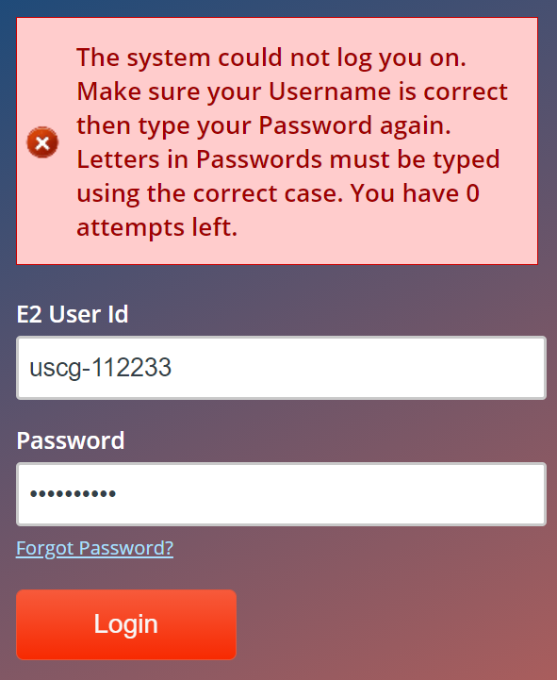
Login Status Message Incorrect E2 User Id
Incorrect User Id but correct or incorrect password entered will result in the ‘system could not log you on and 0 attempts left’ message.
Notes:
Check to see that your User Id has been entered correctly. The User Id is not case sensitive.
If you have forgotten your User Id:
Click Login Help
Click Retrieve E2 User Id
Enter your Employee Id
Your User Id will be populated in the E2 User Id field
Enter your password and click Login

Slide 24
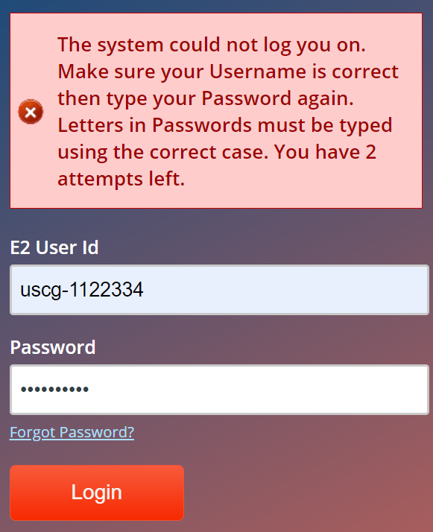
Login Status Message Incorrect Password
Correct User Id but incorrect password entered will result in ‘countdown warning’ message.
Notes:
Your User Id has been entered correctly. Enter the correct password. The password is case sensitive so type the password in the correct case.
If you have forgotten your password:
Click Forgot your Password
Click Reset Password
Enter your User Id
Answer the security questions and enter your email address
Access the email and follow the prompts to create a new password

Slide 25
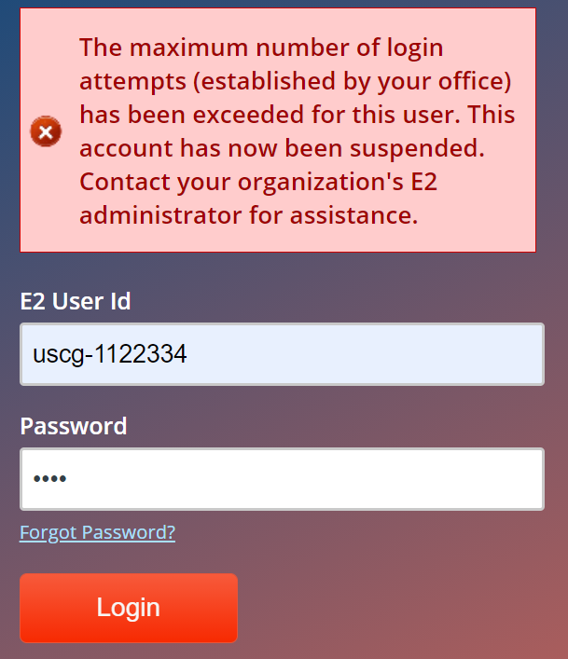
Login Status Message Exceeded 3 attempts with incorrect password
Correct User Id but incorrect password entered three times.
Notes:
Your User Id has been entered correctly but the password has been entered incorrectly at least 3 times.
User’s help desk will need to unlock account so user can try again with existing password.

Slide 26
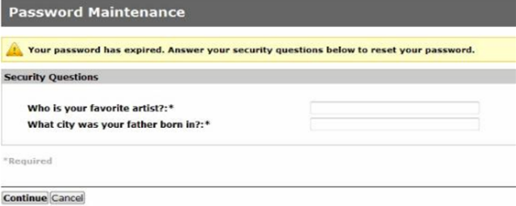
Password Expired Expedited Password Feature
When you log in, and your password is expired, E2 will detect the entry of an expired password and will require you to enter the answers to your security questions.
Notes:
E2 will detect the entry of an expired password at logon and will require you to enter the answers to your security questions.
Enter the answers to your security questions and click Continue.

Slide 27
User Settings Account Status
Account Status is displayed in a user’s settings.
Current Status of users’ account and action that can be taken:
Traveler is Active - The user's account is in a normal status and can log in to E2. No action is needed.
Needs Initialization or Initialization Email Expired - The user has not responded to an initialization email within the require time limit. Initialize the user’s account to send the new user email again. The user has 72 hours to take action.
Locked - The user's account is locked. This occurs because the maximum number of consecutive unsuccessful log on attempts was exceeded. Press Unlock User to allow the user to log in using their existing password.
Notes:
Use Unlock if,
User is locked out because CAP LOCKS turned on (or similar) but remembers password
User is able to try logging in again with current password.
Use Initialize if,
User is locked out because they could not remember password –
Email is sent to the user with timed link
Unlock button not available
New User Email expired or deleted
User has forgotten password

Slide 28
Scenario 2
Initialize User Account
A new user accidently deleted the new user access email they received.
Access the new user and initialize their account.
Unlock User Account
A user in the office has locked themselves out of their account by attempting to log in with the incorrect password more than the allotted times.
Access the user and unlock their account.

Slide 29
Initialize/Unlock Users
Notes:
Before you can initialize a user, make sure the user’s primary email address is correct. You can view the email address on the User Settings page or within the user’s profile. If the user's email address is incorrect, they will not receive the initialization email.
To view a users account status and determine if you need to Initialize or Unlock, click Initialize/Unlock User in the Administration Options menu, on the left side of the page. The User Search page appears.
Search for the user you want to view account status and take action to initialize or unlock.
Locate the user on the list and click Init/Unlock.

Slide 30
Account Status Active
Notes:
The Account Status is displayed in the User Settings.
The account status can also be viewed by using the Initialize/Unlock link.

Slide 31
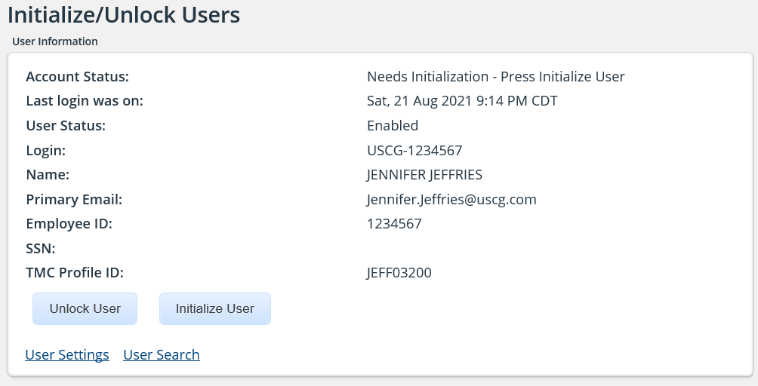
Initialize User
Notes:
After clicking Initialize/Unlock, the Initialize/Unlock Users page appears.
Verify the Account Status. If the user does not know their password or their initialization email has expired, you will need to Initialize the user will receive a new user email and be able to set up a new password.
Click Initialize User. The page updates and a initialization success message appears.
The user is automatically sent an email containing a link that must be used within 72 hours to reset their security profile and log on to E2.

Slide 32
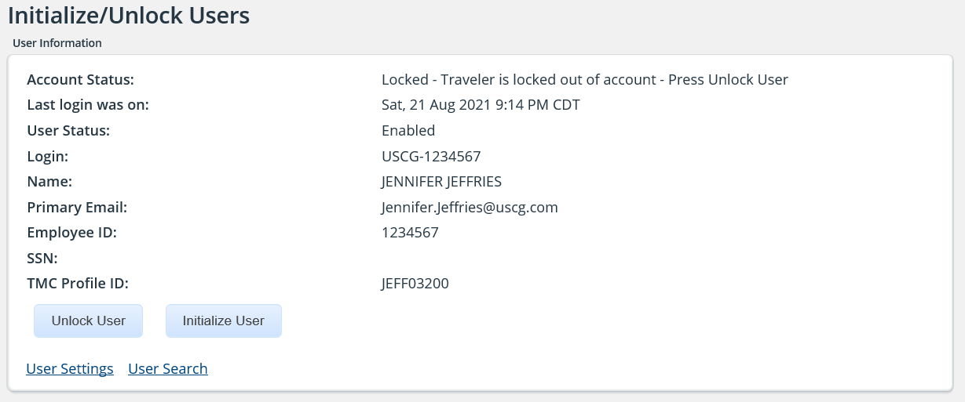
Unlock User
Notes:
After clicking Initialize/Unlock, the Initialize/Unlock Users page appears.
Verify the Account Status. If the user is locked out of their account because they have tried more than 3 times to log in with the incorrect password, the status will be Locked.
If the user knows their password, you can Unlock the account.
To unlock a user, click Unlock User. The page updates, an unlock success message appears, and an email is sent to the user notifying them that their account has been unlocked.
The user now has 3 more attempts to log in with their same password.

Slide 33
Search Documents

Slide 34
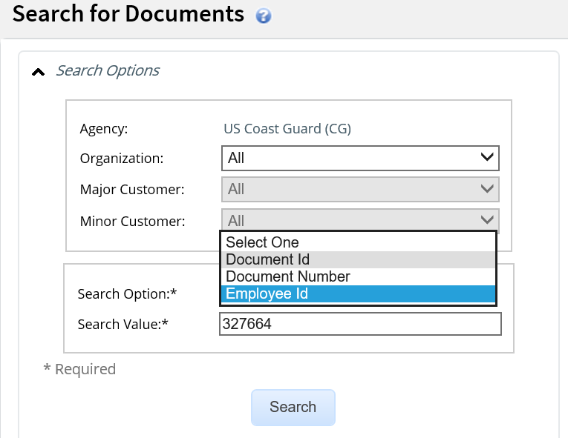
Searching for Documents
You can search for trips or travel documents by the Document Id, Document Number or Employee Id.
Users with Arranger permissions can also use Travel for Others to search all trips by traveler name.
Notes:
You can search for trips or documents by using Search for Documents in the Administer User section of the Administration Options menu.
You must have at least one User Settings administrator permission to have access to this function.
Enter your search criteria. You can search using:
Trip Id
Employee ID
Document Number
Click Search.

Slide 35
Searching for Documents Results
Notes:
A list of matching trips appears below the search criteria.
Click Show to access the document.

Slide 36
Routing Pools

Slide 37
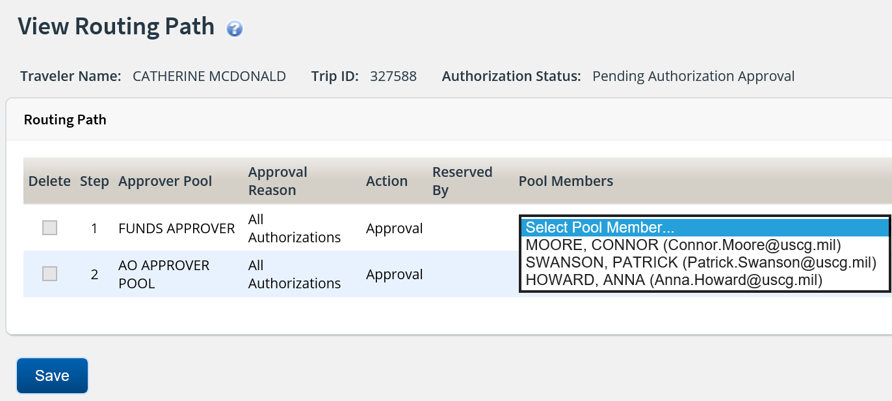
Document Routing
E2 utilizes rules to route submitted travel documents to the appropriate approvers. Once routing is set up, the traveler submits the document and E2 routes it via the approval routing path.
Routing Pools = groups of approvers
Routing Rules = define when documents are routed to specified pools for approval
Routing Templates = collection of rules and associated pools to be applied to all users in Minor Customer or individual traveler profiles
Notes:
Click the User Options Menu and select Online Help to access the knowledge portal and search for user guides AG20 and AG21 for detailed information about routing.

Slide 38
What is a Routing Pool?
Routing pools are collections of approvers meant to review and approve travel documents when documents route to their pool for a specified reason.
Approvers who have administration permissions can modify the routing pools to add or remove approvers.
High Risk
Unit Funds Approver
Orders Approval
Notes:
Each routing rule is assigned to a specific routing pool. When the rule is triggered, the document is sent to that routing pool for approval.
Pools can contain multiple approvers.
Regardless of the routing pool type, when a document is ‘unlocked’ all approvers in the pool will receive an email.

Slide 39
Routing Pools Creating levels of approval
Unit Funds Approver
Katie Hall
Jackie Jones
Mike Hill
First Level
High Risk Approval
PPC
Sharon Wilkes
Lauren Sikes
Jafar Milner
Conditional
Level
Last Level
Orders Approval
Pat Gwen
Rhonda Owen
Jill Grant
Notes:
To create multiple levels of approval there needs to be multiple routing pools to associated to each level.
Approvers can belong to multiple pools.

Slide 40
Two Types of Routing Pools
Primary Pool
True Pool
One approver in the pool is designated as Primary
Primary approver will receive approval notification email
Documents are automatically locked to primary approver
A primary approver is not identified
All approvers in the pool will receive approval notification email
Approver intending to approve a document must lock it
Notes:
Each routing rule is assigned to a specific routing pool. When the rule is triggered, the document is sent to that routing pool for approval.
Pools can contain multiple approvers. Best practice is at least (2) approvers in a pool.
Regardless of the routing pool type, when a document is ‘unlocked’ all approvers in the pool will receive an email alerting them a document is pending approval.

Slide 41
Scenario 3
Search Existing Routing Pools
Search for and select an existing routing pool.
Search: Base National
Select: Funds Approver Base national Capital Region
Modify the pool:
Delete an approver.
Add a new approver.
If there are documents pending approval for the pool where an approver was added, the approver can click My Approvals and the document is now displayed in their pool.
The document will no longer display on the pending approval list for the approver that was removed from the pool.
At this time, changes to the Routing Templates are managed by PPC. Please work with PPC or your Travel Assist Team if additional changes to the routing are required.

Slide 42
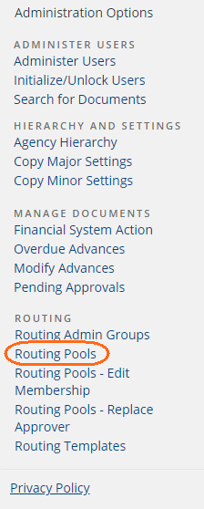
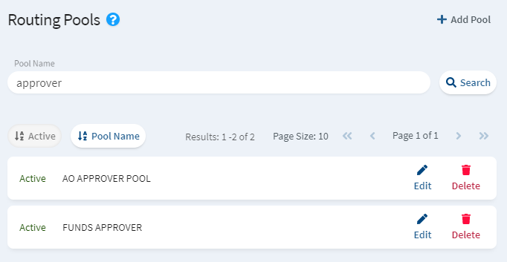
Search for a Routing Pool
Notes:
Click Routing Pools in the Administration Options menu.
Enter all or part of the Pool Name. Leave this field blank to search for all pools.
Click Search. If there are matches, search returns a list.
Click on Edit to view or edit the pool.

Slide 43
Scenario 4 Modify Pool Membership
Edit Membership:
An approver in the office needs to be added to multiple pools.
Use the Edit membership functionality to make the change.
Replace Approver:
An approver in the office is leaving and a new approver is taking their place.
Use the Replace approver functionality to replace the out-going approver with a new approver in all the pools the out-going approver exists.

Slide 44
Modifying Pool Membership Using Edit and Replace Membership tools
Edit Membership allows admin to add or remover an approver to/from MANY pools at once.
Replace Membership allows admin to replace one approver with another approver across all the pools the replaced approver exists.
When an approver is removed or replaced, E2 identifies the list of documents locked to the approver and unlocks them. It then sends two emails - one to the formerly locked approver identifying that they are no longer the approver for the document, and the other to the remaining members of the routing pool advising them the document is ready for approval.

Slide 45
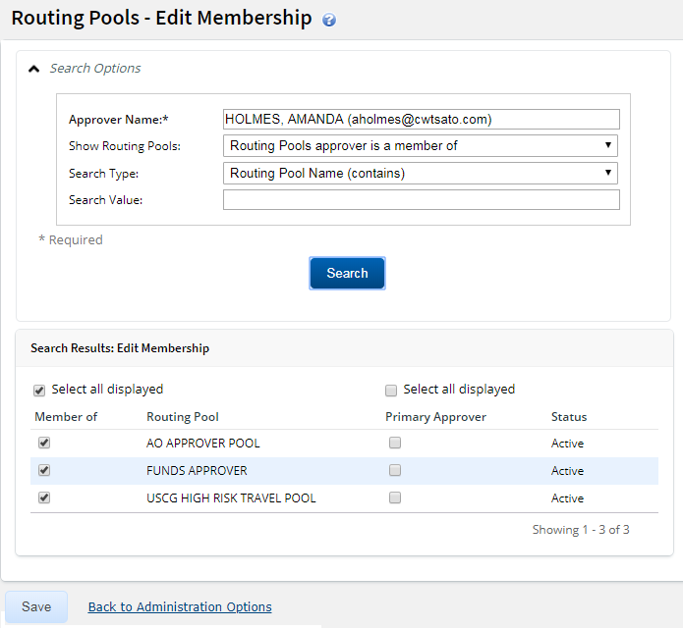
Routing Pools Edit Membership
Notes:
To remove or add an approver to one or more pools at the same time, click Routing Pool – Edit Membership from the Administration Options.
Enter an Approver Name. Enter three or more characters that are part of the approver’s first or last name, and then pause and wait for the auto suggest list to appear.
Select an approver from the list.
Select other criteria if needed and then click Search.
In the Show Routing Pools field,
Select Display All Routing Pools to add and remove the approver from multiple pools at once.
Select Routing Pools approver is a member of to remove the approver from pools.
Select Routing Pools approver is not a member of to add the approver to pools.
Use the Search Value field to define a specific pool name that needs update. Leave blank to return a list of pools based on the Show Routing Pools field definition.
To add the approver, select individual routing pools or check Select all displayed to identify the pools which to add the approver
To remove the approver, clear the Member of checkbox corresponding to applicable routing pools or clear Select all displayed.
Click Save.
On a successful removal, E2 removes the selected approver and identifies the list of documents locked to the approver. E2 unlocks the documents and sends two emails and logs actions to the document history:
one to the formerly locked approver identifying that they are no longer the approver for the document,
and the other to the remaining members of the routing pool advising them of the availability of the document for approval.

Slide 46
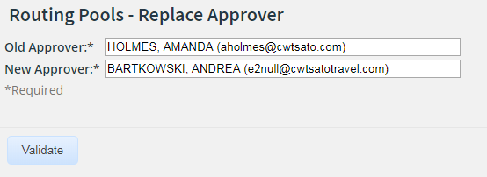
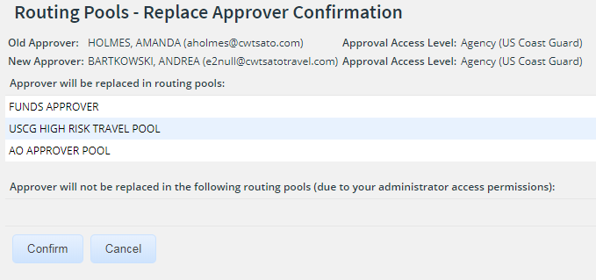
Routing Pools – Replace Approver
Notes:
To replace an approver in all pools that the current approver belongs to, click
Routing Pools – Replace Approver in the Administration Options menu.
Enter the Old and New Approver and click Validate.
The impacted routing pools are displayed for validation purposes. If correct, click Confirm.
Routing pools are updated. If the old approver was the primary approver for a
routing pool, the new approver inherits the primary approver status.
Documents that are pending approval by the old approver are unlocked.
Actions are logged to the document history

Slide 47
Review Administer Users
When a user has exceeded the number of allowed login attempts but they know their password, what should an administrator do to allow them to access E2?
Unlock. This will provide additional attempts for the user to log in.
If a user forgets their password, what button in their user settings can an administrator click to generate an email so the user can reset their password?
Initialize User. This will send a new user email to the member.
What functionality can be used to add an approver to multiple pools at the same time?
Routing Pools – Edit Membership can be used to add or remove an approver from multiple pools at the same time.
Once an approver has been added to a routing pool, the approver can view and access the document from their pending approval list as long as it is not locked to another approver. True of False ?
True, the document pending approval is immediately available to the added approver.

Slide 48
Review Administer Users
When a user has exceeded the number of allowed login attempts but they know their password, what should an administrator do to allow them to access E2?
Unlock. This will provide additional attempts for the user to log in.
If a user forgets their password, what button in their user settings can an administrator click to generate an email so the user can reset their password?
Initialize User. This will send a new user email to the member.
What functionality can be used to add an approver to multiple pools at the same time?
Routing Pools – Edit Membership can be used to add or remove an approver from multiple pools at the same time.
Once an approver has been added to a routing pool, the approver can view and access the document from their pending approval list as long as it is not locked to another approver. True of False ?
True, the document pending approval is immediately available to the added approver.

Slide 49
Reports

Slide 50
Reports
E2 provides a comprehensive report package. A list of all reports the user has access to are displayed on the Reports tab. All users can generate reports about their own travel. Users that have been provided a higher level access, can run reports at various levels.
Users that are provided adhoc access in their user settings can create and generate ad hoc reports.
Users can also be provided access to the report scheduler in their user settings.

Slide 51
Scenario 5
Access the E2 Knowledge Portal and search for Reports.
Access and review the Report Catalog.
Review Table of Contents
Access one of the reports and view available information for the report
Close out of the E2 Knowledge Portal and access the Reports tab.
Review list of reports and search options available.
Generate several reports and options available to export, search and customize.

Slide 52
Report Categories
Reports are categorized by their purpose and the general type of information they provide.
Each report is assigned a report Id that reflects the type of report.
Category Code | Description
DOC | Documents
FIN | Financials
HIS | Configuration History (system/user)
RES | Reservations
RTG | Routing
USR | Users
Report Id | Description
C | Chart
I | Interactive Report (customizable formatting, filtering, sizing, can be exported to excel with minimal formatting)
M | Map
R | Report (data report designed for online viewing; view may be exported)

Slide 53
Generating Reports
Click Reports on the E2 task bar to view all reports available to you.
Click the report name to run the report.
Notes:
To generate a report, click Reports on the E2 task bar. All of the reports available to you appear on the E2 Reports tab.
Use the Library search field to locate a report. Type any part of a report name
or description and Enter (or click the magnifying glass icon) to generate a
results list.
Click the X at the end of the Library search field to clear the search and
restore the full reports list.
Click the report name to run the report.

Slide 54
Input Controls
Input Controls display if the report has mandatory or optional filters available.
Once values have been selected, click OK to generate the report.
Notes:
If the report has optional or mandatory filters, the Input Controls window
appears.
Select or enter filter values.
Dates should be entered in DD-MMM-YYYY format (example: 01-JAN-
2014) or click the calendar icon to select a date.
If the fields on the input controls are a range (i.e. From/To, On or After,
On or Before, Min/Max), both elements of the range must be entered.
At the bottom of the window:
Click OK to generate the report and close the Input Controls window.
Click Apply to generate the report and leave the Input Controls window
open.
−Click Reset to clear all filter selections.
−Click Cancel to close the window.

Slide 55
Viewing Reports
Notes:
Use the navigation controls to move around in the report. You can enter a
specific page or use the arrows to move from page to page.
When generating a large report, the first few pages will be immediately
viewable while the additional pages are loaded. If necessary, click Cancel
Loading Data to stop the process. Any pages already loaded will be viewable.
If the report is generated from LIVE data, click the Refresh icon to refresh the
report with the most current data. For other reports, this would only refresh the
report display.
Click the Back icon to exit the Report Viewer and return to the Library (list of
reports), or return to the previous version of the report.
Click the Export icon to export the report (as it appears in the Report Viewer)
to another format.
Click the Options icon to open the Input Controls window and make changes to
the report filters.

Slide 56
Customizing Interactive Reports
You can customize interactive reports before exporting to support your data analysis requirements, or to meet specific online viewing needs.
Notes:
Interactive reports have a report Id that ends in I.
You can customize interactive reports before exporting to support your data
analysis requirements, or to meet specific online viewing needs. Customizations
include:
−Comprehensive formatting by column
−Robust filtering by column
−Sorting column data
−Moving and resizing columns
After running an interactive report, click the column you want to apply changes
to and select the icon from the menu. Icons available are Formatting, Filter,
Sort Ascending or Sort Descending.

Slide 57
Exporting Reports
Notes:
Click the Export icon and select a report format. For example select “As Excel”
to export the report in Microsoft Excel® format, or select “As XLSX” to export
the report in Microsoft Open XML format.
Review the exported report and use your tool’s search, filtering and
reformatting capabilities to analyze the data.
Review columns and data, and make any adjustments necessary. Remember to
delete any header, footer or report title information before performing data
analysis tasks. For interactive reports, the title appears on the first page and
input control selections appear on the last page.
Complete the export process, select a location and save the report.
The steps to export an interactive report are the same as exporting other
reports. If you are going to export an interactive report, we recommend that
you do not move or resize columns prior to exporting. This will ensure that the
export is as clean as possible with respect to merged Excel columns.

Slide 58
Frequently Used Reports
DOC001I Document Status (Interactive)
DOC003I Documents Pending Approval (Interactive)
DOC004I Overdue Trips (Interactive)
DOC010I Approved Travel Authorizations (Interactive)
DOC011I Closed Vouchers (Interactive)
USR002I User Settings and Profile (Interactive)
FIN002R Financial Interface Transaction Detail
Permissions in your user settings determine which workgroups you can generate reports for

Slide 59
Resources
For more information on system administration in E2 Solutions, please see the following Administrator Guides in Online Help:
AG: 10 Administer Users
AG: 20 Document Routing
Reports Catalog and Reports CBT
To access customized traveler and approver user guides, an FAQ, and additional ETS/E2 details, access the USCG PPC website:
https://www.dcms.uscg.mil/ppc/travel/ets/

Slide 60
Questions?

