Slide 1

Approving Official
United States Coast Guard

Slide 2
Agenda
1
Training Objectives
2
Overview & Getting Started
3
Document Approval Overview
4
My Approvals
Reviewing, Approving, and Returning Travel Documents
5

Slide 3
Objectives
Overview
Getting
Started
Approving Documents
Understanding E2 Solutions and the different document types and their processes
Setting up your password, logging in for the first time, updating your profile, and general system navigation
Accessing documents pending your approval, adding POET funding information, approving documents, and returning documents for correction

Slide 4
Icons are used in this presentation to help identify the type of information being delivered.
They are found in the upper left corner of applicable slides.
New information
Scenarios
Information recap
Knowledge reviews

Slide 5
E2/ETS
Overview

Slide 6

E2 Solutions Overview
Integrates travel orders and vouchers with TMC services plus integration to FSMS for a web-based, end-to-end solution for travel and expense management.
+
+
=
Travel Authorization & Voucher System (TAVS)
Travel Management
Center (TMC) Services
Financial Systems
Integration
Notes:
End-to-end product solution for travel and expense management provided through a web-based, government-wide service.
Paperless travel authorization and vouchering, travel management center services, and financial system processing for faster and more reliable traveler reimbursement.
Note: For PCS Travel, USCG will be using the mLINQS system. At this time Civilian PCS with mLINQS is scheduled to go live in May 2022 ; Uniform PCS on MLINQS is targeted for October 2022. Reach out to PPC or your Travel Assist Team for additional details on PCS travel.
Please do not create test reservations. If you create a reservation and do not plan to travel, please cancel it or you risk being charged fees. Work with your Travel Assist Team if you need access to a test or training environment to perform any internal demonstrations or training sessions.

Slide 7
Getting Started
First Log On, Profile, and Navigation

Slide 8
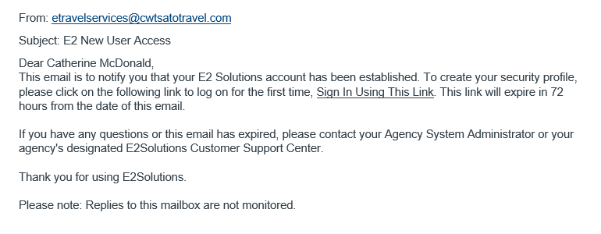
New User Email
Notes:
User will receive “E2 New User Access” email needed to create password.
Email is valid for 72 hours.
Click Sign in Using this Link to start the process.

Slide 9
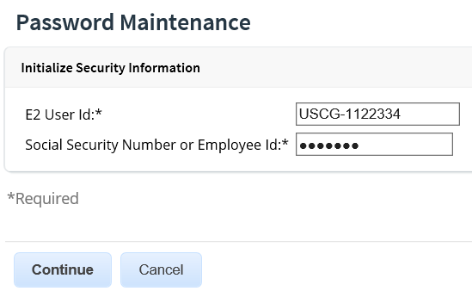
Password Maintenance
Initialize Security Information
Enter your E2 User Id provided by USCG. It will start with USCG- followed by your 7 digit employee id. Example: USCG-1234567
Enter your USCG Employee Id in the Employee Id field. (DO NOT Enter your SSN #)
Notes:
Non USCG employees, such as Invitational travelers, will have a different E2 User Id. User Id will be USCG-S##### (# = assigned 5 digit number)

Slide 10
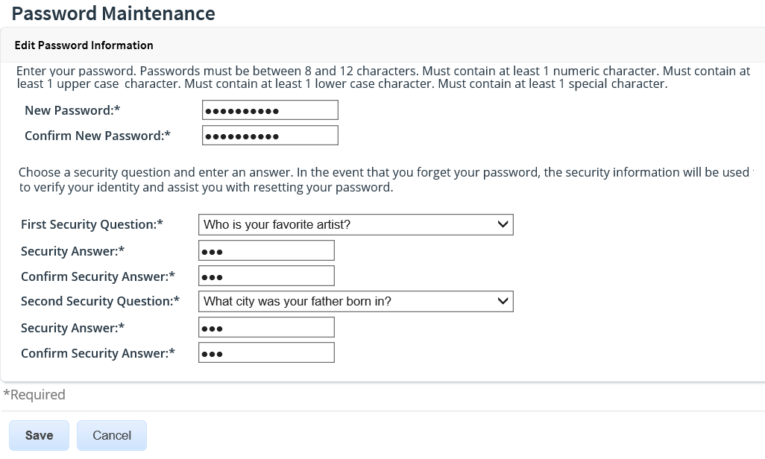
Password Maintenance
Creating Password & Security Questions
Notes:
Create your new password and confirm. Your new password is case sensitive.
Establish two separate security questions. In the event you forget your password, the security information will be used to verify your identity and assist you with resetting your password.
Your security question answers are not case sensitive.
Click Save.

Slide 11
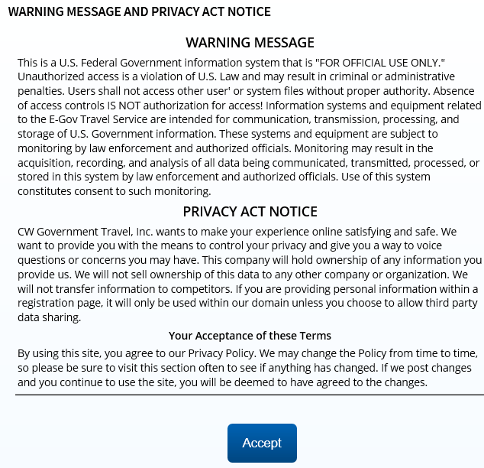
Warning Message & Privacy Act Notice
Notes:
Review the Warning Message and Privacy Act Notice.
Click Accept.
You will be prompted to accept the Warning Message and Privacy Act Notice each time you login.

Slide 12
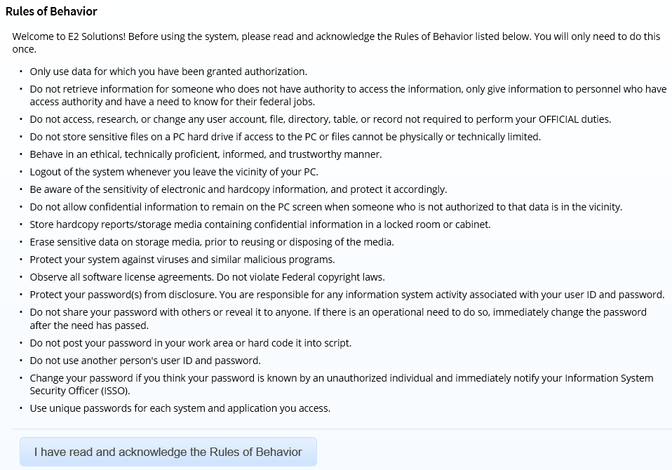
Rules of Behavior
Notes:
You will only be presented and asked to accept the Rules of Behavior the first time you log into the system.

Slide 13
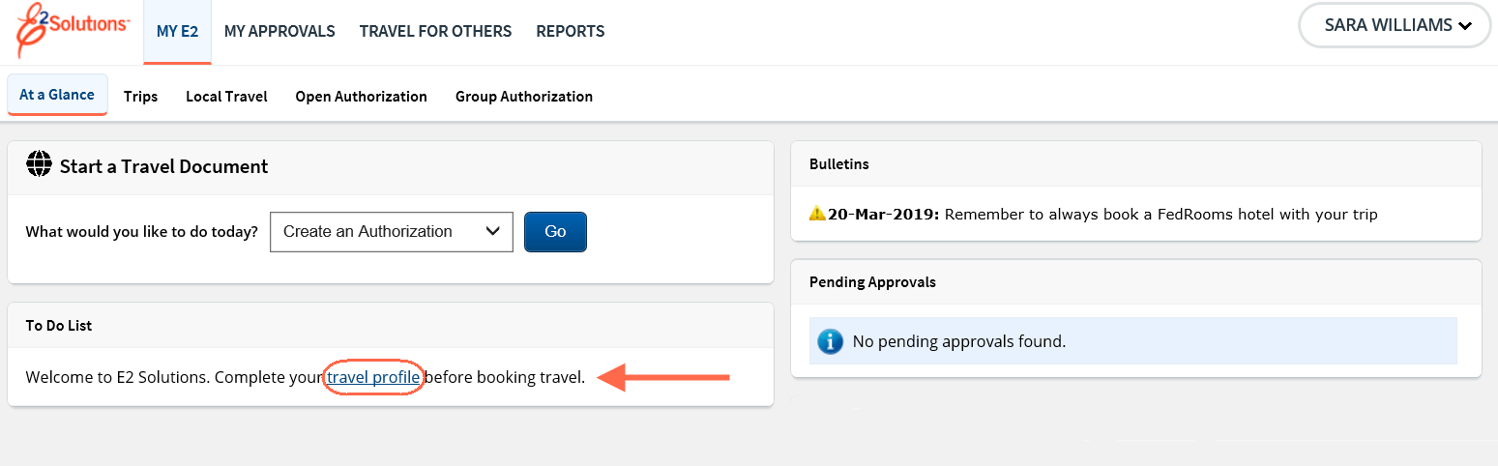
First Login Complete
Notes:
After logging in, you are landed on the My E2 page. You are encouraged to review and update your user profile.
Once you have accessed the new user email for your production account and initialized your account, delete the email as you will no longer be able to access E2 Solutions using that email. You will now access E2 using the URL – https://e2.gov.cwtsatotravel.com.

Slide 14
Scenario 1
View and Update User Profile
  Log in as the approver
  Access the profile
  Verify each section of the profile
  Complete any necessary information
Basic Navigation and Online Help
  Navigate the various areas of E2
  Access Online Help to search for keywords
    USCG Help Desk and TMC contact information
  Access USCG PPC Travel page to view customized user guides and QRCs
    https://www.dcms.uscg.mil/ppc/travel/ets/

Slide 15
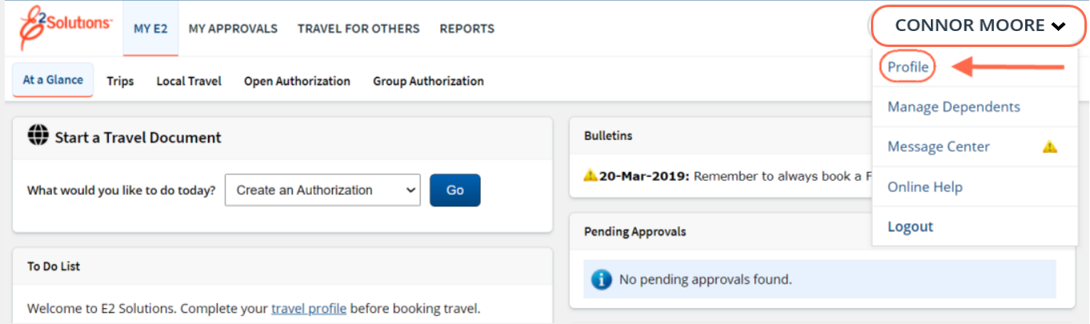
Verify and Update Profile
Notes:
Access your travel profile via the User Options menu by clicking on your name and selecting Profile.

Slide 16
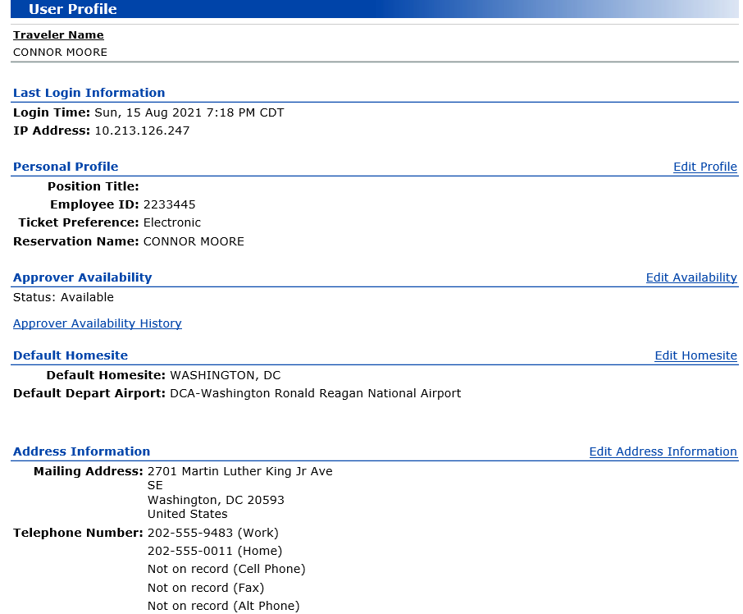
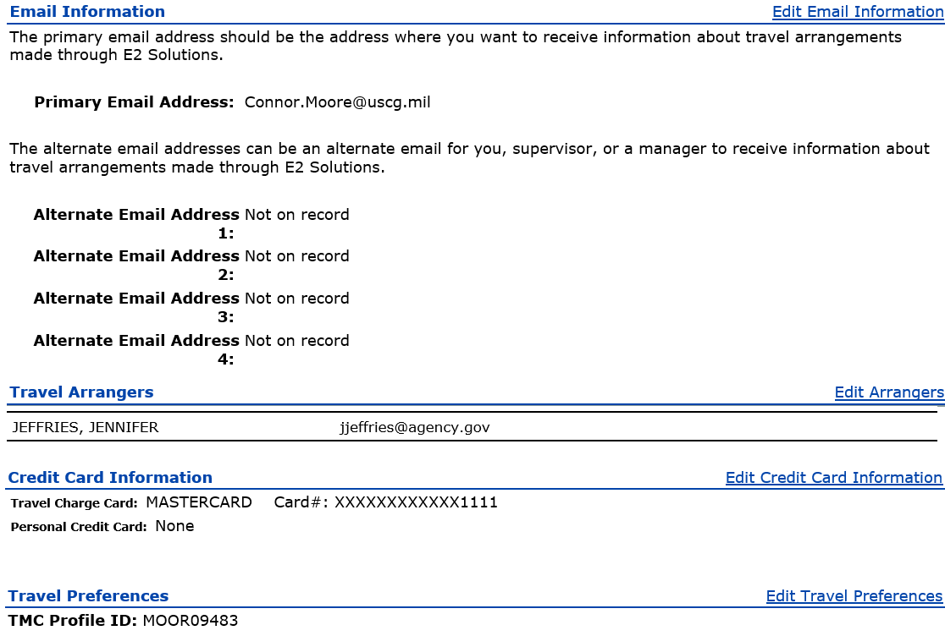
My Profile
Notes:
The following profile information is required before you can use E2:
Reservations Name as it should appear on all your commercial airplane reservations
Default home site and departure airport
Your home address
Email information
Add your official email address as your primary email
Add the email of your supervisor (E7 or higher, like a chief)
Travel Arrangers
Add an arranger and designate them to be able to send vouchers on your behalf
Credit card information – Airfare, Rail and Hotel should be set to Travel Charge Card once you enter your GTCC. If you do not have a GTCC, set the airfare and rail to
CBA and enter a personal card for hotels.
Be sure to activate your GTCC once received and add it to your profile immediately. The TMC cannot issue your ticket if the GTCC is not activated.
Travel preferences
Other Features
Government fares cannot only be billed to a GTCC, or the Agency’s Centrally Billed Account if the traveler doesn’t have a GTCC.
Government fares cannot be purchased with a personal credit card so be sure your profile is complete prior to booking travel.

Slide 17
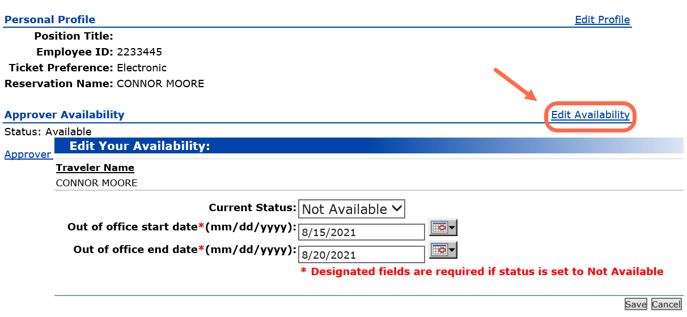
Approver Availability
Notes:
If an approver is unavailable to approve documents, the approver should update their availability. The document is made available to other approvers in the routing pool.
To change your approver availability:
Access your Profile from the User Options menu.
Click Edit Availability, on the right side of the Approver Availability section.
The Edit Your Availability page appears.
Select the Current Status from the list.
If Current Status is Not Available, enter the Out of office start date and Out of office end date, or use the calendar to select the dates.
Click Save. If the approver has locked travel documents, they are unlocked and available to other approvers in the routing pool.

Slide 18
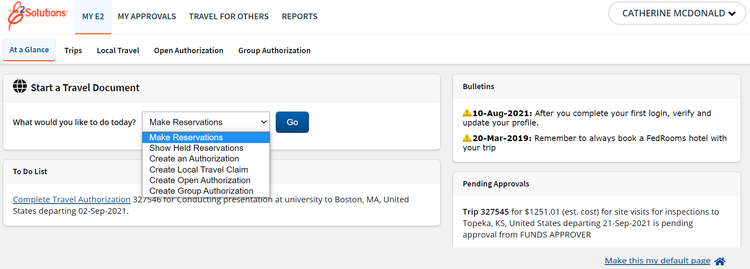
My E2
Notes:
The task bar includes these travel functions:
My E2 to access your To Do list, Start a Travel Document list, and lists of trips, local travel claims, open and group authorization. The Trips tab provides access to all trip documents, including authorizations, vouchers, and travel advances.
My Approvals to review travel documents that were prepared for you by an arranger (all users) or to approve travel documents (if you are an approver).
Travel For Others is where you begin a travel arranger session for another user.
Reports to generate travel activity reports.
The User Options Menu provides access to the Profile, Online Help, Log Out and Message Center.
Click your name to access the User Options Menu:
Profile to view or update your E2 profile, including your travel preferences.
Message Center to view important information from USCG, or E2 administrators, read selected news feeds and access web sites approved by as relevant to government travel.
Online Help (or Find Answers from some pages)provides access to the E2 knowledge portal where you can search for answers to your E2 questions, access computer-based training videos and user guides, chat with support agents or submit email questions to the customer support staff.
The My E2 At a Glance tab is your default landing page. Change your default by using the Make this my default page in the lower right corner on several pages.

Slide 19
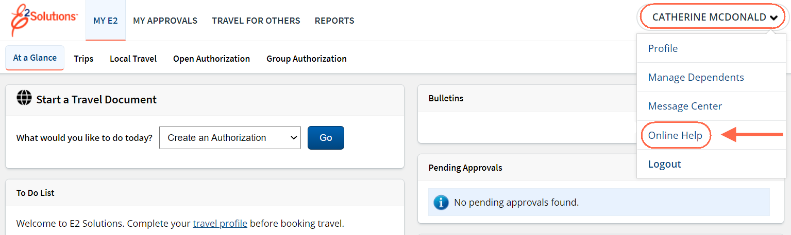
Online Help
Use E2’s knowledge portal to search for answers for questions about E2, and access standard computer-based tutorials, quick reference cards and user guides.
Notes:
Click the User Options Menu and select Online Help to access the knowledge portal.

Slide 20
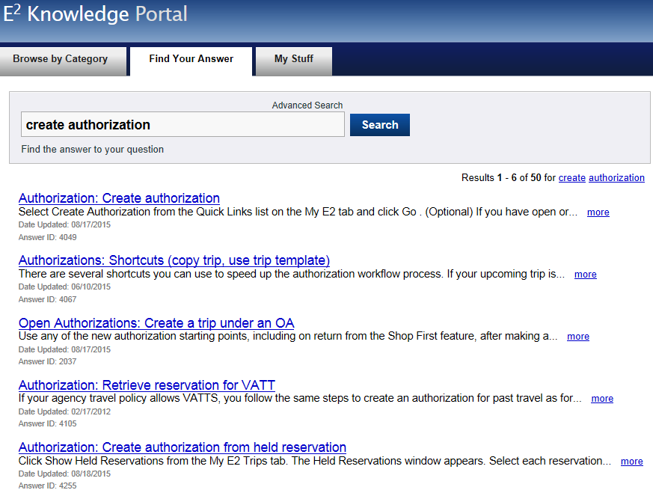
Online Help
Find Your Answer
Notes:
Type your question or keywords into the Search field and click Search.
You can search the word “troubleshooting” to receive a list of errors you may encounter. Click on the link that you want more information on and follow the steps outlined in the knowledge base.
You can also search for User Guide, Administrator Guide, CBT or Quick Reference Card to access additional information about a topic.

Slide 21
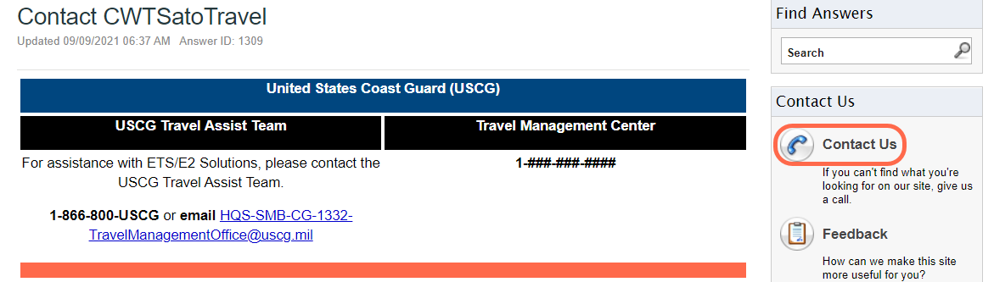
Online Help
Contact Us Details
Notes:
The Contact Us link will display information on how you can reach the Travel Assistance Team and the Travel Management Center for reservation assistance.

Slide 22
Review
First Log On, Profile and Navigation
After receiving your new user email, how long do you have to take action on it before it expires?
Once you have set up your password, what is the first thing you should do?
In your profile, what link should you click to indicate you will be out of the office and not available to approve documents?
Where do you go to access the knowledge portal to search for answers and access your Help Desk and TMC contact information?

Slide 23
Review
First Log On, Profile and Navigation
After receiving your new user email, how long do you have to take action on it before it expires?
New User email expires 72 hours after being sent.
Once you have set up your password, what is the first thing you should do?
Access, review, and update your profile.
In your profile, what link should you click to indicate you will be out of the office and not available to approve documents?
Edit Availability
Where do you go to access the knowledge portal to search for answers and access your Help Desk and TMC contact information?
Online Help or Find Answers

Slide 24
Approval
Overview

Slide 25
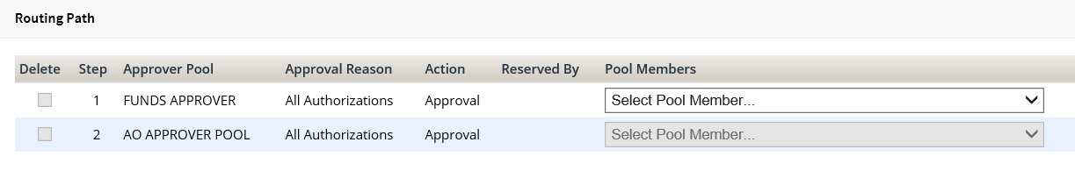
Approval Routing
Levels or steps of approval are determined when a document is submitted for approval.
Each level of approval is assigned to a group of approvers (routing pool).
Certain travel policy exceptions will cause the trip to route to a 3rd level of approval for review by the High Risk with PPC.

Slide 26
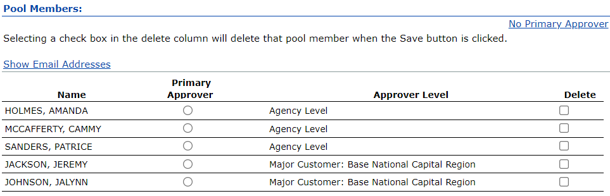
Approval Routing Pools
As an approver you are assigned to one or more routing pools which can include a primary approver who automatically receives all documents to approve within the pool.
USCG has elected to create the Funds Approver and AO routing pools without a primary approver designation. In this configuration, E2 makes the document available to all approvers in the pool until an approver locks the document to prevent another approver from accessing the document.

Slide 27
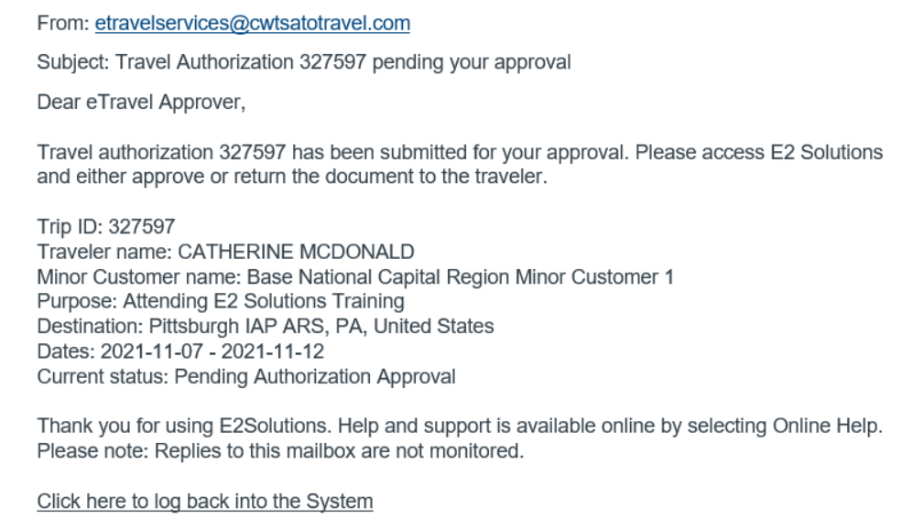
Approver Emails
Document Pending Approval
Approvers will receive an email when a document is pending their approval.

Slide 28
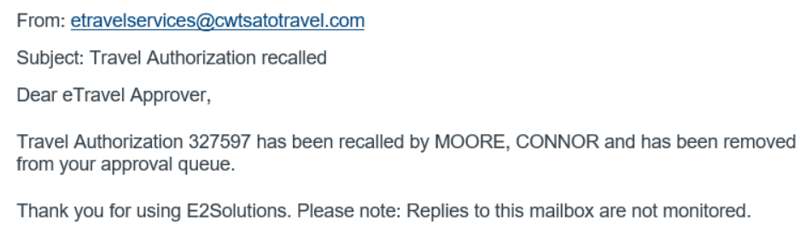
Approver Email
Recalled Document
If a traveler or arranger needs to change the document after if has been submitted for approval but before it completes the approval process, they can recall it. Approvers will be sent an email letting you know the document is no longer pending your review.

Slide 29
Real Time Validation / Funds Check
The Funds Approver is responsible for adding the POET lines to the travel documents. If you are in a smaller unit and there is not a Funds Approver, the AO will need to add the POET to fund the trip.
When approving documents in E2, a real-time validation process will check the funding available in FSMS when documents are approved. If warning messages or errors display, the Funds Approver should correct the POET before proceeding with approval.
The funds check will take place when the Approver approves the following documents:
TDY Authorization
TDY Voucher
Local Travel Claim
Travel Advance
Open Authorization
At this time Group Authorizations will not be obligated in FSMS.

Slide 30
My Approvals
Notes:
Per USCG
ALCOAST 456/21:
4. Discontinued Mandatory Use of CG Form 2070 after 05 Jan 2022:
ETS streamlines the process for Coast Guard travelers. Members are required to update their profiles with their supervisor's information in the notification portion to confirm entry of travel into ETS. Travelers must receive their command's permission to travel prior to ETS entries. Commands should assist travelers with understanding the appropriate supervisory level to approve travel.
Units seeking greater control of member travel may elect to continue to use CG Form 2070.

Slide 31
Scenario 2
As an approver, you should be familiar with where to go to access documents pending your or your approval group’s review.
Access My Approvals
Complete the tasks to become familiar with My Approvals and various approver functions applicable across all document types.
Review list of documents pending approval.
Select Filter Options and view available selections.
Open a pending trip and determine if it is locked to you. If not, lock the document.
View the trip history to determine the minor customer the trip is associated to and if the traveler is traveling under the JTR or FTR.

Slide 32
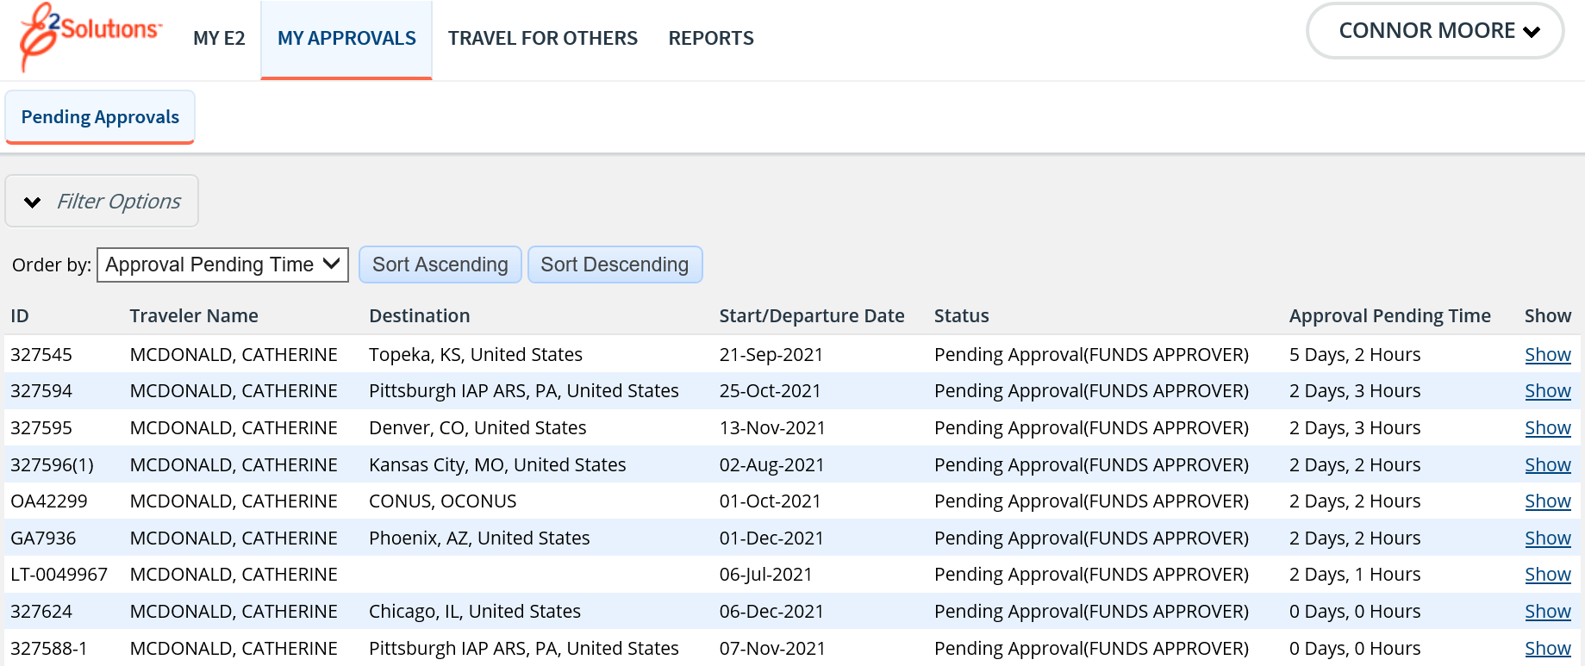
My Approvals
E2 provides access to approver functions through the My Approvals tab on the taskbar.
Notes:
The default Pending Approvals list shows all documents assigned to you for your approval.
Filter Options can be used to search for a specific document type or to search by other criteria.
Locate the document you want to approve and click Show.

Slide 33
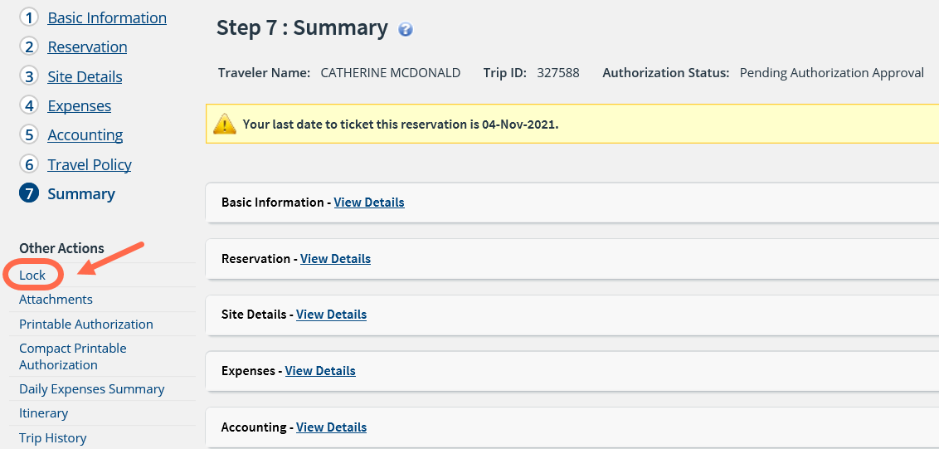
Document Summary
Locking and Unlocking a document
When an approver opens a travel document, the Summary page appears. The approver will need to lock the document if it is not already locked to them to take any action.
Notes:
Locking a document prevents other approvers from accessing it. You cannot approve it (or take any other action) unless it is locked.
If you are the primary approver in your routing pool, the document is assigned to you for approval and it would be locked when you open it.
The document is locked to you if the Unlock link appears in OTHER ACTIONS, on the left side of the page, and the Unlock button appears at the bottom of the page.
If the Lock link appears in OTHER ACTIONS and the Lock button appears at the bottom of the page, the document is not currently locked to any approver. Click the Lock link (or Lock button) to continue.
Use the Summary page to review the document. If you need to see additional information, click the View Details or Edit Details link for that section. You can also click any step in the workflow which will display in the upper left corner of every document.

Slide 34
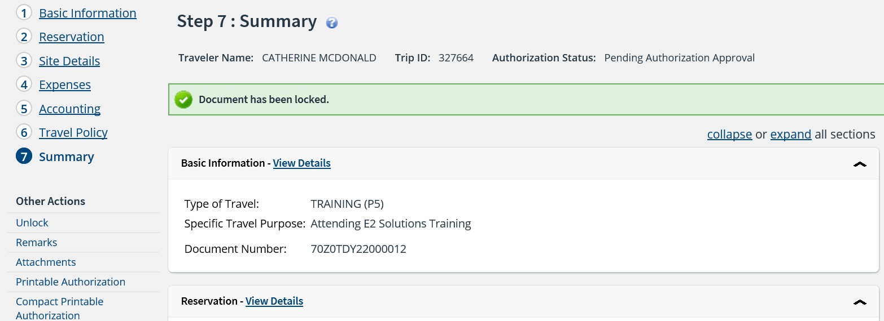
Document Summary
Locking and Unlocking a document
Notes:
A confirmation message will display once the document is locked or unlocked by you.
A document must be locked by the approver before approval action can be taken on the document.

Slide 35
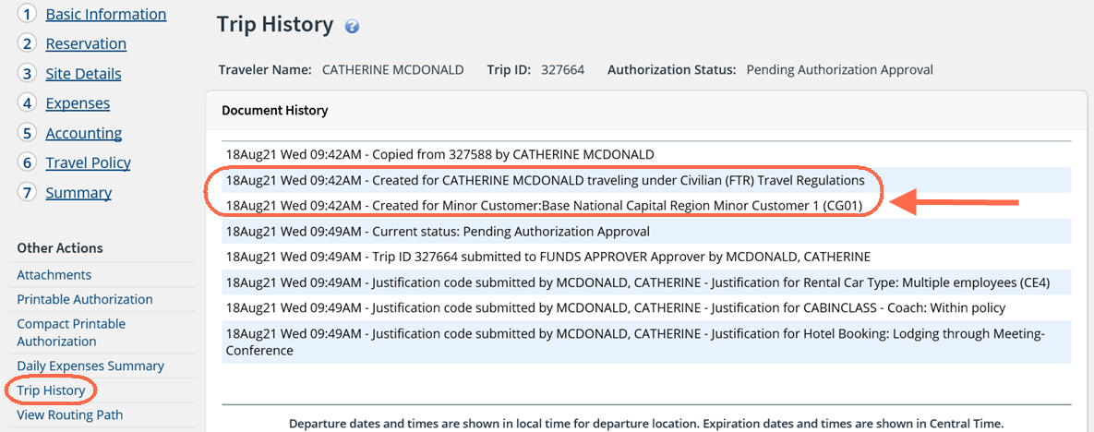
Viewing Trip History
Notes:
You can determine the which minor customer the trip is associated to by looking at the pending trip’s Trip History.
The link to access Trip History is found under Other Actions in the trip’s left navigation menu.
The minor customer information is located at the beginning of the trip history. You can also determine if the traveler is traveling as a civilian and following Federal Travel Regulations (FTR) or as uniformed personal following Joint Travel Regulations (JTR) from the trip history.

Slide 36
Authorizations

Slide 37
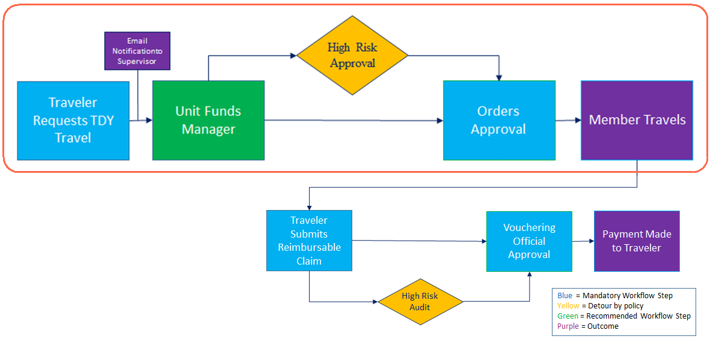
TDY Authorization Workflow
Notes:
This is the TDY Authorization workflow. Travelers or arrangers will create reservations and authorizations, which are then submitted for approval.
The authorization will first stop at your Unit Funds Approver for approval, where the POET will be applied.
If the trips meets any of the conditional requiring additional approval, it will route to the HIGH RISK approval group.
If the trip does not meet the HIGH RISK conditions, or once approved by the HIGH RISK approval group, it will route to the AO for approval.
Once the authorization is approved, the details are sent to the TMC which gives them permission to ticket the reservations.
The traveler’s supervisor will receive all travel related emails once the traveler has added their email to their profile. The document will not route to the
supervisor for approval.

Slide 38
Reviewing & Approving Authorizations
The Approver’s role in E2/ETS:
Review trip information to ensure validity
Review policy justifications exceptions
Review estimated expenses and requested reimbursement types are valid
Funds Approver will apply the correct POET line for trip funding (the POET must be added before an authorization can be approved by the final approver). All approvers should review the funding details.
Upon final review, the approver can either approve the document or return it to the traveler/arranger for modifications.
At time of final approval, the funding information is automatically sent to the TMC so that tickets can be issued.

Slide 39
Scenario 3
Review and Approve an Authorization
An authorization has been routed to you for approval. Access the document and review the following:
  Basic information
  Site details
  Reservations
  Expenses, to include requested reimbursement types and Pay To field Travel policy exceptions
  Remarks and Attachments
Funds approver will add the POET. All approvers should view the funding details.
  Review all account code functionality including adding, deleting, adding and using favorites and using trip templates.
Approve the authorization.

Slide 40
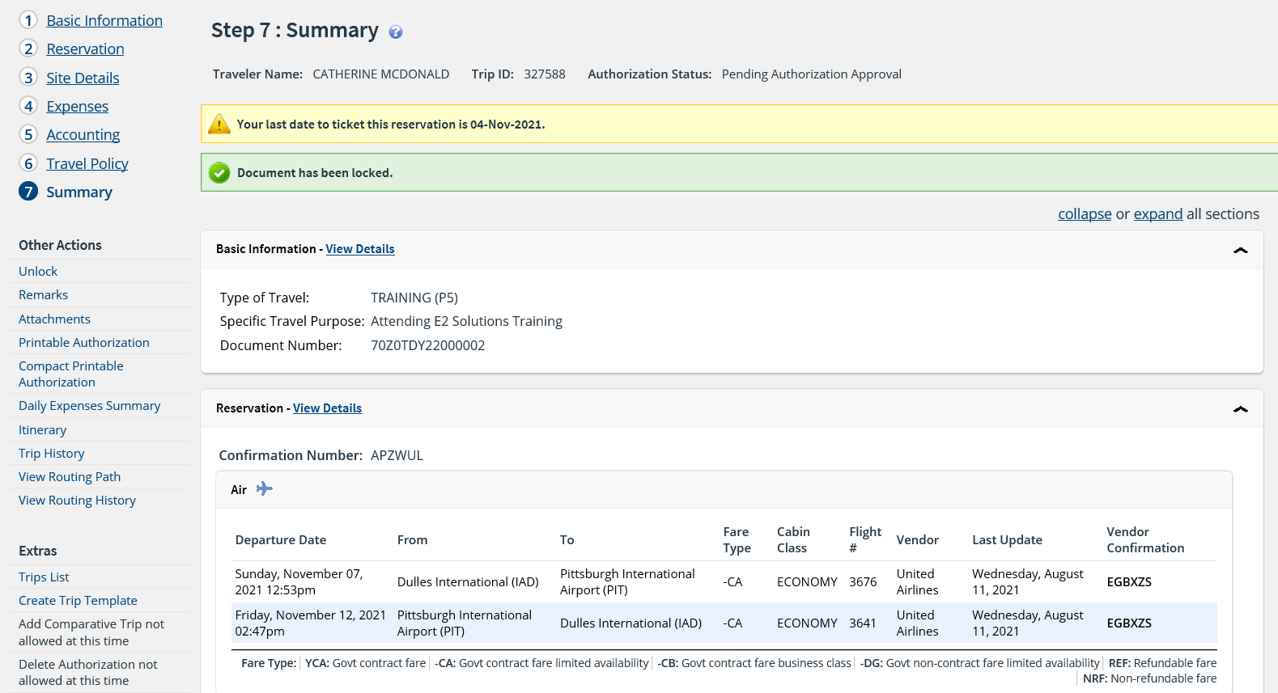
Authorization Approval
Opening the document for review
Notes:
Once an approver clicks Show from the pending approval list, the summary page displays.
Click Lock if the document is not already locked to you.
Use the Summary page to review the authorization. If you need to see additional information or make changes to the authorization, click the View Details or Edit Details link for that section. Be sure to save your changes.
When you have finished reviewing the document, you can return to the Summary page to:
Approve the document.
Return to Traveler for revision.
Unlock the document so another approver within your routing pool can access the travel request and take action on it.

Slide 41
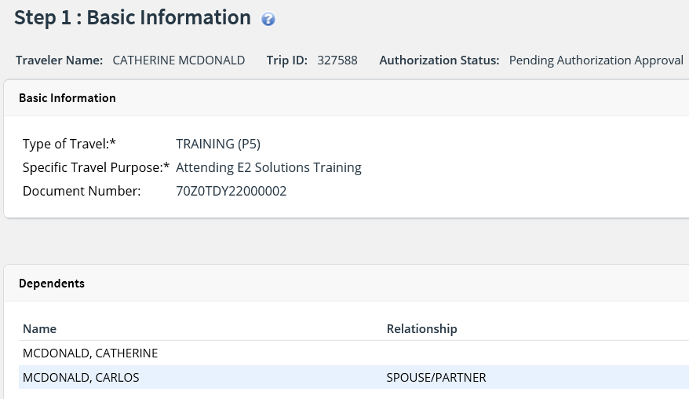
Authorization Approval
Reviewing Basic Information
Notes:
Type of travel, specific travel purpose, and document number appear on the Basic Information page.

Slide 42
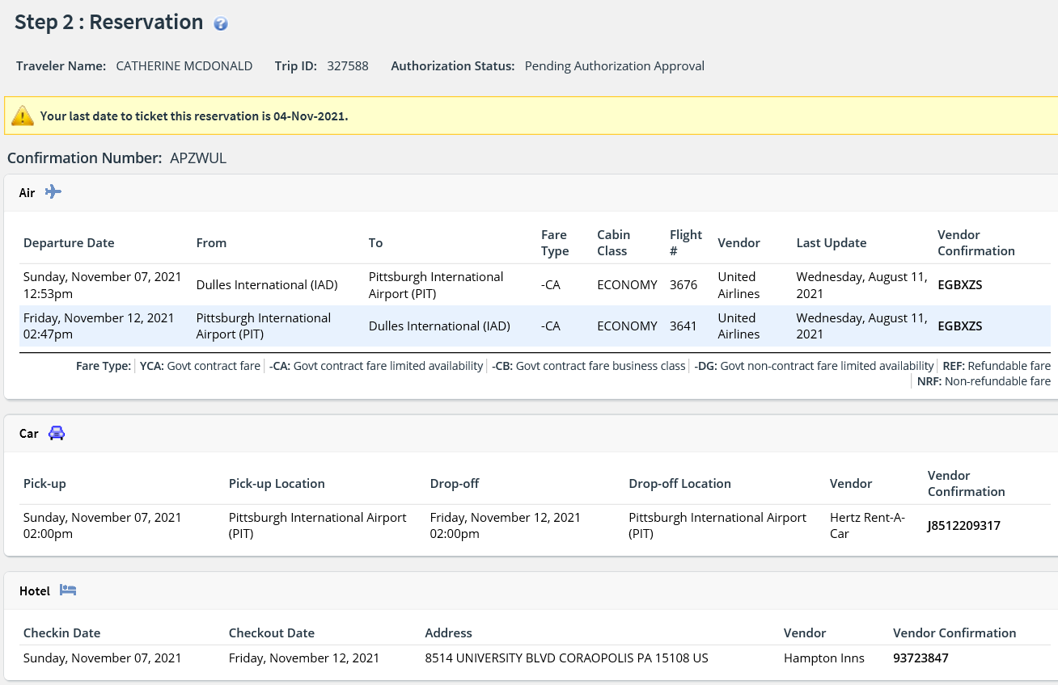
Authorization Approval
Reviewing Reservations
Notes:
If the traveler has associated reservations for air, car, rail, and/or hotel, they will appear on the Reservation page.

Slide 43
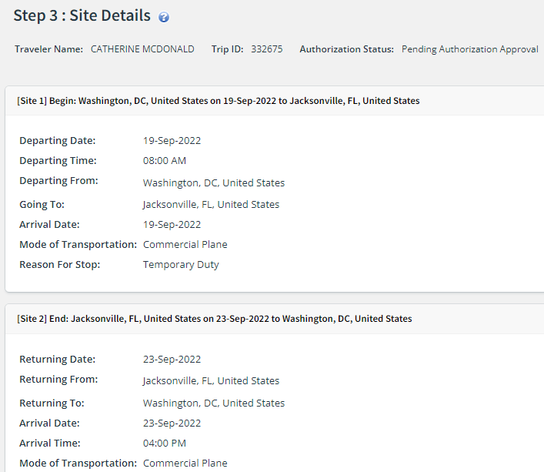
Authorization Approval
Reviewing Site Details
Travel dates, trip per diem locations, mode of transportation, and reason for stop appear on the Site Details page.

Slide 44
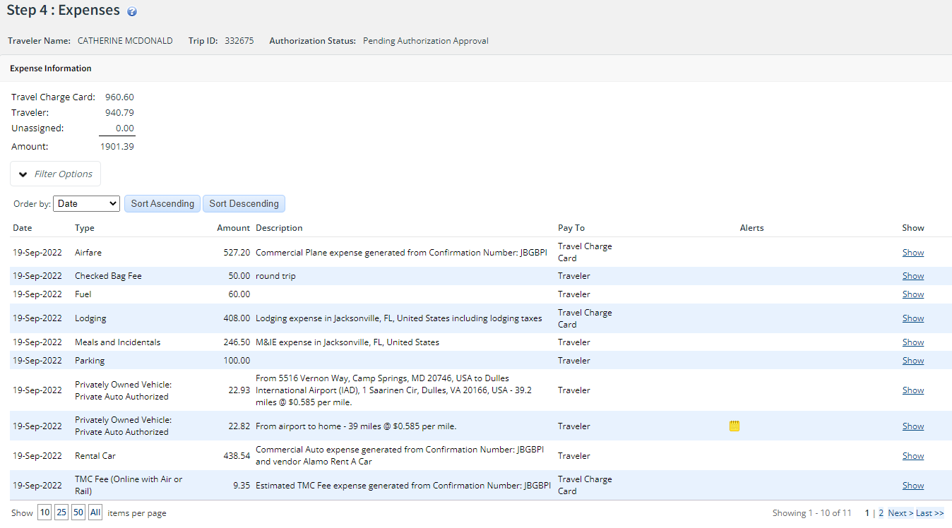
Authorization Approval
Reviewing Expenses
Notes:
Estimated expenses for the trip appear on the Expenses page.
If there is an associated reservation, certain details about the expenses, such as airfare, rental car, rail, and lodging, are generated from the reservation information.
Review all Pay To Fields
Air Payment Integration Enabled – Pay To cannot be changed on Airfare or TMC fee and should reflect how the traveler’s ticket will be purchased – Travel Charge Card or
Agency Billed.

Slide 45
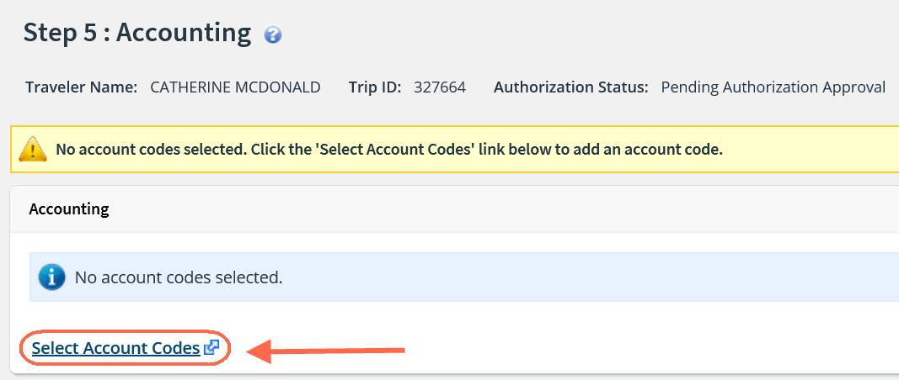
Authorization Approval
Selecting an Account Code/POET
Notes:
The POET (Project, Organization, Expenditure, Task) lines are also known as Accounting Codes in E2.
Click Select Account Codes to add a POET to the authorization.
Note: The funding validation will be done when the approver approves the authorization.

Slide 46
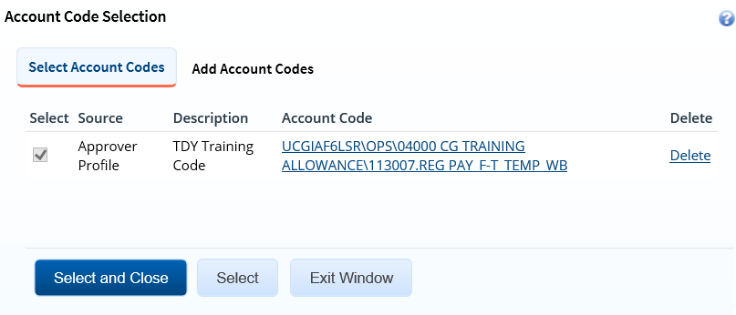
Authorization Approval
Selecting a Favorite Account Code/POET
Notes:
Once Select Account Codes is clicked, the default view is to Select Account Codes. You can also Add Account Codes from this page, as well.
Favorite account codes, or POET lines, can be saved in your profile once they have been used at least once. This makes it convenient to add them to future documents using the same POET line or lines.
To select a favorite POET, check the box next to the line to be used and click Select and Close.
Multiple POET lines can be added to an authorization.
If the needed POET is not saved as a favorite, click the Add Account Code tab to add a new POET.

Slide 47
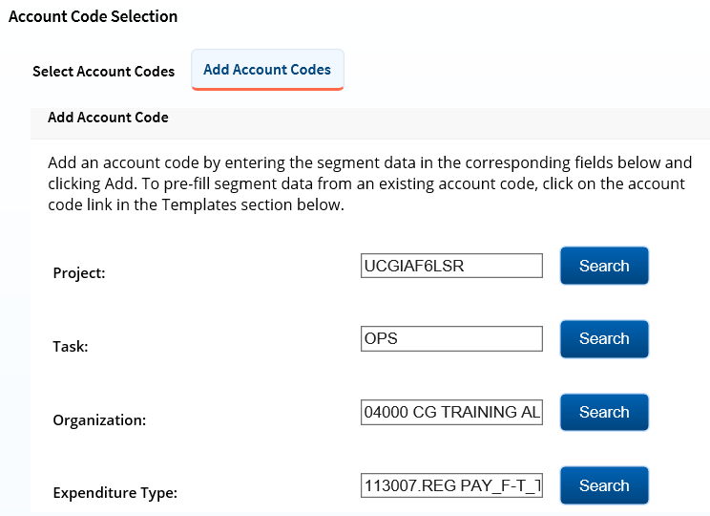
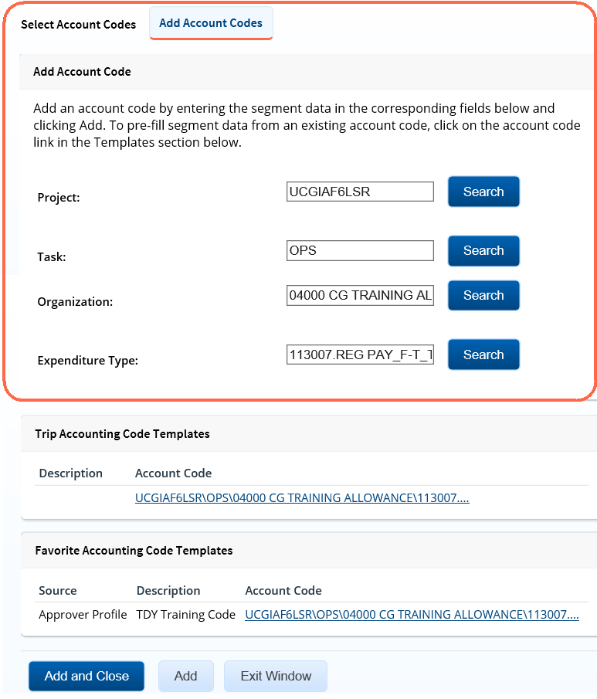
Authorization Approval
Adding an Account Code/POET
Notes:
To add an account code, start by entering the segment data in the Project, Task, Organization, and Expenditure Type fields.
You can use the Search button to search for segment data that is valid for the previously identified segment value. A list of valid options will be displayed to select from.
Once all segments have been entered, click Add and Close. If an additional POET needs to be added, click Add instead and you will remain on the Add Account Codes page to add another POET.

Slide 48
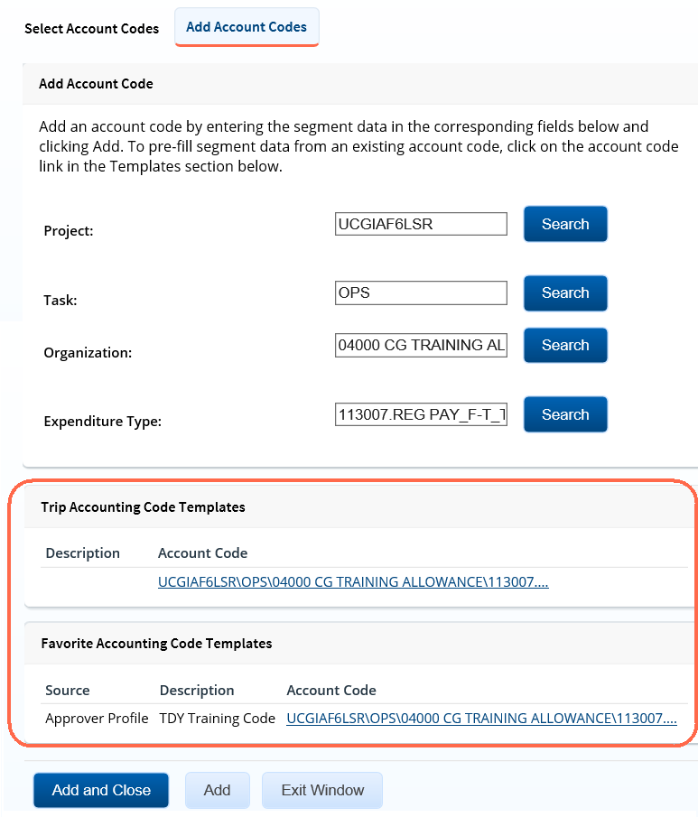
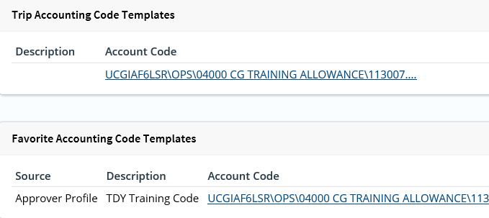
Authorization Approval
Add Account Codes using Templates
Notes:
Account code templates allow you to prepopulate all or part of an account code, and then alter or add segment values as needed.
Any account code already associated with the authorization appears in the Trip Account Code Templates section on the Add Account Codes tab of the Account Code Selection window.
Favorite account codes are listed in the Favorite Account Code Templates section.
Select a template from either section, and then scroll to the top of the tab to enter or search for the remaining segment values.

Slide 49
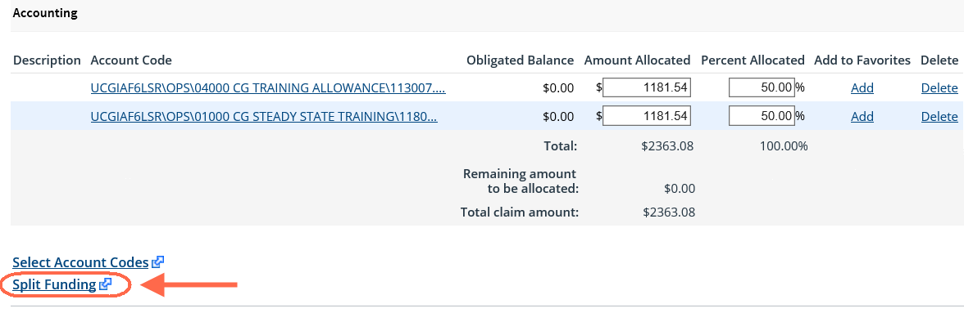
Authorization Approval
Split Funding (Multiple POET Lines)
Notes:
If you select or add multiple POET lines to fund the travel, you then have the option to identify which expense types should be funded from each line, identify a single expense to be split across multiple POET lines, or you can choose to fund expenses for a range of days from each POET line.
Splitting funds by expense type is the default action.

Slide 50
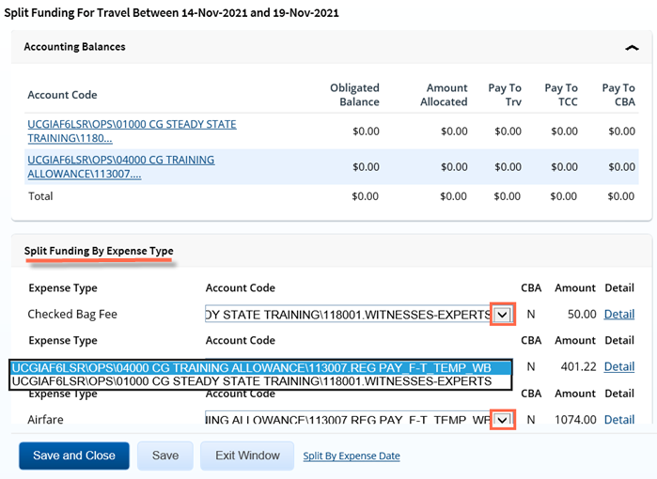
Authorization Approval
Split Funding by Expense Type
Notes:
Split Funding by Expense Type is the default action for allocating expenses to certain POET lines for funding.
Select the POET lines to fund each type by clicking the down arrow on the Account Code drop down menu for each expense.

Slide 51
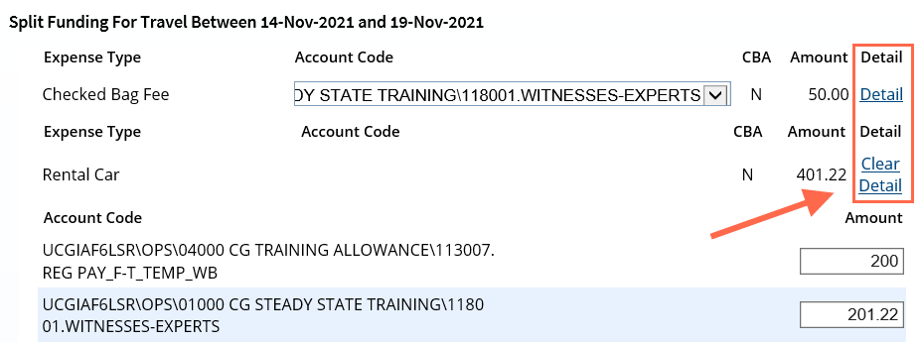
Authorization Approval
Split Funding by Expense Type Using Detail
Notes:
If you need to fund an expense from more than one account, use the Detail link to split the expense across multiple POET lines.
Click the Detail link for the expense type. This expands the section for that expense type. You can then identify the expense amount to be funded by each POET line.
If you need to remove the split details, click the Clear Details link.

Slide 52
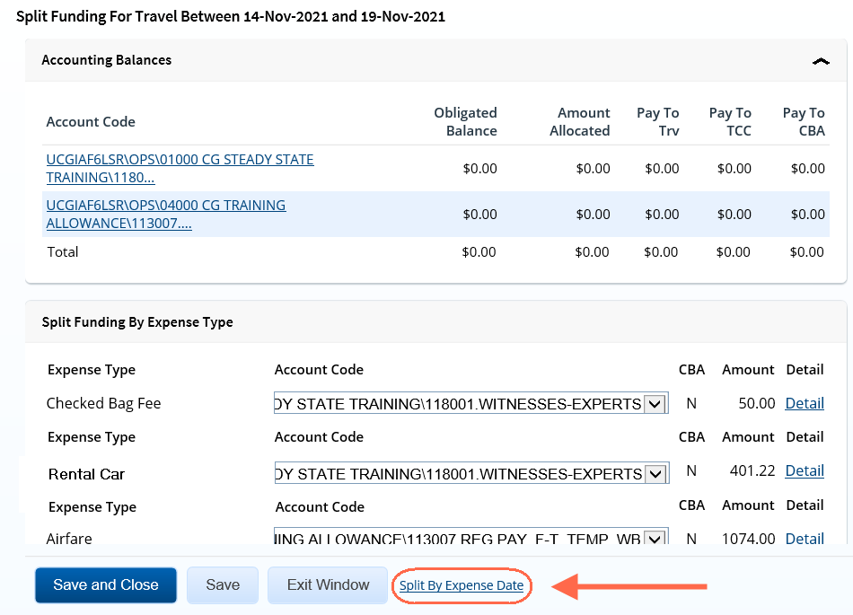
Authorization Approval
Split Funding by Expense Date
Notes:
If you need to fund specific days of the trip by different POET lines, use the Split By Expense Date feature.
You cannot split funds by expense type and also by expense date. If you have already split your funds, you will be prompted to confirm your actions if you attempt to change your funding method from expense type to expense date.

Slide 53
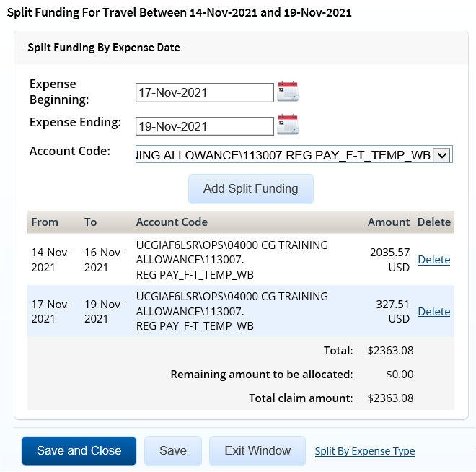
Authorization Approval
Split Funding by Expense Date
Notes:
Select the date range for the funding. Expenses within this date range will be funded from the selected account.
Expense Beginning – Enter the beginning date of the range (formatted DD-MMM-YYYY) in the field, or click the calendar icon to select a date from the drop-down calendar.
Expense Ending – Enter the ending date of the range in the field, or click the calendar icon to select a date from the drop-down calendar.
Select the POET line to use for funding from the Account Code drop-down list.
Click Add Split Funding. The details for the established date range display in the data grid below the button.
Repeat the steps until you have funded all of your estimated expenses.
Click Save and Close to save your selections, close the Split Funding window, and return to the authorization's Accounting page.

Slide 54
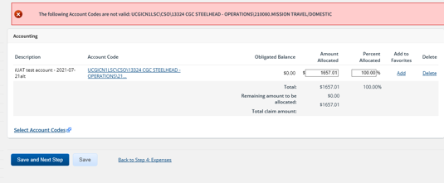
Adding POET Errors
If the POET entered on the accounting step is not a valid POET line, the approver will receive an error at that time.
The POET must be corrected before proceeding.
An error could occur if an approver adds a favorite account code that is no longer being used to fund documents.

Slide 55
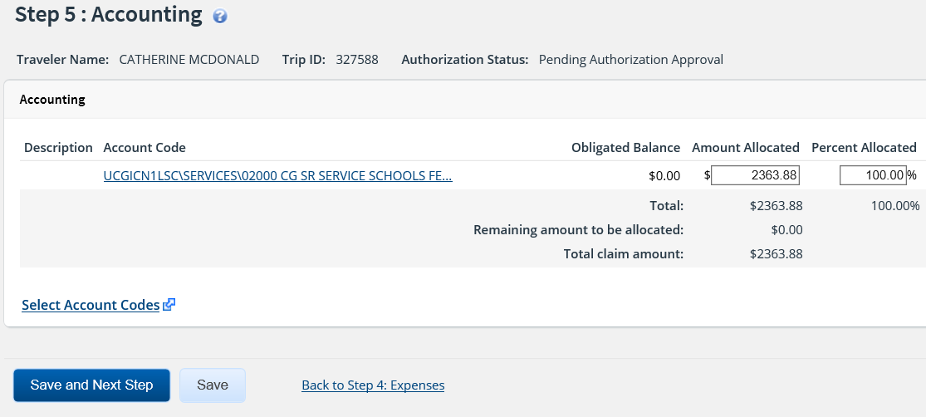
Authorization Approval
Completing Accounting
Notes:
Once funding for the trip has been identified, click Save and Next Step to review Travel Policy exceptions.

Slide 56
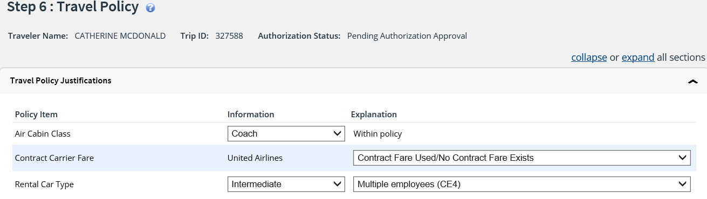
Authorization Approval
Reviewing Travel Policy Justifications
Notes:
The Travel Policy page contains the Travel Policy Justifications, Warnings and City Pair Information.
The Travel Policy Justifications section displays each policy item, information and an explanation showing within policy or an out of policy justification selected by the traveler or arranger during the authorization creation or reservation booking process.

Slide 57
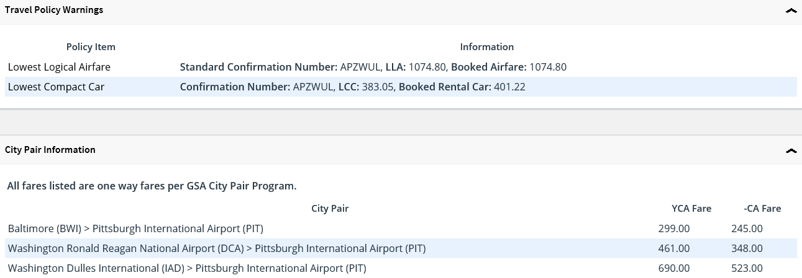
Authorization Approval
Reviewing Travel Policy Warnings and City Pair Information
Notes:
Other items that may deviate from standard policy, including hotel booked over per diem rate, actual reimbursement type selected for lodging or M&IE and official days off during the trip, appear in the Travel Policy Warnings section.
The City Pair Information section of the authorization's Summary page displays contracted fares for trip sites, including all combinations for metro-related city pairs. All listed fare are one-way fares.

Slide 58
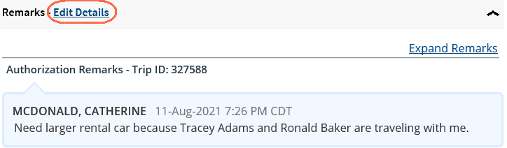
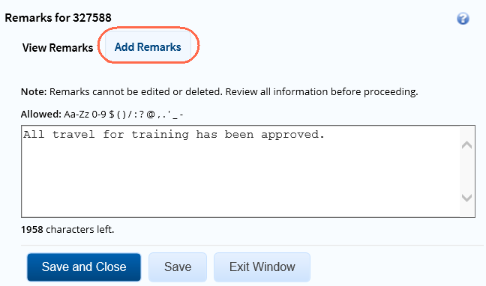
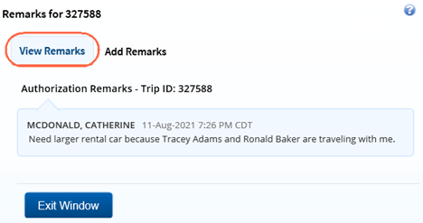
Authorization Approval
Reviewing and Adding Remarks
Notes:
General remarks about the authorization display in the Remarks section of the authorization's Summary page.
The traveler or arranger, or even a previous approver, may have added additional information to the authorization request. You should always review any remarks attached to the authorization.
Remarks automatically displays in a scrolling box. If you prefer to view the remarks as part of the page, click the Expand Remarks link.
Click Edit Details to open the Remarks window. It opens to the View Remarks tab.
Click the Add Remarks tab to add remarks to the authorization.
Enter your remarks and review them. Remarks cannot be edited or deleted after you save them; make any changes before saving.
TIP: Avoid copying and pasting text from other applications. Doing so may result in invalid character errors.
Click Save and Close to save your remarks and close the Remarks window.

Slide 59
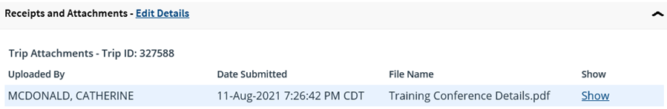
Authorization Approval
Reviewing Attachments
Notes:
Attachments are listed in the Receipts and Attachments section on the authorization's Summary page.
The traveler or arranger, or even a previous approver, may have added attachments to the authorization request.
Additional information may include files attached to the authorization request. You should always review any files attached to the authorization.

Slide 60
Authorization Approval
Other Actions
Other Actions | Description
Lock/UnLock | Lock the document to take ownership. Once the document is locked, the Unlock link will display.
Remarks | Review or add remarks to authorization.
Attachments | View or add receipts or other documents to the trip.
Printable Authorization | View or print the authorization.
Compact Printable Authorization | View or print a compact (typically, one page) version of the authorization.
Daily Expense Summary | View expense/per diem by day.
Itinerary | View reservation details, including ticket data (if available).
Trip History | View history for an authorization and a voucher.
View Routing Path | View the approval path for the document.
View Routing History | View the audit trail of routing events.
Comparative Airfare | View estimated coach airfare for a trip that uses a mode of transportation other than commercial or government plane.
The Other Actions section contains links to actions you may want to perform while approving an authorization.
It is located in the left navigation pane of the authorization.

Slide 61
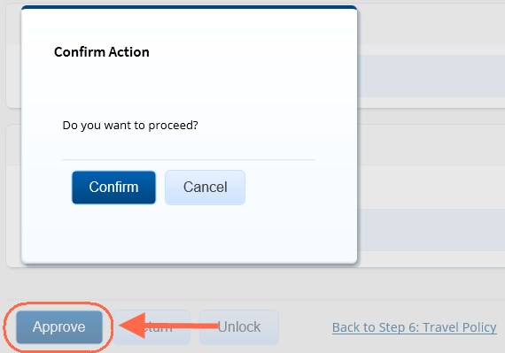
Authorization Approval
Approve and Confirm
Notes:
After reviewing the authorization, scroll down to the bottom of the Summary.
To Approve the document, click Approve. The Confirm Action window displays.
Click Confirm.
When the authorization is approved, your Pending Approvals list displays a message that the authorization was successfully approved, and the trip is removed from the list.

Slide 62
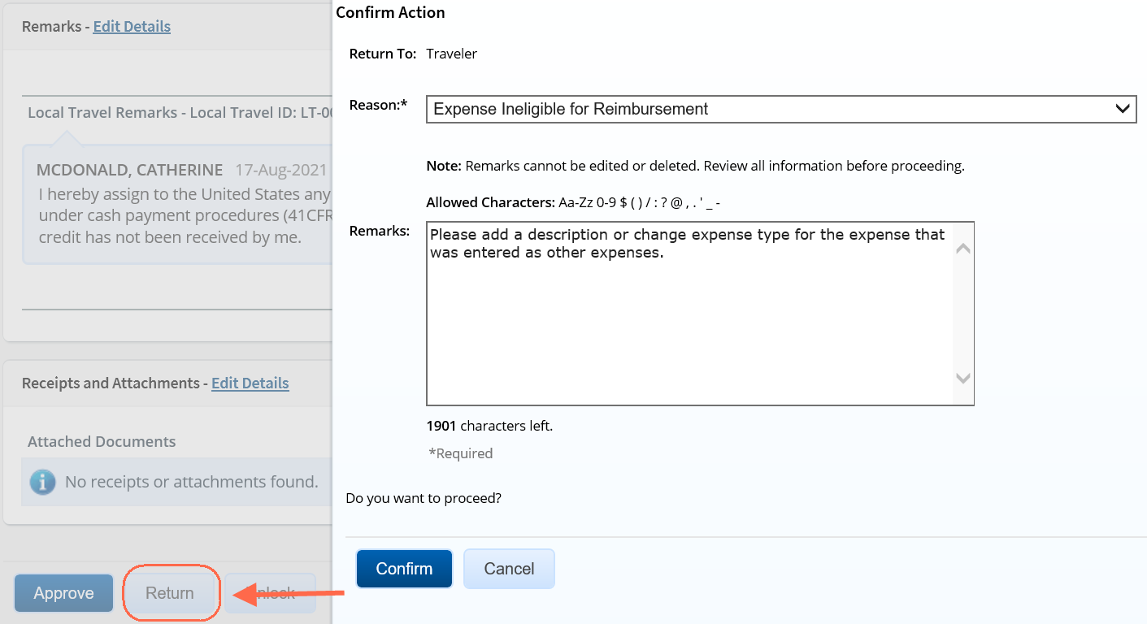
Authorization Approval
Returning Authorization for Revisions
Notes:
After reviewing the authorization, scroll down to the bottom of the Summary.
To return the authorization for revisions, click Return.
The default option when returning a document is Return to Traveler. To return it to a previous approver, select that option.
Click the Reason list and select a reason for returning.
Enter Remarks to provide additional details.
Click Confirm to return the document, or Cancel to return to Summary.

Slide 63
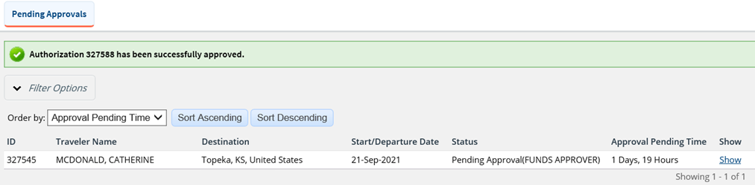
Authorization Approval
Complete
Notes:
Once the trip is approved, your Pending Approval list appears with a message indicating that the authorization was successfully approved, or returned, and the trip is removed from your pending approval list.
The traveler receives an email indicating their trip was approved or returned.

Slide 64


Funds Validation Successful
When the Approver clicks to approve the authorization, the funds check takes place. If funds are available, the trip is approved and removed from the pending approval queue.
No message is displayed in the approval confirmation window when funds are available.
A message is added to the trip history indicating the funds check was successful.
Notes:
The funds check is performed on the Project/Task combination for each accounting line that has been added.
A warning or error message is not displayed if the funds check is successful.

Slide 65

Funds Validation Failed
When the Approver clicks to approve the authorization, the funds check takes place.
If funding isn’t available, a warning message displays. The POET must be corrected before proceeding. Not correcting the POET will cause the Final Approver to receive a hard stop and they will be unable to move forward with approval.
Click Cancel and return to the Account step to select another POET.
Notes:
The funds check is performed on the Project/Task combination for each accounting line that has been added.
A warning or error message is displayed if the funds check is not successful, and the Project/Task warning will
include the Project and Task that does not contain enough funding along with the available amount.

Slide 66


Funds Validation Failed continued
The Funds Validation warning message displays at the top of the Summary page and also in the Trip History.

Slide 67

Funds Validation Failed
When more then one POET line is entered to fund the trip, the Funds Validation warning message will indicate only the POET lines where the funds check failed.
When the funds check fails on multiple POET lines, the message will display that information.

Slide 68

Approving Amended Authorizations
If you are reviewing an amended authorization, however, you may want to compare the amended document with the original document.
Click the View Amendment Changes link in the Other Actions section to display the Amendment Changes Summary window, which allows you to review the differences between the current amendment and the original authorization/most recent amendment.
Notes:
When an authorization is amended, the trip ID is appended with a dash and a number (-X). For example, if a traveler amends an authorization for trip ID 12345, E2 appends -1 to the trip ID for the first amendment (e.g., 12345-1), -2 for the second amendment (e.g., 12345-2), and so forth.
If an amended authorization is routed for approval, the process is the same as the approval process for a new authorization.
You can also print or view the printable authorization document for each version of the authorization, including the version you are reviewing for approval.

Slide 69
Comparative Trips
A comparative trip is an alternate travel scenario that is used for comparison purposes during the authorization creation and approval process.
Travelers should add a comparative trip when they have set up your authorization to do something different than what they are typically authorized to do.
Examples include:
    Driving vs Flying
    Departing out of a different city than your homesite
    Flying into a different city
    Other reasons determined by your unit, office or agency that require a cost comparison
The primary authorization should be set up for the travel the traveler intends to do.
A traveler can add a comparative trip to the authorization after completing all steps in the authorization workflow and before it is submitted for approval. This will allow the traveler to calculate the cost of what is allowed, and then if needed adjust the primary authorization expenses to what they will be allowed to enter reimbursement for.

Slide 70
Scenario 4
Approving Authorization with a Comparative Trip
The traveler is going round trip from Washington, DC to Pittsburgh, PA.
The traveler prefers to drive to Pittsburgh rather than fly.
An authorization has been created and a comparative trip was added.
If needed, expenses will be adjusted so that the traveler will only enter expenses up to
what they are allowed to claim based on the cost of the YCA fare of the flights.
* Instructor may adjust travel details as needed

Slide 71

Viewing Comparative Trips
Notes:
If a member is taking an alternate but not authorized method of transportation, they are limited to the constructed cost of the authorized travel, i.e cost of travel method plus any
TMC fees applicable.
The traveler should add a comparative trip to their authorization so the approver can view the alternate option.
The YCA fare can be viewed on the Travel Policy Step of the authorization.
On the Comparative Trip Summary page, you can review the primary trip cost and the comparative trip cost.
Review the Comparative Trip Summary under Other Actions. If what the member “wants to do” exceeds the “allowed to do” USCG has created an expense line,
Constructed Cost of GTR, to capture the entitled amount so that the traveler does not need to adjust the POV mileage to equal the GTR amount.
The traveler needs to calculate the correct amount of what they are allowed, add the Constructed Cost of GTR expense, and add remarks indicating the reason for the expense.
If what the member wants to do is less than what they are allowed to do i.e. driving is less expensive than the YCA fare, they can keep the POV mileage expense that has been added.
and do not need to use the Constructed Cost of GTR. Approvers should review any remarks to ensure the traveler has added necessary details indicating the reason for the
expense.

Slide 72
Review
Approving Authorizations
An approver must add the POET to an authorization before final approval can occur. True or False?
Once you access a document from My Approvals, what is the first action you should take if you are not the primary approver?
What page do you need to be on to approve or return the authorization to the traveler/arranger or previous approver?
When does the Funds Check take place?

Slide 73
Review
Approving Authorizations
An approver must add the POET to an authorization before final approval can occur. True or False?
True.
Once you access a document from My Approvals, what is the first action you should take if you are not the primary approver?
Lock the document if you intend to approve the document.
What page do you need to be on to approve or return the authorization to the traveler/arranger or previous approver?
The Summary page.
When does the Funds Check take place?
When an approver clicks to Approve the document.

Slide 74
Travel
Advances

Slide 75

Travel Advances
Travelers may request a travel advance in E2 for a trip after the authorization is approved.
Travelers can request multiple advances for a trip but the system will limit them to 80% of their total travel estimate, excluding airfare.

Slide 76

Travel Advance Approval
Reviewing Advance Summary
Notes:
Once an approver clicks Show from the pending approval list, the summary page displays.
Click Lock if the document is not already locked to you.
Use the Summary page to review the advance. If you need to see additional information or make changes to the advance, click the View Details or Edit Details link for that section. Be sure to save your changes.
When you have finished reviewing the document, you can return to the Summary page to:
Approve the document.
Return to Traveler for revision.
Unlock the document so another approver within your routing pool can access the travel request and take action on it.

Slide 77

Travel Advance Approval
Reviewing Advance Basic Information
Notes:
General information about the travel advance displays in the Basic Information section of the Advance Summary page. This information includes the amount already requested, advance amount, and document number.

Slide 78

Travel Advance Approval
Reviewing Advance Accounting
Notes:
Accounting information for the advance displays in the Accounting section on the Advance Accounting page.
Before a travel advance can receive final approval, one or more accounts must be selected to fund the advance.
Review the accounts selected to fund the advance.
If you need to make funding selections, or change existing funding selections or allocations, click the Edit Details link in the Accounting section header. This displays the Advance Accounting page.
The approver can make changes or select accounts for the advance.
Click the Account Code link to view segment details for the selected account code. (Click Exit Window to close the segment details window.)
If you need to adjust allocations between multiple accounts, enter the appropriate amounts in the Amount Allocated or Percent Allocated field for each account.
Click the Add link to save the account code as a favorite.
Click the Delete link to remove the account from the advance.
If you need to select accounts to fund your trip, click the Select Account Codes link to find new accounts or select accounts from favorites.
Click Save to save your changes.

Slide 79

Travel Advance Approval
Approve and Confirm
Notes:
After reviewing the authorization, scroll down to the bottom of the Summary.
To Approve the document, click Approve. The Confirm Action window displays.
Click Confirm.
When the advance is approved, your Pending Approvals list displays a message that the advance was successfully approved, and the advance is removed from the list.

Slide 80

Travel Advance Approval
Returning Travel Advance for Revisions
Notes:
After reviewing the advance, scroll down to the bottom of the Summary.
To return the authorization for revisions, click Return.
The default option when returning a document is Return to Traveler. To return it to a previous approver, select that option.
Click the Reason list and select a reason for returning.
Enter Remarks to provide additional details.
Click Confirm to return the document, or Cancel to return to Summary.
Once the advance is returned, your Pending Approval list appears with a message indicating that the advance was successfully returned, and the document is removed from your pending approval list.

Slide 81
Open
Authorizations
Notes:
Also known as Blanket Authorizations

Slide 82
Reviewing & Approving Open Authorizations
Open authorizations (often known as "blanket authorization" or OA) are pre-approved requests to travel during a specified time period. They may be limited to specific travel types, locations, or maximum costs.
An open authorization can cover multiple trips for up to one fiscal year.
Once the OA is approved, travelers or arrangers can create trips under an approved authorization. If travel requests conform to all the properties and limitations of the approved open authorization, it automatically inherits the approval status and does not require additional approval steps.
If the OA is amended by the traveler or arranger after approval, it will also route to you for approval.
The Approver’s role in E2/ETS:
  Verify the OA is within travel policy.
  Funds Approver will apply the correct POET line for OA funding (the POET must be added before an open authorization can be approved by the final approver.) All approvers should review the funding details.

Slide 83
Open Authorizations Created in DA
USCG also has an automated process where some OA’s will be created automatically by USCG systems (Direct Access) and populate into E2 as an approved OA.
Travelers or arrangers can create trips under the OAs created in Direct Access the same way they create a trip under an OA created in E2.
OAs created and approved in Direct Access that populate into E2 automatically must be amended in Direct Access.
If a traveler or arranger attempts to create an amendment in E2 for an OA that was originally created in Direct Access, an error will display.
If the OA has been amended in Direct Access but the dates do not show correctly in E2, verify with the person at USCG that created the OA that the funding was also updated as if this isn’t updated, the dates will not show correctly.
Notes:
Automated OAs that will be populated from Direct Access will typically be those for Schools, Reservist or PCS.
One way to identify if the OA was created in E2 or from Direct Access is by the Document Number.
The document number displays on the Basic Information step.
Created in E2: 70Z0BLK……
Created directly in Direct Access: 70Z0PCS…., 70Z0RSV…., 70Z0TAS

Slide 84
Scenario 7
Review and Approve an Open Authorization
An open authorization has been created in E2 and has been routed to you for approval. Access the document and review the following:
Basic information
Travel Details
Expense Details – Per Trip and Total OA
Accounting – add a POET line
Remarks and Attachments
Funds approver should add the POET lines. All approvers should review the funding details.
For this scenario, use a favorite account code template and change at lease one value.
Once reviewed, approve the document.

Slide 85

Open Authorization Approval
Reviewing Summary
Notes:
Once an approver clicks Show from the pending approval list, the summary page displays.
Click Lock if the document is not already locked to you.
Use the Summary page to review the open authorization. If you need to see additional information or make changes to the OA, click the View Details or Edit Details link for that section. Be sure to save your changes.
When you have finished reviewing the document, you can return to the Summary page to:
Approve the document.
Return to Traveler for revision.
Unlock the document so another approver within your routing pool can access the travel request and take action on it.

Slide 86

Open Authorization Approval
Reviewing Basic Information
Notes:
The Open Authorization purpose, allowed travel dates and, types of travel along with the document number appear on the Basic Information page.

Slide 87

Open Authorization Approval
Reviewing Travel Details
Notes:
Allowed destinations and transportation appear in the Travel Details section.

Slide 88

Open Authorization Approval
Reviewing Expense Details
Notes:
Per trip and total OA expense limits, along with travel advance and reimbursement types permitted, appear in the Expense Details section.

Slide 89

Open Authorization Approval
Reviewing Accounting
Notes:
POET lines are added to the OA just like authorizations, vouchers, and local travel claims.

Slide 90

Open Authorization Approval
Approve and Confirm
Notes:
After reviewing the authorization, scroll down to the bottom of the Summary.
To Approve the document, click Approve. The Confirm Action window displays.
Click Confirm.
When the open authorization is approved, your Pending Approvals list displays a message that the authorization was successfully approved, and the document is removed from the list.

Slide 91

Open Authorization Approval
Returning Revisions
Notes:
After reviewing the open authorization, scroll down to the bottom of the Summary.
To return the authorization for revisions, click Return.
The default option when returning a document is Return to Traveler. To return it to a previous approver, select that option.
Click the Reason list and select a reason for returning.
Enter Remarks to provide additional details.
Click Confirm to return the document, or Cancel to return to Summary.

Slide 92
Approving
Group
Authorizations

Slide 93
Reviewing & Approving Group Authorizations
A group authorization is a way to plan travel for a group and receive approval before the individual travelers make specific travel plans.
Travelers or arrangers create individual reservations and travel authorizations under the group authorization once it is approved. If the individual trip conforms to the limitations of the GA, it will inherit the approval of the GA and will not require additional approval steps.
A group authorization must include at least two travelers and the travelers must be in the same Minor Customer.
Per USCG, generally GAs could be used for Conference type travel when the date and locations are not expected to change.
The Approver’s role in E2/ETS:
  Verity the GA is within travel policy.
  Funds Approver will apply the correct POET line for GA (the POET must be added before a group authorization can be approved by the final approver). All approvers should review the funding details.
Notes:
The person that creates the GA is the owner and if an approver returns the GA, it is returned to the owner and not the individual travelers.

Slide 94
Scenario 8
Review and Approve a Group Authorization
A group authorization has been created in E2 and has been routed to you for approval. Access the document and review the following:
Basic information
Travel Details
Expense Details – Per Trip and Total OA
Accounting – POET
Remarks and Attachments
Funds approver should add the POET lines. All approvers should review the funding details.
For this scenario, use a favorite account code template and change at lease one value.
Once reviewed, approve the document.

Slide 95

Group Authorization Approval
Summary
Notes:
Once an approver clicks Show from the pending approval list, the summary page displays.
Click Lock if the document is not already locked to you.
Use the Summary page to review the group authorization. If you need to see additional information or make changes to the GA, click the View Details or Edit Details link for that section. Be sure to save your changes.
When you have finished reviewing the document, you can return to the Summary page to:
Approve the document.
Return to Traveler for revision.
Unlock the document so another approver within your routing pool can access the travel request and take action on it.

Slide 96

Group Authorization Approval
Basic Information
Notes:
The type of travel, duration, and specific travel purpose appears in the Basic Information section.

Slide 97

Group Authorization Approval
Reviewing Site Details
Notes:
Travel dates, per diem locations, and mode of transportation appear in the Site Details section.
The Departing From and Returning To fields will always show Traveler’s Homesite. However, when the traveler creates an authorization from this GA, they may have the option of selecting a different departure and return site.

Slide 98

Group Authorization Approval
Reviewing Travelers
Notes:
The Travelers section shows the travelers who will be allowed to create authorizations from this GA. It also shows the travelers that will be authorized to book a rental car and include a rental car expense on their trip created from the GA.

Slide 99

Group Authorization Approval
Reviewing Expense Details
Notes:
The Expense Details step shows you the estimated expenses per traveler. Any authorizations created from the GA that exceed this amount will be routed for approval. It also shows you the additional reimbursement types that will be available for selection on authorizations created from the GA.
The per diem, reduced, and conference reimbursement types are always available. The optional types available are controlled by the owner’s travel policy and may include:
Actual lodging
Actual Meals
Zero expenses

Slide 100

Group Authorization Approval
Reviewing Accounting
Notes:
Before a group authorization can receive final approval, one or more accounts must be selected to fund the trip.
The traveler, arranger or a previous approver may have added account codes.
Use Select Account Codes to select accounts to fund the GA.

Slide 101

Group Authorization Approval
Approve and Confirm
Notes:
After reviewing the group authorization, scroll down to the bottom of the Summary.
To Approve the document, click Approve. The Confirm Action window displays.
Click Confirm.
When the group authorization is approved, your Pending Approvals list displays a message that the authorization was successfully approved, and the document is removed from the list.
Once the GA is approved, the travelers on the GA will receive an email so that they can book their individual trip.

Slide 102

Group Authorization Approval
Returning for Revisions
Notes:
If the group authorization has to be returned it will be returned to the owner (the person that created the GA).
After reviewing the group authorization, scroll down to the bottom of the Summary.
To return the authorization for revisions, click Return.
The default option when returning a document is Return to Traveler. To return it to a previous approver, select that option.
Click the Reason list and select a reason for returning.
Enter Remarks to provide additional details.
Click Confirm to return the document, or Cancel to return to Summary.

Slide 103
Review
Approving Open and Group Authorizations
Once an open authorization is approved, the traveler can begin creating individual trips under the OA. True or False?
How can Open Authorizations be identified on the My Approvals page?
Once an OA or GA is approved, does an approver need to approve the trips created
under the OA or GA?
.
The Funds Approver or AO will not need to approve OAs in E2 if they were created in the Direct Access system. True or False ?
.

Slide 104
Review
Approving Open and Group Authorizations
Once an open authorization is approved, the traveler can begin creating individual trips under the OA. True or False?
True
How can Open Authorizations be identified on the My Approvals page?
The trip ID will have OA before it.
Once an OA or GA is approved, does an approver need to approve the trips created
under the OA or GA?
Only if the individual trips do not adhere to the parameters of the OA or GA.
The Funds Approver or AO will not need to approve OAs in E2 if they were created in the Direct Access system. True or False ?
True. Approvers will only need to approve travel documents in E2 if they were created in E2.

Slide 105
Voucher

Slide 106
Types of Vouchers
Incremental
Final
Supplemental
This voucher type is typically used for long term trips where traveler request reimbursement every 30 days.
A reimbursement request for expenses the traveler has incurred, and when the traveler will file voucher(s) for additional expenses later.
A reimbursement request when the traveler has completed the trip and do not expect to file another voucher for the trip.
Every trip must have, at minimum, a final voucher.
A reimbursement request for additional travel expense reimbursement after a final voucher for the trip has been fully approved.

Slide 107

Voucher Workflow
Notes:
When the traveler returns from travel, a voucher is created from the approved authorization and submitted for reimbursement.
If the voucher meets any of the conditions requiring additional approval, it will route to the HIGH RISK approval group,
If the voucher does not meet any of the conditions, it will routed to the Voucher AO for approval.
Once approved, information is sent to FSMS and payment is made to the traveler.
The traveler’s supervisor will receive all travel related emails once the traveler has added their email to their profile.

Slide 108
Reviewing & Approving Vouchers
The Approver’s role in E2/ETS:
Review claim information to ensure validity
Ensure all required receipts are attached to the claim
USCG has configured a voucher tolerance not to exceed 10%. The traveler will not be able to submit a voucher where they have exceeded 10% of the amount they were authorized to spend on the trip.
Upon final review, the approver can either approve the document or return it to the traveler/arranger for modifications.
Since the funds have already been approved and obligated for the trip, generally the Funds Approver is not in the routing to approve a voucher. This may vary if you are in a smaller unit or have a different routing set up.

Slide 109
Scenario 5
Review and Return a Voucher to traveler for revisions
A voucher has been routed to you for approval. Access the document and review the following:
Basic information
Expenses including Reimbursement Type and Pay To
Accounting (POET)
Liquidation if a travel advance was approved for the trip
Remarks and Attachments
Once reviewed, return the document to the traveler for a correction.
Select a reason of your choice, and an enter a remark.

Slide 110

Voucher Approval
Reviewing Summary
Notes:
Vouchers display on the pending approval list with a (#) after the trip id. The # indicates what voucher this is for the trip i.e. (1) indicates it is the first voucher for the trip.
Once an approver clicks Show from the pending approval list, the voucher summary page displays.
Click Lock if the document is not already locked to you.
Use the Summary page to review the voucher. If you need to see additional information or make changes to the voucher, click the View Details or Edit Details link for that section. Be sure to save your changes.
When you have finished reviewing the document, you can return to the Summary page to:
Approve the document.
Return to Traveler for revision.
Unlock the document so another approver within your routing pool can access the voucher and take action on it.

Slide 111

Voucher Approval
Reviewing Basic Information
Notes:
The document header displays the traveler name, trip id, voucher id (indicating what voucher it is for the trip) voucher type and voucher status.
The type of travel, travel purpose, travel dates including departure and arrival time if the trip is less than 3 days, claim dates, document number and voucher finality indicator appear on the Basic Information page.

Slide 112

Voucher Approval
Reviewing Expenses
Notes:
Expenses that the traveler has submitted for reimbursement appear on the Expenses page. The expenses are shown by date and sorted alphabetically. A summary of expenses by entity to be reimbursed appears at the top of the section.
Approving officials see a credit card icon in the Alerts column if the traveler added the expense directly from their travel charge card transaction list.
Review the Pay To field which indicate where the reimbursement for the expense should be directed. The pay to on Airfare/Rail and TMC fee should reflect how the ticket was purchased – Travel Charge Card or Agency Billed. Review the Pay to fields to ensure they are correct so that the reimbursement to Traveler/Travel Charge Card and/or Agency Billed (used for Airfare/Rail and TMC fee if traveler does not have a GTCC) are processed correctly. On the voucher if the amount allocated to pay to traveler and travel charge card exceeds what was allocated to pay to travel and travel charge card, or the amount allocated to agency billed exceeds what was allocated to pay to agency, an amendment will need to be created as the payment will not be correctly processed in FSMS.

Slide 113

Voucher Approval
View Cost Variance Summary
The View Cost Variance Summary under Other Actions can be used to view the overall cost of what was authorized vs what is on the voucher.
Notes:
The View Cost Variance Summary under Other Actions can be used to view the overall cost of what was authorized vs what is on the voucher but to compare the pay to allocations to determine if they have been exceeded, access the printable authorization under Attachments and view the total allocated to Traveler/TCC and Agency Billed.

Slide 114


Voucher Approval
View Authorization Pay To Field Allocations
Notes:
The View Cost Variance Summary under Other Actions can be used to view the overall cost of what was authorized vs what is on the voucher but to compare the pay to allocations to determine if they have been exceeded, access the printable authorization under Attachments and view the total allocated to Traveler/TCC and Agency Billed.

Slide 115

Voucher Approval
Reviewing Accounting
Notes:
POET lines entered on the authorization carry over to the voucher and cannot be changed. Amounts may need to be adjusted if more than one POET line was added to fund the trip.
Account code allocations associated to Travel Advances and/or Travel Vouchers must not exceed values specified on the Travel Authorization (including voucher tolerance for vouchers).

Slide 116

Voucher Approval
Reviewing Liquidation
Notes:
If an advance was approved for a trip, that advance must be liquidated. Advances can be liquidated on any voucher, but all outstanding advances must be liquidated on the final travel voucher, if possible, regardless of the amount that was actually disbursed to the traveler.
E2 automatically calculates the maximum outstanding travel advance balance available for liquidation. The traveler, however, can override this maximum amount and liquidate a smaller amount if this is not the final voucher.
Note: Click the View Advance Details link in the Other Actions section to view additional information about the advances for the trip.

Slide 117

Voucher Approval
Reviewing Remarks
Notes:
The Remarks section lists all remarks attached to the voucher and its expenses.

Slide 118

Voucher Approval
Reviewing Receipts
Notes:
The Receipts and attachments section allows you to review any expense-level receipt or other document-level attachment, including documents attached via fax.
Click the Show link to view the attachment.

Slide 119
Voucher Approval
Other Actions
Other Actions | Description
Lock | Lock the document to take ownership. Once the document is locked, the Unlock link will display.
Remarks | Review or add remarks to voucher.
Attachments | View or add receipts or other documents to the trip.
Printable Voucher | View or print the voucher.
Compact Printable Voucher | View or print a compact (typically, one page) version of the authorization.
View Cost Variance Summary | Compare estimated travel expenses with actual expenses by expense type.
Daily Expense Summary | View expense/per diem by day.
Itinerary | View reservation details, including ticket data (if available).
Trip History | View history for an authorization and a voucher.
View Advances Details | View travel advances for the trip.
View Routing Path | View the approval path for the document.
View Routing History | View the audit trail of routing events.
The Other Actions section contains links to actions you may want to perform while approving a voucher.
It is located in the left navigation pane of the authorization.
Notes:
The OTHER ACTIONS section of E2 contains links to commonly performed actions while approving vouchers.

Slide 120

Voucher Approval
Approving the Voucher
Notes:
If a member is taking an alternate but not authorized method of transportation, they are limited to the constructed cost of the authorized travel, i.e cost of travel method plus any
TMC fees applicable. If the traveler added a comparative trip to their authorization, it can be reviewed on the trip dashboard.
In the cases where what the member “wanted to do” exceeds the “allowed to do” USCG has created an expense line, Constructed Cost of GTR, to capture the entitled amount so
that they do not need to adjust the POV mileage to equal the GTR amount.
The traveler needs to calculate the correct amount and add remarks indicating the reason for the expense. The approver should review the expenses and remarks.
After reviewing the authorization, scroll down to the bottom of the Summary.
To Approve the document, click Approve. The Confirm Action window displays.
Click Confirm.
When the voucher is approved, your Pending Approvals list displays a message that the voucher was successfully approved, and the document is removed from the list.

Slide 121

Voucher Approval
Returning the Voucher for Revisions
Notes:
After reviewing the voucher, scroll down to the bottom of the Summary.
To return the voucher for revisions, click Return.
Click the Reason list and select a reason for returning.
Enter Remarks to provide additional details.
Click Confirm to return the document, or Cancel to return to Summary.
When the voucher is returned, your Pending Approvals list displays a message that the advance was successfully returned, and the document is removed from the list.

Slide 122
Local Travel
Claims

Slide 123
Reviewing & Approving Local Travel Claims
A Local Travel Claim is a request for reimbursement for past dated expenses typically incurred within a 50 mile are of the traveler’s homesite.
Local Travel Claims can include 60 consecutive days worth of expenses.
The Approver’s role in E2/ETS:
Ensure the local travel claim is within USCG policy
Verify the expenses are properly documented, to include receipts
Funds Approver will apply the correct POET line for local claim funding (the POET must be added before a claim can be approved by the final approver). All approvers should review the funding.
Upon final review, the approver can either approve the document or return it to the traveler/arranger for modifications.
Final approval of the claim is necessary before payment is disbursed to the traveler.
Notes:
Local travel claims can cover up to 60 consecutive days worth of expenses.

Slide 124
Scenario 6
Review and Approve a Local Travel Claim
A local travel claim has been routed to you for approval. Access the document and review the following:
Basic information
Expenses
Accounting (POET)
Remarks and Attachments
Add the POET line.
  For this scenario, use a favorite that has already been saved.
Once reviewed, approve the document.

Slide 125

Local Travel Approval
Reviewing Summary
Notes:
Once an approver clicks Show from the pending approval list, the summary page displays.
Click Lock if the document is not already locked to you.
Use the Summary page to review the local claim. If you need to see additional information or make changes to the claim, click the View Details or Edit Details link for that section. Be sure to save your changes.
When you have finished reviewing the document, you can return to the Summary page to:
Approve the document.
Return to Traveler for revision.
Unlock the document so another approver within your routing pool can access the travel request and take action on it.

Slide 126

Local Travel Approval
Reviewing Basic Information
Notes:
The Basic Information displays the Type of Travel, Purpose and Dates of the Claim. The Document Number is automatically assigned when it is sent to approver.

Slide 127

Local Travel Approval
Reviewing Expenses
Notes:
The Expenses section of the Summary page displays general expense information from the local travel claim. Review the expenses for the claim to be sure they are within travel policy guidelines.
Click a Show link to view additional details about the corresponding expense, including remarks and receipts.
Note: Icons in the Alerts column identify expenses with special situations or conditions.

Slide 128

Local Travel Approval
Reviewing Accounting
Notes:
Before a local travel claim can receive final approval, an account must be selected to fund the claim
The Accounting section on the local travel claim's Summary page shows the account selected to fund the expenses, as well as the amount allocated to the fund. Expenses must be completely allocated prior to final approval of the claim.

Slide 129

Local Travel Approval
Approve
Notes:
After reviewing the local claim, scroll down to the bottom of the Summary.
To Approve the document, click Approve. The Confirm Action window displays.
Click Confirm.
When the claim is approved, your Pending Approvals list displays a message that the claim was successfully approved, and the document is removed from the list.

Slide 130

Local Travel Approval
Return
Notes:
After reviewing the claim, scroll down to the bottom of the Summary.
To return the claim for revisions, click Return.
Click the Reason list and select a reason for returning.
Enter Remarks to provide additional details.
Click Confirm to return the document, or Cancel to return to Summary.
When the claim is returned, your Pending Approvals list displays a message that the advance was successfully returned, and the document is removed from the list.

Slide 131
Review
Approving Vouchers and Local Travel Claims
What link does an approver click to view a comparison of what the traveler was authorized to spend vs actual expenses entered on the voucher?
Where can an approver view the receipts that the traveler has attached to their document?
Once an approver accesses My Approvals, how can the local travel claims be easily identified?
If an approver wants to view vouchers or local claims they already approved, what option can be used?

Slide 132
Review
Approving Vouchers and Local Travel Claims
What link does an approver click to view a comparison of what the traveler was authorized to spend vs actual expenses entered on the voucher?
View Cost Variance Summary
Where can an approver view the receipts that the traveler has attached to their document?
Receipts and Attachments section
Once an approver accesses My Approvals, how can the local travel claims be easily identified?
The Id begins with an LT. (You can also use the Filter Options to narrow down the list to show only Local Travel Claims.)
If an approver wants to view vouchers or local claims they already approved, what option can be used?
Using the Filter Option.

Slide 133
Mobile
Approvals

Slide 134

Mobile Approvals
Logging In
With Mobile Approvals, approvers can perform simple approval functions for travel documents by accessing E2 on a mobile device, such as an Android, Smartphone or iPhone.
Navigate to e2.gov.cwtsatotravel.com and login as you would on your desktop.

Slide 135

Mobile Approvals
My Approvals
E2 detects you are accessing from a mobile device and renders the screens for best viewing.
After accepting the Warning Message and Privacy Act Notice, My Approval appears.
You are able to view documents by type pending their approval.
Tap a document type to view the list of specific documents of that type pending your approval.

Slide 136

Mobile Approvals
Document Summary
The process to Lock, Unlock, Approve, or Return the document works the same as it does on the standard E2 website.
If you need to perform an action not available via the mobile screens, you can access the desktop version by clicking on the Go To Traveler Home link.

Slide 137
Resources
To access customized user guides, an FAQ, and additional ETS/E2 details, access the USCG PPC website:
https://www.dcms.uscg.mil/ppc/travel/ets/
E2 Online Help is also available by clicking on the User Options menu (your name in the upper right corner of E2) and selecting Online Help.

Slide 138
We would like your feedback…..
Thank you for viewing this training recording. Please type the URL below in your web browser to access a brief survey about your training experience.
www.surveymonkey.com/r/DXDGDKF
Thank you for your feedback!

Slide 139
Questions?

