Slide 1

Federal
Traveler/Arranger Basic
United States Coast Guard

Slide 2
Agenda
1
Training Objectives
2
Getting Started
3
Creating Reservations & Authorizations
4
Comparative Trips
5
Creating Advances, Vouchers and Local Claims
6
CWTSato To Go

Slide 3
Objectives
Overview
Getting Started
Creating Documents
Understanding E2 Solutions and the different document types and their processes
Setting up your password, logging in for the first time, updating your profile, and general system navigation.
Making reservations and creating authorizations, advances, vouchers, and local travel claims. Adding comparative trips to an authorization.

Slide 4
Icons are used in this presentation to help identify the type of information being delivered.
They are found in the upper left corner of applicable slides.
New information
Scenarios
Information recap
Knowledge reviews

Slide 5
E2/ETS
Overview

Slide 6

E2 Solutions Overview
Integrates travel orders and vouchers with TMC services plus integration to FSMS for a web-based, end-to-end solution for travel and expense management.
+
+
=
Travel Authorization & Voucher System (TAVS)
Travel Management
Center (TMC) Services
Financial Systems
Integration
Notes:
End-to-end product solution for travel and expense management provided through a web-based, government-wide service.
Paperless travel authorization and vouchering, travel management center services, and financial system processing for faster and more reliable traveler reimbursement.
Note: For PCS Travel, USCG will be using the mLINQS system. At this time Civilian PCS with mLINQS is scheduled to go live in May 2022 ; Uniform PCS on MLINQS is targeted for October 2022.
Reach out to PPC or your Travel Assist Team for additional details on PCS travel.
Please do not create test reservations. If you create a reservation and do not plan to travel, please cancel it or you risk being charged fees. Work with your Travel Assist Team if you need access to a test or training environment to perform any internal demonstrations or training sessions.

Slide 7
Getting Started
First Log On, Profile, and Navigation

Slide 8
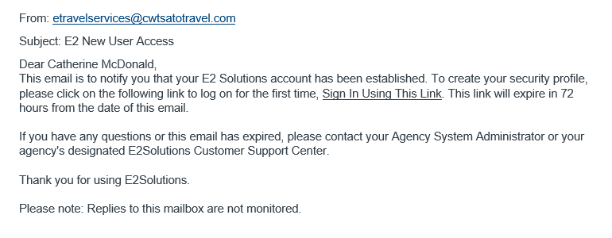
New User Email
Notes:
User will receive “E2 New User Access” email needed to create password.
Email is valid for 72 hours.
Click Sign in Using this Link to start the process.

Slide 9
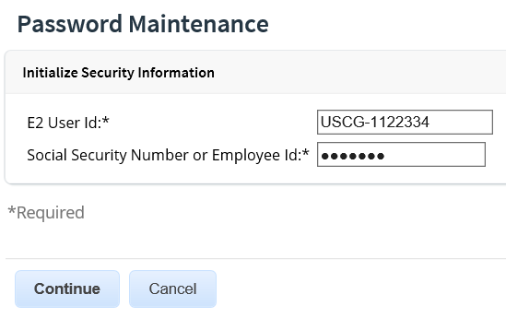
Password Maintenance
Initialize Security Information
Enter your E2 User Id provided by USCG. It will start with USCG- followed by your 7 digit employee id. Example: USCG-1234567
Enter your USCG Employee Id in the Employee Id field. (DO NOT Enter your SSN #)

Slide 10
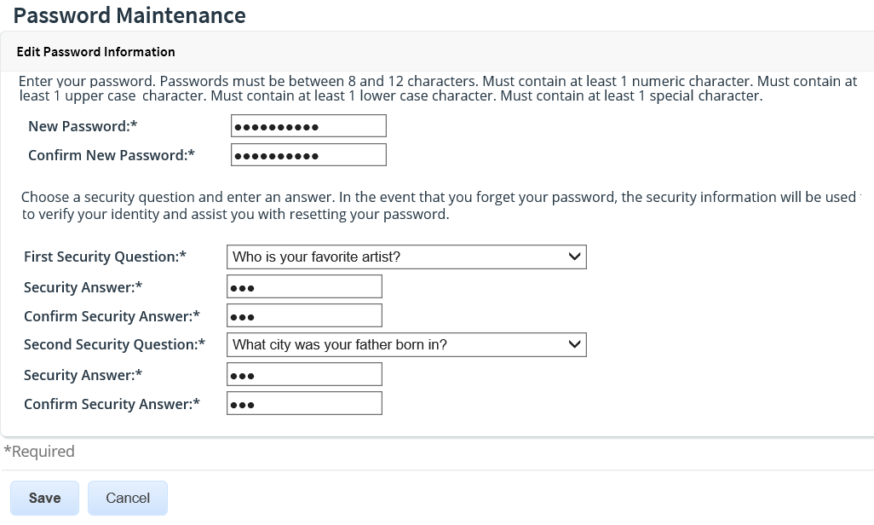
Creating Password & Security Questions
Notes:
Create your new password and confirm. Your new password is case sensitive.
Establish two separate security questions. In the event you forget your password, the security information will be used to verify your identity and assist you with resetting your password.
Your security question answers are not case sensitive.
Click Save.

Slide 11
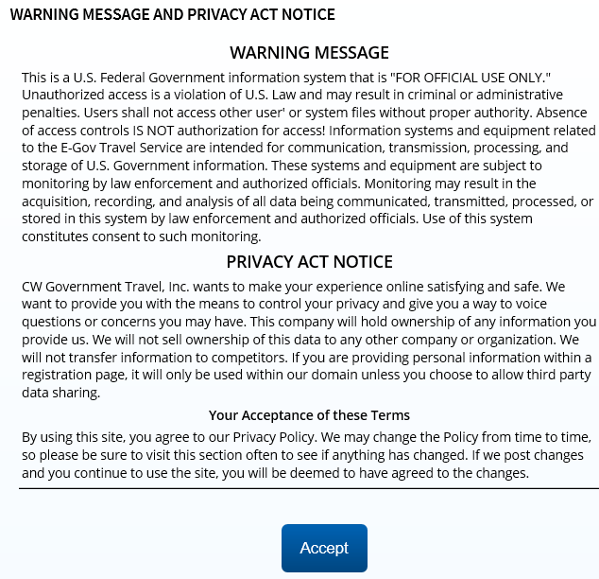
Warning Message & Privacy Act Notice
Notes:
Review the Warning Message and Privacy Act Notice.
Click Accept.
You will be prompted to accept the Warning Message and Privacy Act Notice each time you login.

Slide 12
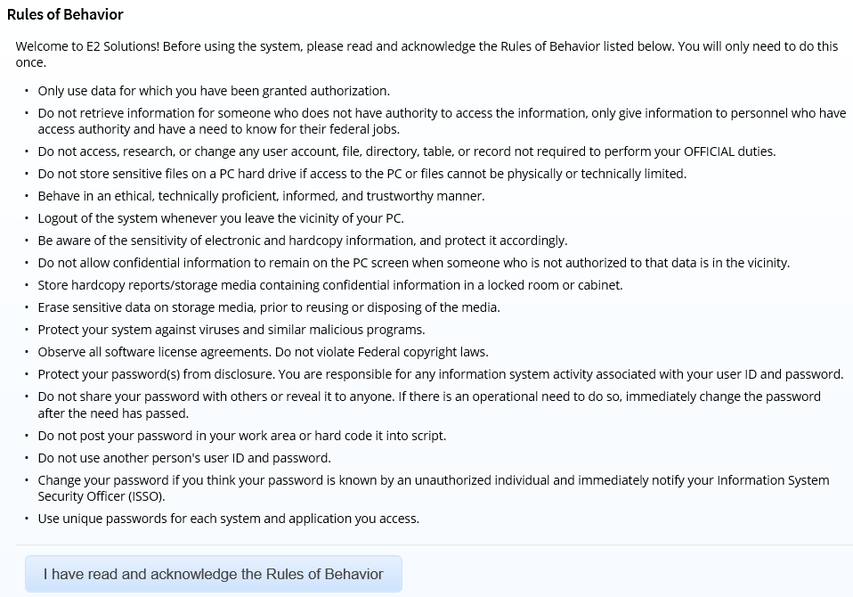
Rules of Behavior
Notes:
You will only be presented and asked to accept the Rules of Behavior the first time you log into the system.

Slide 13
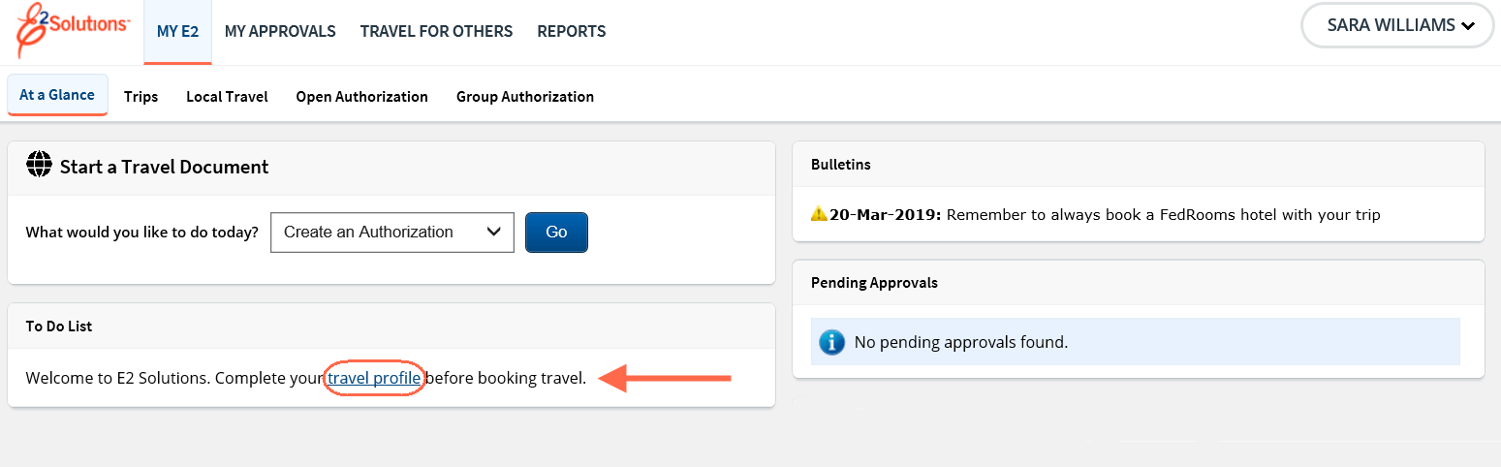
First Login Complete
Notes:
After logging in, you are landed on the My E2 page. You are encouraged to review and update your user profile.
Once you have accessed the new user email for your production account and initialized your account, delete the email as you will no longer be able to access E2 Solutions using that email.
You will now access E2 using the URL – https://e2.gov.cwtsatotravel.com.

Slide 14
Scenario 1
View and Update User Profile
  Log in as the traveler
  Access the traveler’s profile
  Verify each section of the profile
  Complete any necessary information
    Add supervisor email address
    Add arranger if traveler is not creating their own reservations or travel documents
    Add GTCC
    Travel Preferences
  Manage Dependents
Basic Navigation and Online Help
  Navigate the various areas of E2
  Access Online Help to search for keywords
    USCG Help Desk and TMC contact information
  Access USCG PPC Travel page to view customized user guides and QRCs
    https://www.dcms.uscg.mil/ppc/travel/ets/

Slide 15
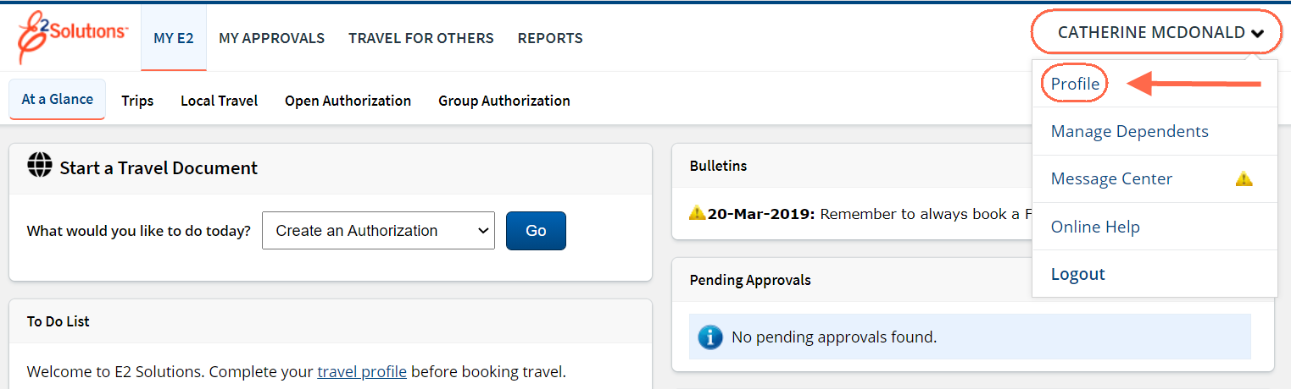
Verify and Update Profile
Notes:
Access your travel profile via the User Options menu by clicking on your name and selecting Profile.

Slide 16
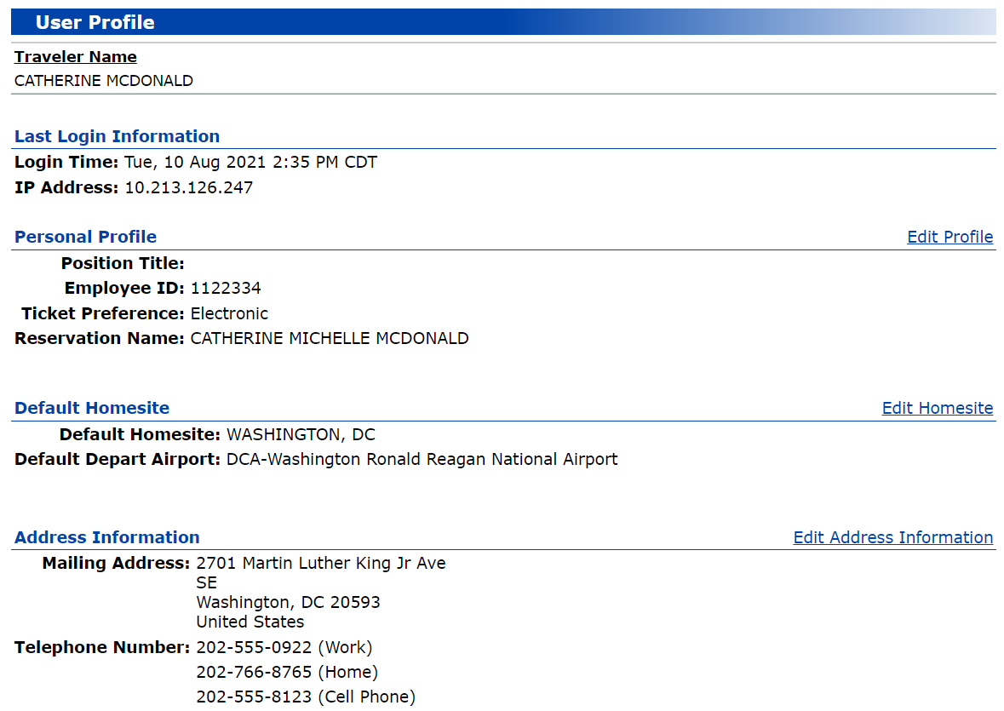
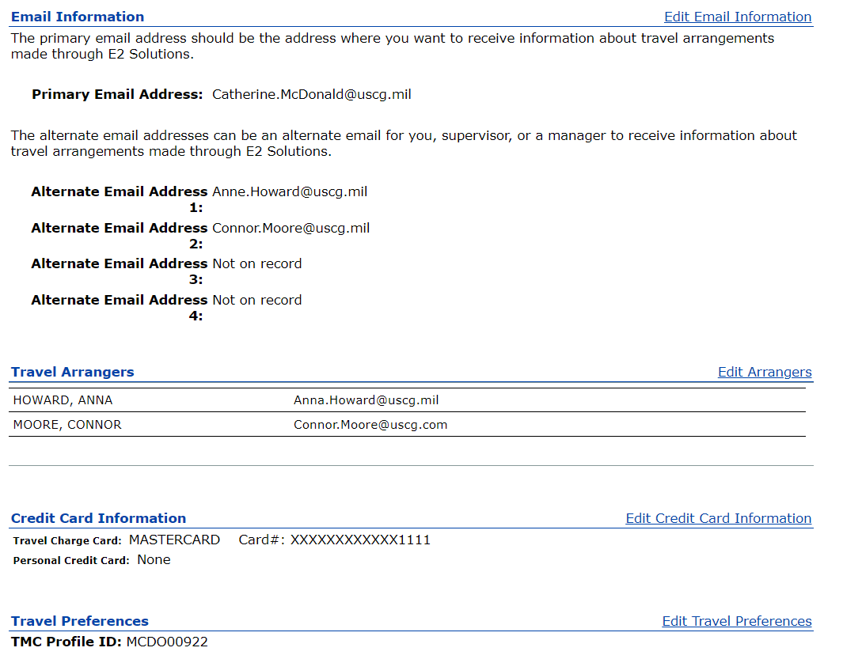
My Profile
Notes:
The following profile information is required before you can use E2:
Reservations Name as it should appear on all your commercial airplane reservations
Default home site and departure airport
Your home address
Email information
Add your official email address as your primary email
Add the email of your supervisor (E7 or higher, like a chief)
Travel Arrangers
Add an arranger and designate them to be able to send vouchers on your behalf
Credit card information – Airfare, Rail and Hotel should be set to Travel Charge Card once you enter your GTCC. If you do not have a GTCC, set the airfare and rail to
CBA and enter a personal card for hotels.
Be sure to activate your GTCC once received and add it to your profile immediately. The TMC cannot issue your ticket if the GTCC is not activated.
Travel preferences
Other Features
Government fares cannot only be billed to a GTCC, or the Agency’s Centrally Billed Account if the traveler doesn’t have a GTCC. Government fares cannot
be purchased with a personal credit card so be sure your profile is complete prior to booking travel.

Slide 17
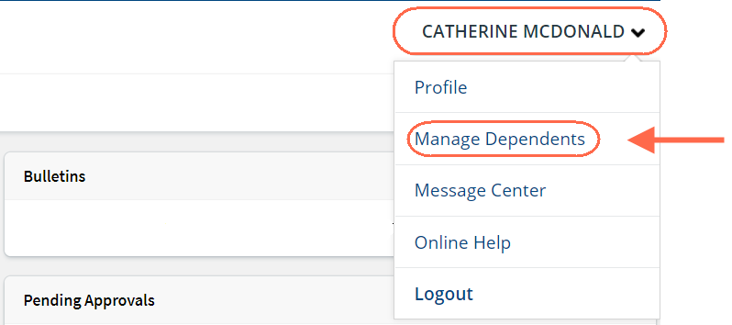
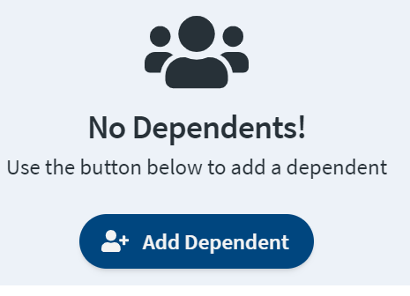
Adding and Managing Dependents
Notes:
To add dependents to your profile, access the Manage Dependents page from the User Options menu and click Add Dependent.

Slide 18
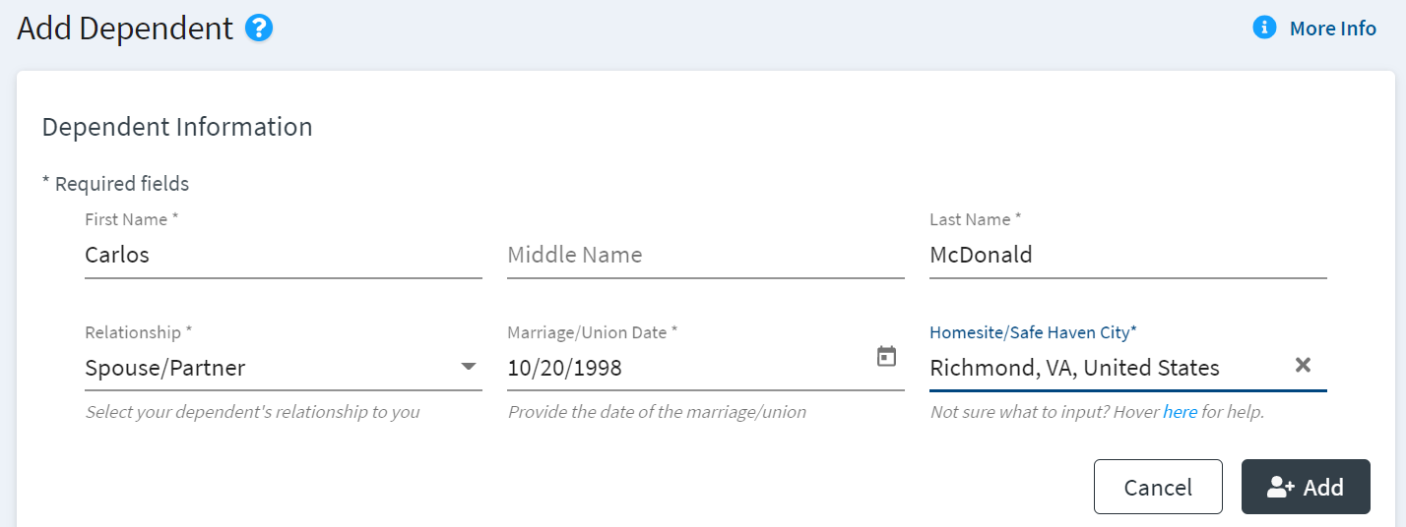
Adding New Dependent
Notes:
Add the required information and click Add to add your dependent to your profile.

Slide 19
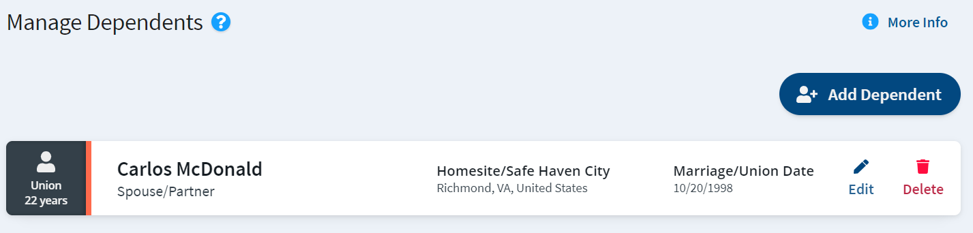
Managing Dependents
Notes:
Once a dependent is added to your profile, you can manage their information from Manage Dependents.
You can add additional dependents, as necessary.

Slide 20
User Profile Data
Pushed from ETS to OBT to the GDS
E2 Solutions/ETS
GetThere Online Booking Tool
Global Distribution System (GDS)
  Name
  Email
  Phone number
  Credit card information
  E2 Solutions profile information
  Secure flight information
  Seat Preferences
  Frequent club numbers
  E2 Solutions profile information
  All GetThere profile information
  E2 profile ID
  TMC ID
Notes:
The information in your E2 Profile pushes to the Online Booking Tool (OBT).
Additional information is added to your online booking profile such as your TSA Secure Flight Details, and frequent traveler numbers.
Once the profile is completed, the information pushes over to the global distribution system so the TMC can create or finalize your reservation and issue your ticket.

Slide 21
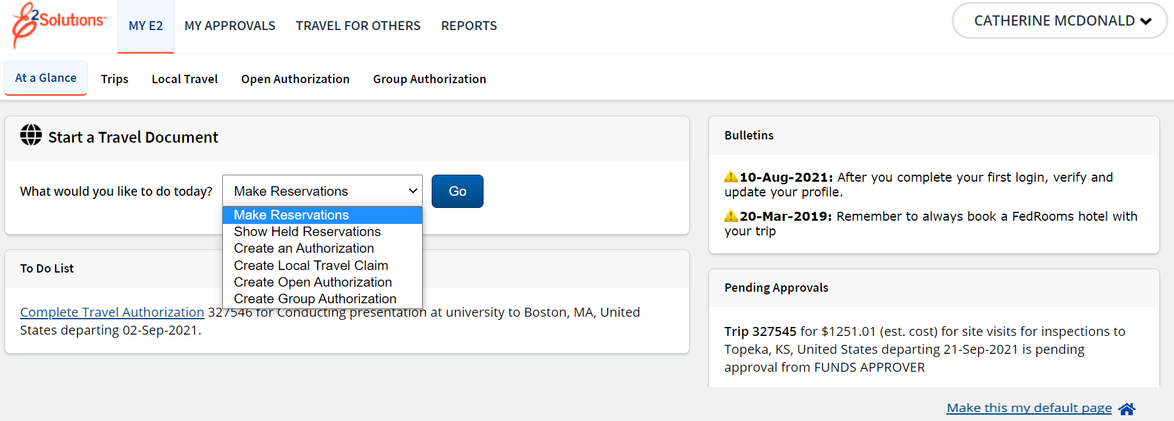
My E2
Notes:
The task bar includes these travel functions:
My E2 to access your To Do list, Start a Travel Document list, and lists of trips, local travel claims, open and group authorization. The Trips tab provides access to all trip documents, including authorizations, vouchers, and travel advances.
My Approvals to review travel documents that were prepared for you by an arranger (all users) or to approve travel documents (if you are an approver).
Travel For Others is where you begin a travel arranger session for another user.
Reports to generate travel activity reports.
The User Options Menu provides access to the Profile, Online Help, Log Out and Message Center.
Click your name to access the User Options Menu:
Profile to view or update your E2 profile, including your travel preferences.
Message Center to view important information from USCG, or E2 administrators, read selected news feeds and access web sites approved by your agency as relevant to government travel.
Online Help (or Find Answers from some pages)provides access to the E2 knowledge portal where you can search for answers to your E2 questions, and access computer-based training videos and user guides.
The My E2 At a Glance tab is your default landing page. Change your default by using the Make this my default page in the lower right corner on several pages.

Slide 22
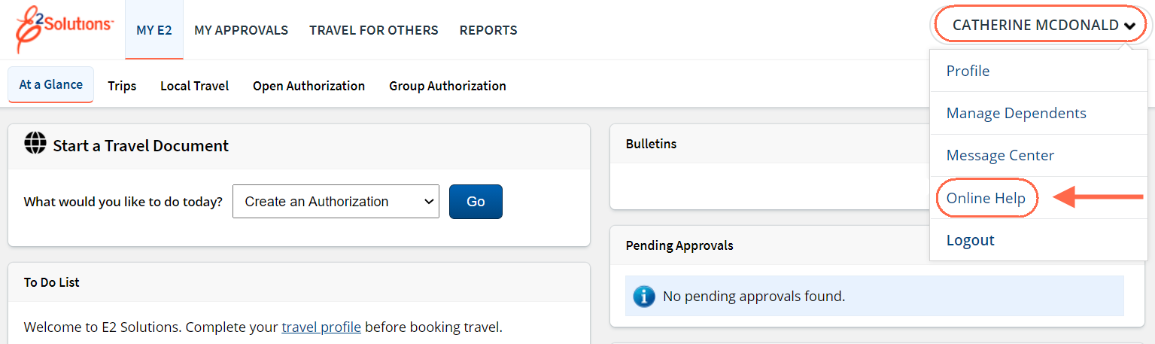
Online Help
Use E2’s knowledge portal to search for answers for questions about E2, and access standard computer-based tutorials, quick reference cards and user guides.
Notes:
Click the User Options Menu and select Online Help to access the knowledge portal.

Slide 23
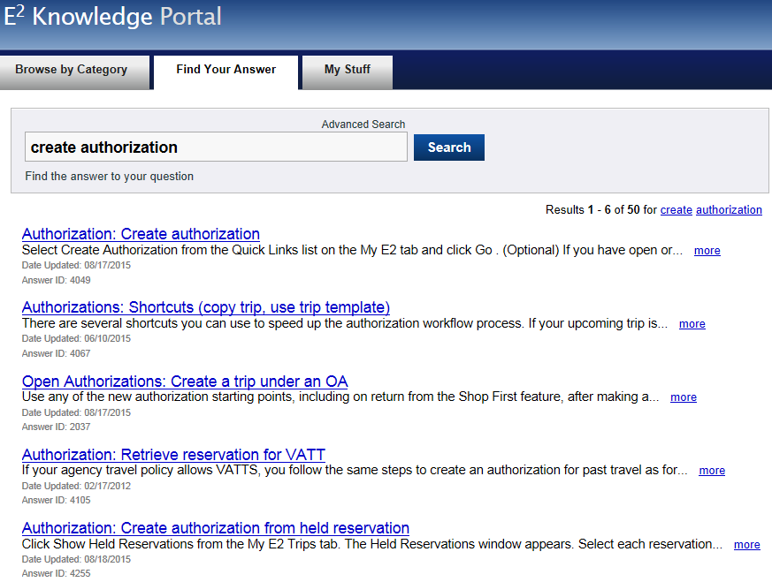
Online Help
Find Your Answer
Notes:
Type your question or keywords into the Search field and click Search.
You can search the word “troubleshooting” to receive a list of errors you may encounter. Click on the link that you want more information on and follow the steps outlined in the knowledge base.
You can also search for User Guide, Administrator Guide, CBT or Quick Reference Card to access additional information about a topic.

Slide 24
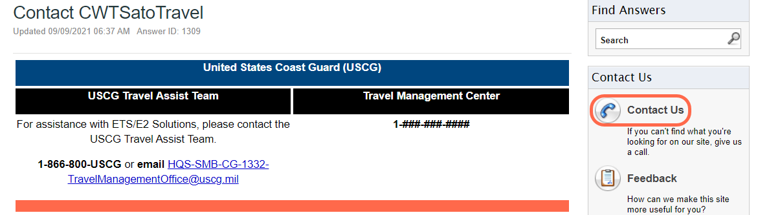
Online Help
Contact Us Details
Notes:
The Contact Us link will display information on how you can reach the Travel Assistance Team and the Travel Management Center for reservation assistance.

Slide 25
Review
First Log On, Profile and Navigation
After receiving your new user email, how long do you have to take action on it before it expires?
New User email expires 72 hours after being sent.
Once you have set up your password, what is the first thing you should do before booking travel?
Access, review, and update your profile.
In your profile, what link should you click to update your secure flight information and known traveler number?
Edit Travel Preferences
Where do you go to access the knowledge portal to search for answers and access your Help Desk and TMC information?
Online Help or Find Answers

Slide 26
Review
First Log On, Profile and Navigation
After receiving your new user email, how long do you have to take action on it before it expires?
New User email expires 72 hours after being sent.
Once you have set up your password, what is the first thing you should do before booking travel?
Access, review, and update your profile.
In your profile, what link should you click to update your secure flight information and known traveler number?
Edit Travel Preferences
Where do you go to access the knowledge portal to search for answers and access your Help Desk and TMC information?
Online Help or Find Answers

Slide 27
Arranging Travel for Others
Notes:
Travel For Others in ETS is similar to Proxy in TPAX.

Slide 28
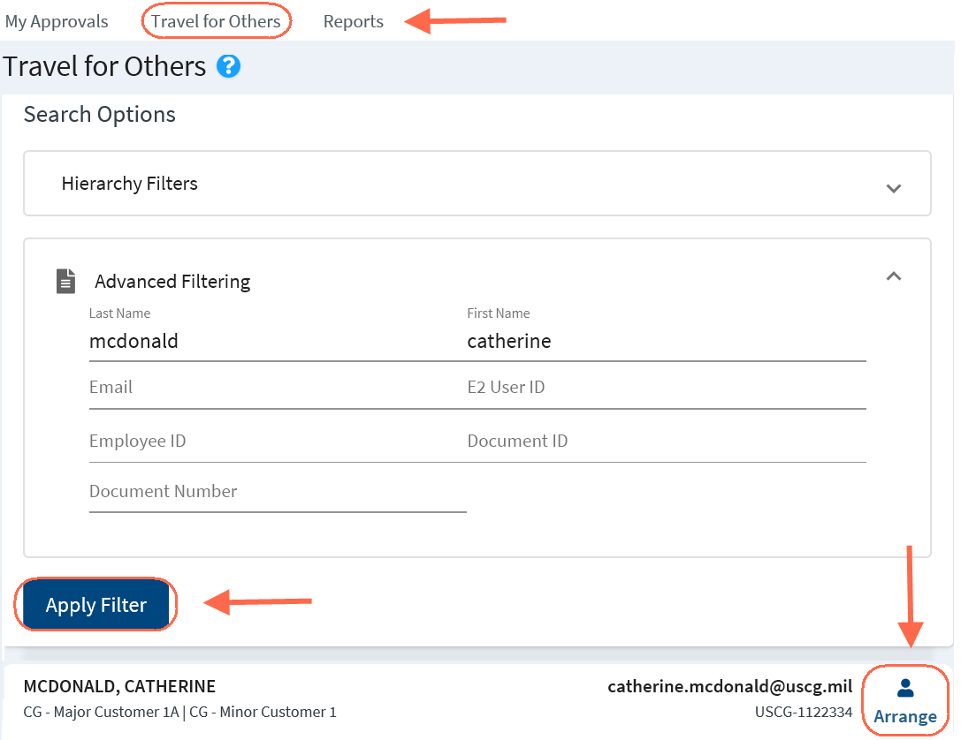
Travel for Others
Creating Travel Documents for Another Traveler
Notes:
Travelers can create, modify, cancel, delete, and print travel documents for their own travel.
Arrangers can also perform these actions for travelers who have given them permission to arrange their travel or by permissions granted by USCG.
Any user, regardless of user type or role, can be designated as a travel arranger.
On the My E2 taskbar, click Travel for Others.
Enter your search criteria to search for a specific user.
Click Apply Filter.
Click Arrange next to the traveler’s name to view or create their trips.

Slide 29
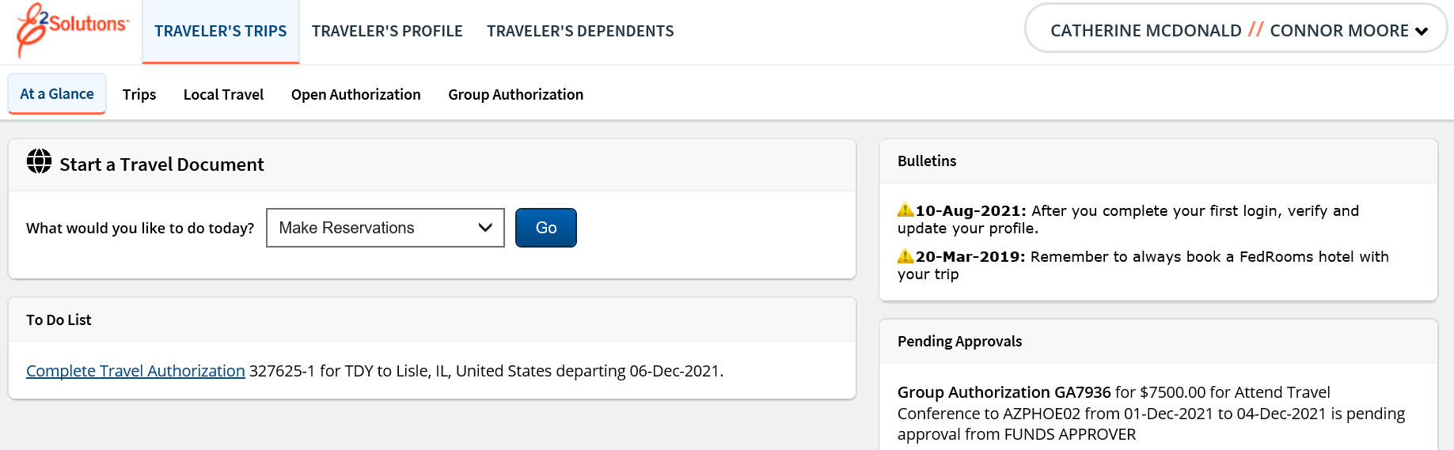
Travel for Others
Creating Travel Documents for Another Traveler
Notes:
The name of the user you are arranging for displays next to your name in the upper right corner.
As an Arranger, you have access to the traveler’s trips and profile.
To exit the Arranger session, click the User Options Menu and select Stop arranging for, and you will be returned to the Travel for Others page.

Slide 30
Creating Reservations and
Authorizations

Slide 31
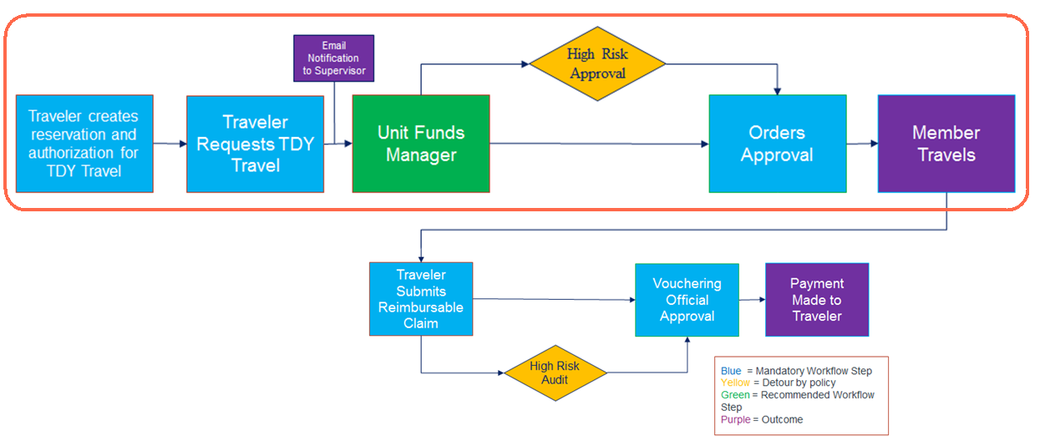
TDY Authorization Workflow
Notes:
In the TDY Authorization workflow, travelers or arrangers will create reservations and authorizations, which are then submitted for approval.
The authorization will first stop at your Unit Funds Approver for approval, where the POET will be applied.
If the trips meets any of the conditional requiring additional approval, it will route to the HIGH RISK approval group.
If the trip does not meet the HIGH RISK conditions, or once approved by the HIGH RISK approval group, it will route to the AO for approval.
Once the authorization is approved, the details are sent to the TMC which gives them permission to ticket the reservations.
Your supervisor will receive all travel related emails once you have added their email to your profile.

Slide 32
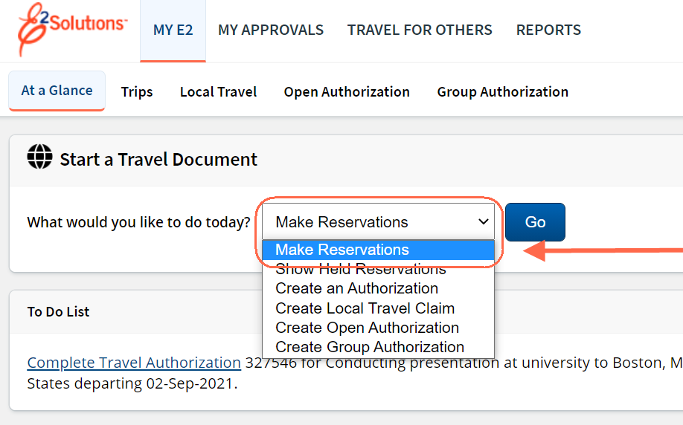
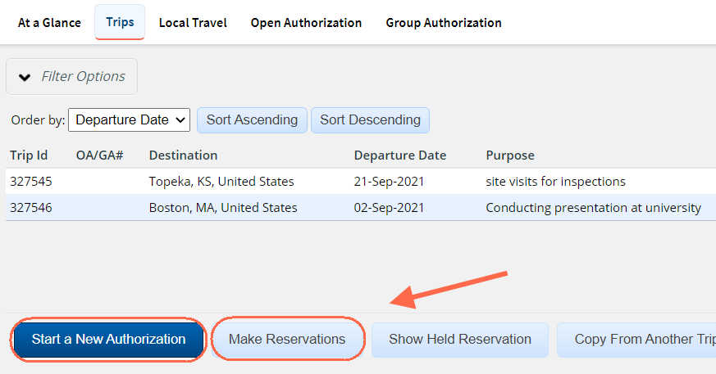
Creating Reservations
Start New Authorization or Make Reservations
Notes:
An Authorization is a request to travel that contains the date, time, TDY locations, reservations and estimate expenses for the trip. E2 lets you shop for flights, rail, hotel and car rental and reserve travel before you create your authorization, or during the actual authorization process.
Make Reservations allows you to create a reservation before starting an authorization. This can be done from My E2, the At A Glance tab by selecting Make Reservations from the drop down menu, or by clicking on the Trips tab and selecting either Start a New Authorization or Make Reservations.
Start a New Authorization allows you to start the creation of a new authorization. During the authorization process you can make reservations, associate reservations previously booked in E2, or retrieve a reservation made with the TMC.
Please do not create test reservations. If you create a reservation and do not plan to travel, please cancel it or you risk being charged fees. Work with your Travel Assist Team if you need access to a test or training environment to perform any internal demonstrations or training sessions.

Slide 33
Scenario 2
Make Reservations and Create Authorization
The traveler is going round trip from Washington, DC (IAD) to Jacksonville, FL (JAX). Book flights, hotel and rental car using the online booking tool. Use the information below to create the authorization and submit for approval. Add any remarks and attach any documentation that your unit or approver may require.
Basic Information
Type of Travel: Training Purpose: E2 Solutions
Expenses
Airfare: Amount from reservation booked automatically populates
Checked Bag Fee: Estimate $50 round trip
Lodging: Use reimbursement type Per Diem and amount from reservation
Estimated Lodging Tax: Estimate $20/per night
Fuel for Rental Car: Estimate $60
M&IE: Automatically populates Per Diem based on location from Site Details (indicate a meal provided)
Parking at airport: Estimate $100
Private Auto Mileage: From: 5516 Vernon Way Suitland MD 20746 To: Washington Dulles Airport Calculate Distance
Private Auto Mileage From: Home To: Airport Use Own Calculation 39 Miles Enter Reason
TMC Fee: Online Booking $9.35 (will automatically populate)
* Instructor may adjust travel details as needed

Slide 34
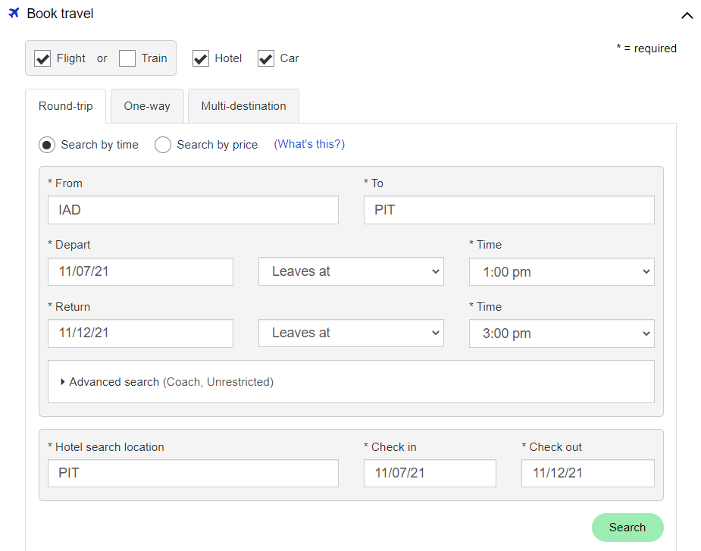
Online Booking Tool Home Page
Notes:
Select your search criteria on the Book Travel page. You can book flights, rail, hotel and rental cars.
When making a reservation. book all components of the reservation (flight, hotel, rental car) at once. This ensures the reservations are made under a single confirmation code.
Once all trip components have been entered, click Search.
Justifications may be required during the reservation and authorization process based on selections made during the booking process.
To return to E2 without booking a reservation, click Return to E2 in the upper right corner of any OBT page.

Slide 35
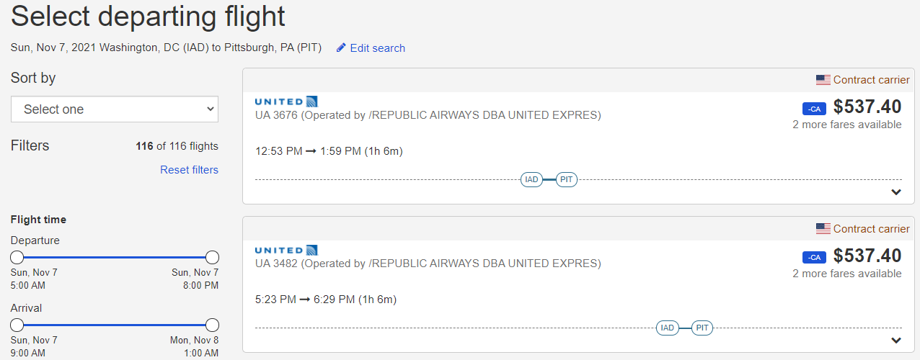
Searching for Departure Flights
Notes:
Flight options are displayed as “cards”. Select a card by clicking or tapping anywhere on it to open a “drawer” with more detailed information.
To select a flight option and continue the shopping process, the drawer must be opened so the Select button becomes visible.

Slide 36
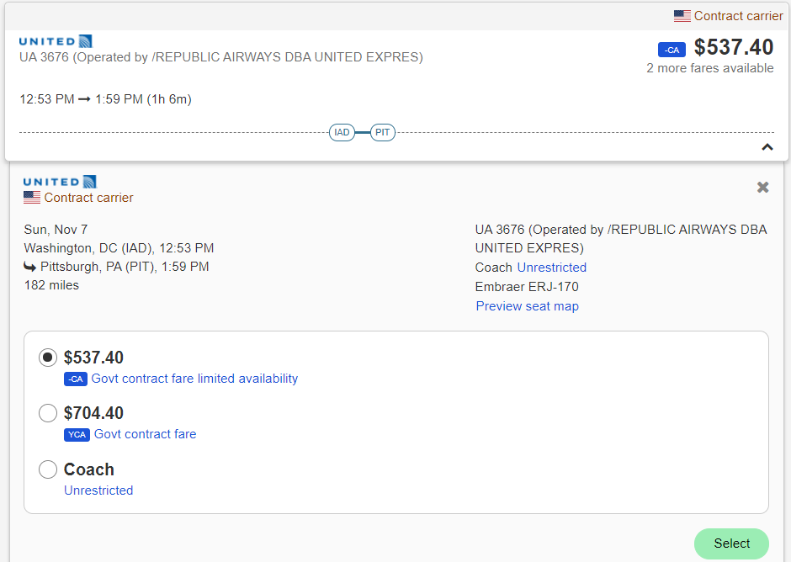
Selecting Departure Flights
Notes:
To select a flight option and continue the shopping process, the drawer must be opened so the Select button becomes visible. Once you select your outbound flight options for return flights or the next destinations indicated will display.
Contract Carrier—The American flag icon and Contract carrier text appear in a special row at the top of the card for contract carrier airlines. The indicator also appears below the airline in the expanded drawer.
Flight —Each flight option card includes a graphical representation of that flight’s components, allowing the traveler to quickly compare the different flight options. This visual view of each flight option (called the flight line) includes the airport code for that flight’s origin, destination, and any layover airports. The location of items on the flight line represents the relative time of each “event” (e.g., the relative start time of the flight, duration of each flight segment, length of layovers, overall trip time).
Multiple Airlines—When a flight option involves multiple airlines (i.e., mixed carriers), a special indicator and the text Multiple airlines appear on the card, along with all of the airlines and flight numbers that make up the flight option. Opening the drawer provides more details about the individual flights.
Out of Policy—Flight options that are not in accordance with the traveler’s travel policy are designated as Out of policy in a special row at the top of the card. When the drawer is opened, an expandable option labeled Why is this out of policy is shown. Clicking this link reveals the specific violations for that flight choice.

Slide 37
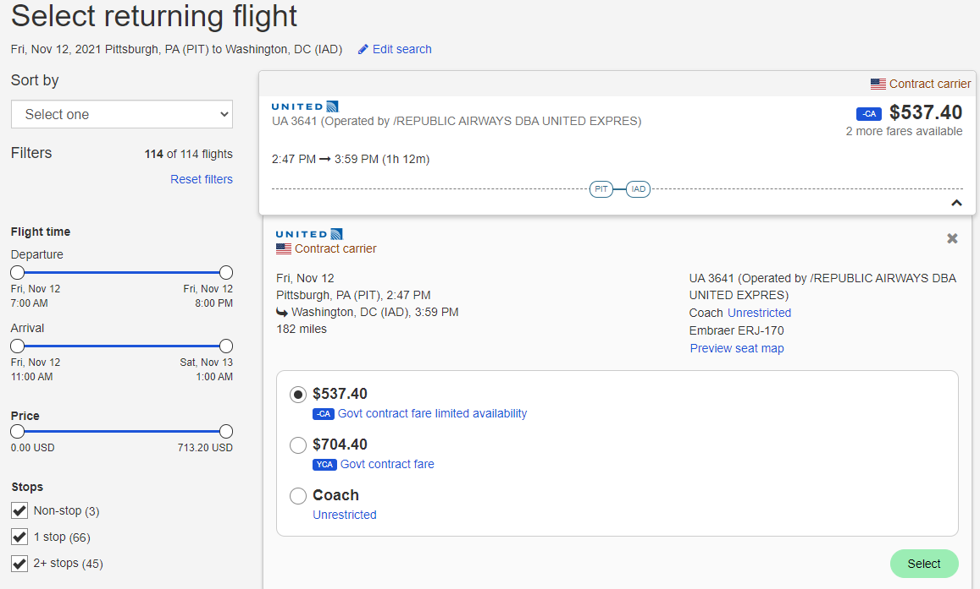
Selecting Return Flights

Slide 38
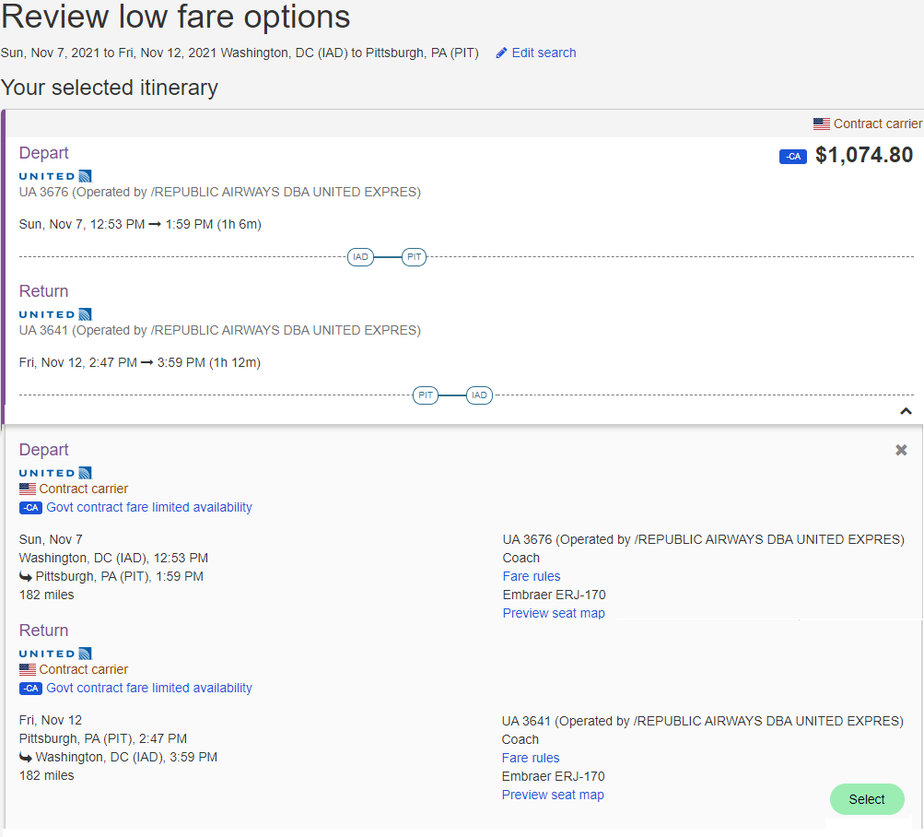
Low Fare Options
Notes:
If lower fares exist for your selected itinerary, the options are presented for possible selection.
To select your existing itinerary, click the Select button in the drawer opened in the "Your selected itinerary" section.
To select another option, scroll down and click on the flight card for that option in the "Low fare options" section, and then click the Select button in the expanded drawer.

Slide 39
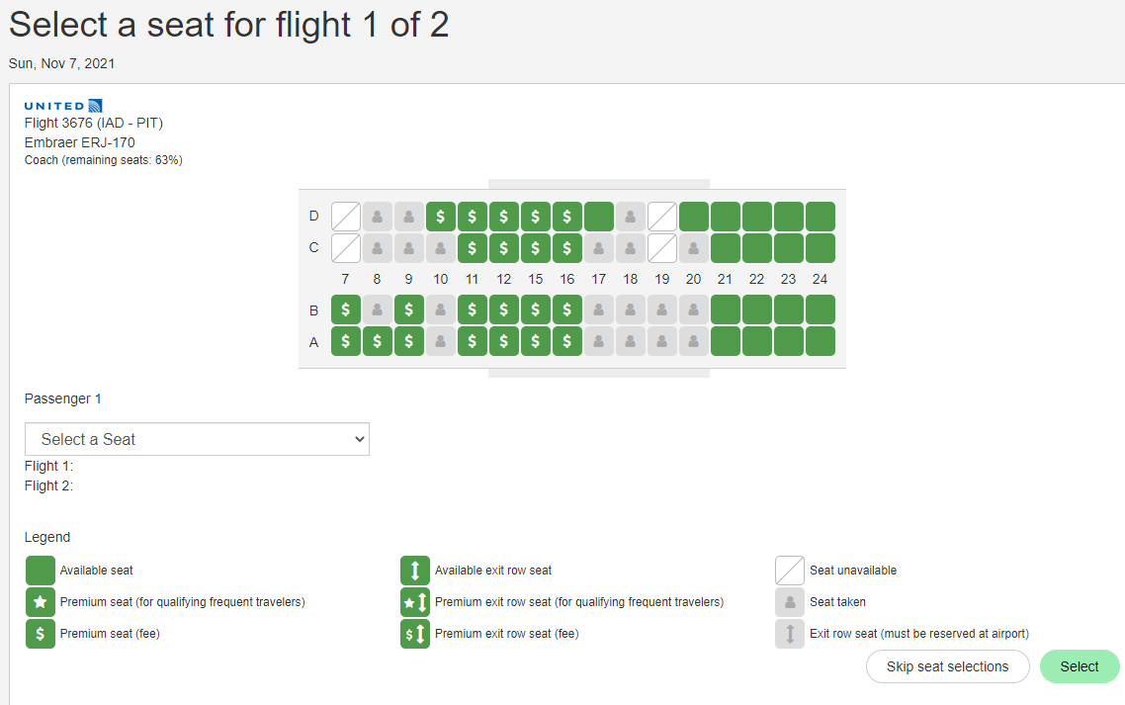
Selecting Seats
Notes:
If the carrier allows the seats to be selected, the seat map will appear and seats can be selected for each segment of the trip.

Slide 40
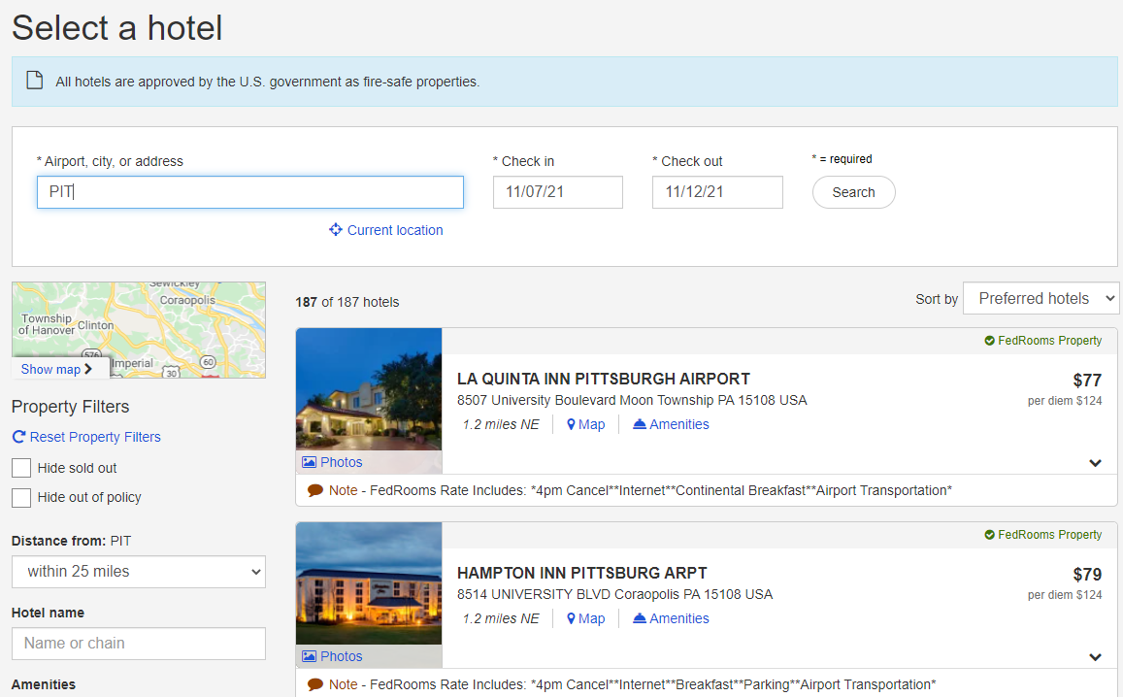
Searching for a Hotel
Notes:
If your trip requires hotel accommodations, Review all options returned in the search results, and then click anywhere within a hotel "card" to expand the drawer for that option. The drawer provides further detail, including the different types of rooms available and their rates, the hotel details, amenities, and a map. If your trip requires hotel accommodations, the Select a Hotel page is displayed.
Filter Options display on the left side of the page to allow you to hide sold out or out of policy hotels.
You can also search by distance, search for specific hotels and search hotels that have certain amenities
Review the hotel options. Each hotel along with the per diem rate and other details are displayed in a hotel card.
To view rates and other details click on the icon or anywhere within a hotel "card" to expand the drawer.

Slide 41
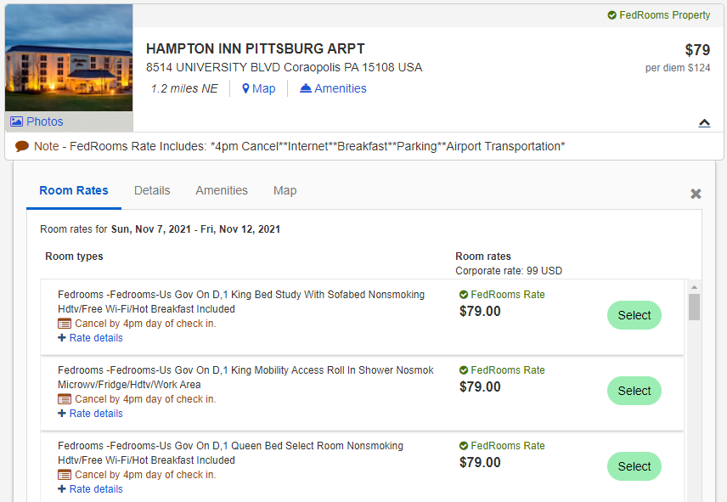
Selecting a Hotel - Hotel Details
Notes:
Once the hotel card is expanded, a list of rates display with the Room types and Rate rules.
FedRooms Rates are identified with a checkmark indicating FedRooms Rates.
Review the Room types and rate rules, and click Select to make your choice.
Once you make your selection, a page displays to review the cancellation policy and enter any special hotel request.

Slide 42
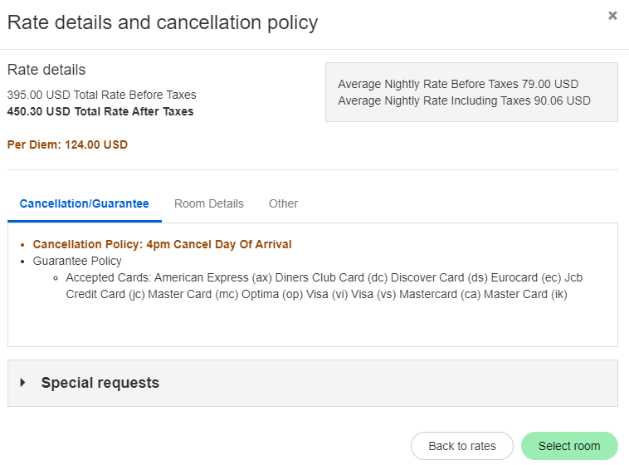
Reviewing Rate Details

Slide 43
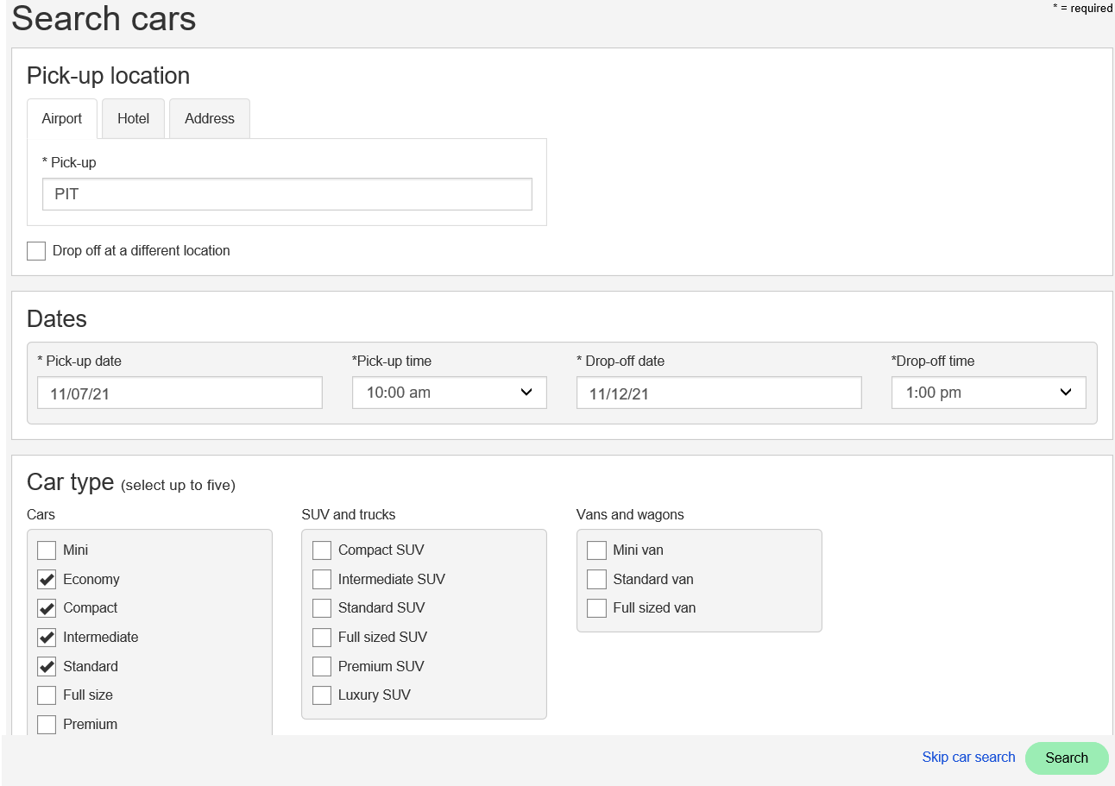
Searching for a Rental Car
Notes:
If you selected a rental car as part of your trip components, the "Search cars" page appears.
The Pick-up location defaults to Airport and can be changed to Hotel or an Address.
The dates and times are populated with your air or rail times. Adjust if needed.
You can search up to 5 car types at a time. Uncheck or check car type options.
Click Search to review the car rates and details.

Slide 44
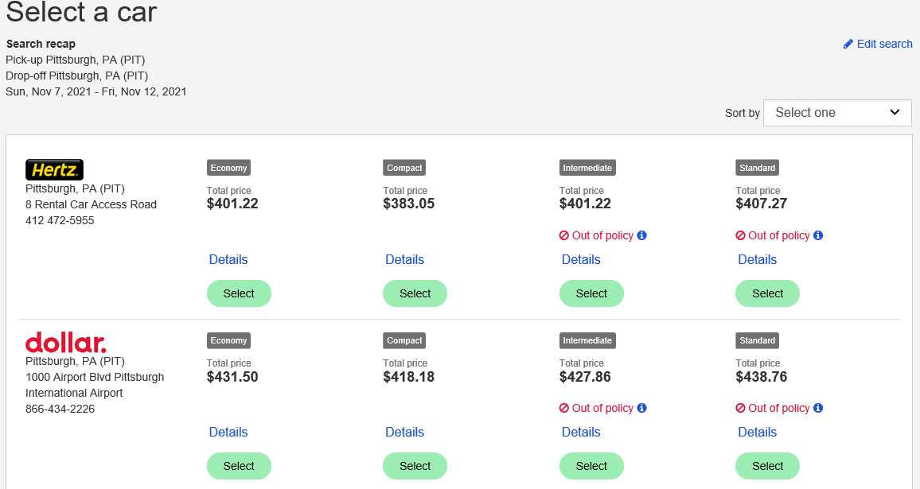
Selecting Rental Car
Notes:
Click Details to view additional car information. Out of policy icon indicates if the car is outside your agency’s travel policy.
Click Select to choose a car.

Slide 45
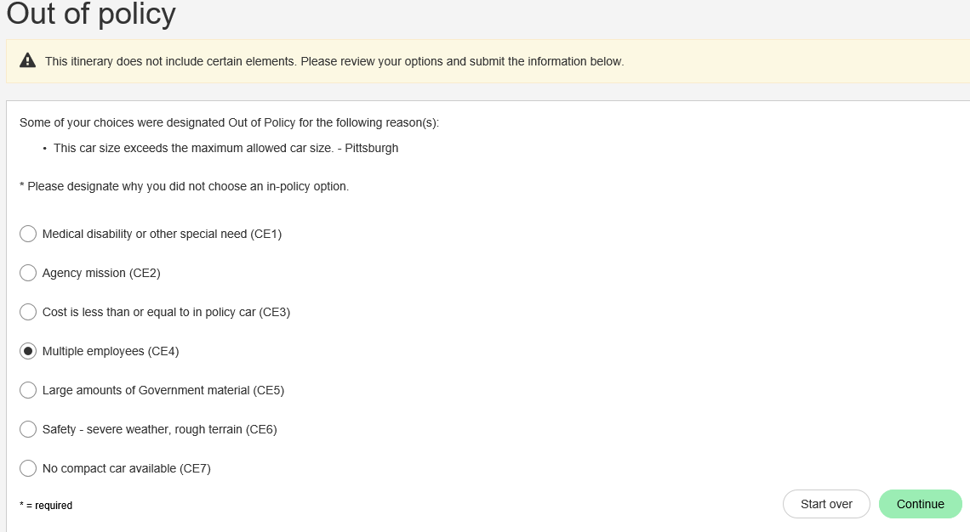
Policy Exceptions
Notes:
If an Out of Policy car is selected, you will be prompted to select an Out of Policy reason code.
Once selected, click Continue.

Slide 46
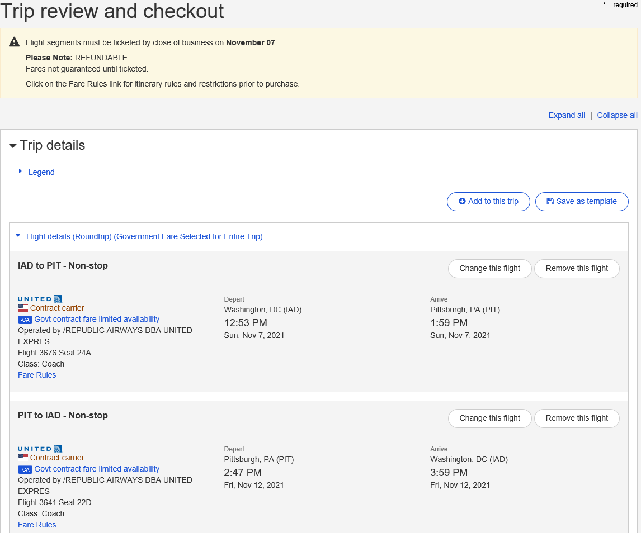
Trip Review and Checkout
Screen 1
Notes:
Once you have selected all components of the trip, the Trip review and checkout page displays.
The Trip Details and Estimated Cost sections of the page are expanded by default and recap all of your current selections, including details for selected flights, rail, hotel rooms and rental cars, and a summary of the estimated trip cost.
If you do not want to make the reservation, click Return to E2 found in the upper right corner of the screen. The Reservation will not be saved or confirmed.

Slide 47
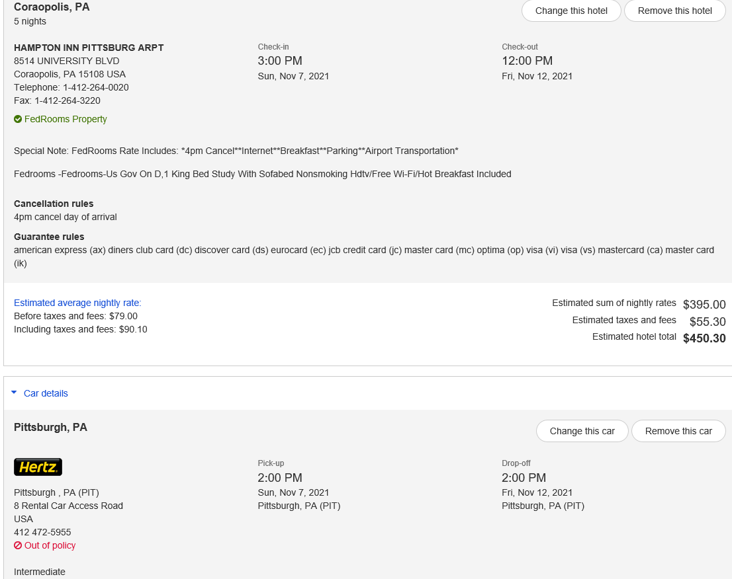
Trip Review and Checkout
Screen 2
Notes:
Scroll down to review all trip components.
Use the change or remove options to modify your selections.

Slide 48
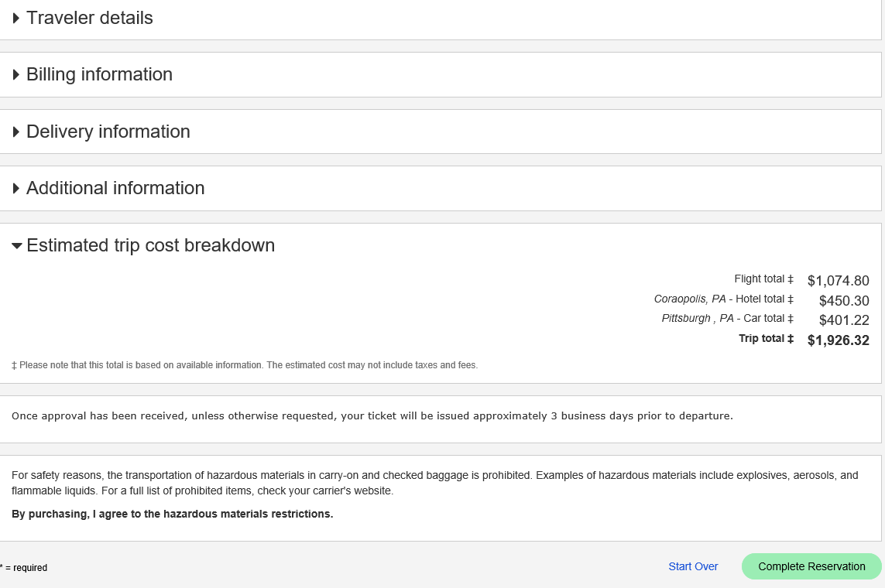
Trip Review and Checkout
Screen 3
Notes:
Government fares cannot only be billed to a GTCC, or the Agency’s Centrally Billed Account if the traveler doesn’t have a GTCC.
Government fares cannot be purchased with a personal credit card so be sure your profile is complete prior to booking travel.
To complete the transaction and make reservations for all of your selected trip components, scroll to the bottom of the page and click Complete Reservation.
The reservations are held for CWTSato Travel to access and ticket once approval of the trip is received.

Slide 49
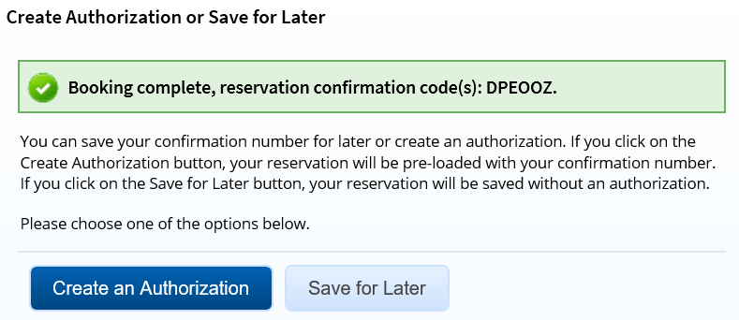
Create Authorization or Save for Later
Once you have booked your reservations, you are returned to E2 and can create the authorization or save the reservation for later.
Notes:
Click Create Authorization to begin the authorization workflow. The Reservation step automatically loads your new reservation information.
Click Save for Later to hold your new reservation. You can use it to create a new authorization, or associate it with an existing authorization, at a later time. Reservations that are saved for later are placed in the Held Reservation queue.

Slide 50
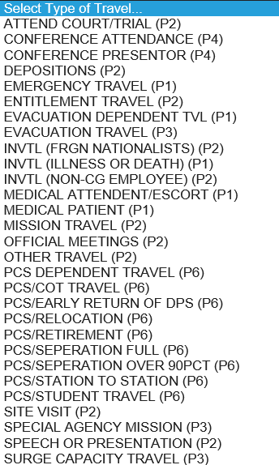
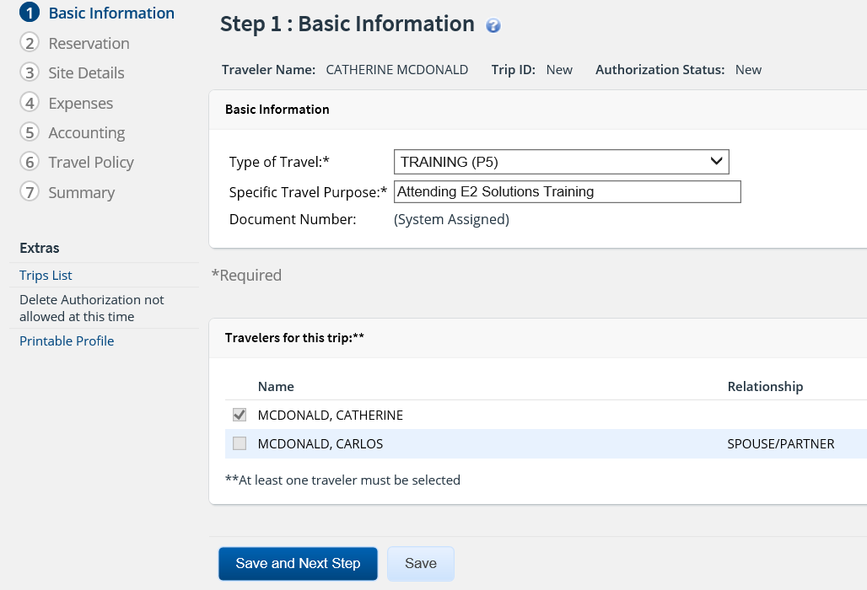
Create Authorization
Step 1: Basic Information
Notes:
Each travel document has a step-by-step workflow that guides users through each step to create the document.
The Basic Information step is the starting point for all new authorizations. To begin an authorization, you must complete and save this basic information before continuing.
Type of Travel is selected from the drop-down list.
Specific Travel Purpose is a free format field.
Document Number will be system assigned.
Click Save and Next Step to save the information and move to the next step in the authorization.

Slide 51
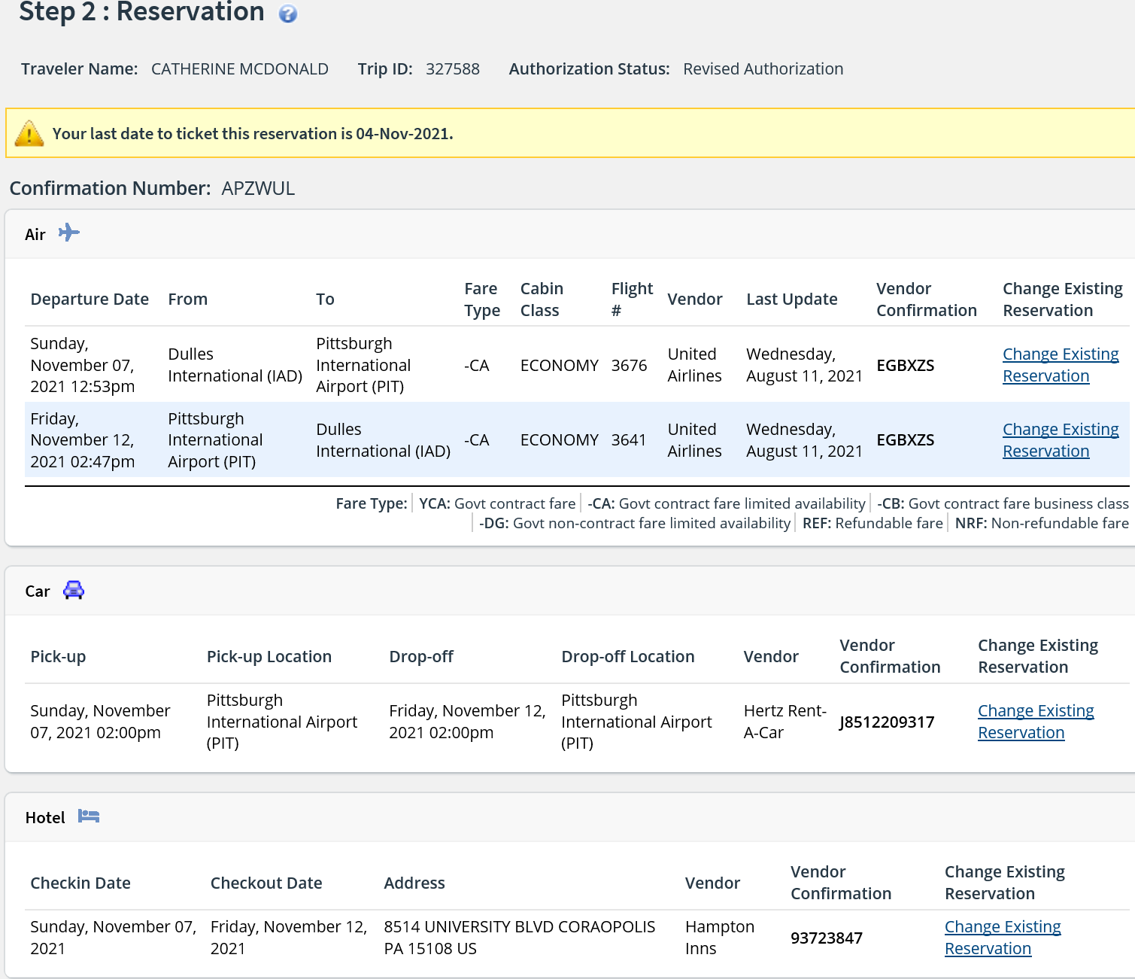
Create Authorization
Step 2: Reservation
Notes:
Use the Reservation page to:
Review reservations associated with the authorization.
Make changes to an existing reservation.
Make New Reservations - Book online flight, rail, rental car, and hotel reservations.
Manage Reservations - Associate reservations with the authorization or retrieve reservations made for you by the Travel Management Center
(TMC).
Refresh reservation details – Update changes to reservations made for you by the Travel Management Center (TMC).

Slide 52
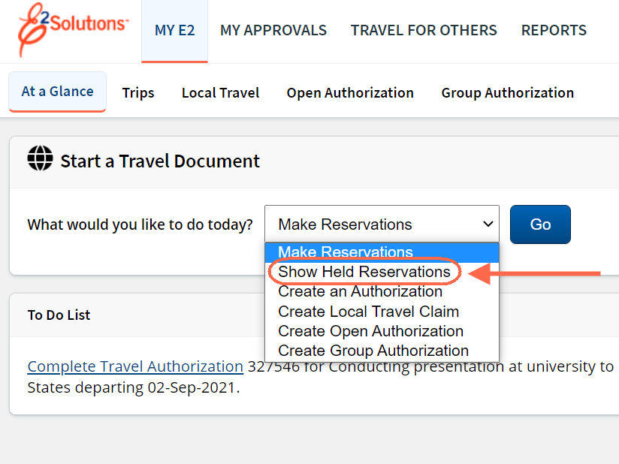
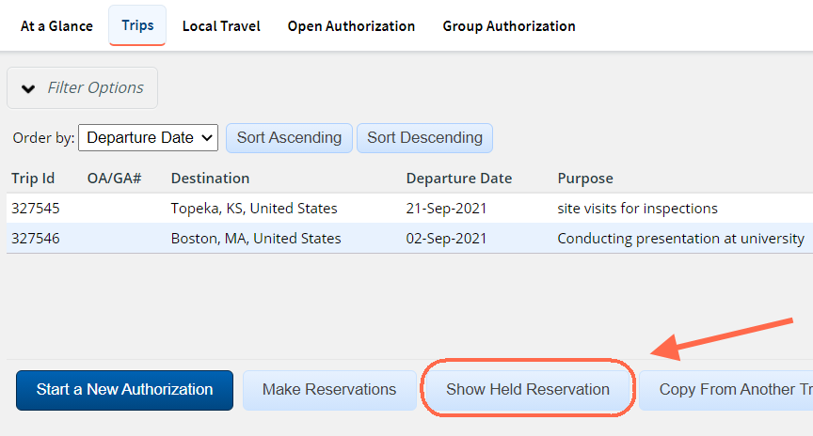
Managing Previously Booked Reservations
If the traveler has previously booked a reservations online, the reservations can be associated to the authorization by first selecting the booked reservation to start the creation of the authorization or by starting an authorization and then selecting the reservation from a list.
To select the reservation first before creating the authorization, use Show Held Reservation to select the reservation.
Notes:
If you have already booked reservations online, the reservations can be associated to the authorization.
From My E2, At A Glance, select Show Held Reservations from the drop-down menu and select the reservation to use for the authorization.
From the Trips tab, click Show Held Reservations and select the reservation to use for this authorization.
Start a New Authorization, and on Step 2, use Manage Trip Reservations to select the reservation to associate to the authorization.

Slide 53
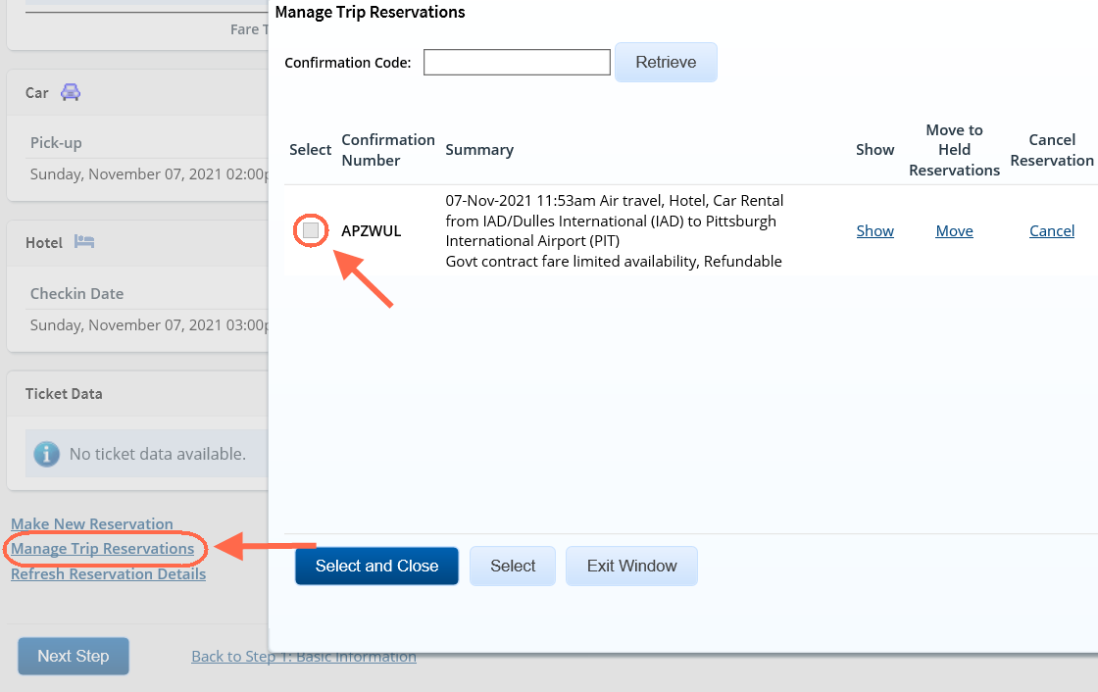
Managing Previously Booked Reservations
Start a new authorization and on Step 2, use Manage Trip Reservations to select the reservation to associate to the authorization.
Notes:
Start a new authorization and on Step 2, use Manage Trip Reservations to select previously held reservation to associate to the authorization.

Slide 54
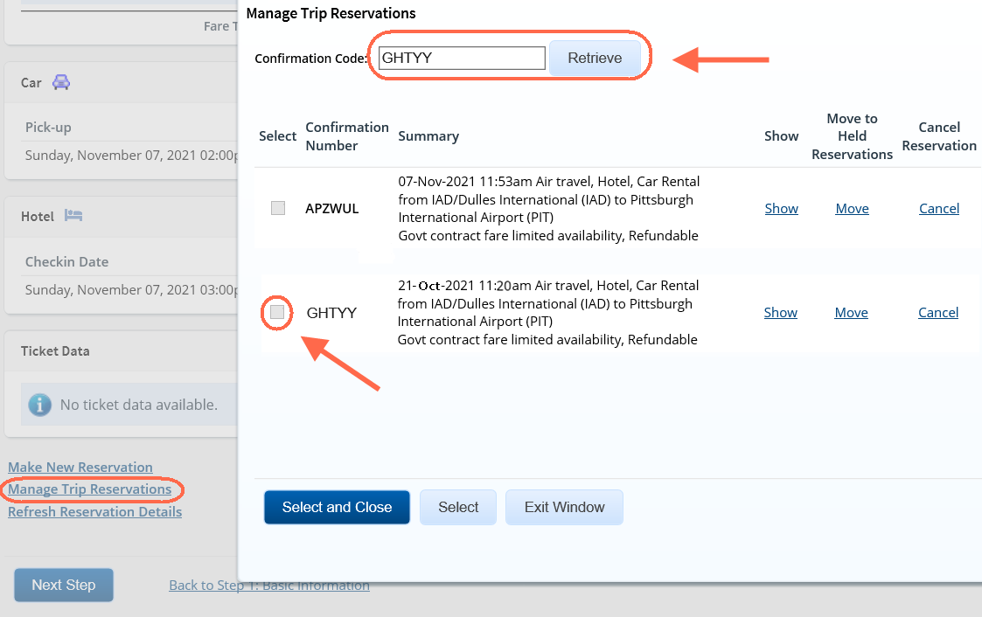
Managing Previously Booked Reservations
If the traveler booked reservations by calling the TMC, then use Manage Trip Reservations to retrieve the reservation into E2. Enter the confirmation code and retrieve the reservations. If it is the correct reservation, select it to add it into the authorization.
Reservations booked directly with the TMC will not display in the Held Reservation list until they are retrieved into E2.
Notes:
If the traveler booked reservations by calling the TMC, then use Manage Trip Reservations to retrieve the reservation into E2. Enter the confirmation code and retrieve the reservations. If it is the correct reservation, select it to add it into the authorization.
Reservations booked directly with the TMC will not display in the Held Reservation list until they are retrieved into E2.

Slide 55
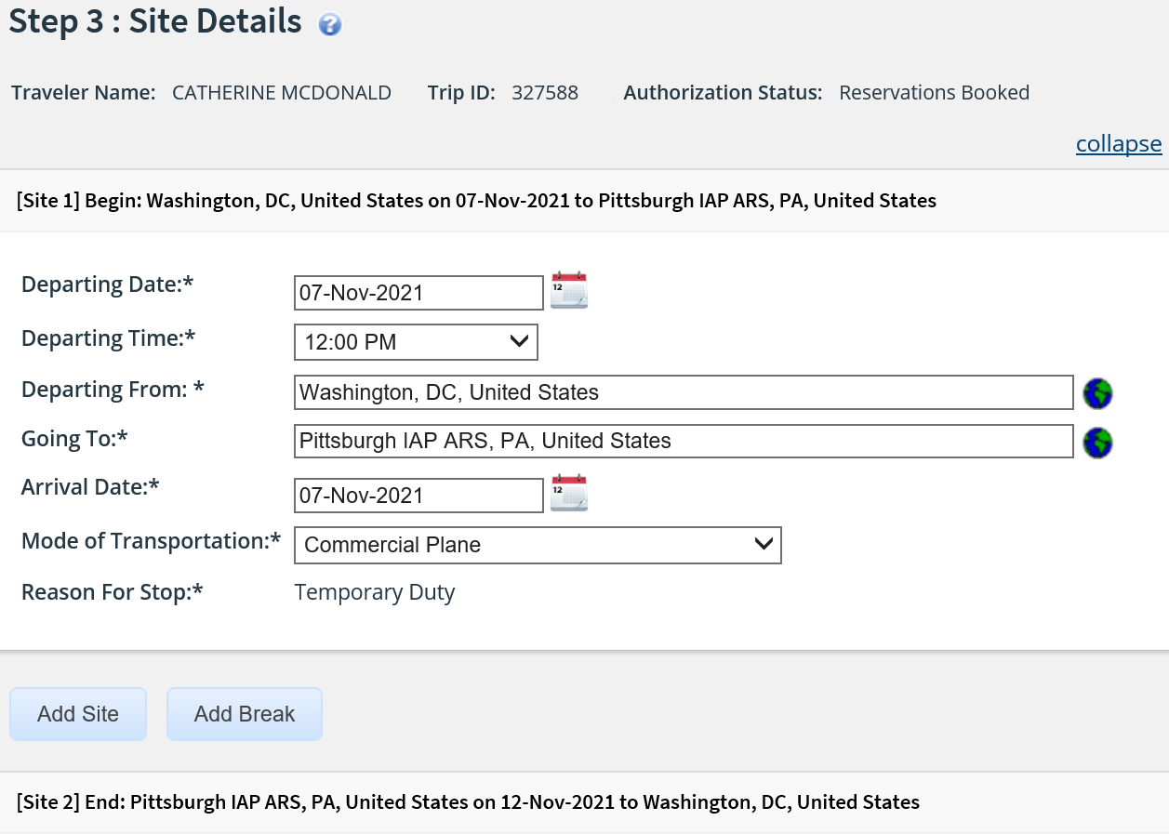
Create Authorization
Step 3: Site Details
Notes:
Use the Site Details page to select your trip per diem locations or, if you do not have associated reservations, to provide travel details. If the authorization has associated reservations, the information on this page is populated from the reservation’s details.
You should review and verify that the per diem location is accurate.
To update the Departing From or Going to fields:
Type three or more characters of the location name and then pause until the suggestion list appears.
Select the location from the list. If the correct location does not appear on the suggestion list, click the globe icon and use the search options and then choose the location from the list.
Click Add Site to add an additional destination to your trip.
Click Add Break to add a break (to return back to your homesite) between your beginning and ending destinations.
Click Save and Next Step to save the information and move to the next step in the authorization.

Slide 56
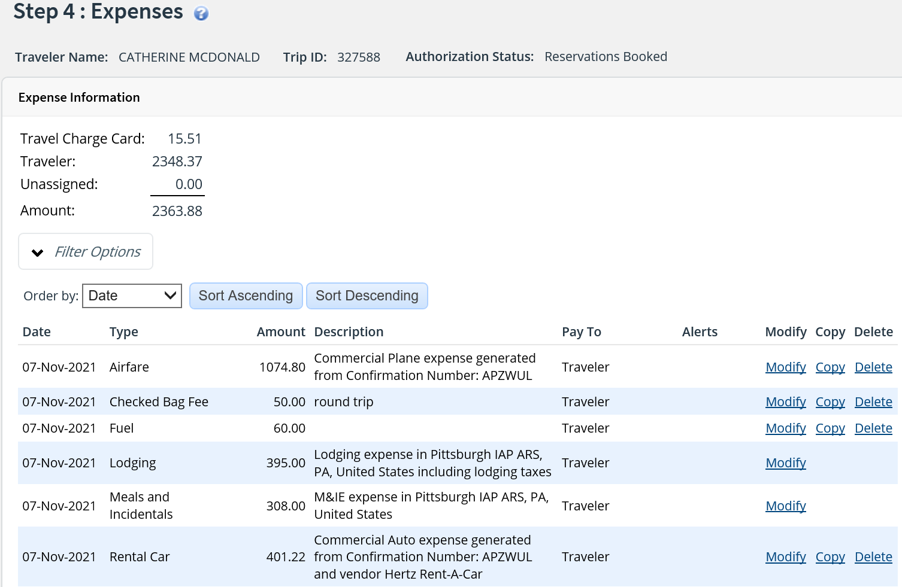
Create Authorization
Step 4: Expenses
Notes:
Use the Expenses page to review and update estimated expenses for the trip including:
Lodging expenses, including reimbursement types for each site.
Meals and incidental expenses (M&IE) for each site, including reimbursement types for each site.
Adding additional estimated expenses.
Review your estimated expenses. If you have an associated reservation, the estimated expenses are generated from the reservation information, including airfare, rail, lodging and rental car expenses (if applicable).
The “Pay to” field displays indicating how the expense will be paid and reimbursed. Review the Pay to fields to ensure they are correctly set so that enough funding gets allocated to Traveler/Travel Charge Card expense and/or Agency Billed expenses (used for Airfare/Rail and TMC fee if traveler does not have a GTCC).
Meals and incidental expenses are based on the per diem rates for the sites on your trip. If you do not have an associated reservation, the lodging rates are also based on the per diem rates for the sites on your trip.
Click Add New Expense to add additional estimated expenses to the trip.
Click Modify to adjust the date or amount of an expense.
Click Copy to duplicate an expense for a different date.
Click Delete to remove an expense.
Click Save and Next Step to save the information and move to the next step in the authorization.

Slide 57
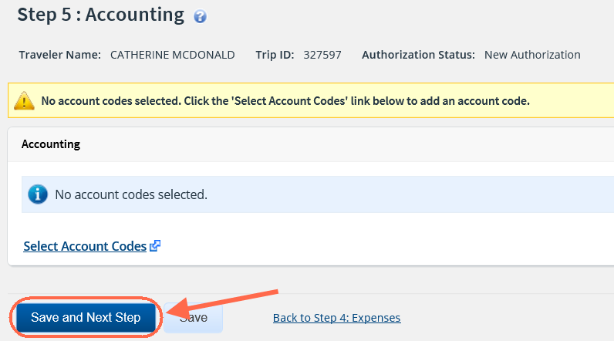
Create Authorization
Step 5: Accounting
Notes:
The POET (Project, Organization, Expenditure, Task) lines are also known as Accounting Codes in E2.
Your trips POET line or lines will be added by the Funds Approver. You can click Save and Next Step to move to Step 6: Travel Policy.

Slide 58
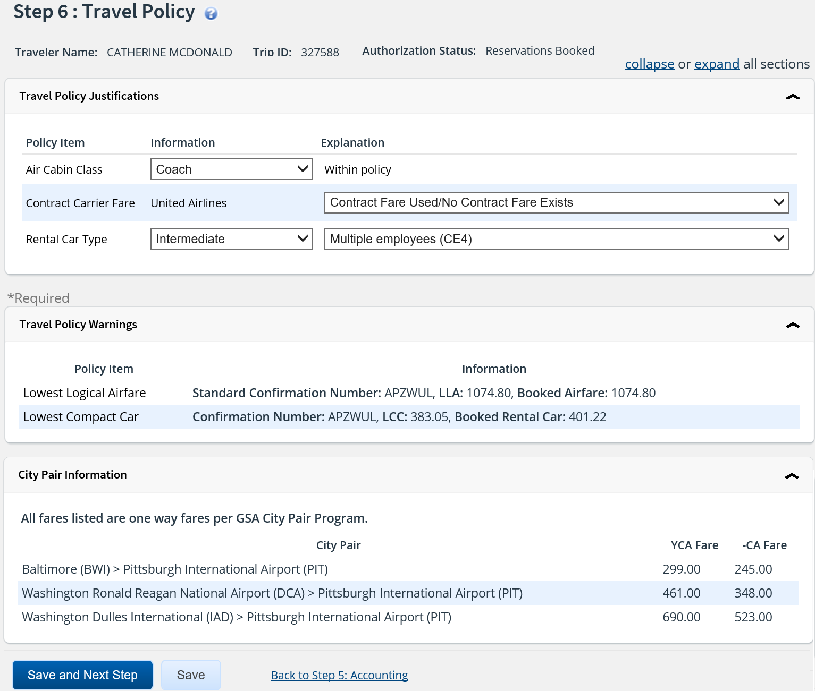
Create Authorization
Step 6: Travel Policy
Notes:
The Travel Policy page displays information about your trip that may be outside USCG’s travel policy. It also displays contracted fare information for any city pairs that exist for your trip. The following sections may appear:
Travel Policy Justifications
Travel Policy Warnings
City Pair Information
Information will populate here based on the your reservation. If an explanation is not selected for an out of policy justification, the traveler or arranger will need to select an explanation from the drop down list to continue.
Click Save and Next Step to save the information and move to the next step in the authorization.

Slide 59
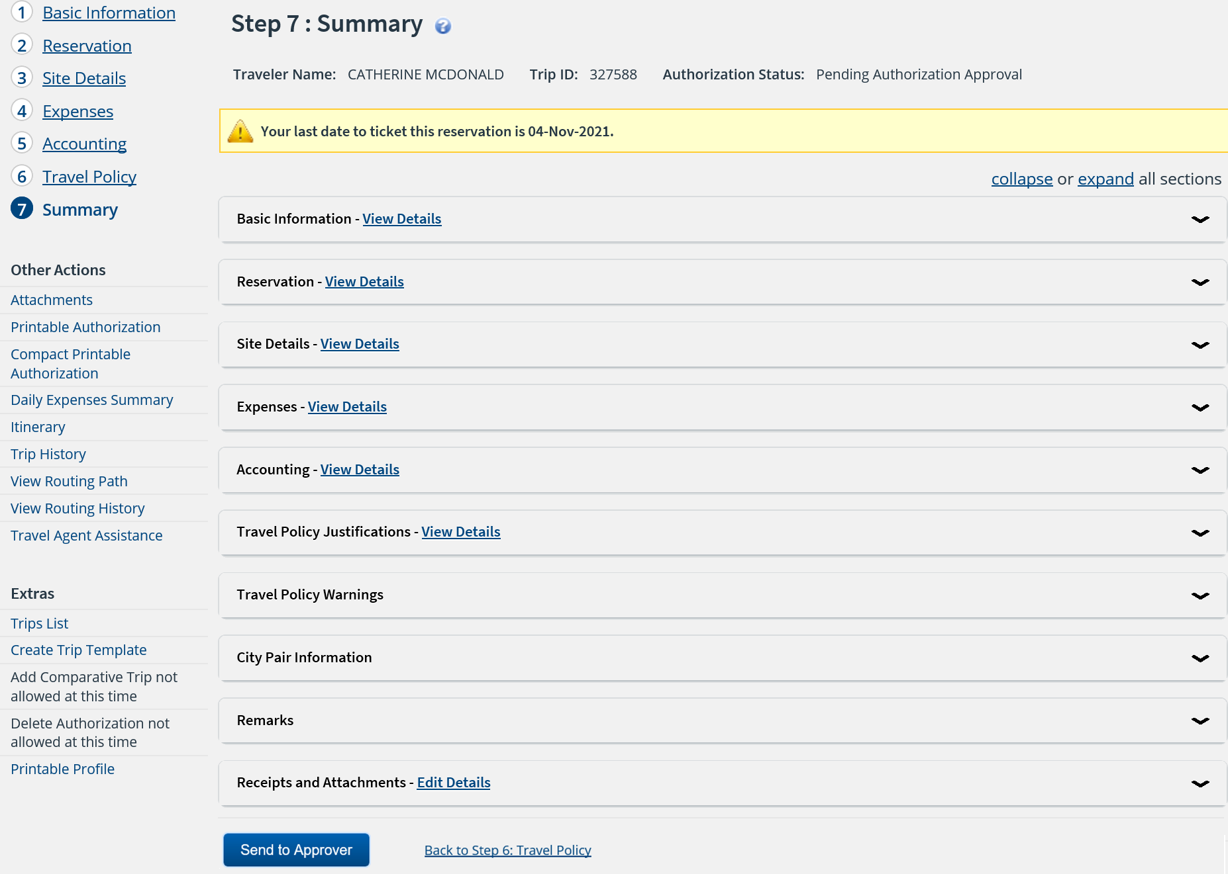
Create Authorization
Step 7: Summary
Notes:
The Summary step allows you to review the authorization and make sure it is correct before you submit it for approval.
Use Edit Details within a section header to return to that step in the workflow process to make changes.
Be sure to save changes and work your way back to the summary.

Slide 60

Create Authorization
Other Actions
Others Actions are links to functions that are not part of the basic authorization workflow. Located to the left in the navigation pane, the available actions vary depending where you are in the authorization creation process.
Other Actions | Description
Remarks | Review or add remarks to the authorization
Attachments | View or add receipts or other documents to the trip.
Printable Authorization | View or print the authorization.
Compact Printable Authorization | View or print a compact (typically, one page) version of the authorization.
Daily Expense Summary | View expense/per diem by day.
Itinerary | View reservation details, including ticket data (if available).
Trip History | View history for the entire trip.
Add Non-Federal Sponsor | identify expenses that are funded by non-federal sources
View Routing Path | View the authorizations routing path. Available once the authorization is sent for approval
View Routing History | Displays an audit trail of routing events for the authorization
Travel Agent Assistance | Request reservation assistance from your TMC.
Notes:
The OTHER ACTIONS section of E2 contains links to commonly performed actions while creating authorizations. Links vary depending on the status of the document and the step in the workflow that is currently displayed.

Slide 61
Create Authorization
Extras
Just below the Other Actions menu, the Extras section provides quick access to additional actions. Common Extras links include leaving the workflow to view a document list or deleting the current document.
Extras | Description
Trips List | Returns to Trips tab.
Create Trip Template | Saves trip details and expenses in a template for similar travel.
Currency Calculator | Displays on the Expense Step if you book a foreign destination.
Add Comparative Trip | Adds an alternate trip scenario for comparison purposes during the authorization approval process.
Cancel Authorization | Cancels the authorization and associated reservations.
Printable Profile | Displays your profile and a printable version of your profile appears in a new browser window.
Notes:
The EXTRAS section of E2 contains links to other functionality available while creating authorizations. Links vary depending on the status of the document, and the step in the workflow that is currently displayed.

Slide 62

Create Authorization
Send to Approver and Confirm
Notes:
Click Send to Approver to submit the authorization.
Validation checks are performed and any exceptions will be listed in the Confirm Action modal.

Slide 63

Viewing Authorization Pending Approval
Notes:
Authorizations and other trip components can be accessed at anytime from the Trips tab.
Other Actions:
After you submit your authorization for approval, the system automatically assigns routing rules to the document, and additional links become available in
OTHER ACTIONS. These links only appear after the document has been submitted for approval (the document is in pending approval status). You can view the approval path for your document and, in some circumstances, make changes. You also receive email notification as your voucher passes through each step in the approval process.

Slide 64

Viewing Routing Path
Notes:
When a document has been submitted for approval, the status changes to Pending Approval, and it is sent on a specific path that may include multiple approval steps, which are triggered by a set of rules that are applied to the document.
Once the authorization is in a Pending Authorization Approval status, you can view the routing path.
Open the trip from the Trips list and click View Routing Path under Other Actions.
You can view the approver responsible for the current step. The Pool Members list is populated with all of the members of the approver group associated with the approval step.
For example, if the approver is unavailable, you can select another approver from the same group to approve the document.
To change the approver for the current step, select the new approver from the Pool Members list.
Click Save.

Slide 65

Recalling a Document
Notes:
When a document has been submitted for approval, the status changes to Pending Approval. While the document is in a pending approval status, the traveler or arranger can Recall a document.
Recalling a document removes it from the approvers queue. The document goes into a Revised status and changes can be made, and then resubmitted for approval.
The approver or approvers are sent an email letting them know the document is no longer awaiting their action.
To recall the document, access the trip summary, scroll to the bottom and click Recall.

Slide 66

Selecting Rail
Notes:
During the reservation booking process, Rail reservations may be booked, similar to air reservations.
Once departure and arrival stations, and travel dates are identified, rail options are displayed.
Rail options include vendor details (train number, type of equipment, travel time, and other details), departure and arrival information, and are details.
The government fare indicator means that the fare is considered to be refundable based on Amtrak's cancellation policies. This is a helpful indicator that may appear for both coach and upgrade cabin classes; however, you should always review fare rules (including cancellation policy) and cabin class to be certain the fare meets your agency's travel policy and the mission requirements.

Slide 67

Email: Authorization Approved
Notes:
Once the authorization is approved, approved authorization emails will be sent to the primary and alternate email addresses in the traveler profile.

Slide 68

Email: Authorization Returned
Notes:
If the approver returns the authorization, an email will be sent to the primary and alternate emails in the traveler’s profile.
Review the information, access the trip and make the necessary changes and resubmit the authorization for approval.

Slide 69
Review
Creating Reservations and Authorizations
After completing reservations in the Online Booking Tool (OBT), what options are immediately provided if you chose to make your reservation first?
You can either Hold the reservation for later use or Start the creation of your authorization.
The Site Details are populated based on the booked reservations. If the Going To field does not match the true TDY location, what should be done to correct it?
Update the location by typing in the TDY site name and select or click the globe icon to search for the site.
If you book reservations through the TMC, you need to retrieve your reservation during the Reservation step to associate it to your authorization. True or False ?
True. Reservations booked directly with the TMC will not display in E2 for selection until they are retrieved.
How can a traveler make a change to an authorization that is in a pending approval status?
Recall the trip, which will change the status from Pending Approval to Revised.

Slide 70
Review
Creating Reservations and Authorizations
After completing reservations in the Online Booking Tool (OBT), what options are immediately provided if you chose to make your reservation first?
You can either Hold the reservation for later use or Start the creation of your authorization.
The Site Details are populated based on the booked reservations. If the Going To field does not match the true TDY location, what should be done to correct it?
Update the location by typing in the TDY site name and select or click the globe icon to search for the site.
If you book reservations through the TMC, you need to retrieve your reservation during the Reservation step to associate it to your authorization. True or False ?
True. Reservations booked directly with the TMC will not display in E2 for selection until they are retrieved.
How can a traveler make a change to an authorization that is in a pending approval status?
Recall the trip, which will change the status from Pending Approval to Revised.

Slide 71
Comparative Trips

Slide 72
Comparative Trips
A comparative trip is an alternate travel scenario that is used for comparison purposes during the authorization creation and approval process.
You should add a comparative trip when you have set up your authorization to do something different than what you are typically authorized to do. Examples include:
    Driving vs Flying
    Departing out of a different city than your homesite
    Flying into a different city
    Other reasons determined by your unit, office or agency that require a cost comparison
Your primary authorization should be set up for the travel you intend to do.
You add a comparative trip to your authorization after you complete all steps in the authorization workflow and before you submit the authorization for approval. This will allow you to calculate the cost of what is allowed, and then if needed adjust the primary authorization expenses to what you will be allowed to enter reimbursement for.

Slide 73
Scenario 2
Creating Authorization and Adding a Comparative Trip
The traveler is going round trip from Washington, DC to Pittsburgh, PA.
The traveler prefers to drive to Pittsburgh rather than fly.
An authorization will be created and a comparative trip will be added.
If needed, expenses will be adjusted so that the traveler will only enter expenses up to
what they are allowed to claim based on the cost of the YCA fare of the flights.
* Instructor may adjust travel details as needed

Slide 74


Adding a Comparative Trip
Notes:
If a member is taking an alternate but not authorized method of transportation, they are limited to the constructed cost of the authorized travel, i.e cost of travel method plus any TMC fees applicable.
The traveler should add a comparative trip to their authorization so the approver can view the alternate option.
Make a note of the YCA fare from the Travel Policy Step so that amount can be entered in the comparative trip.
From the Summary, under Extras, click Add Comparative Trip and select Create from Current trip so the details in the primary authorization carry over.
workflow to complete the comparative trip.

Slide 75

Completing Comparative Trip
Notes:
Proceed thru each step in the comparative trip workflow indicating what you are normally allowed to do
i.e. if comparing flying vs driving, enter Commercial Plan in the Site Details and add the round trip YCA fare as an Airfare expense on the Expenses step.
On the Comparative Trip Summary page, you can review the primary trip cost and the comparative trip cost.
Click Complete Comparative Trip.

Slide 76

Comparative Trip Summary
Notes:
You are returned to the primary authorization and a message displays that the trip contains a comparative trip.
Review the Comparative Trip Summary under Other Actions. If what the member “wants to do” exceeds the “allowed to do” USCG has created an expense line, Constructed Cost of GTR,
to capture the entitled amount so that the traveler does not need to adjust the POV mileage to equal the GTR amount.
The traveler needs to calculate the correct amount of what they are allowed, add the Constructed Cost of GTR expense, and add remarks indicating the reason for the expense.
If what the member wants to do is less than what you are allowed to do i.e. driving is less expensive than the YCA fare, keep the POV mileage expense that has been added. You do
not need to use the Constructed Cost of GTR. Be sure to add a remark with any details that the approver needs.

Slide 77
Reviewing Trips and
Trip Dashboard

Slide 78

Trips
The Trips tab provides a list of your trips along with icons to identify the status of the traveler’s documents.
Notes:
All active trips appear on your list, regardless of their status. However, trips that are in a revoked, canceled or closed status can be archived. If you have a large number of trips on your list, archiving trips reduces the list.
The following actions are available from the Trips tab:
Click the Show link to go to the travel document or trip dashboard
Click the Copy link to create a new trip by copying the existing trip
Click the Archive link to tag the trip as archived. This action removes the trip from the active trips list.
Click the Unarchive link to remove the archive tag and return to the active trips list. This link appears if you are viewing archived trips in your list.
Click Start a New Authorization to create a new authorization.
Click Make Reservations to access the E2 online booking site to shop for air, rail, hotel and rental car reservations. Find the best price and book your travel.
―Click Show Held Reservations to review your current reservations that are not yet associated with a trip. You can create a new authorization from a reservation.
Click Copy From Another Trip to create a new authorization from your own or from another traveler’s trip, or trip template.
Use the Filter Options to narrow down your list and only display some of your trips.

Slide 79

Trip Dashboard
The Trip Dashboard shows the status of each document associated with the trip and provides access to additional actions for the trip.
Notes:
From the Trips tab, click Show to access a trip. If the trip is approved, the trip dashboard is automatically displayed. If clicking Show takes you into the document, click the Trip Dashboard tab in the upper left corner of the document to access.
In E2, authorizations and vouchers are individual documents; in combination with other items, such as reservations and comparative trips, these documents represent your travel plans, actual travel activity and expenses. This combination of documents is known as your trip.
To make changes to an approved authorization, click Amend Authorization.
To create a travel advance, click Create Travel Advance.
To create a voucher for a trip, click Create Voucher.
Click Cancel Trip to cancel an approved trip.

Slide 80
Travel
Advances

Slide 81

Travel Advances
Once the authorization is approved, a travel advance can be created by accessing the Trip Dashboard of the trip and clicking Create Travel Advance.
Travelers can request multiple advances for a trip but the system will limit them to 80% of their total travel estimate, excluding airfare.
Notes:
The authorization must be approved before a travel advance for the trip can be requested.
Click Create Travel Advance from the trip’s Trip Dashboard to start the Travel Advance creation process.

Slide 82

Create an Advance
Step 1: Basic Information
Notes:
The Travel Advance process is similar to the process to create an authorization.
The maximum amount is based on all travel expenses approved on the authorization, excluding airfare.
If previous travel advances have been approved for the trip, the new advance can not exceed the total allowable amount.

Slide 83

Create an Advance
Step 2: Advance Accounting
Notes:
The POET line for the advance is copied from the travel authorization.
Click Save and Next Step to access the Advance Summary page.

Slide 84

Create an Advance
Send to Approver
Notes:
Click Send to Approver and Confirm to submit the travel advance request for approval.
You can view the routing path of the travel advance similar to an authorization. Your travel advance is displayed on the associated trip’s Trip Dashboard.

Slide 85
Vouchers

Slide 86
Types of Vouchers
Incremental
Final
Supplemental
An initial reimbursement request for your trip when you know you will file voucher(s) for additional expenses incurred on the trip. This voucher type is typically used for long term trips where reimbursement every 30 days
A reimbursement request when you have completed your trip and do not expect to file another voucher for the trip. Every trip must have, at minimum, a final voucher.
A request for additional travel expense reimbursement after a final voucher for the trip has been fully approved.

Slide 87

Voucher Workflow
Notes:
When the traveler returns from travel, a voucher is created from the approved authorization and submitted for reimbursement.
If the voucher meets any of the conditions requiring additional approval, it will route to the HIGH RISK approval group,
If the voucher does not meet any of the conditions, it will routed to the Voucher AO for approval.
Once approved, information is sent to FSMS and payment is made to the traveler.
The traveler’s supervisor will receive all travel related emails once the traveler has added their email to their profile.

Slide 88

Creating Final Voucher from To Do List
Once a trip is completed, a reminder appears on the traveler’s To Do List to create the voucher.
Notes:
Click Create Voucher to start the voucher process from the To Do List.

Slide 89

Creating a Voucher
Trips List
Voucher can also be started from the Trips list by clicking Show to access the Trip Dashboard to start the voucher.
Notes:
Click Show for the approved trip you need to create a voucher for from the Trips list.

Slide 90

Creating a Voucher
Trip Dashboard
Notes:
All voucher types can also be created from the Trip Dashboard.
Click Create Voucher to request reimbursement once your trip is complete.

Slide 91
Scenario 3
Create a Voucher
The traveler has returned from their trip. Travel dates and sites remained the same. Create a final voucher, and update all expenses. Note: With the exception of Airfare/Rail, TMC Fee and VTF, the Pay to field defaults to Traveler. Review and update if needed to ensure the correct entity is being reimbursed which may depend on how the expense was paid – Agency Billed, Traveler or Travel Charge Card.
Expenses
Airfare: Amount from authorization. Review how the airfare was purchased and adjust the Pay To if needed.
Checked Bag Fee: Capture exact expense for each way - $25.00
Lodging: Amount captured from booked reservation is still accurate
Lodging Tax: Update with actual receipt amount $13.75 per night
Fuel for Rental Car: Update with actual receipt amount of $48.00
M&IE: Automatically populates Per Diem based on location from Site Details (a meal was provided one day of trip)
Parking at airport: Update with actual receipt amount $98.00
Private Auto Mileage: From: 5516 Vernon Way Suitland MD 20746 To: Washington Dulles Airport Calculate Distance
Private Auto Mileage From: Home To: Airport Use Own Calculation 39 Miles Enter Reason
Rental Car Amount from authorization
TMC Fee: Online Booking $9.35
Once all expenses have been added, view cost variance to ensure your voucher doesn’t exceed 10% of what was authorized.
Some expenses will be added from the GTCC transaction list, and some expenses will be updated manually.
Add receipt for expenses $75 or over. Airfare invoice will be automatically added to the trip.

Slide 92

Create a Voucher
Step 1: Basic Information
Notes:
Basic information for a voucher includes:
Travel type and purpose from the approved authorization
Your travel dates from the approved authorization
Claim expense begin and end dates (voucher cut-off date)
Source for transportation and other expenses (This selection list only appears when you are creating a voucher after amending an authorization and the amendment process deleted an “in process” voucher.)
System assigned Document number
Voucher finality indicator
Enter the voucher cut-off date in the Claim Expenses Between End Date field or select a date using the calendar icon. The default date is the final day of your trip. This date should only be changed if you are not claiming expenses for every day of the trip i.e. you are on a long term trip and this is the first voucher of several vouchers that will be filed.
Select an option For this trip this is the:
Final Voucher – trip is complete and no additional expenses are expected.
Not Final Voucher – trip is in progress and will have additional expenses to file.
Final Voucher and Update Site Details – trip is complete but itinerary changed after authorization was approved.
Click Save and Next Step.

Slide 93

Create a Voucher
Step 2: Expenses
The Pay To field defaults to “Traveler” for ALL expenses. Review and modify as needed to indicate if you want the reimbursement to go to your Travel Charge Card or to the Traveler. If an expense such as Airfare was paid by the agency, you should select Agency Billed.
Notes:
The Expenses step allows you to review and update your travel expenses.
The Expenses page shows the estimated expenses that are carried over from the authorization to your voucher.
(Some expense amounts are carried over at the amount estimated on the authorization and some expense types are carried over at an amount of 0.00).
Click Modify to update lodging, M&IE and other expenses.
Click Add New Expense to add additional expenses to the voucher
Perform additional tasks, such as deleting (removing an expense not used) , or copying (duplicating an expense for a different date).
Review the Pay To field which indicates where the reimbursement for the expense should be directed. The pay to on Airfare/Rail and TMC fee should reflect how your ticket was purchased – Travel Charge Card or Agency Billed. Review the Pay to fields to ensure they are correct so that the reimbursement to Traveler/Travel Charge Card and/or Agency Billed (used for Airfare/Rail and TMC fee if traveler does not have a GTCC) are processed correctly. On the voucher if the amount allocated to pay to traveler and travel charge card exceeds what was allocated to pay to travel and travel charge card, or the amount allocated to agency billed exceeds what was allocated to pay to agency, an amendment will need to be created as the payment will not be correctly processed in FSMS.
The View Cost Variance Summary under Other Actions can be used to view the overall cost of what was authorized vs what is on the voucher but to compare the pay to allocations to determine if they have been exceeded, access the printable authorization under Attachments and view the total allocated to Traveler/TCC and Agency Billed.
Use the Add Credit Card Expense link to view your GTCC transaction list, and select transactions that reflect expenses on this voucher.

Slide 94

Automated Travel Charge Card Process
E2 supports automated government travel charge card (GTCC) process, allowing you to view transactions incurred on their government travel card and apply them to your voucher or local travel claim. This saves you the time of typing in incurred expense details on your claim.
The transaction list is updated data by data feed from CitiBank. If you access your transaction list and do not see a specific charge, try again later for the list to update.
Notes:
The Credit Card Expense Import feature allows travelers to enter TCC transactions as expenses.

Slide 95

Create a Voucher
Selecting Government Travel Charge Card (GTCC) Transactions
Notes:
To view your GTCC transaction list and select transactions that reflect expenses on this voucher, click Add Credit Card Expense.
The Add Credit Card Expense window appears, listing all of the GTCC transactions that are currently available for assignment as an expense.
Locate and select the travel charge card transaction that you want to add to the voucher expenses for reimbursement.
Select the Expense Type from the list (if necessary). The expense type that appears by default reflects a mapping established by your workgroup, if available.
Click Save and Close, and the selected expenses will be added to the voucher expenses.

Slide 96

Create a Voucher
Step 3: Accounting
Notes:
The account codes used on the authorization carry over to the voucher.
If multiple POET lines were used to fund the trip, allocations may need to be adjusted.
Click Save and Next Step.

Slide 97

Create a Voucher
Step 4: Voucher Liquidations
The liquidation step is added to the voucher workflow if a travel advance was approved for the trip.
Notes:
If an advance was taken on the trip, the Liquidation step displays.
If this is a final voucher, the Advance Amount to Liquidate will be populated with the maximum “pay to traveler” amount based on the total claimed expenses set to pay to the traveler in order to liquidate the advance.
Note: If this is not the final voucher, the Advance Amount to Liquidate will be an editable field. Type in the amount.

Slide 98

Create a Voucher
Step 5: Summary
Notes:
The Summary step allows you to review the voucher and make sure it is correct before you submit it for approval.
Use Edit Details within a section header to return to that step in the workflow process to make changes.

Slide 99

Create a Voucher
Other Actions
Other Actions | Description
Remarks | Select to review or add remarks to voucher.
Attachments | Select to view or add receipts or other documents to the trip.
Printable Voucher | Select to view a PDF version of the voucher.
Compact Printable Voucher | View or print a compact (typically, one page) version of the voucher.
View Cost Variance Summary | Compares estimated travel expenses with actual expenses by expense type.
Daily Expenses Summary | Displays expense/per diem by day.
Trip History | View history for the entire trip.
Override Pay To | Diverts M&IE expenses that are assigned as Pay to Traveler to your travel charge card. Link only available if Split Pay functionality being used.
Just like the Others Actions available during the Authorization workflow, the Voucher workflow has additional Other Actions available, such as View Cost Variance and Override Pay To.
Notes:
The OTHER ACTIONS section of the voucher contains links to commonly performed actions while creating vouchers. Links vary depending on the status of the document, and the step in the workflow that is currently displayed.
If the overall voucher total amount under View Cost Variance Summary exceeds the overall authorized amount by 10% or more, you will need to amend the authorization to add additional funding to the trip. Once you complete an amendment and have that approved, you can create the voucher and send it for approval.

Slide 100

Create a Voucher
Extras
Extras | Description
Trips List | Returns to Trips Tab.
Create Trip Template | Saves trip details and expenses in a template for similar travel.
Delete Voucher | Removes the voucher from the system.
Printable Profile | Displays your profile and a printable version of your profile appears in a new browser window.
Just below the Other Actions menu, the Extras section provides quick access to additional actions.
Common Extras links include leaving the workflow to view a document list or deleting the current document.
Notes:
The EXTRAS section of E2 contains links to other functionality available while creating vouchers. Links vary depending on the status of the document, and the step in the workflow that is currently displayed.

Slide 101

Create a Voucher
Send to Approver
Notes:
Scroll down to the bottom of the summary and click Send to Approver to submit the voucher.
Read the acceptance policy. When you submit the voucher, this acceptance is logged and becomes part of the trip history.
Click Confirm.
To return to the summary, click Cancel.

Slide 102

Create a Voucher
Send to Traveler
Notes:
If an arranger creates a voucher on the traveler’s behalf but does not have permission the submit the voucher for approval, the traveler is required to review the voucher as the initial step in the official approval process.
Rather than the Send to Approver button, the arranger will see the Send to Traveler. The traveler will receive an email alerting them they need to log into E2 and perform the traveler review before they can submit the voucher to the approver.

Slide 103

Viewing Voucher Pending Approval
Notes:
Other Actions:
After you submit your voucher for approval, the system automatically assigns routing rules to the document, and additional links become available in
OTHER ACTIONS. These links only appear after the document has been submitted for approval (the document is in pending approval status). You can view the approval path for your document and, in some circumstances, make changes. You also receive email notification as your voucher passes through each step in the approval process.
Recall:
If you need to change a document after you submit it for approval but before it completes the approval process, you can recall the document. Recalling a document removes it from the approval process and changes the document status from Pending Approval to Revised. You can make changes and then submit the voucher for approval again.
The approver will receive an email noting that the document was recalled by the traveler.

Slide 104
Review
Creating and Submitting Vouchers
What type of voucher do you file if you have completed your trip and do not to expect to incur any additional expenses for a trip?
What link under Other Actions is used to add receipts to the trip?
What Other Action link can you use to view a comparison between your total estimated expenses verses your claimed expenses?
View Cost Variance
After a document is sent to the approver how can a traveler determine what approvers it went to?
Open the voucher and View Routing Path

Slide 105
Review
Creating and Submitting Vouchers
What type of voucher do you file if you have completed your trip and do not to expect to incur any additional expenses for a trip?
Final Voucher
What link under Other Actions is used to add receipts to the trip?
Attachments
What Other Action link can you use to view a comparison between your estimated expenses verses your claimed expenses?
View Cost Variance
After a document is sent to the approver how can a traveler determine what approvers it went to?
Open the voucher and View Routing Path

Slide 106
Local Travel
Claims

Slide 107

Creating Local Travel Claim
A Local Travel Claim (Local Travel Voucher) is a request for reimbursement for expenses incurred typically within a 50 mile radius of your home site or permanent duty station.
Notes:
A local travel claim can include expenses for up to 60 days.

Slide 108

Create a Local Travel Claim
Step 1: Basic Information
Notes:
Basic information for a voucher local travel claim includes:
Travel purpose, and official travel type (if enabled)
Dates covered by the local travel claim (60 day maximum)
Document number
This is the first step in the local travel workflow. No other steps are enabled at this time. You must complete this step in the process before you can proceed.
Enter the purpose and begin and end date and click Save and Next Step to save the information and move to the next step in the claim.

Slide 109

Create a Local Travel Claim
Step 2: Expenses
Notes:
Click Add New Expense to add expenses to the claim. Use the Add Credit Card Expense link to select and add transactions from your GTCC expense list, as done in the TDY Voucher.
Click Modify to adjust the date or amount of an expense.
Click Copy to duplicate an expense for a different date.
Click Delete to remove an expense.
Click Next Step to move to the next step in the claim.

Slide 110

Create a Local Travel Claim
Step 3: Accounting
Notes:
The POET (Project, Organization, Expenditure, Task) lines are also known as Accounting Codes in E2. POET lines replace TONOs.
Your trips POET line or lines will be added by the Funds Approver. You can click Save and Next Step to continue to the Summary.

Slide 111

Create a Local Travel Claim
Step 4: Summary
Notes:
The Summary step allows you to review the local travel claim and make sure it is correct before you submit it for approval.
Use Edit Details within a section header to return to that step in the workflow process to make changes.

Slide 112

Create a Local Travel Claim
Send to Approver
Notes:
Scroll to the bottom of the document and click Send to Approver to submit the local travel claim.
If you are an arranger and you do not have permission to submit the claim on behalf of the traveler, click Send to Traveler.

Slide 113
Review
Creating and Submitting Local Travel Claims
What is the maximum number of days a local travel claim can cover in E2?
What step in the local travel claim workflow allows you to enter the begin and end dates?
Step 1: Basic Information
Local travel is typically considered travel within ____ miles of your permanent duty station.
50 miles
What features allows you to easily create a new local travel claim from an existing local travel claim?
The Copy feature allows you to copy an existing local travel claim to create a new claim with the same expenses. You can modify the new claim as necessary.

Slide 114
Review
Creating and Submitting Local Travel Claims
What is the maximum number of days a local travel claim can cover in E2?
Local Travel Claims (or Local Travel Vouchers or LTVs or LTCs) can include up to 60 consecutive days worth of expenses.
What step in the local travel claim workflow allows you to enter the begin and end dates?
Step 1: Basic Information
Local travel is typically considered travel within ____ miles of your permanent duty station.
50 miles
What features allows you to easily create a new local travel claim from an existing local travel claim?
The Copy feature allows you to copy an existing local travel claim to create a new claim with the same expenses. You can modify the new claim as necessary.

Slide 115
Traveler Review

Slide 116

Traveler Review: Email
Travelers who have an arranger create their voucher or local claim and do not have permission to send on the travelers’ behalf will need to review the claim as part of the claim’s approval process before it is sent to the approver.
Travelers will receive an email if a voucher is pending their review.

Slide 117

Traveler Review: My Approvals
Vouchers and Local Travel Claims pending the traveler’s review are found by clicking the My Approvals Tab. The documents can also be accessed via the Trips or Local Travel tab.
Notes:
To begin reviewing a voucher or local claim prepared by an arranger, access My Approvals. Travelers can also access their document to review from the Trips or Local Claims tab.
Click Show to open the voucher.

Slide 118

Traveler Review: Reviewing Summary
Notes:
The Summary step allows you to review the voucher and make sure it is correct before you approve it.
Review each step in the document workflow to verify accuracy of the claim.

Slide 119

Traveler Review: Approve or Modify
Notes:
After reviewing the voucher:
Click Approve to send it to the approving official.
Click Modify Voucher (or Modify Claim if it is an LT) to make changes.
After making changes the Send to Approver will display.

Slide 120

CWTSato To Go
Travelers can download the CWTSato To Go App on their mobile device, and create an account to begin using all the features.
View all travel plans in one place:
  CWTSatoTravel itineraries synchronized automatically.
  Other trips can be forwarded to plans@cwtsatotogo.com.
Useful Travel information on the go:
  Flight alerts are pushed to your device.
  Mobile check-in on more than 250 airlines.
  Synchronization of trips with to your calendar.
  Search flight status to check arrival time of other flights.
Practical tools and destination information:
  Advanced itinerary sharing.
  View maps and driving directions.
  Currency converter and global tip calculator.
  Five-day weather forecast.
To check out all the features, access the website:
https://www.cwtsatotravel.com/services/cwtsatotogo.aspx
Notes:
Travelers must create their mobile account using their official email address, which must be present in their travel profile.

Slide 121
Resources
To access customized user guides, an FAQ, and additional ETS/E2 details, access the USCG PPC website:
https://www.dcms.uscg.mil/ppc/travel/ets/
E2 Online Help is also available by clicking on the User Options menu (your name in the upper right corner of E2) and selecting Online Help.

Slide 122
We would like your feedback…..
Thank you for viewing this training recording. Please type the URL below in your web browser to access a brief survey about your training experience.
www.surveymonkey.com/r/DRPXXR7
Thank you for your feedback!
© 2022 CW Government Travel, Inc

Slide 123
Questions ?

Slide 124
© 2022 CW Government Travel, Inc

