Slide 1
FACILITATOR INSTRUCTIONS
Prior to facilitation, print the CGLDF Coaching cards and cut them out. There are 50 questions that can be used for any of the 28 competencies.
You will need 1 card per participant.
FRAMING
Brief: “You are the experts of your own experience. This activity is about having a discussion and sharing some of that knowledge in the category of_______. “
*Note: It is up to the facilitator to pick which competency you want to discuss during the session. Participants will fill in the blanks on the cards with the chosen topic i.e. “Health and Wellness”
OBJECTIVE
Swap questions and answers to learn about the other people on your team.
GUIDELINES
1. Pair up with one other person to ask the question on your card, listen to your partners response, and then answer the question on your partners card.
2. Swap cards after each conversation and hold your card in the air to signal that you are looking for a new partner.
Optional round 2:
Add a round with instructions on how participants should listen. The rules are the same as round one but instruct participants to really pay attention to how they are listening.
Most people tend to listen in 2 different ways subjective or objective. Subjective is when you are listening to “Win” (one up someone's story, waiting for your turn to talk etc.). Objective is when you listen to understand and set aside your lifetime of experience. You are just there to hear that person without judgement and then follow up with some curiosity.
*Note: Continue as long as the energy is high, end a positive note.
DE-BRIEF
What did you learn about other group members?
How can you use what you learned today in other situations?
What beliefs about yourself and the other group members were reinforced during your discussions?
How can you challenge yourself to improve and grow?

Slide 2
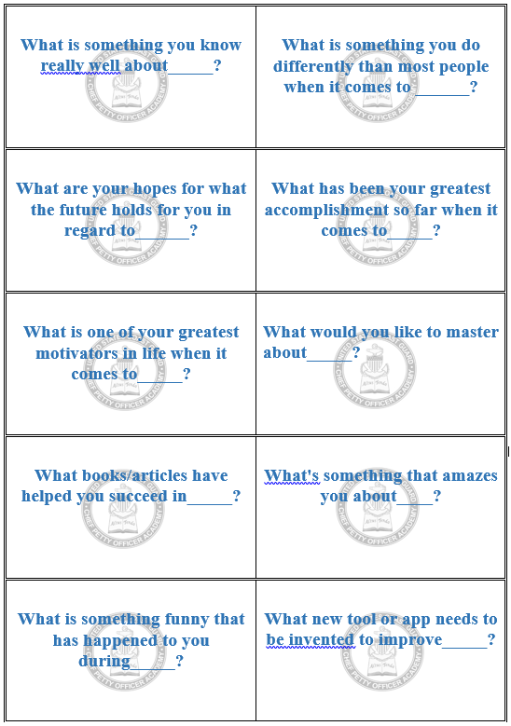

Slide 3
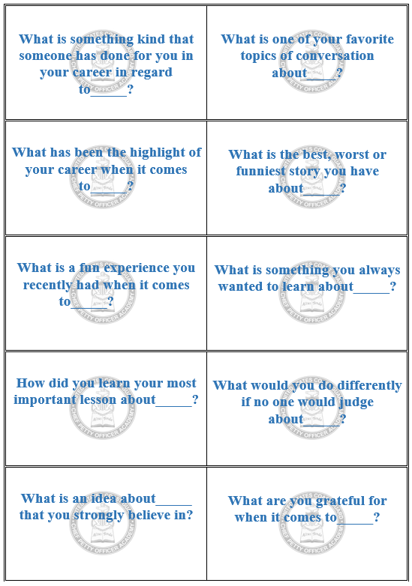

Slide 4
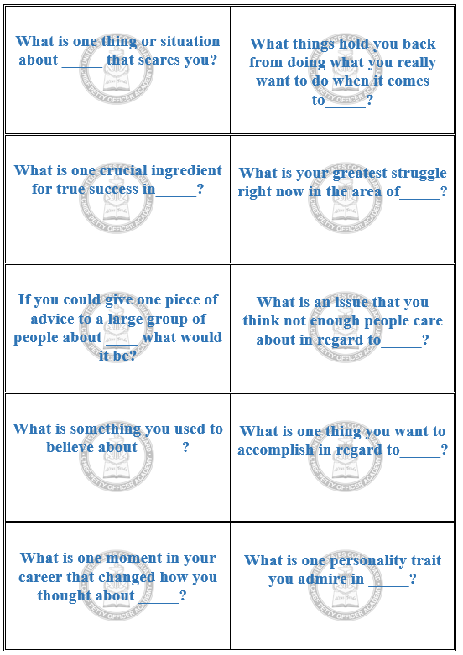

Slide 5
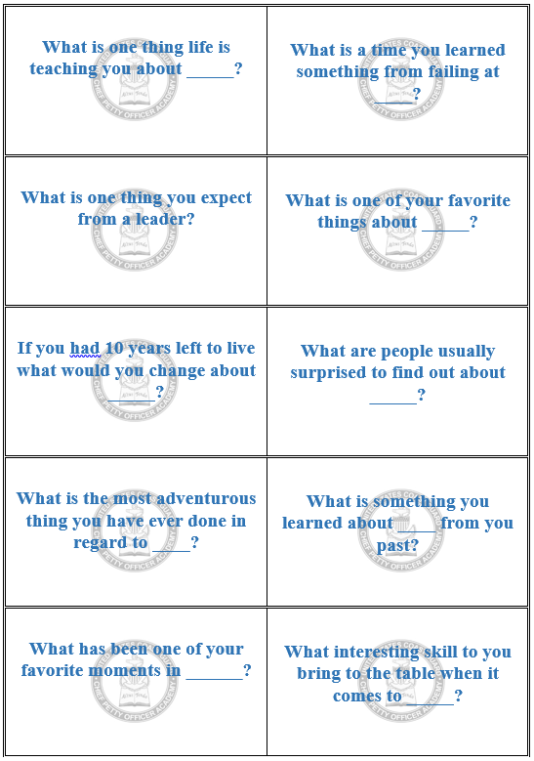

Slide 6
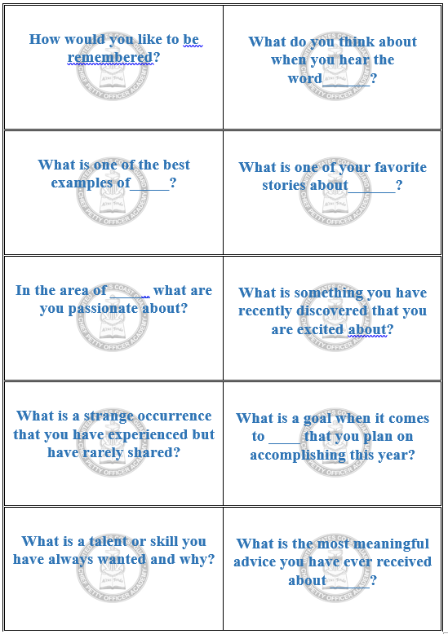

Slide 7
QUESTION BANK
What is something you know really well about_____?
What is something you do differently than most people when it comes to ______?
What are your hopes for what the future holds for you in regard to______?
What has been your greatest accomplishment so far when it comes to_____?
What is one of your greatest motivators in life when it comes to_____?
What would you like to master about_____?
What books/articles have helped you succeed in_____?
What's something that amazes you about____?
What is something funny that has happened to you during_____?
What new tool or app needs to be invented to improve_____?
What is something kind that has done for your in your career in regard to_____?
What is one of your favorite topics of conversation about____?
What has been the highlight of your career when it comes to_____?
What is the best, worst or funniest story you have about_____?
What is a fun experience you recently had when it comes to_____?
What is something you always wanted to learn about_____?
How did you learn your most important lesson about_____?
What would you do differently if no one would judge about_____?
What is an idea about_____ that you strongly believe in?
What are you grateful for when it comes to_____?
What is one thing or situation about _____ that scares you?
What things hold you back from doing what you really want to do when it comes to_____?
What is one crucial ingredient for true success in_____?
What is your greatest struggle right now in the area of_____?
If you could give one piece of advice to a large group of people about ____ what would it be?
What is an issue that you think not enough people care about in regard to_____?
What is something you used to believe about _____?
What is one thing you want to accomplish in regard to_____?
What is one moment in your career that changed how you thought about _____?
What is one personality trait you admire in _____?
What is one thing life is teaching you about _____?
What is a time you learned something from failing at ____?
What is one thing you expect from a leader?
What is one of your favorite things about _____?
If you had 10 years left to live what would you change about _____?
What are people usually surprised to find out about _____?
What is the most adventurous thing you have ever done in regard to ____?
What is something you learned about ____ from you past?
What has been one of your favorite moments in ______?
What interesting skill to you bring to the table when it comes to _____?
How would you like to be remembered?
What do you think about when you hear the word______?
What is one of the best examples of_____?
What is one of your favorite stories about______?
In the area of _____ what are you passionate about?
What is something you have recently discovered that you are excited about?
What is a strange occurance that you have experienced but have rarely shared?
What is a goal when it comes to ____ that you plan on accomplishing this year?
What is a talent or skill you have always wanted and why?
What is the most meaningful advice you have ever received about _____?

