Slide 1
Command Sponsor Training

Slide 2
Command Sponsor Training
USCG Health, safety, and Work-life
Heather Miles
Transition Relocation Manager
D13, Base Seattle
Heather.M.miles@uscg.mil
(206) 217-6674
Notes:
Hello, I am Heather Miles, the D13 Transition & Relocation Manager. Thank you for your attention as we complete an overview of the Command Sponsor Training. I am available for information and referral to both the sponsor and the incoming member. You can reach the work-life office at 206-217-6674. Your work-life team will support you in getting the needed information and resources.

Slide 3
Objectives
Why Sponsor?
What do Reporting Members Want to Know?
What does the Sponsor Need to Know?
Sponsor Roles
Ongoing Support
Notes:
The objectives of this training are designed to help you be prepared and know what to expect as a sponsor… Ideally, increasing the successful transition of our incoming service members and their families.

Slide 4
Why Sponsor?
Advanced planning, prior to a PCS, can ease the stress of a move, encouraging Semper Paratus
First days and weeks can be critical to members’ personal and professional readiness
Proactive Readiness: Quicker familiarity = More productivity
Assist members and families with moving process
Improve stability, wellness, and retention
Reduce lost work time
Enhance your evaluations
Notes:
Why is the command sponsor program important to the Coast Guard and unit mission? Why be a Sponsor? The ultimate goal is creating connections, increasing success with our shipmates.
This is one way we create a sense of community within the organization. The command climate and organizational readiness are supported through a robust command sponsor program.
Think back to your first duty station and your first move with the Coast Guard. If you now have a spouse and/or children, think about how the first move with a family may have differed from your first move as a single member.
This is where the Golden Rule comes into play. What do you wish you had known? What would have helped to reduce stress and would have set you and your family up for success at your new duty station? If you think in these terms, you are on your way to being proactive by helping the incoming member during those important pre-move and first-days stages.
Your new Shipmate will be freed up to be a proactive team member when tasks connected to the move and personal life are completed and not causing stress.
Having an active/productive team reduces lost work time, improves morale and the overall success of the organization.

Slide 5
Sponsor Roles
Share resources
Be aware of potential concerns
Special needs family members
School-aged children
Housing needs
Financial issues
Deployment issues
Transportation issues
Advocate for yourself
Let your supervisor know the time needed for this extra responsibility
Provide the incoming member your role in their PCS
Make Appropriate Referrals*
Housing
Work-Life
Legal
Command Financial Specialist
Coordinate the arrival process
Airport pickup?
Check-in process
First 72 hours
Follow up!!!
* Be careful of making personal recommendations for businesses, neighborhoods, schools, etc!
Notes:
What are the roles and responsibilities within the Command Sponsor Program? The unit, the incoming member and the sponsor each have separate roles and responsibilities.
Ideally, when the unit was assigning a sponsor, they were able to take in to consideration the circumstances and the characteristics of both the incoming member and the sponsor selected – considering things such as pay grade, marital status, and family size - just to name a few. As the member is preparing for their move, they will need to take the time to do their own personal and family assessment. They will be establishing a timeline. It is their responsibility to access the resources that you as the sponsor have made available to them. They have administrative requirements that only they can do. You as the sponsor – it is your role to provide information and resources to the incoming member, take into consideration the needs of the member and their family, provide them with local advice and suggestions, give them referrals that they are seeking in a timely manner. It is very important that you follow-up after you have said you will give them something. Help to coordinate their arrival, provide them directions of they need it, and meet them when they check in. Upon arrival, give them a tour and an orientation to your local unit and continue to be there as support during the first days and weeks while the member and their family are getting settled.

Slide 6
What Do Members Want to Know?
Housing and temporary lodging
Childcare/school info
Spouse jobs
Report date
Leave in transit
Deployment schedule (if applicable)
Location of command & contact info
Supervisor’s info
Medical
Special Needs info
Driving/Registration Info
Car seat/seatbelt/mobile phone laws
Firearms Info
Ombudsman info
Local resources
Commissary/Exchange
Legal
Vehicle storage
Shopping
Parks
Notes:
Let’s put ourselves in the shoes of the incoming member; what do they need to know?
The top questions that come through the relocation office are related to housing, childcare and school information, and spouse employment. Be prepared to provide referral information or POCs for these questions and more. There is not an expectation that you are an expert on all topics; we do want you to be able to provide a referral at a minimum.
Be prepared to discuss relevant, introductory unit information. The person will probably be interested in learning more about the local area – keep the tone positive, allowing for the incoming person to form their own opinions.

Slide 7
Housing
Housing can be expensive in D13. Housing decisions impact access to local resources, commute time and work life balance. In some areas, a 20 mile commute could take in excess of an hour.
The BAH Primer explains how BAH is calculated:
https://cg.portal.uscg.mil/units/dol/dol-3/BS/SitePages/Welcome%20Aboard!.aspx
Housing Points of Contact
Trupti Thatte-Maupin
CG AIRSTA / SFO Port Angeles, WA
Phone: 360-417-5826
trupti.thatte-maupin@uscg.mil
Hubert Lynn
Sector North Bend
541-756-9258
Hubert.lynn@uscg.mil
Donny Lee
Sector Columbia River
503-325-0204
donny.a.lee@uscg.mil
Ed Livingston
Base Seattle
206-217-6483
edward.livingstonjr@uscg.mil
Notes:
Housing decisions can be stressful. Picking the house you will want to stay in for your entire tour, within budget, and in the right location. The BAH primer can help families understand how BAH is calculated so they can make an informed decision about how much they have to spend on rent and utilities. Housing Points of Contact can provide localized information.

Slide 8
Childcare
Childcare can be expensive, waitlists and limited access are issues families may encounter.
Service members have access to a subsidy that can significantly offset the cost of childcare: https://elibrary.cnic-n9portal.net/familyenrollment/community-programs/family-enrollment/
Connect the incoming personnel with our Childcare Specialist prior to arrival so they receive up to date information to make informed decisions:
Kelly M. Smitherman
Kelly.M.Smitherman@uscg.mil
(503) 861-6242
https://www.dcms.uscg.mil/Base-Seattle/Work-Life/
Notes:
Preparing incoming families with information on childcare resources is vital for the success of a PCS. Families may make decisions on where to live depending upon how far reliable care is located. The D13 CDSS will connect with the incoming family to provide them with the necessary resources.

Slide 9
Spouse Support
Unemployment Compensation
Forty six (46) states offer unemployment compensation for a spouse leaving a position due to a PCS. However, without information in prior to the PCS, many of our spouses miss out on an earned benefit. https://www.dcms.uscg.mil/Base-Seattle/Work-Life/
Licensure Reimbursement
Spouses are now eligible for license reimbursement for up to $500 for relicensing and certifications required by the new state. (When they move to a new state in support of their service member).
https://www.dcms.uscg.mil/Our-Organization/Assistant-Commandant-for-Human-Resources-CG-1/Reserve-and-Military-Personnel-CG-13/Military-Personnel/Spouse-License-Reimbursement/
Spouse Employment Assistance
Spouses who are interested in employment opportunities have access to employment assistance services through Work Life. Services include resume review, resume writing courses, and local employment agency referrals.
Notes:
PCSing with a spouse may bring about considerations on where to live, what type of commute he or she may also have, and if they are looking to attend an education program or find employment. If they are working at the current duty station, they may need to review that states laws on benefits military spouses have during a PCS. If a spouse is licensed or certified in a profession, they may want to see options available for transferring the license or certificate such as costs and testing.

Slide 10
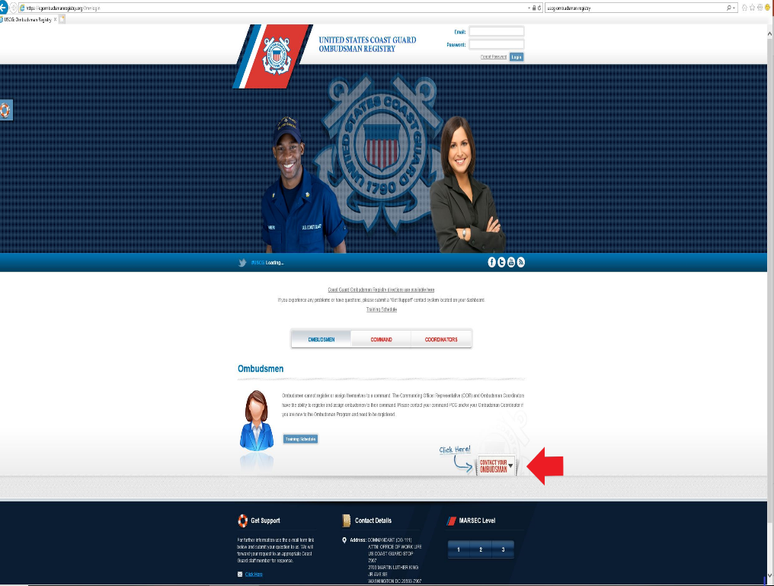
Ombudsman
Your unit Ombudsman connects families with the Command. They have current information to share, and can help ease the PCS challenges.
Ombudsman are appointed by the unit command to provide information on unit updates provided by Commands, local resources and referrals to non-profit organizations. The information and referrals serve as a significant source of support to dependents.
Connect the incoming personnel and family with the Ombudsman to promote a smooth move!
https://cgombudsmanregistry.org/?m=login
Notes:
Most units have an Ombudsman who has received formal training and been appointed by the unit command to be a two-way link between the families and the command. They are sent information on Coast Guard programs that are relevant to families, and should have information on local resources to provide to families.

Slide 11
What to Ask?
Contact info (personal email, phone)
Would you like a welcome package mailed to you?
If so, get mailing address and provide to TRM
When do you arrive?
What are your plans for housing?
Have you requested government housing, or if not preferred, a release so that you can get BAH?
Marital status?
Children? Ages? (Need childcare/school info?)
Home of Record? (Where is the member’s family support?)
Family health concerns? Is anyone enrolled in Special Needs?
Financial concerns?
Notes:
What do you need to know to be a good sponsor?
Some information you are providing to the incoming member will be about the general area and unit, but by collecting some basic information about this person and their family you can be proactive and individualize what you share verses information overload.
The first critical exchange is sharing contact information; I suggest that you share your personal contact information (phone and email), as this will help you remain in contact during the move. I am not suggesting that you make yourself available at all hours, but the best time to talk and focus may be after duty hours. When sharing email and phone numbers, you may also discuss the best times for both of you to talk.
Find out about their family and their general needs. Ask about their interests. Maybe you can highlight some fun things to do in the area.
If you are both married, would it be helpful for your spouses to talk?

Slide 12
FOLLOW UP
Unit and community integration is a 12 month process
Check in with member regularly after arrival, weekly for first 8 weeks, monthly until 12 months from initial contact has passed
Provide requested information (or follow up on referrals to requested info)
Remember to provide information on:
Update address with USPS
Update DEERS
Update TRICARE
Direct Access
CGPAAS
Primary Care Manager
Alert Warning System
Notes:
Follow through and follow up!
You made contact with incoming member, you have assessed their needs for the move, and you have provided them with the information and referrals; but your job is not over, just yet. It is important that you continue to check in with the member throughout this process - even after they have arrived. Moving is stressful and there are many things to think about; it is easy for things to fall through the cracks. Help them out by being the person on the outside looking in, help them to remember things like – Did they submit their forwarding address to the post office? Did they update their TriCare information in DEERS?
Stay in contact with the member, help them through this process and help them to get settled into their new community.
Once you are starting to wrap up this process with the member, it is a good time to check in with your supervisor. Provide feedback: What went well? What additional resources would have been helpful to you as the sponsor?
Advocate for yourself with the incoming member. Throughout this process, it is okay to set boundaries; your availability and what you are able to do for them. Though remember, if you have said you will do something, it is important to follow though.
Once you have completed your role as a sponsor, consider including it as a bullet on your evaluation. You have picked up an extra role and helped out your shipmate.

Slide 13
Sources of Support
USCG Work-Life Office – 310-521-6117 extension 313
CGSuprt
www.cgsuprt.com; 1-855-247-8778
Navy Fleet and Family Support Center
https://www.navylifepnw.com/ffsp
Social service programs such as spouse employment, parenting classes and groups
Directorate of Personnel and Family Readiness
Joint Base Lewis-McChord; 253-967-3633
https://jblm.armymwr.com/categories/community-support
Lending closet for temporary household goods, spouse employment, parenting classes and groups
Notes:
There are many additional resources available to you as the sponsor and to the incoming person. There is no way to capture them all on one slide, but the few that are listed here are general overviews and able to provide a lot of information. Your Work-Life team is here to support you. Does your unit have an ombudsman? Remember to share their contact information as well.
CGSUPRT continues to be a resource through all stages of your Coast Guard career; for not only the member, but also their family.
In this area we have local DOD partners available to provide support to our community. The Navy provide services similar to Work-Life through the Fleet & Family Support Center. Our Army & Air Force partners provide services at Joint Base Lewis McChord through the Armed Forces Community Service program.
Thank you very much for being a part of the Command Sponsor Program.

