Slide 1
New Employee Orientation
Module 1: DHS Overview
Rev. 8-28-2015
Notes:
In this presentation, you will learn a little about the history of the Department of Homeland Security, its mission areas, and about the components that work to achieve that mission.

Slide 2
DHS History
September 11, 2001 – Terrorists attack the United States
October 8, 2001 – President George W. Bush creates the White House Office of Homeland Security
November 19, 2002 – Congress passes legislation mandating the Department of Homeland Security
November 25, 2002 – President Bush signs the Homeland Security Act into law
January 24, 2003 – DHS becomes operational
March 1, 2003 – Largest merger of agencies becomes DHS
Notes:
While there had been several incidents in the years prior to 2001, the events of September 11 brought the need for a centralized collaborative approach to protecting the Nation. Over an 18-month period, Congress and the President took swift action to stand-up the Department of Homeland Security. The Department became the largest merger of agencies since the Department of Defense merged Cabinet-level agencies in the 1940s.

Slide 3
Defining Homeland Security
“The Department is a multi-mission, multi-function agency, covering long-standing functions such as civil defense, emergency response, customs, border control, law enforcement, and immigration.”
2014 Quadrennial Homeland Security Review
Notes:
The Department of Homeland Security is leading efforts to protect the Nation along with federal, state, local, and tribal partners. Homeland security involves a collaborative approach to protecting the Nation from terrorism; planning and responding to emergencies; ensuring legitimate crossing of our borders; and offering citizenship benefits to those who qualify.

Slide 4
DHS Vision
“A homeland that is safe, secure, and resilient against terrorism and other hazards where American interests, aspirations, and way of life thrive.”
2014 Quadrennial Homeland Security Review
Notes:
In 2014, DHS released its second Quadrennial Homeland Security Review (QHSR) that details the Department’s mission over a four-year period. The QHSR is the most comprehensive analysis of the Nation’s security ever, and outlines the strategic framework to guide participants in homeland security toward a common goal. The QHSR focuses on three key concepts that are essential to, and form the foundation for, a comprehensive approach to homeland security, specifically, security, resilience, and customs and exchange.

Slide 5
DHS Five Mission Areas
Mission 1: Preventing Terrorism and Enhancing Security
Mission 2: Securing and Managing Our Borders
Mission 3: Enforcing and Administering our Immigration Laws
Mission 4: Safeguarding and Securing Cyberspace
Mission 5: Ensuring Resilience to Disasters
Notes:
The QHSR identified five mission areas that are the center of all activities for homeland security, and are not limited to DHS. The QHSR does provide the framework from which the Department sets its mission and priorities, including creating collaborative relationships with federal, state, local, tribal, and territorial governments.
Each of these mission areas has two or more goals associated with it. It is important that you understand the QHSR and the role it plays in setting our strategic framework, so the document is part of your required reading list.

Slide 6
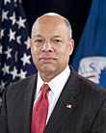
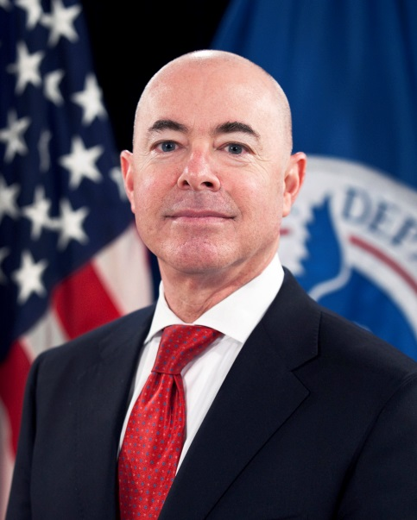
DHS Leadership
Jeh Johnson, Secretary
Alejandro Mayorkas, Deputy Secretary
Notes:
The Department is led by Secretary Jeh Johnson. He was sworn in on December 23, 2013 as the fourth Secretary of Homeland Security. Prior to joining DHS, Secretary Johnson served as General Counsel for the Department of Defense, where he was part of the senior management team and led the more than 10,000 military and civilian lawyers across the Department. As General Counsel of the Defense Department, Secretary Johnson oversaw the development of the legal aspects of many of our nation’s counterterrorism policies, spearheaded reforms to the military commissions system at Guantanamo Bay in 2009, and co-authored the 250-page report that paved the way for the repeal of “Don’t Ask, Don’t Tell” in 2010. Secretary Johnson’s career has included extensive service in national security, law enforcement, and as an attorney in private corporate law practice. Secretary Johnson was General Counsel of the Department of the Air Force from 1998 to 2001, and he served as an Assistant U.S. Attorney for the Southern District of New York from 1989 to 1991.
In private law practice, Secretary Johnson was a partner with the New York City-based law firm of Paul, Weiss, Rifkind, Wharton & Garrison LLP. In 2004, Secretary Johnson was elected a Fellow in the prestigious American College of Trial Lawyers, and he is a member of the Council on Foreign Relations. Secretary Johnson graduated from Morehouse College in 1979 and received his law degree from Columbia Law School in 1982.
Deputy Secretary Alejandro Mayorkas was sworn in as Deputy Secretary of Homeland Security on December 23, 2013. Since 2009, following his nomination by President Obama and subsequent confirmation, Deputy Secretary Mayorkas served as the Director of the Department of Homeland Security’s United States Citizenship and Immigration Services (USCIS), the agency charged with operating the largest immigration system in the world. In that position, he led a workforce of 18,000 members throughout more than 250 offices worldwide and oversaw a $3 billion annual budget. While at USCIS he oversaw a number of important programs and enhancements, including the implementation of Deferred Action for Childhood Arrivals (DACA) as well as important reforms that safeguard our nation’s security, and ensure the integrity of the immigration system.

Slide 7
Top Strategic Priorities - Internal
Strengthening Departmental Unity of Effort
Building the Department You Deserve

Slide 8
Unity of Effort
“Resource constraints also provide the impetus to build and mature our organization into one that is greater than the sum of its parts – one that operates with much greater unity of effort.”
Secretary Johnson, Unity of Effort memorandum, April 22, 2014

Slide 9
Strengthening Unity of Effort
Goal: To enhance the cohesion of the department by:
Building on the department’s many strengths, most notably, the professionalism, skill and dedication of its people
Honoring the rich history and tradition of its components
Deploying transparent and unified decision-making processes that leverage analytics
Approach:
Inclusive discussion and decision-making forums
Strengthened management processes
Collaborative strategy, planning and analytic capability
Enhanced coordination to effectively harness department resources
Notes:
Accomplishing these missions requires unity of effort—both across every area of DHS activity and among the numerous homeland security partners and stakeholders.

Slide 10
Building the Department you Deserve
Goal: A department culture that supports and champions employees’ service, resulting in them feeling fulfilled, appreciated and empowered with responsibility and opportunity.
Focus areas for fiscal years 2014-2015:
Transparent and clear hiring and promotion processes
Quality training and professional development to enable job performance
Rewards and recognition to acknowledge strong performance
Performance management that promotes priorities and values and drives accountability
Communication that strengthens our connections to each other and to the mission

Slide 11
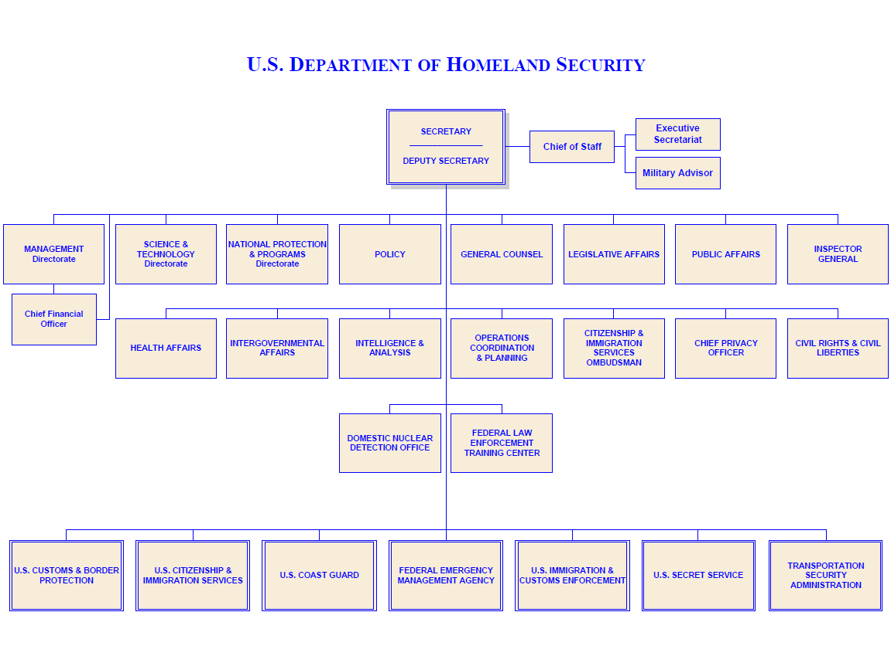
DHS Organization
Notes:
DHS is a very robust organization, with many components, directorates, and offices working together to achieve the mission. This chart depicts the current infrastructure of the Department. On the bottom of the chart are the seven operational components, each with its own distinct organizational and mission. The remaining boxes on the chart represent headquarters for DHS. We will discuss this in more detail in the coming slides.

Slide 12
Office of the Secretary
Privacy Office (PRIV)
Civil Rights and Civil Liberties (CRCL)
Office of Inspector General (OIG)
Citizenship and Immigration Services Ombudsman (CISOMB)
Office of Legislative Affairs (OLA)
Office of the General Counsel (OGC)
Office of Public Affairs (OPA)
Office of Executive Secretariat (ESEC)
Military Advisor’s Office (MIL)
Office of Intergovernmental Affairs (IGA)
Notes:
The Office of the Secretary oversees activities with other federal, state, local, and private entities, and consists of multiple offices that each contribute to the overall mission.
The Privacy Office works to preserve and enhance privacy protections for all individual, to promote transparency of DHS operations, and to serve as a leader in the privacy community.
Civil Rights and Civil Liberties provides legal and policy advice on issues relating to civil rights and liberties and investigates and resolves complaints. They also lead Equal Employment Opportunity Programs.
The Office of Inspector General is responsible for conducting and supervising audits, investigations, and inspections relating to the programs and operations of DHS.
The CIS Ombudsman provides recommendations for resolving individual and employer problems to ensure national security and the integrity of the legal immigration system.
The Office of Legislative Affairs serves as primary liaison to members of Congress and their staffs, and the White House and Executive Branch.
The Office of the General Counsel integrates approximately 1,700 lawyers from throughout DHS into a full service legal team, and includes an ethics division.
The Office of Public Affairs coordinates public affairs activities across all components and serves as the lead public information office during a national emergency or disaster.
The Office of the Executive Secretariat (ESEC) provides all manner of direct support to the Secretary and Deputy Secretary, as well as related support to leadership and management across the Department. This support takes many forms, the most well known being accurate and timely dissemination of information and written communications from throughout the Department and our homeland security partners to the Secretary and Deputy Secretary.
The Military Advisor’s Office advises on facilitating, coordinating and executing policy, procedures, and preparedness activities and operations between DHS and the Department of Defense.
Finally, the Office of Intergovernmental Affairs promotes an integrated national approach to homeland security by ensuring, coordinating, and advancing federal interaction with state, local, tribal, and territorial governments.

Slide 13
Headquarters Components
National Protection and Programs Directorate (NPPD)
Science and Technology Directorate (S&T)
Management Directorate (MGMT)
Domestic Nuclear Detection Office (DNDO)
Federal Law Enforcement Training Center (FLETC)
Office of Policy (PLCY)
Office of Health Affairs (OHA)
Office of Intelligence and Analysis (I&A)
Office of Operations Coordination and Planning (OPS)
Notes:
In addition to the individual offices within the Office of the Secretary, there are several Headquarters components that coordinate activities across the enterprise. The National Protection and Programs Directorate works to advance the Department’s risk-reduction mission. Science and Technology is the primary research and development arm of DHS. Management is responsible for anything to do with budget and finance, human resources, IT systems, facilities, and tracking of performance measures.
The Domestic Nuclear Detection Office works to enhance the nuclear detection efforts of all government agencies and the private sector to ensure a coordinate response to such threats. The Federal law Enforcement Training Center provides career-long training to law enforcement professionals to help them fulfill their responsibilities safely and proficiently. Policy formulation and coordination activities are centralized through the Office of Policy. Medical activities are coordinated through the Office of Health Affairs. The Office of Intelligence and Analysis is responsible for using information and intelligence from multiple sources to identify and assess current and future threats to the Nation.
Finally, the Office of Operations Coordination and Planning is responsible for monitoring the security of the Nation on a daily basis and coordinating activities within DHS and with governors, Homeland Security Advisors, law enforcement partners, and critical infrastructure operators in all 50 states.

Slide 14
Operational Components
Customs and Border Protection (CBP)
Federal Emergency Management Agency (FEMA)
Immigration and Customs Enforcement (ICE)
Transportation Security Administration (TSA)
U.S. Citizenship and Immigration Services (USCIS)
U.S. Coast Guard (USCG)
U.S. Secret Service (USSS)
Notes:
[SKIP OVER YOUR COMPONENT-SPECIFIC NOTES IF PROVIDING AN OPTIONAL COMPONENT-SPECIFIC BRIEFING.]
Headquarters does not work to achieve the mission alone. As you have seen in the previous three slides, the Office of the Secretary and Headquarters is often the coordinating arm of all DHS activities. There are seven operational components within DHS, each with its own mission that aligns to the five QHSR mission areas.
Customs and Border Protection is responsible for protecting our Nation’s borders in order to prevent terrorists and terrorist weapons from entering the United States, while facilitating the flow of legitimate trade and travel. The Federal Emergency Management Agency prepares the Nation for hazards, manages federal response and recovery efforts following any national incident, and administers the National Flood Insurance Program.
Protection of the nation’s transportation systems, not just airports—to ensure freedom of movement for people and commerce is the responsibility of the Transportation Security Administration. United States Citizenship and Immigration Services is responsible for the administration of immigration and naturalization adjudication functions and establishing immigration services policies and priorities.
The United States Coast Guard protects the public, environment, and economic interests in the Nation’s ports and waterways in any maritime region as required to support national security. Finally the United States Secret Service not only protects the President and other high-level officials, but investigates counterfeiting and other financial crimes and computer fraud. They are extremely involved in security planning for highly visible events, such as the political conventions, Olympics, and Super Bowl.

Slide 15
To learn more about DHS:
Connect (http://dhsconnect.dhs.gov)
www.dhs.gov
Quadrennial Homeland Security Review (QHSR)
DHS Strategic Plan for Fiscal Years 2012-2016
DHS Human Capital Strategic Plan for Fiscal Years 2015-2019
DHS-101
Notes:
As a DHS employee, there are many resources available so that you can learn more about the Department, its mission, and your component’s role in protecting the Nation. When you arrive at your duty station, you can access Connect, the Department’s communications intranet portal. You should also visit www.dhs.gov, the publicly accessible site of DHS. Included in your required reading assignments is the QHSR and the Department’s strategic plan. Enterprise Learning and Development offers a two-day course entitled DHS-101, which explores each component and/or office more in-depth.
Your DHS New Employee Orientation continues with presentations on employee rights and responsibilities, emergency preparedness, benefits, mandatory training, ethics, and your initial security briefing. Your component and/or specific office may have additional briefings for you.

Slide 16
Oath of Office
I (state your name) do solemnly swear
(or affirm) that I will support and defend
the Constitution of the United States against all
enemies, foreign and domestic; that I will bear
true faith and allegiance to the same; that I take
this obligation freely, without any mental
reservation or purpose of evasion; and that I will
well and faithfully discharge the duties of the
office on which I am about to enter.
So help me God.

