Slide 1


U.S. Department of Homeland Security
Employee Preparedness
New Employee Orientation Module 3
Rev. 8-28-2015
Notes:
One of the best ways to help ensure the Department of Homeland Security is ready to face natural or man-made disasters is to recognize that our people come first—that employees need to take care of themselves and their families before they are able to think about work. So, in this presentation, we’ll discuss some basic steps that we can take now to better prepare ourselves and our families for emergencies that could threaten our homes, our workplaces, and our communities.
As we discuss emergency preparedness, we won’t be talking about buying a gas mask, donning a chemical suit, or digging a bomb shelter in your backyard—but rather, some very basic steps that you can take today that really will make a difference if you ever find yourself in an emergency situation.
Much of what we will be discussing today echoes advice from the Ready campaign, online at Ready.gov. At the end, I’ll provide some additional Web sites where you can go to get further information about emergency preparedness.
[ENSURE YOU HAVE ON HAND THE “PREPARING MAKES SENSE – GET READY NOW” BROCHURE FROM READY.GOV (SEE ORDER FORM AT
http://www.ready.gov/document/ready-order-form-dec-2011
CLICK ON READY PUBLICATION ORDER FORM - INVENTORY #9-0974)]

Slide 2
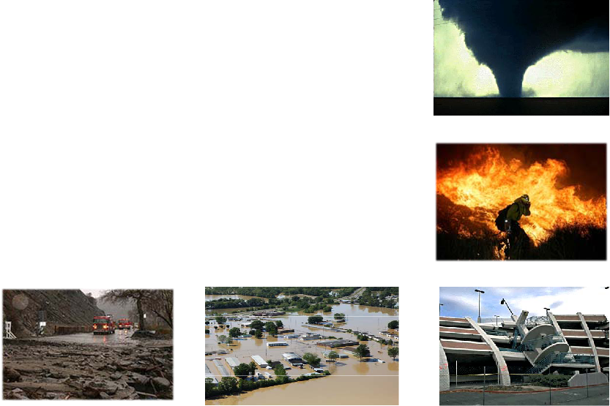
Preparing makes sense.
Get ready now.
Important to be prepared for possible disasters and other emergencies
Natural or human-caused disasters can strike suddenly, at anytime and anywhere
There are three actions anyone can take that can help make a difference…
Notes:
So, why prepare?
Well, emergencies and disasters—natural and man-made—can happen at any time, without warning. And while your local, state and federal governments, along with disaster relief organizations, are committed to helping people in need, that assistance may sometimes be delayed in times of disaster. That’s why it’s important for you and your family to be prepared. If you want to be in a position to help yourself—and especially if you want to be in a position to help others, like colleagues, neighbors, or family—then now is the time to get ready.
Preparing for the unexpected makes sense. And, there are three simple steps you can follow that can make a big difference in a wide range of disasters…

Slide 3
Three Steps
Get a kit.
Make a plan.
Be informed.
Notes:
…Get a kit, make a plan, and be informed.
We’re now going to show a short video that introduces these three steps, and how they can help keep you and your family safe.
[START READY VIDEO – http://www.fema.gov/media-library/assets/videos/78834 – ENSURE SPEAKERS ARE CONNECTED AND TURNED UP]
For additional information, use the following links:
http://www.ready.gov/america/getakit/index.html
http://www.ready.gov/america/makeaplan/index.html

Slide 4

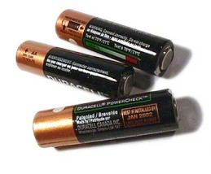
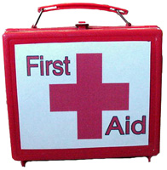

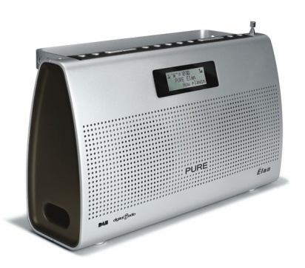

Get a Kit.
Get a kit
Make a plan
Be informed
Your Kit for Home
Water
Food (and a manual can opener)
Flashlights and batteries
First aid kit
Battery-powered radio
Duct tape
Plastic sheeting
Notes:
Now let’s talk a bit more about those three steps.
First: Get a kit. As you saw in the video, it’s a good idea to prepare a kit of basic emergency supplies to keep at home.
Be prepared to improvise and use what you have on hand to make it on your own for at least three days, maybe longer. While there are many things that might make you more comfortable, think first about the basics, like water and food.
An emergency preparedness kit contains items that you may need if you are confined to your home for an extended period of time (such as after a disaster or during a winter storm), or if you are told to evacuate on short notice.
[REFER EMPLOYEES TO BROCHURE FOR COMPLETE LIST OF ITEMS TO INCLUDE IN KIT]

Slide 5
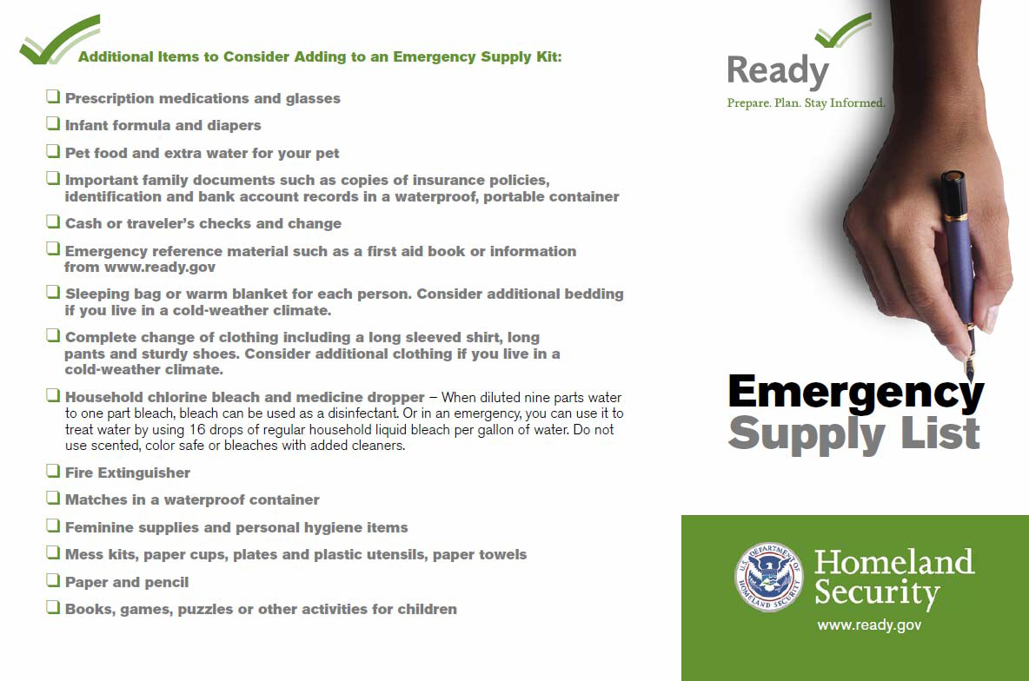
Home Kit (cont’d)
Get a kit
Make a plan
Be informed
Clothing and bedding
Medications
Cash
Important papers
Contact information and a map
Pet supplies & shot records
  Photocopies of important documents
Notes:
Assemble all these items in one place, and then keep your kit where it is easily accessible. Your items should all be stored in a container that’s easy to find and easy to move, like the large plastic tub you saw in the video. You may want to keep your kit where you’re likely to take shelter during a storm, such as in a basement, or near your car, in case you need to evacuate quickly.
If one big kit is too difficult to move, consider two smaller kits.
Once you have your kit, be sure to check it every six months and replace expired or outdated items. Check expiration dates of food, water, and medication… check batteries… and change out the clothing you have to make sure it’s weather-appropriate. And yes, even bottled water can go bad—it’s typically good for up to five years from the date it was packaged.
Also to consider to add to the kit would be copies (or originals) of important documents to include insurance, passports, marriage / divorce/ adoption orders, medical records, drivers license, vehicle registrations, certifications for a responder.
An animal emergency supply kit should be prepared to include food, water, medicines, first aid kit, pet litter and litter box, crate, sanitation.
Please note that food, baby supplies, and water be rotated regularly. They may want to make these rotations when they change their smoke detector batteries or move their clocks forward or backwards when Standard Time changes to Daylight Savings Time.

Slide 6
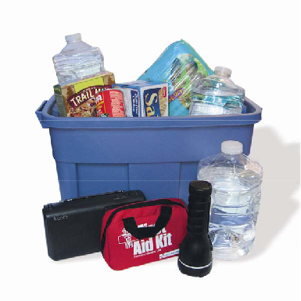

Your Kit for the Office
Get a kit
Make a plan
Be informed
Water and non-perishable food
Flashlight
First aid kit
Whistle
Dust mask
Change of clothing
Rain gear
Comfortable walking shoes
Blanket
Medications
Notes:
Now, it’s also a good idea to keep some basic emergency supplies at the office. But what you keep at the office may be a little different from what you keep at home.
Just like you may buy your own umbrella and keep it at the office in case it rains, it’s a good idea to keep some other basic emergency supplies at work in case something else unexpected happens.
Your kit for the office should contain:
water and non-perishable food
flashlight
first aid kit
whistle to attract attention
dust mask
change of clothing
rain gear; and
comfortable walking shoes—in case you need to walk home or go to another meeting place

Slide 7
Make a Plan.
Get a kit
Make a plan
Be informed
Learn the Plan at Work
Two initial decisions for protection:
  STAY
  GO
Determine whether it’s safer to go outside or safer to stay inside.
  Evacuation of building or area (e.g., if there’s a fire in the building)
  In-place protection (e.g., chem bio attack, civil disturbance on the street)
If you are not in immediate danger, stay safe where you are and get more information.
In any event, TAKE YOUR KIT!
Notes:
Most responses to emergencies really come down to variations on one of two basic protective actions—because either it’s safer to go outside, or it’s safer to stay inside.
These two protective actions are called evacuation, and in-place protection (also known as “sheltering in place”).
Evacuation is the simpler of the two concepts. You’ve probably been doing fire drills since elementary school. Just keep in mind that you may need to evacuate the building for other reasons besides fire—for example, a bomb threat, or the internal release of a dangerous chemical.
When you hear the fire or evacuation alarm sound, go to the nearest safe exit. Follow instructions from your Floor Monitor and others in your building’s Occupant Emergency Organization.
Stay to the right in stairwells, to allow emergency responders to ascend the stairs while you are evacuating. Once you are clear of the building, go to the appropriate rally point and check in with your supervisor. Do not panic, but move swiftly, and treat every drill as if it were real.

Slide 8
Learn the Plan (cont’d)
Get a kit
Make a plan
Be informed
In-Place Protection
Maintain a barrier between yourself and any dangerous conditions
Stay calm; be patient
Assist others
Await further information
Notes:
If in-place protection orders are issued, move promptly, just as you would if the fire alarm went off. Grab your emergency preparedness kit and other personal belongings (like your keys, purse, medication, etc.)—unless you believe they have been contaminated. Then go to the predetermined safe area in your building, closing and locking your office doors behind you. Await further guidance from your Floor Monitor or other members of the building’s Occupant Emergency Organization.
Be prepared to improvise and use what you have on hand to maintain a barrier between yourself and any contamination. You should also attempt to contact anyone from your office who may have gone to lunch, or any expected visitors, to inform them of the protective action and advise them to seek appropriate shelter.
Be prepared to assist anyone who has special needs, or who may be vulnerable to extreme heat or cold.
It may take authorities some time to provide information on what is happening. Try to remain calm and be patient.
In earthquake areas special consideration should be made towards areas where voids are likely to be created or exist for refuge during a collapse
Be sure to talk to the occupant emergency program coordinator for the building in which you work for more information and unique procedures that may be specific to your work site.

Slide 9
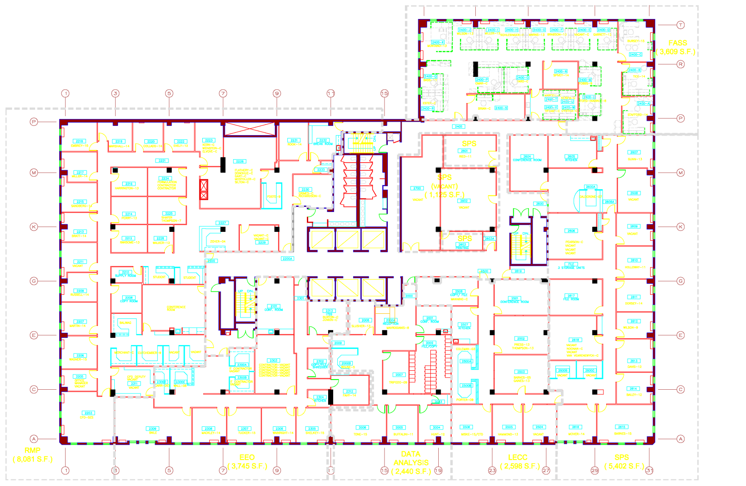
Sample safe area for in-place protection
(away from windows and exterior walls)
Get a kit
Make a plan
Be informed
Notes:
In this sample floor plan of an office building, the shaded area indicates the designated “safe area” – away from windows and exterior walls. Follow the specific procedures in your building to locate the designated safe area.

Slide 10

Make a Plan.
Get a kit
Make a plan
Be informed
Make a Family Emergency Plan
Your family may not be together when disaster strikes, so it is important to plan in advance:
  What you would do in different situations?
  How you would contact one another?
  How you would get back together?
Talk to your child’s school, caregiver
  What’s the plan?
  How they will communicate with families?
Notes:
Discuss with your family the disasters that can happen where you live. Decide what you and your family will do when your daily routines are disrupted by an emergency.
Your family may not be together when disaster strikes, so it is important to plan in advance: What you would do in different situations; how you would contact one another; and how you would get back together.
Plan together what each person is expected to do, where everyone will go, and how to get there. Establish responsibilities for each member of your household and plan to work together as a team.

Slide 11
Make a Family Emergency Plan (cont’d)
Get a kit
Make a plan
Be informed
Sit down as a family and plan in advance what each family member will do in an emergency.
Use Ready.gov template provided.
Keep copies of Plan at home, at work, provide to a relative.
Don’t wait for an emergency to make these decisions!
Notes:
That wraps up “learning the plan” at the office. Now let’s talk about your home.
There are many great resources out there to help with making a plan. Ready.gov has a good template for developing a plan. There are two components to the plan: a full page sheet that you should complete with your family and then put the plan into your emergency supply kit and then smaller cut out cards that you can keep in your wallet, purse or backpack.

Slide 12
Make a Family Emergency Plan (cont’d)
Get a kit
Make a plan
Be informed
Share emergency contact numbers.
If you need to get away, plan in advance how you will meet and where you will go.
  Pick two meeting locations: a place near your home, and a place outside your neighborhood.
Establish an out-of-town point of contact where family members can check in with someone not impacted by the emergency.
Notes:
Pick two family meeting locations: a place right outside your home, in case of a sudden emergency, such as a fire; and a place outside your neighborhood, in case you cannot return home or must evacuate the area.

Slide 13
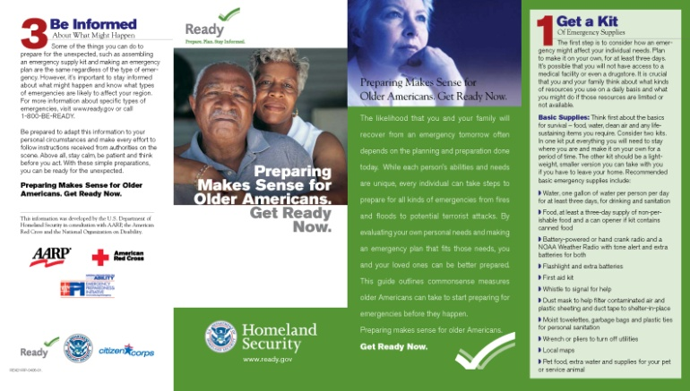
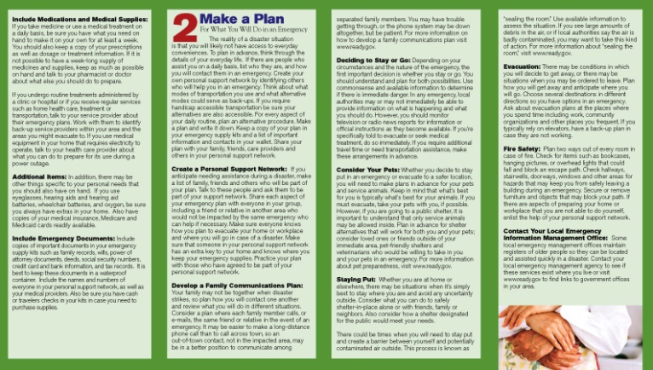
Make a Family Emergency
Plan (cont’d)
Get a kit
Make a plan
Be informed
Special Considerations
Consider your family’s unique needs
Develop an emergency plan that considers each person’s unique needs, including a personal support network to call on in the event of an emergency
Don’t forget special needs – medications, medical equipment, eye glasses
Notes:
As you develop your family plan, you need to consider those family members who already depend on you for care (i.e. family members who may have physical or mental limitations). FEMA has developed a wonderful brochure to assist with planning for individuals with disabilities and other special needs. One important factor is to develop a support network to assist older Americans and individuals with disabilities or other special needs.
As we mentioned earlier, make a specific plan for your animals. If you are not able to get home, make sure you have a friend or neighbor take your pets if they must evacuate or care for them if you are unable to get home for a few days.
Plan for your pets in case of emergency and plan how you will assemble your pets and anticipate where you will go; develop a buddy system for your pets with your neighbors friends or relatives; talk to your Vet about emergency planning considerations; gather contact information about for emergency animal treatment.

Slide 14
Family Communications Plan (cont’d)
Get a kit
Make a plan
Be informed
Consider a plan where each family member contacts the same out-of-town friend or relative
  May be easier to make a long distance call
  Try SMS (cell phone text messaging) or e-mail
TO: 202 555 1212
I'm ok. on my way to Aunt Ethel’s. see you there.
Notes:
Develop a family communications plan.
Consider a plan where each family member calls, e-mails, or messages the same friend or relative.
It may be easier to make a long distance phone call than to call across town, so an out-of-town contact may be in a better position to communicate among separated family members. Be sure each family member knows the phone number and has coins or a prepaid phone card to call the emergency contact. You may have trouble getting through, or the phone system may be down altogether, but be patient. Also try other means of communication.
Try SMS (cell phone text messaging), e-mail, or even online instant messages. If traditional landline or cell phone systems are overloaded, you may still be able to send a text message.
Still, you may not be able to contact your loved ones during an emergency, so you need to have default actions: If you can’t communicate, does everyone know where to meet? And if plan A fails, what’s plan B?
Here’s an example. I might go to my family meeting point, taking my emergency preparedness kit, and send a text message to my out-of-town emergency contact to tell him I’m okay, where I am, and what I’m planning to do next.
Depending on your circumstances and the nature of the emergency, the first important decision is whether you stay put or get away. You should understand and plan for both possibilities.

Slide 15
Be Informed.
Get a kit
Make a plan
Be informed
How local authorities will inform the public about an incident
Know region-specific procedures – shelters, evacuation routes
Know different ways to get where you need to go
Notes:
Now let’s talk about the third step: Be Informed.
Some of the things you can do to prepare for the unexpected, such as making an emergency supply kit and developing a family communications plan, are the same for both a natural or man-made emergency.
However, there are important differences in some emergencies that will impact the decisions you make. Learn more about the potential emergencies that are most likely to occur in your area and the appropriate way to respond to them.
Also, identify how local authorities will notify you during a disaster and how you will get important information—whether through local radio, television, or NOAA weather radio. Methods of getting your attention vary from community to community. You might get an emergency text alert, hear a special siren, get a telephone call—or emergency workers may go door-to-door.
Contact your local Office of Emergency Management or your local chapter of the American Red Cross for more information about your community.
Some local governments have Web sites that allow you to register e-mail addresses, cell phones, pagers, and other devices to receive emergency text alerts. If such a service is available where you live or work, sign up right away, and tell the rest of your family to sign up as well.

Slide 16
Links for Alert Systems
Get a kit
Make a plan
Be informed
Notes:
[INSERT LIST OF YOUR CITIES ALERT AND NOTIFICATIONS URLS / WEBSITES
Example:
Washington, DC: http://alert.dc.gov/
Montgomery County: http://alert.montgomerycountymd.gov/]

Slide 17
Sign up for Emergency Alerts
Get a kit
Make a plan
Be informed
Sign up for emergency e-mail and text message alerts from the local community where you work
You should also sign up for emergency alerts where you live
Tell your family members and other loved ones to sign up as well
Check with your state and local authorities for links to local government alert systems where you live

Slide 18
Evacuations
Get a kit
Make a plan
Be informed
Stay where you are unless directed to evacuate.
Your best initial action is to “shelter in place” and stay attentive to media broadcasts.
Be prepared to walk or use transit.
If you have a car, try to keep at least a half tank of gas in it at all times, especially when you’re aware of a threat.
Notes:
Plan how you will assemble your family and anticipate where you will go. Consider several destinations in different directions so you have options in an emergency.
Also, consider different eventualities. What if it’s only safe to evacuate to the north, for example? Or what if a river is flooded, and a main bridge is closed?
If you have a car, try to keep a half tank of gas in it at all times in case you need to evacuate. Familiarize yourself with alternate routes, and other means of transportation out of the area.
If you do not have a car, plan how you will leave if you have to.
Take your emergency supply kit, and lock the door behind you.
Take your pets with you. If it’s not safe for you to remain, it’s not safe for them. But understand that only service animals may be permitted in public shelters.
If time allows, call or e-mail your out-of-state contact in your family communications plan, and tell them where you are going. If there is damage to your home or you are instructed to do so, shut off water, gas and electricity before leaving. Leave a note telling others when you left, and where you are going, and check with neighbors who may need a ride.
Like your office, schools and daycare centers should have site-specific emergency plans. Ask about the plans in place. Ask about their default actions in different emergency situations. You don’t want to be planning to pick up your child if his or her school will be locked down. And find out how the school will communicate with parents in an emergency.

Slide 19
Evacuation Route Information
Get a kit
Make a plan
Be informed
Notes:
[INSERT EVACUATION ROUTE INFORMATION AND MAPS, IF APPLICABLE; OTHERWISE DELETE SLIDE]

Slide 20
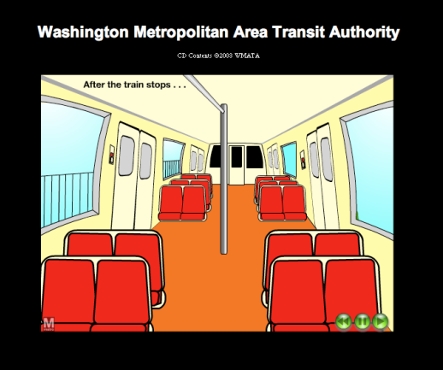
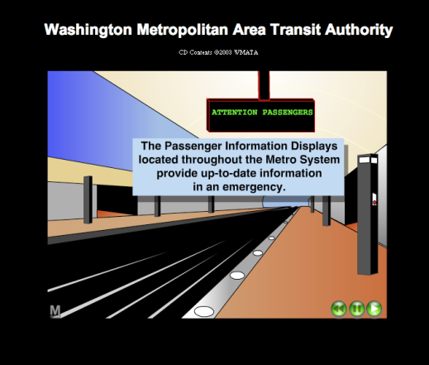
Metro Emergency
Get a kit
Make a plan
Be informed
To report an emergency in the Metro, call Metro Transit Police at [insert number]
Know where emergency intercoms are located
Be familiar with emergency exit procedures
See the Metro web site for short safety animations
Notes:
[UPDATE INFORMATION IF METRO IN YOUR AREA; OTHERWISE DELETE SLIDE]

Slide 21
Alternate Modes of Travel
Get a kit
Make a plan
Be informed
Take time now to learn alternate routes and ways to get where you need to go
Keep a local map with you in case you need to walk or take another form of transportation
Check the Metro Web site at www.metroopensdoors.com for current information on service changes, station closings, etc. – or call (202) 637-7000
Notes:
[INSERT METRO INFORMATION FOR YOUR AREA IN BULLET THREE OR REMOVE]

Slide 22
Three Steps to being Prepared
Get a kit
Make a plan
Be informed
Get a kit.
  For Home
  For Work
Make a plan.
  At Work: Occupant Emergency Plan
  At Home: Family Plan
  Have a family communications plan
Be informed.
  Emergency Text Alerts
  City Evacuation Routes
  Public transit options
Notes:
Okay, we talked about three steps you can take to prepare for emergencies.
We talked about getting a kit of emergency supplies…
About making a plan for what you will do in an emergency…
And about being informed of what might happen, and how best to respond.
So, take these three simple steps now to prepare yourself and your family.

Slide 23

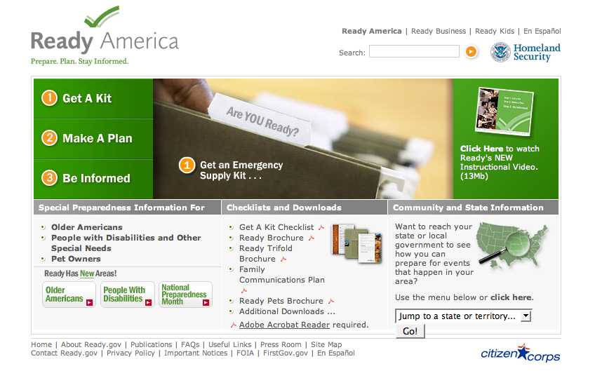
Resources
Get a kit
Make a plan
Be informed
www.ready.gov
http://dhsconnect.dhs.gov, click the
Notes:
If you would like more information, visit ready.gov or go to Connect and click on the green check mark.
Remember, NOW is the time to prepare. Stay safe!

Slide 24
Pass the Word…
Get a kit
Make a plan
Be informed
Pass along this information to your family members.
Provide the information to your Home Owners’ Association, your child’s class, Boy or Girl Scout Troops.
Make sure that your child’s day care provider, sports team, summer camp, your dog’s boarding kennel – all have emergency plans and know what they are.
The more that the people around you are prepared for an emergency – the easier it will be to execute your own plan.
Notes:
Share what you’ve learned with your family and friends. Don’t wait until you’re in the middle of a crisis to prepare.
Preparedness doesn’t just serve you. If you don’t need help in an emergency, someone else might. Next, we’ll cover opportunities for you to serve those affected by disasters when the need is greatest.

Slide 25

U.S. Department of Homeland Security
Surge Capacity Force
Rev. 12-4-2015
Notes:
As federal employees, we are committed to serving our nation through our agency’s mission. However, there may be times when we can serve in a different capacity. It is the mission of the Federal Emergency Management Agency (FEMA), a component of the Department of Homeland Security (DHS), to prevent, mitigate, respond to and recover from disasters, whether natural or manmade. In very rare circumstances, a disaster may occur that is of such magnitude that even FEMA’s disaster reservist workforce may not be enough to meet the needs of those impacted by the event.
In circumstances as exceptional as these, the Surge Capacity Force, or SCF, will back up FEMA’s reservists with an employee force willing to be deployed to a disaster location to help with response and recovery. The SCF is a FEMA-led volunteer program for employees who want to help where the need is greatest in support of natural disasters, acts of terrorism, and other man-made disasters, including catastrophic incidents. The SCF will assist FEMA with response and recovery in the aftermath of a catastrophic event.
The Post Katrina Emergency Management Reform Act directs the DHS Secretary to create an employee volunteer force, with employees from throughout the Department and other federal agencies, to staff a Surge Capacity Force. During a declared disaster, the DHS Secretary will determine if SCF support is necessary. The Secretary will then authorize FEMA to task and deploy eligible volunteer personnel from DHS components and other Federal Executive Agencies.

Slide 26
Surge Capacity Force (SCF)
Eligibility
  Permanent, full-time or temporary, full-time DHS federal employees
Requirements
  Supervisor approval to complete the five mandatory training courses
  Supervisor approval to register as a member
  Active and valid government travel card
  Commitment to the mission of helping disaster survivors
Types of work
  Acquisitions
  Disaster Survivor Assistance
  External Affairs
  Financial Management
  Human Resources
  Individual Assistance
  Information Technology
  Logistics
  Public Assistance
  Planning
Notes:
Why Join SCF?
Are you passionate about volunteering and assisting those in need? If you answered yes, you should consider joining the DHS Surge Capacity Force.
With your help, we can be ready to respond to any event or to simultaneous events, no matter how large the impact.
Joining the SCF is an opportunity for you to assist your fellow citizens during intense disasters or emergencies.
Being a part of the SCF is a special way to show your support of DHS's mission to protect the American homeland and the American people.
Not only will you make a difference in the lives of those in need, you will also learn new, valuable skills.
Currently, only DHS permanent, full-time or temporary, full-time federal employee are eligible to participate in the SCF.
In order to volunteer, you must first obtain:
Supervisor approval to complete the five mandatory training courses (independent study taken online). The five courses include:
IS-100.b Introduction to Incident Command System (ICS)
IS-102.c Deployment Basics for FEMA Response Partners
IS-35.14 - FEMA Safety Orientation
IS-700.a National Incident Management System (NIMS), an Introduction
IS-800.b National Response Framework (NRF)
Supervisor approval to register
Government travel card
All volunteers will be trained and used in any number of capacities/program areas depending on the type of event. FEMA may also reach out to individuals in the SCF that have specific occupational skills.
The short video we’re about to watch is a brief look at the work SCF volunteers from across the agency performed during Hurricane Sandy.
[play video -- http://dhsconnect.dhs.gov/news/Pages/The-Surge---A-Short-Video-about-the-Surge-Capacity-Force.aspx – Note: the video is almost 8 minutes in length.]

Slide 27
Surge Capacity Force (continued)
What to expect when deployed as a member of the SCF
  Long hours, usually 12 hours a day / 7 days a week
  Austere conditions both at work and with lodging while on deployment
  Working in a fast-paced environment with changing needs and priorities
  Once registered as a member of the SCF
  Receive a profile in FEMA Deployment Tracking System (DTS)
  You will need to be available to deploy within 24 hours of notification
  When available, you are deployable for up to 45 days
  You will be on the deployment roster for one year
  You will manage your availability in the FEMA DTS
Notes:
You should carefully consider your personal situations before volunteering (e.g., health, family, conditions while deployed, etc.). Conditions will be challenging. If SCF is activated, it means that the incident is catastrophic. Living conditions are often austere during deployments and include, but are not limited to, no running water, no electricity, sleeping in tents or other non-conventional forms of housing (e.g., ships) to include weather extremes. You should also expect long hours, usually 12 hour days, seven days a week for the duration of your deployment.
Once registered:
24 hour notice to deploy
Deployable for up to 45 days
On the deployment list for one year
Change your availability if circumstances warrant

Slide 28
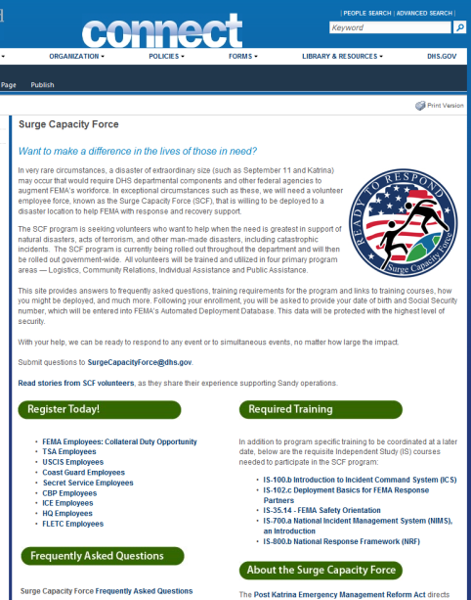
Surge Capacity Force (continued)
What you can do now
  Speak with your supervisor about your eligibility
  Complete the five, online independent study training courses
  Contact your component point of contact to register
  Make long-term plans for yourself, family, office for when you are deployed
  Be realistic regarding your ability to commit to this mission
  Take into account your personal situations (e.g., health, family, conditions while deployed, etc.) before volunteering
Helpful links
  Connect: http://dhsconnect.dhs.gov/Pages/SurgeCapacityForce.aspx
  FEMA SCF Mailbox: surgecapacityforce@dhs.gov
  Ready.gov: http://www.ready.gov/
Notes:
If you are interested in getting involved as a member of the Surge Capacity Force, first, speak with your supervisor about your eligibility to participate. If approved, take the online courses, which can be found on the DHS SCF website (http://dhsconnect.dhs.gov/Pages/SurgeCapacityForce.aspx). You can also find a link to your component-specific SCF information and registration under “Register Today,” as well as answers to frequently asked questions. [INSERT COMPONENT-SPECIFIC INFORMATION ON REGISTRATION AND REQUIREMENTS, IF APPLICABLE]
Following your enrollment, you will be contacted by your component point of contact who will provide you an orientation packet explaining SCF specifics. You can also find helpful information, such as a family communication plan, on Ready.gov.
With your help, we can be ready to respond to any event, no matter how large, or to multiple, simultaneous events. Please visit the DHS Surge Capacity Force website on Connect, sign up and talk to your manager today! If you have additional questions, please contact FEMA via the surgecapacityforce@dhs.gov mailbox.

