Slide 1
Kodiak, AK
Are You Ready?
Photos Courtesy of www.uscg.mil and www.defenselink.mil
Notes:
Instructions
Customize this briefing throughout to heighten interest and relevance to local circumstances.
Replace [Name of Location] with the name of the region or area which your audience encompasses.
If there is a specific office responsible for preparedness, that information can be listed on this slide as well.
When briefing, use this slide to introduce yourself and your role in this project.

Slide 2
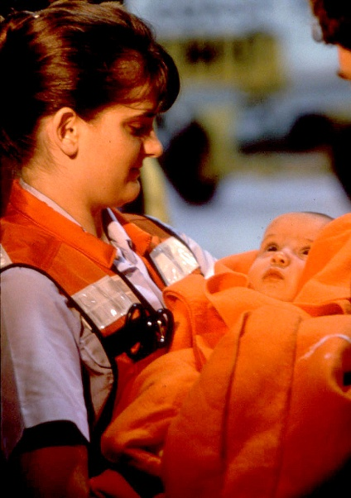
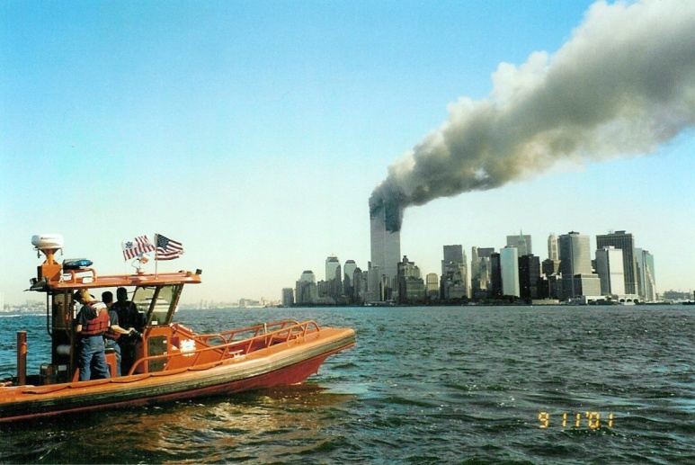
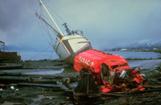
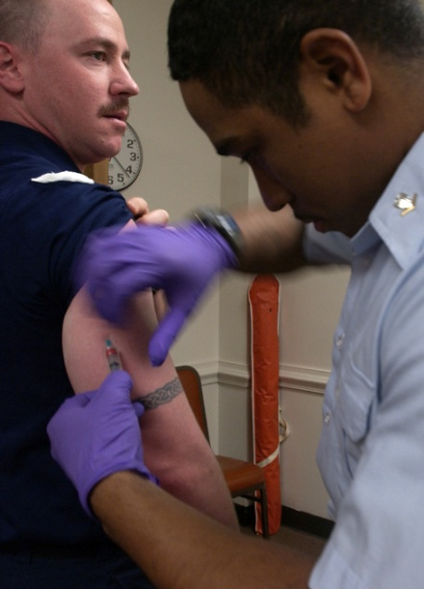
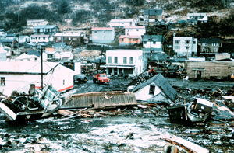
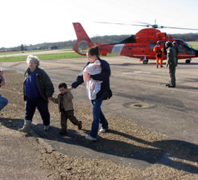
Emergencies happen.
Notes:
Suggested Narration
Emergencies happen every day, all around the world.
In the United States, losses from flooding average more than 2.4 billion dollars a year.
Home fires cause thousands of deaths and injuries.
Hurricane Katrina stranded 60,000 people and destroyed 300,000 homes.
Terrorism deaths are on the rise worldwide.
An influenza pandemic remains a real threat to our nation and the world, and there is concern that the highly pathogenic avian H5N1 virus will evolve into a virus capable of human-to-human transmission.
And emergencies can and do occur at military installations.

Slide 3
Natural hazards can happen here
Flood/Mud Slides
Hurricane Force Winds
Tsunami
Winter Storm
Earthquake
Notes:
Suggested Narration
In our area, we are most susceptible to these natural hazards. (elaborate)
Instructions
Your regional area briefing should have the “most likely” and “also possible” natural hazards displayed on slides 3 and 4.
Check local information to see if adjustments to these categories are needed for your particular location. If necessary, move icons from one slide to another.
Share recent local examples of the “most likely” and “also possible” natural hazards in your area (for example, “We experienced severe flooding after Hurricane Katrina in 2005” or “Nearby wildfires caused the station to be evacuated twice in the last 10 years.” If there were no actual incidents in the past, just describe the base area as susceptible to the listed hazards.

Slide 4
Other natural hazards are possible here
Wild Fire
Power Outage
Notes:
Suggested Narration
Although less likely to occur, we face other possible natural hazards in this area. (elaborate)
Instructions
As for the previous slide, compile and explain any local hazards that could cause problems.
Note that, although things like a power outage or a dam failure may not be “natural” hazards, they are often brought about by forces of nature.

Slide 5
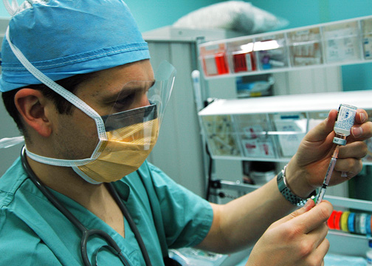
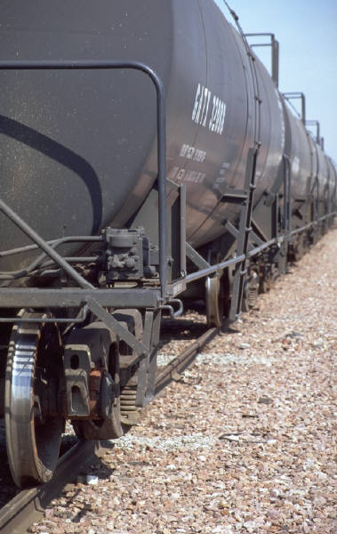
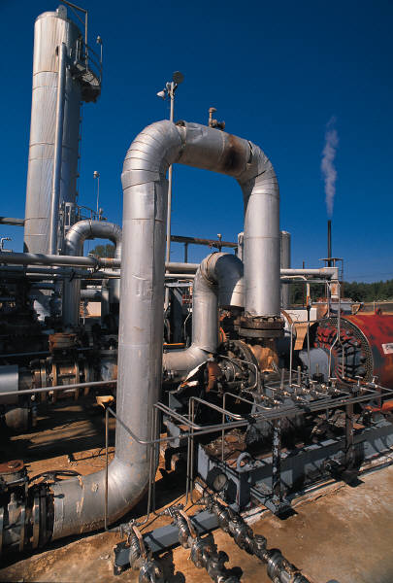
Not all dangers are acts of nature
Notes:
Suggested Narration
Not all dangers are acts of nature. Some may involve technological hazards or communicable diseases. We can be affected by industrial accidents, such as train derailments, chemical releases, or a nuclear power plant emergency. Increased mobility and travel can accelerate the spread of infectious diseases, as in an influenza epidemic.
Instructions
If there are any major hazardous materials industries or rail lines in the area, make note of their proximity to the station and housing areas.
If there are any recent epidemics in the news, use them as an example (pandemic influenza, mumps, mad cow disease, West Nile virus, severe acute respiratory syndrome, etc.)

Slide 6
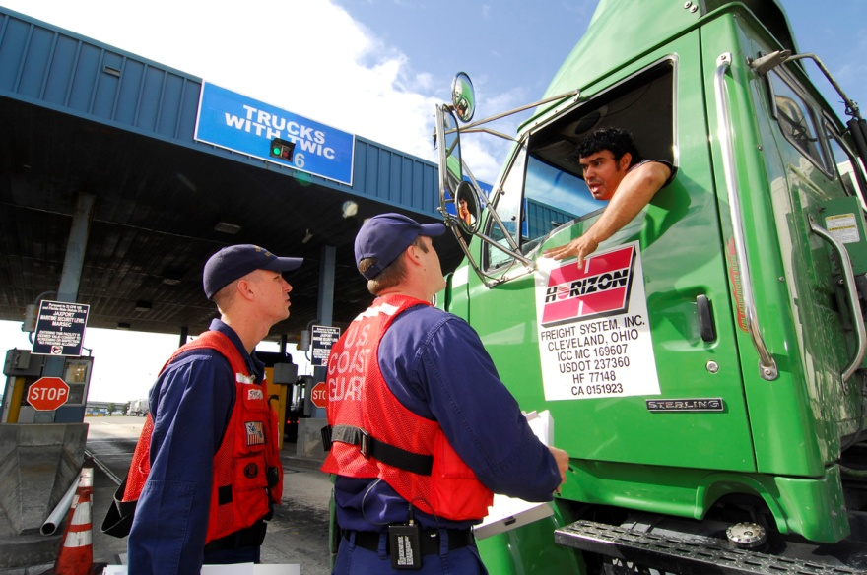
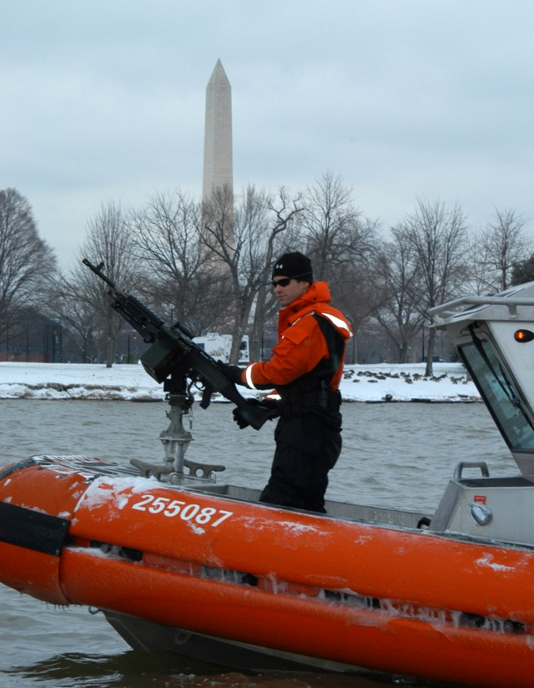
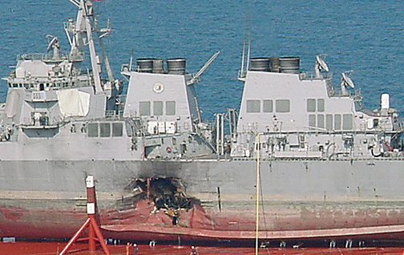
Terrorists target the military
Notes:
Suggested Narration
Terrorists can and do target military installations.
We must be constantly on alert for the use of
explosive devices
biological and chemical attacks, and even
radiological dispersion devices.

Slide 7
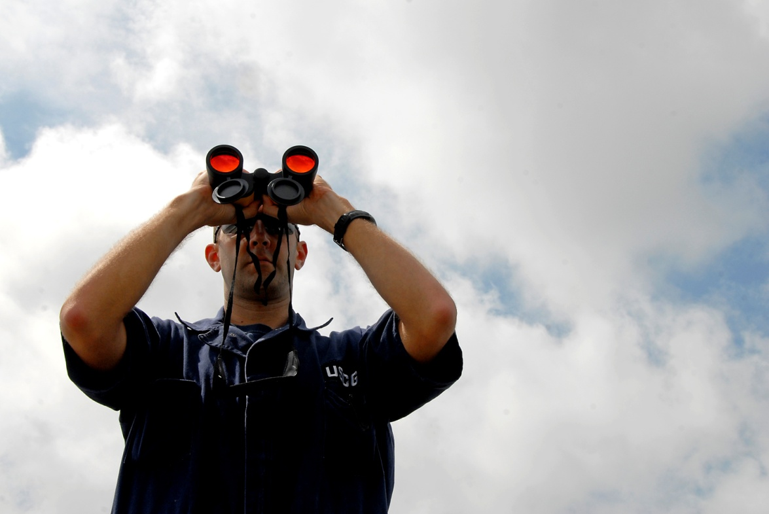
Families must be “always prepared”
Coast Guard personnel adhere to the motto "Semper Paratus"…
…... and their families must be ready when they are called to duty.
Notes:
Suggested Narration
Being prepared for emergencies is not just a good idea; it can be a matter of life or death.
When disaster strikes, Coast Guard personnel are likely to be involved as first responders, who address the most critical needs first.
Coast Guard families are strongly encouraged to prepare for emergency situations and be ready to manage for themselves while their Coast Guard member focuses on his or her duty.

Slide 8
Think ahead about the possibilities
Flood
Tsunami
Influenza Pandemic
May have time to prepare or evacuate
Winter Storm
Chemical Spill
Terrorist Strike
Could have little time to respond
Unless you are prepared for an emergency, your family could be without food, water, and even medicine for a number of days.
Notes:
Suggested Narration
There are significant differences among all these potential threats, which will affect the decisions you make and the actions you take.
In some emergencies—like a flood, hurricane, or influenza pandemic—you may have time to prepare or evacuate.
Other dangers, like a tornado, chemical spill, or terrorist strike can leave you little time to respond.
While you may have little time to react, by thinking ahead you’ll have time to prepare.
Unless you are prepared for an emergency, your family could be without food, water, and even medicine for a number of days.

Slide 9
Follow these steps to prepare
Get a kit
Make a plan
Be informed
Notes:
Suggested Narration
We’re going to go over the three main steps to prepare for emergencies.
Get a kit
Make a plan, and
Be informed
We’ll talk about general actions as well as specific procedures for this area. Feel free to ask questions about any part.
Instructions: You can make a group session more interesting with some interaction:
Suggested Narration
Let’s talk about emergency kits and see how prepared everybody is. Now don’t be embarrassed or anxious – everybody will get a chance to raise their hands. Here we go – raise your hand if you or your family have
separate emergency kits for your home, your office, and your car
an emergency kit at home that you can take with you if you have to evacuate
a designated kit of emergency supplies at home that you check periodically
emergency supplies at home – kind of scattered around in drawers or cabinets
last one – raise your hand if you know what kinds of things go in an emergency kit.
O.K., I’m going to call on people with their hands up. Keep them up as long as you have something to add that hasn’t been named yet.
If possible, write the items list on an easel pad or white board.

Slide 10
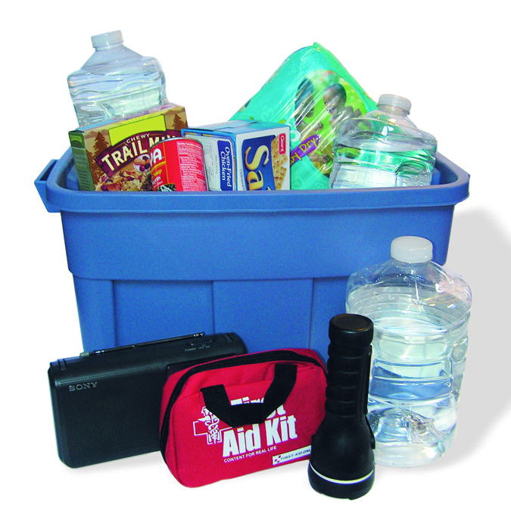
Get a kit
Build a basic home emergency kit
Food, water, and medical supplies
Flashlight, radio, and batteries
Maps, plans, cash, and personal documents
Make portable kits
For vehicle and workplace
Update kits periodically.
Notes:
Suggested Narration
A first step in preparing your family for hazards is to make an emergency kit. Here’s a simple checklist [pass out handout]. You can find other and more specialized lists on Ready.gov and the American Red Cross websites.
Be sure to include copies of important personal documents such as birth and marriage certificates, titles, and insurance information.
You may also need to include additional supplies for any children, pets, or special needs adults, such as diapers, games, or rain gear.
Keep enough supplies in your home kit for at least three days and make sure everyone in the family knows where to find it.
In addition to your basic home kit, assemble a portable kit to take with you when you evacuate, as well as emergency kits for your vehicle and workplace. These kits should include a minimum of food, water, first aid supplies, and your family emergency plans.
After you have assembled your emergency kits, make sure to continually evaluate their contents and their relevance to the threats in your area. Throw away and replace any expired or damaged medications, food, or water.

Slide 11
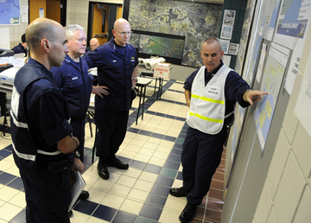
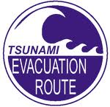
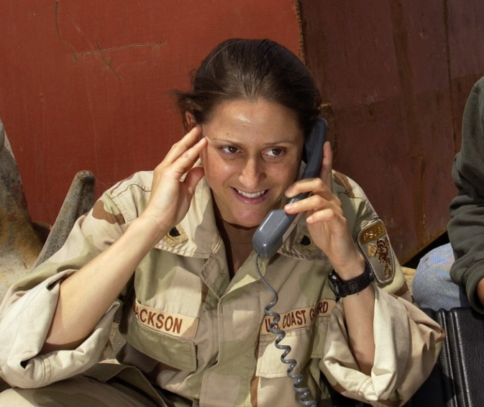
Have a plan
Emergency Plan
Communication Plan
Notes:
Suggested Narration
Another tool essential to protecting you and your family in possible emergencies is a family readiness plan. It is important that you plan ahead as a family for all types of emergencies and responses, especially since your Coast Guard family member is likely to be on duty responding. Everyone in the family should understand what to do, where to go, and what to take in the event of an emergency.
A family emergency plan covers evacuation and shelter options.
A family communication plan helps you get in touch if you are separated.
Instructions: Here is another opportunity for interaction:
What kinds of emergencies do you think you and your family need to plan for in this area?
Seek examples from the audience, ask clarifying questions if needed.
Planning Practice #1
O.K., let’s work on just one of the things your plan will need to include. There’s a fire in the middle of the night, and you need to know that everyone got out safely. Where should everyone meet?
Let them think about it and then ask what they came up with and why.
If you’re not all at home together, where are some of the places your family might be when an emergency strikes?
Seek examples from the audience. If no one has brought up Coast Guard personnel separated from their families when an emergency strikes at home, bring this up yourself.
Planning Practice #2
Your Coast Guard member is deployed overseas when a disaster happens where the rest of the family is living. Communication lines are knocked out, and the family is evacuated. Your plan should name someone outside the area as your common emergency contact where you can leave messages. Who would that be?
Let them think about it and then call on some people to share their decision.

Slide 12
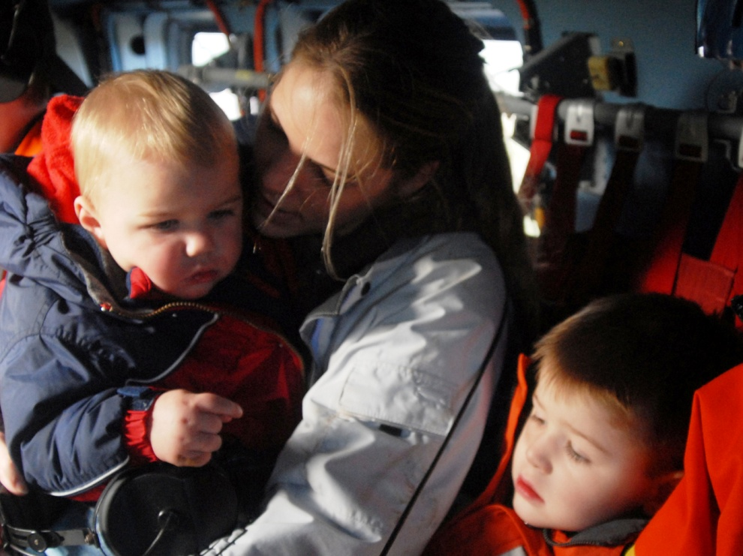
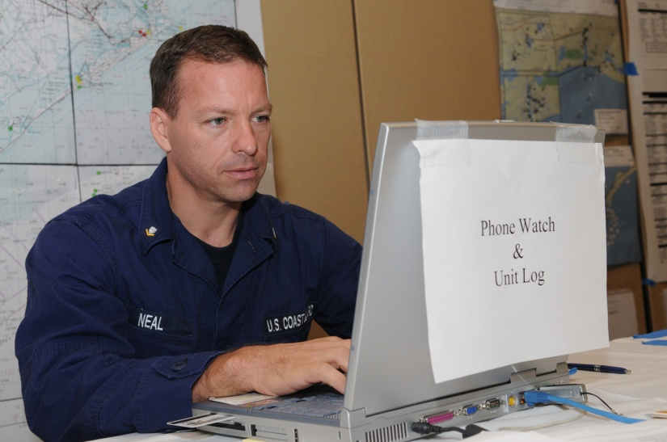
Kodiak Information
Emergency plans and procedures
Emergency notification
Procedures and codes
Warning (and all clear) signals
Station closure notification process
Standard and emergency muster procedures
Notes:
Instructions
Replace [Location] with the scope of the area you are addressing.
Use this slide (and add additional ones, if needed) to present specific local information.
Direct audience to handouts and other information sources.
Describe any applicable mass notification systems.

Slide 13
Tsunami Warning Signal
Kodiak has a siren that sounds on base, Bells Flats and in town notifying citizens of tsunami danger.
The tsunami warning siren sounds a long wavering note for three minutes.
If you hear the siren, head to safe, high ground.
The tsunami siren is testing every Wednesday at 1400.
Any time you feel an earthquake that lasts more than 15 seconds you should head for high ground immediately.

Slide 14
Chemical Warning Signal
Kodiak’s emergency warning sirens also warn for chemical hazards. The chemical hazard siren also is tested on Wednesday afternoons, and sounds like a telephone busy signal.
There is no “all clear” signal. Citizens must listen to the radio or other public announcement systems for the all clear.

Slide 15
The City of Kodiak has a Emergency Preparedness Plan…check it out
http://www.city.kodiak.ak.us/Emergency/Pages/default.aspx

Slide 16
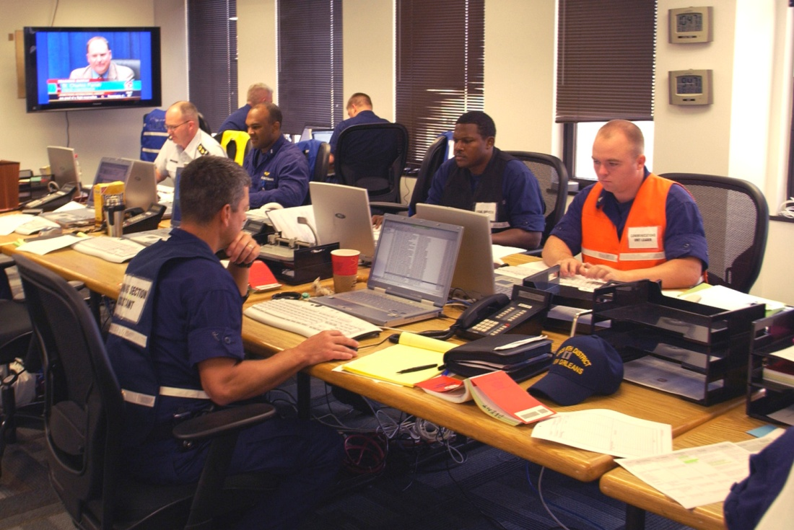
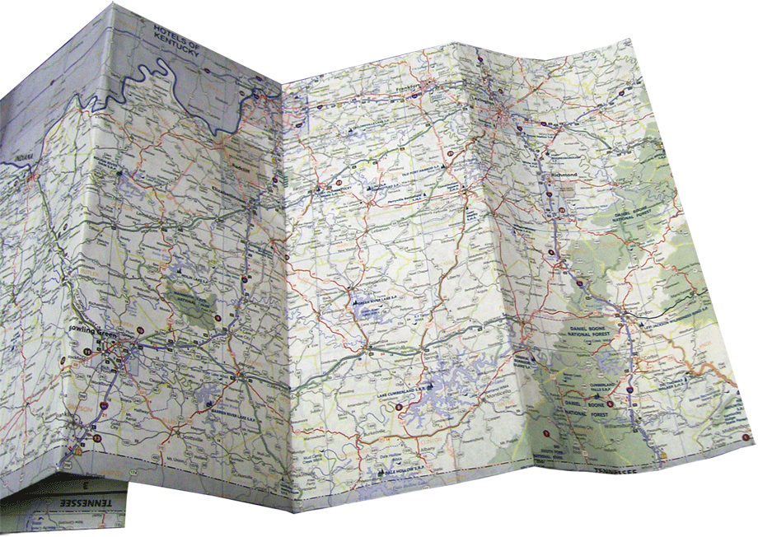
Kodiak Evacuation Information
Instructions for essential personnel
Instructions for nonessential personnel
Evacuation routes and maps
Notes:
Suggested Narration
Coast Guard personnel and their families frequently move. Be familiar with local plans and procedures – review them periodically and whenever move.
Instructions
Replace [Location] with the name of the area you are addressing.
Include information on access control procedures. Explain plans for moving key and essential personnel onto the station while allowing nonessential personnel to evacuate.

Slide 17
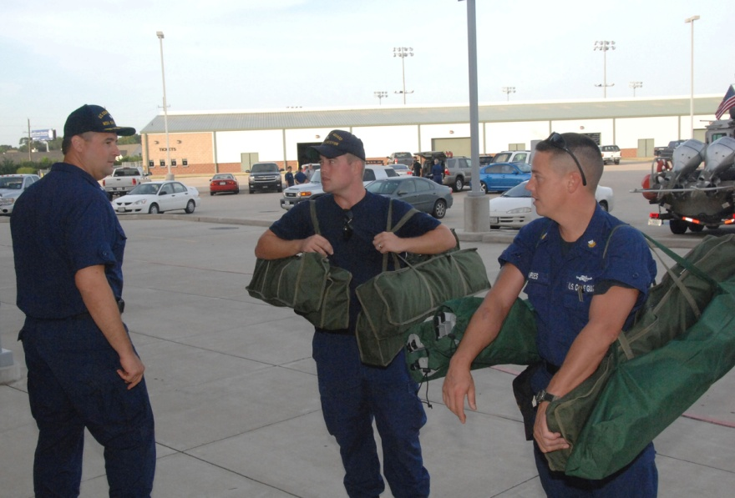
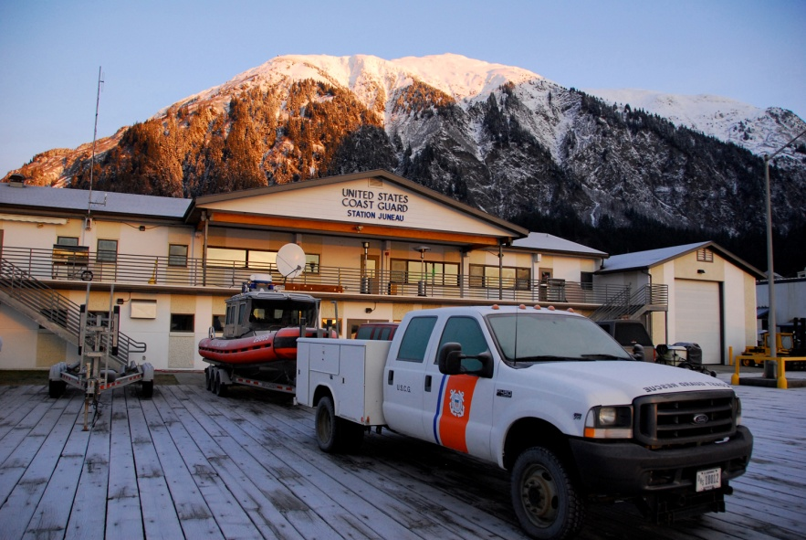
Discuss your options
Evacuate
Move to civilian shelter
Move to a safe haven
Temporarily shelter-in-place
Notes:
Suggested Narration
Safe and effective evacuation requires planning ahead—there may be little advance warning. In the event of an evacuation, you may end up at a civilian shelter or safe haven.
Be sure to consider children, pets, and special needs adults when putting together your emergency plan. Adjust your plan to accommodate all of your family members’ needs.
In some cases, such as a hazardous material emergency, you might decide (or be directed) to “shelter in place,” staying where you are in your home, your office, your school, or even your car. Sheltering in place may involve sealing openings around windows and doors or just staying inside.

Slide 18
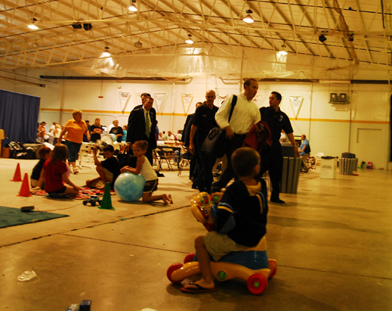
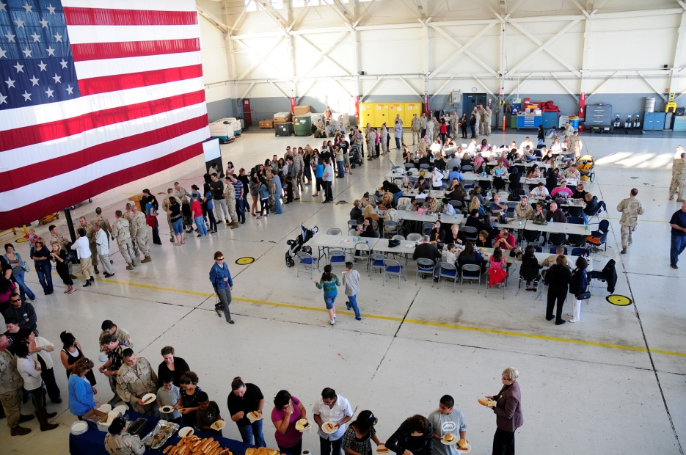
Area Shelters and Safe Haven Locations
Civilian shelters
Kodiak High School
Any School
Safe Havens
Peterson Elementary
Beacon Hill
Notes:
Suggested Narration
A shelter is a publicly identified facility providing temporary protection for a limited time. Certified shelters within the local community are usually preferred over safe haven facilities at a Coast Guard facility. Plans are coordinated with local authorities and may include provision for food, water, medicines, and security.
A local safe haven is a on-base facility providing temporary protection during large-scale incidents, such as earthquakes and tsunamis. These are not usually publicly identified until Immediately before or during an actual emergency.
A remote safe haven is a distant Department of Defense facility that provides short- to medium-term lodging of displaced personnel during large-scale incidents, such as hurricanes and extended wildfires. Remote safe havens are usually not activated until an evacuation has been ordered.
Instructions
List area shelters and safe havens. (If possible, show a map with locations highlighted.)

Slide 19
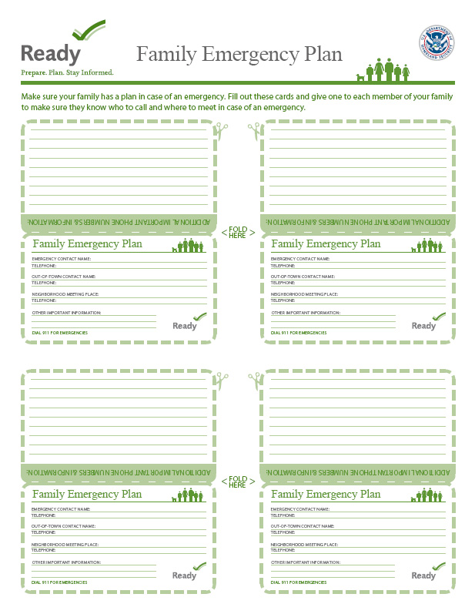
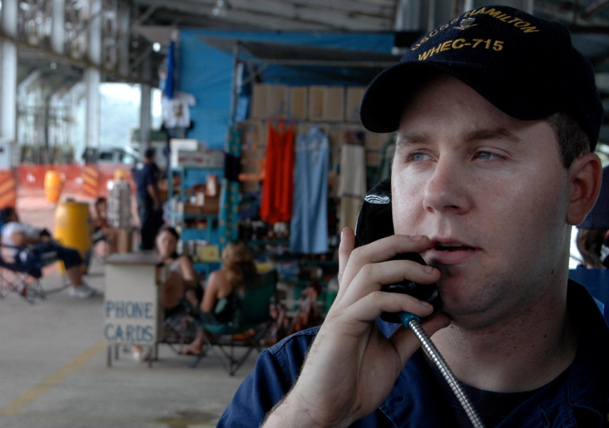
Keep in touch
Know contact information.
Make emergency contact cards.
Conduct a dry run.
Notes:
Suggested Narration
Your family may not be together when a disaster strikes, so plan how to contact one another, recognizing that you may not be able to reach a Coast Guard member who is on duty to address the emergency. Prepare a family communication plan that includes information on where family members spend the most time, such as work or school.
Make emergency contact cards for everyone in the family. Include important personal information, out of town contacts, and medical conditions.
After discussing your options, conduct a dry run of your evacuation plan. Try to identify any problems or obstacles so you can fix them before a real emergency occurs.

Slide 20
More Kodiak Information
Phone Numbers
Coast Guard Region and Station Notification (e.g., 911)
Regional Ombudsman 487-5525
Community/State Emergency Management 486-8000
Websites
http://www.uscg.mil/bsuKodiak/default.asp http://www.uscg.mil/worklife/default.asp http://www.city.kodiak.ak.us/Emergency/Pages/default.aspx
Notes:
Suggested Narration
Remember, Coast Guard personnel and their families frequently move to new duty stations. Be familiar with your installation’s plans and procedures – review them periodically and whenever you change duty stations.
Instructions
Replace [location] with the name of the applicable area.
Complete information on what numbers to call for help.

Slide 21
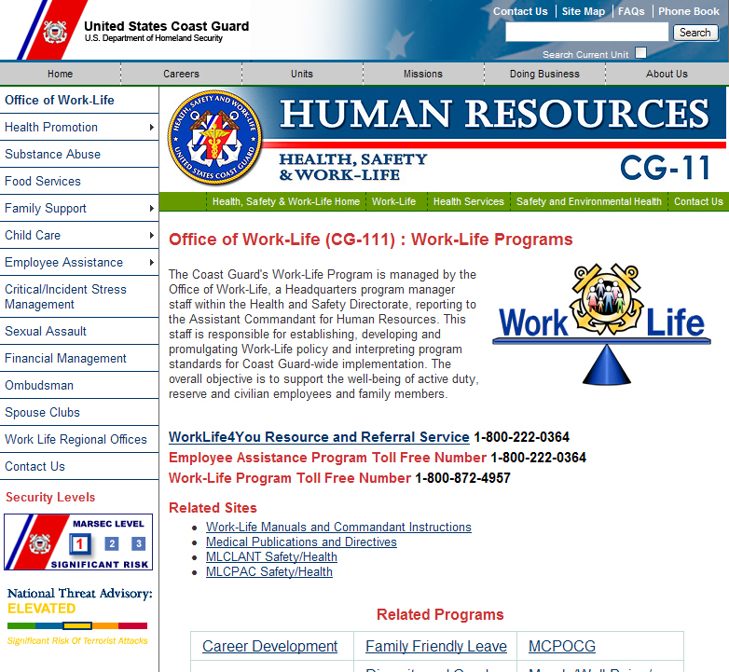
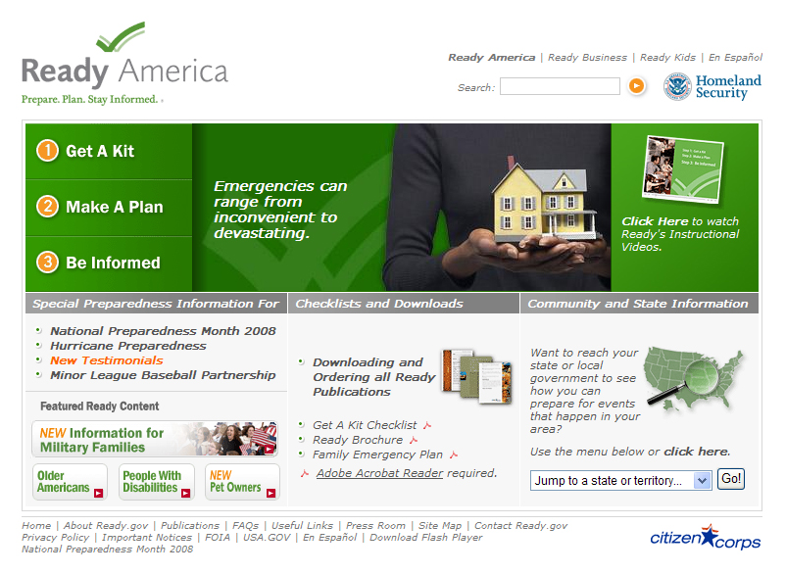
Be informed
Resources are available
Handouts
Websites
Work-Life
www.uscg.mil/worklife
Ready.gov
www.ready.gov/america
Notes:
Suggested Narration
Emergency planning is up to you, but you do have resources available that can help you prepare.
You can find general and regional disaster information through a number of sources, including the Internet, television, radio, or briefing sessions like this one.
We have a number of fact sheets available: [describe and hand out].
The Coast Guard’s Work-Life website provides helpful tips, forms, and links. Ready.gov is the government’s primary source of emergency preparedness information.

