Slide 1
Reserve OER
LT Timothy Kroll
PSC, RPM-1, OES Manager

Slide 2
interactive Personnel Electronic Records Management System (iPERMS)
https://iperms.mymilrecord.uscg.mil/login/
Accessible to view and download 24/7 for all Active, Reserve, and Retired Members

Slide 3
References & resources
Officer Accessions, Evaluations, and Promotions COMDTINST M1000.3 (series), Chapter 5 (Jul2020)
COAST GUARD OFFICER EVALUATION SYSTEM PROCEDURES MANUAL
PSCINST M1611.1 (series), Chapter 7 (Dec2021)
HQS-SMB-CGPSC-RPM-OER@USCG.MIL
(703) 254-6894 (mobile)

Slide 4
Policy states that …
It is the Member’s responsibility to make sure that their records are accurate and complete.
Every commissioned day must be covered by an OER.
The period of report must not exceed 30 months for biennial, 18 months for annual, and 12 months for semi-annual.

Slide 5
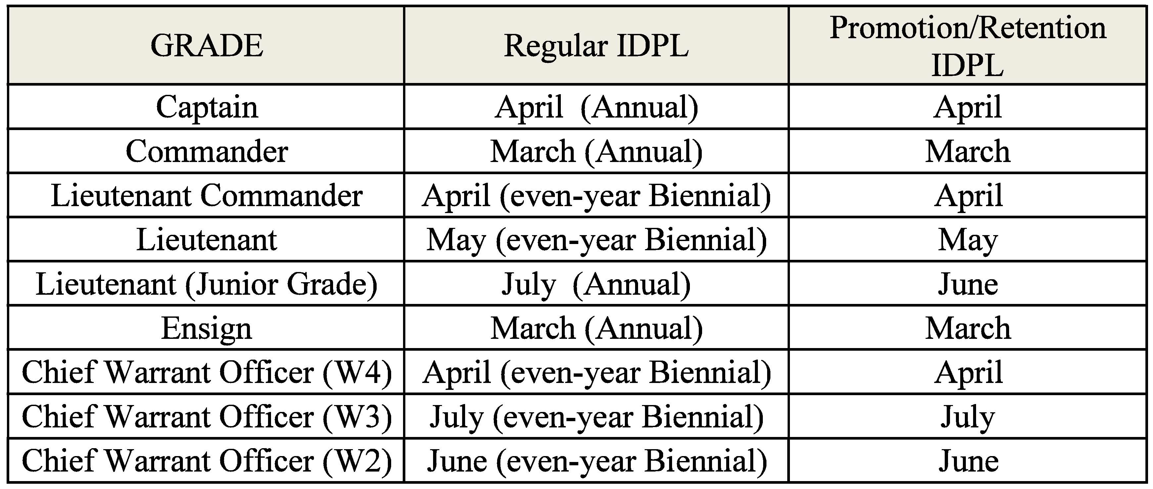
IDPL Submission schedule

Slide 6
Reserve OER types
Annual or Biennial
Detachment/PCS of RO
Detachment/PCS of ROO
Boards/Panel
Promotion*
Concurrent
Continuity

Slide 7
COMMON MISTAKES

Slide 8
COMMON MISTAKES

Slide 9
Common mistakes
Only Supervisors can sign OER before EOP
RO, Reviewer, and ROO must sign OOA EOP
ROO must sign after Reviewer
All reserve OER must have at least one IDPL and at least one ADPL on the rating chain except for units with more than 50% Reserve membership.

Slide 10
Did you know?
IDPL scheduled officers on active duty, including multiple sets of active-duty orders with no break in service, 181 consecutive days or greater, must follow the ADPL submission schedule and be treated as an ADPL schedule officer for as long as they remain on active duty.
----- NOT Concurrent OER ----

Slide 11
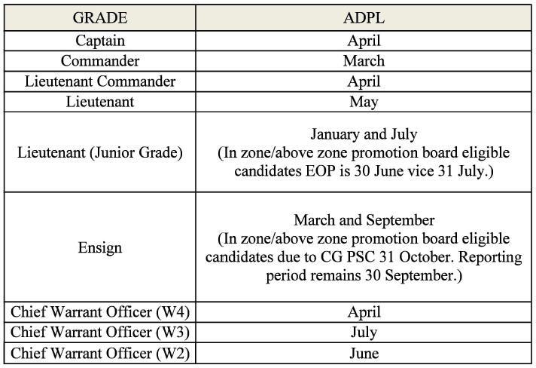
ADPL Submission schedule
Becomes ANNUAL
Becomes SEMI-ANNUAL
Becomes ANNUAL

Slide 12
Concurrent oer
30 to 180 days at a different unit or under a different rating chain
Current policy: One Page Concurrent
Proposed Change: One or Two Page(s) Concurrent
It’s up to the MBR and their CMD

